Slide 1
Tech Enthusiast
Africa Digital ID Hackathon use case

Slide 2



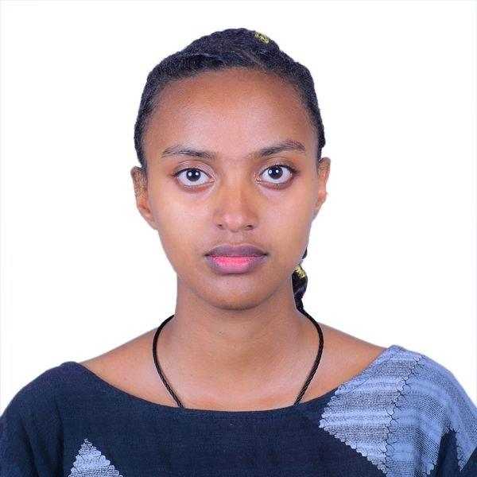

Eastern Africa
Team introduction
Ethiopia | Tech Enthusiast
Addis Ababa University and Addis Ababa Science and Technology University
Fraol Megersa
Biruk Abza
Yonathan Yifat
Biruktawit Abza
Dagemawi Negash

Slide 3
Welcome to RefuPass
RefuPass is a privacy-preserving, offline-capable digital ID system that enables refugees to access humanitarian aid securely without repeated registration.
01
Refugees must repeatedly register with multiple NGOs to access aid, causing duplication, delays, and privacy risks.
02
RefuPass enables one-time identity verification and shared registration, allowing NGOs to enroll the same verified person without repeating the full registration process.
03
RefuPass uses Digital ID by verifying beneficiaries through eSignet, which can integrate with systems like Fayda(in Ethiopia), and then issuing a secure PDF/QR aid pass for service access.

Slide 4
Meet Selam
Selam is a refugee mother living in Ethiopia.Like many refugees, she depends on multiple NGOs for food, healthcare, and other essential services.
But every time she seeks support, she faces the same challenges due to these problems:
Refugees still rely on paper-based NGO registration and Aid access requires repeated manual verification
Risk of exclusion when documents are missing or unmatched
NGOs struggle with:
  duplicate records
  low aid delivery
  privacy risks
Confusing and fragmented aid processes between providers

Slide 5
What is the Solution ?
01
Selam verifies her identity once using a trusted Digital ID system (e.g., eSignet/Fayda), eliminating repeated manual registration.
02
RefuPass issues Selam a secure QR/PDF aid pass linked to her eligibility and services.
03
Selam can access support from multiple NGOs using the same trusted pass, with minimal data sharing.
04
Aid workers quickly scan and verify Selam’s pass, reducing wait times, paperwork, and duplicate records.

Slide 6
Information flow (Technical)
System Diagram
A beneficiary is verified via eSignet, enrolled by an NGO, issued a secure PDF/QR aid pass, and later verified and redeemed by a worker.
Data model and design
The main entities are Person, Verification Session, Program Enrollment, Eligibility, Issued Pass, Redemption, and Grievance. The system separates identity verification from aid eligibility, so trusted identity proof comes first, and aid entitlement is issued afterward as a RefuPass pass.
Key tools utilized:
Includes eSignet for Digital ID verification, SQLAlchemy and Pydantic in the backend, JWT for authentication, and PDF/QR generation libraries for beneficiary passes. The prototype uses the eSignet flow as the Digital ID layer and RefuPass as the aid access and verification layer.
Tech stack description
Frontend: Modern frontend framework
Backend: FastAPI(Python)
Database: PostgreSQL + SQLite (offline storage), nginx(reverse proxy)
Infrastructure: Docker, DigitalOcean

Slide 7
User journey flow
It consists of four user journeys, including:
Beneficiary
Arrives at a registration point and presents a Digital ID credential for verification.
Completes identity verification through the eSignet flow, aligned to Fayda in a real deployment.
Receives a secure PDF/QR aid pass after approval.
Presents the pass at the aid distribution point.
Receives aid without repeating full registration.
Platform Admin
Starts beneficiary verification in RefuPass.
Confirms successful Digital ID verification through eSignet.
Adds the verified person to the shared registry.

Slide 8
User journey flow: Continued
NGO Admin
Searches the shared registry for the verified beneficiary.
Enrolls the person into the NGO’s aid program.
Marks the beneficiary as eligible for the current cycle.
Issues the RefuPass PDF/QR aid pass.
Aid Worker
Receives the beneficiary at the distribution point.
Uploads or scans the PDF/QR pass in RefuPass.
Confirms eligibility and validates the pass.
Records redemption and completes aid delivery.

Slide 9
Potential Impact
1 mil +
RefuPass can serve 1M+ refugees in Ethiopia and easy scaleable to 30M+ across Africa.
~47% womens and girls
The solution is designed for refugees and asylum seekers, with strong relevance for women and girls, who make up about 47% of the refugee population in Ethiopia.
~50% projected reduction in repeated registration effort
RefuPass replaces repeated onboarding with one-time verification and reusable passes, reducing duplication for both beneficiaries and providers.
Sources: UNHCR Ethiopia Country Overview; RRS-UNHCR Ethiopia Refugees & Asylum-Seekers Report (2025)

Slide 10
Challenges and stakeholder mapping
Challenges | Solution | Stakeholder
Low digital literacy and trust barriers | Use assisted onboarding and simple PDF/QR-based access | NGOs, camp staff, community worker
Repeated registration across aid providers | Create a shared registry with reusable verified identity | NGOs, UNHCR, and Ethiopia’s Refugees and Returnees Service (RRS)
Need for trusted identity verification | Integrate with eSignet and align to Fayda(Fayda is Ethiopia’s trusted biometric digital identity system ) in real deployment | National ID Program, government, digital ID partners
Privacy and data-sharing concerns | Share only minimum necessary data and use secure aid passes | Regulators, government, humanitarian partners

Slide 11
Challenges and stakeholder mapping (Option 2)
Stakeholder | Role | Stakeholders Interest | Desired situation/ Objectives | Resources/ Support needed for Your Solution
Refugees / displaced people | Main beneficiaries | Access aid safely and quickly | Wallet or QR pass, privacy, grievance support | Wallet or QR pass, privacy, grievance support . Dashboard, backend, audit tools
NGOs / aid agencies | Issue aid entitlements | Reduce duplication and improve accountability | Manage programs and track redemptions
Aid workers | Verify and deliver aid | Fast, accurate eligibility checks | Scan and verify offline | Mobile verifier app, QR scanner, training
Government/ eSignet partne | Identity verification | Trusted and secure identity checks | Support one-time verification | Registry/API access, data agreements

Slide 12


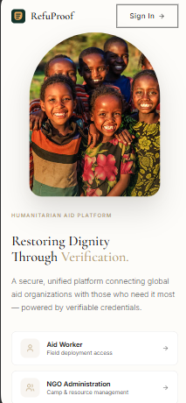
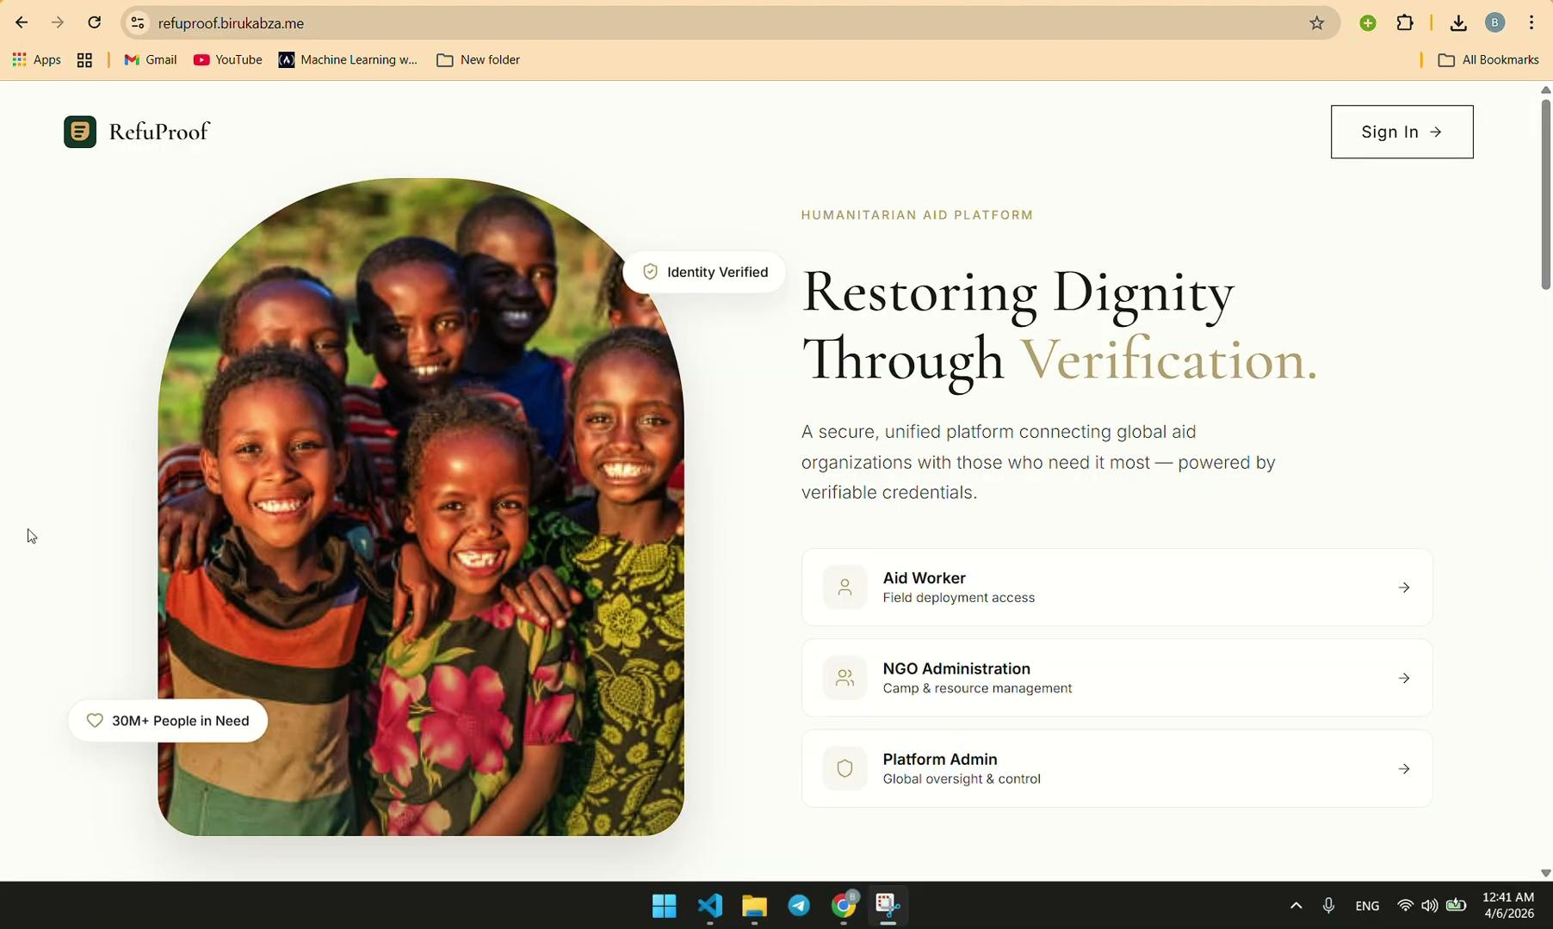
Prototype

Slide 13
Go-to-market strategy
Value proposition for users:
  RefuProof helps refugees access aid faster with one-time registration and secure digital or QR-based entitlements. It protects privacy, works offline, and helps NGOs prevent duplicate aid claims.
Key aspects of GTM strategy:
  Distribution channels: Partner with NGOs, refugee centers, aid distribution points, and government/digital ID partners.
  Product messaging and marketing tactics for users:
“Register once, prove eligibility securely, and receive aid even with poor internet.”
Marketing tactics may include, Running NGO pilot demos, train aid workers, provide simple beneficiary guides, and share pilot results with humanitarian partners.

Slide 14
Annex
Not to be Presented
Supporting slides and ideas.
Github link
Techinical Documenation
References
TIME – Ethiopia’s Refugee Digital ID Initiative
UNHCR – Registration and Identity Management
UNHCR – Ethiopia Country Overview

