Slide 1
Tech Enthusiast
A title image will appear here.
Don’t worry about this space
Africa Digital ID Hackathon use case

Slide 2



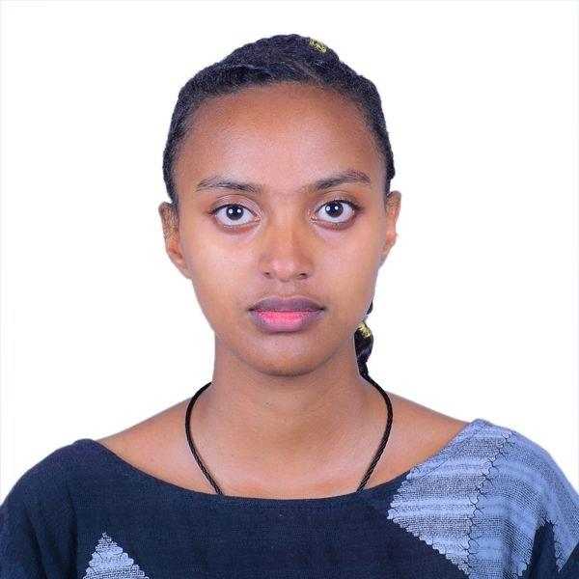
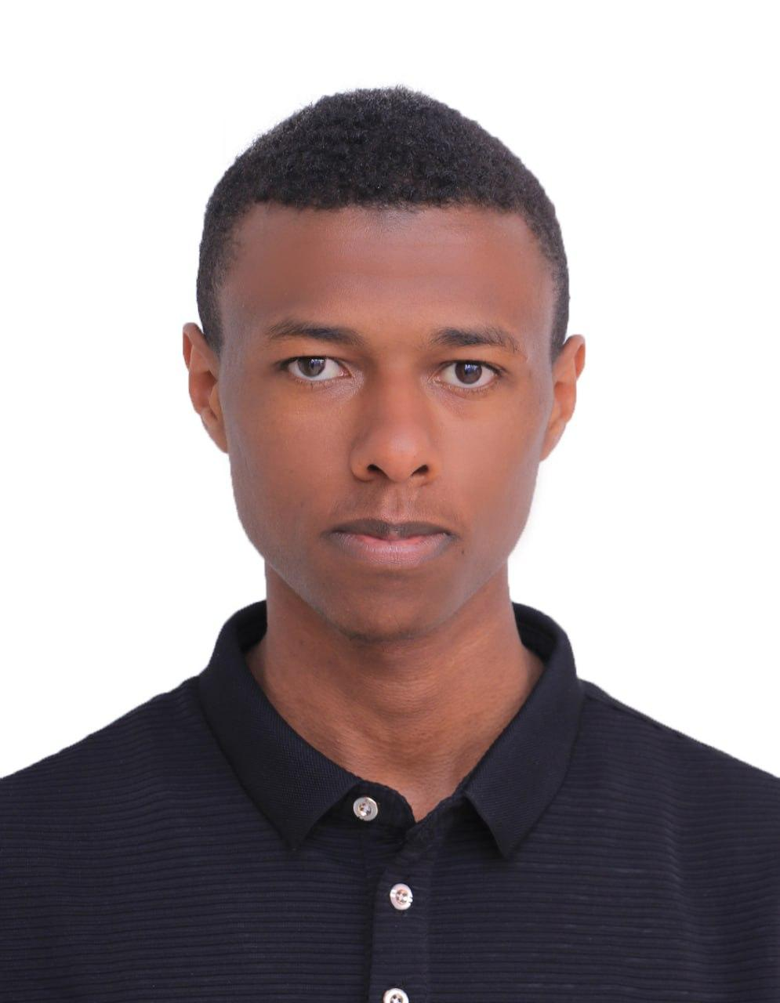
Eastern Africa
Team introduction
Ethiopia | Tech Enthusiast
Addis Ababa University and Addis Ababa Science and Technology University
Fraol Megersa
Biruk Abza
Yonathan Yifat
Biruktawit Abza
Dagemawi Negash

Slide 3
Time: 1 min
Use case introduction: Focus sector and the challenge that digital ID will solve.
RefuProof is a privacy-preserving, offline-capable digital ID system that enables refugees to access humanitarian aid securely without repeated registration.
01
Refugees must repeatedly register with multiple NGOs to access aid, causing duplication, delays, and privacy risks.
02
RefuPass enables one-time identity verification and shared registration, allowing NGOs to enroll the same verified person without repeating the full registration process.
03
RefuPass uses Digital ID by verifying beneficiaries through eSignet, which can integrate with systems like Fayda(in Ethiopia), and then issuing a secure PDF/QR aid pass for service access.

Slide 4
Time: 1 min
Problem statement: Provide a short description of the problem
In Ethiopia, refugees still rely on repeated in-person, paper-based NGO registration. With 1M+ refugees, fragmented identity and aid systems create a major inclusion gap.
What is the current process for accessing benefits, completing transactions, or engaging with systems?
Aid access usually depends on manual registration, paper records, and repeated eligibility checks by each provider.
What barriers do citizens or businesses face in this process, and who is most affected?
The burden falls most on refugees—especially women-led households, children, and those with weak documentation—who face long travel, wait times, repeated paperwork, inconsistent records, and exclusion when documents are missing.
How does the absence of an integrated digital ID cause or worsen these barriers?
Without a trusted, reusable digital ID, NGOs must repeatedly re-verify individuals, creating duplicates, slowing aid, and increasing privacy risks through repeated data sharing.
What is the scale and urgency of this problem?
The problem is urgent: Ethiopia hosts 1M+ refugees, and the expanding Fayda digital ID creates a timely chance to link trusted identity with aid delivery.

Slide 5
Time: 1 min 30 sec
Proposed solution overview
01
RefuPass is a shared aid platform where refugees are verified once, enrolled by NGOs, and issued a secure pass—reducing repeated registration, speeding up lookup, and minimizing duplication across organizations.
02
RefuPass uses Digital ID via eSignet for trusted verification (demo uses a mock provider, with real deployment aligned to systems like Fayda), then issues a secure PDF/QR aid pass linked to eligibility.
03
One-time identity verification enables reusable aid access across providers while sharing only minimal data. Features include shared registry enrollment, NGO eligibility management, QR/PDF aid passes, and worker-side verification.
04
The solution requires a trusted ID source (e.g., eSignet with an upstream ID system), NGO alignment on shared registration, and a simple digital process for workers to verify and redeem passes.

Slide 6
Time: 1 min
Information flow (Technical)
System Diagram
A beneficiary is verified via eSignet, enrolled by an NGO, issued a secure PDF/QR aid pass, and later verified and redeemed by a worker.
Tech stack description
Frontend: Vite + React
Backend: FastAPIDatabase: PostgreSQL + SQLite (offline storage), nginx(reverse proxy)
Infrastructure: Docker, DigitalOcean
Data model and design
The main entities are Person, Verification Session, Program Enrollment, Eligibility, Issued Pass, Redemption, and Grievance. The system separates identity verification from aid eligibility, so trusted identity proof comes first, and aid entitlement is issued afterward as a RefuPass pass.
Key tools utilized:
Includes eSignet for Digital ID verification, SQLAlchemy and Pydantic in the backend, JWT for authentication, and PDF/QR generation libraries for beneficiary passes. The prototype uses the eSignet flow as the Digital ID layer and RefuPass as the aid access and verification layer.

Slide 7
Time: 1 min 30 sec
User journey flow
It consists of four user journeys, including:
Beneficiary
Arrives at a registration point and presents a Digital ID credential for verification.
Completes identity verification through the eSignet flow, aligned to Fayda in a real deployment.
Receives a secure PDF/QR aid pass after approval.
Presents the pass at the aid distribution point.
Receives aid without repeating full registration.
Platform Admin
Starts beneficiary verification in RefuPass.
Confirms successful Digital ID verification through eSignet.
Adds the verified person to the shared registry.

Slide 8
User journey flow: Continued
NGO Admin
Searches the shared registry for the verified beneficiary.
Enrolls the person into the NGO’s aid program.
Marks the beneficiary as eligible for the current cycle.
Issues the RefuPass PDF/QR aid pass.
Aid Worker
Receives the beneficiary at the distribution point.
Uploads or scans the PDF/QR pass in RefuPass.
Confirms eligibility and validates the pass.
Records redemption and completes aid delivery.

Slide 9
Time: 1 min 30 sec
Potential Impact
1 mil +
RefuPass can serve 1M+ refugees in Ethiopia and easy scaleable to 30M+ across Africa.
~47% womens and girls
The solution is designed for refugees and asylum seekers, with strong relevance for women and girls, who make up about 47% of the refugee population in Ethiopia.
~50% projected reduction in repeated registration effort
RefuPass replaces repeated onboarding with one-time verification and reusable passes, reducing duplication for both beneficiaries and providers.

Slide 10
Time: 1 min 30 sec
Challenges and stakeholder mapping
Challenges | Solution | Stakeholder
Low digital literacy and trust barriers | Use assisted onboarding and simple PDF/QR-based access | NGOs, camp staff, community worker
Repeated registration across aid providers | Create a shared registry with reusable verified identity | NGOs, UNHCR, RRS
Need for trusted identity verification | Integrate with eSignet and align to Fayda in real deployment | National ID Program, government, digital ID partners
Privacy and data-sharing concerns | Share only minimum necessary data and use secure aid passes | Regulators, government, humanitarian partners

Slide 11
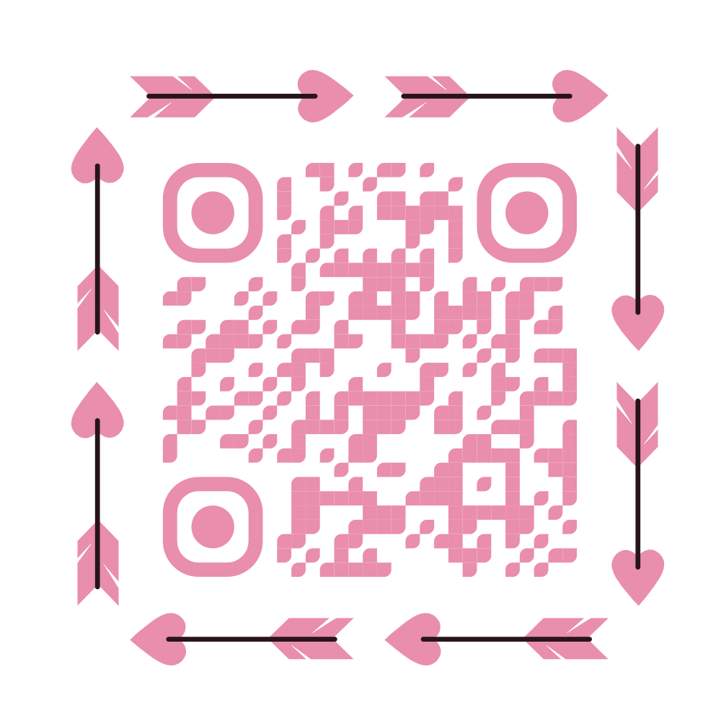
Time: 30 sec
Platform Demo Walkthrough
Step 1: Admin Login
Use default credentials:
Username: admin
Password: admin123(Role: Platform Admin)
Step 2: Create Users
Admin creates:
NGO accounts
Aid Worker accounts
Step 3: Login as Users
Use created credentials to log in as:
NGOAid or
Aid Worker
Step 4: Explore Features
Test platform features for:
NGO dashboard
Aid Worker tools
System Access Info
eSignet hosted at https://auth-esignet.birukabza.me
Backend hosted at http://api.birukabza.me
Website link : https://refuproof.birukabza.me
Scan Me

Slide 12
Annex
Not to be Presented
Supporting slides and ideas.
Github link
Techinical Documenation

