Slide 1
Specialism Project:
QA Cinemas
Team Valor
17th December 2021

Slide 2
Task Overview
To write a fully functional MERN stack program using the fundamental modules learned during training thus far.
We will use:
MongoDB
ExpressJS
ReactJS
NodeJS
Jira/Github

Slide 3
Project Objective
QA Cinemas
Our team was tasked with building a new website for QA Cinemas which should present necessary information. We were required to add multiple pages such as a home page, a listings gallery, a ticket booking page and a payment page which allowed payments through an outside merchant, along with other pages that are also convenient for the user.

Slide 4
Design

Slide 5
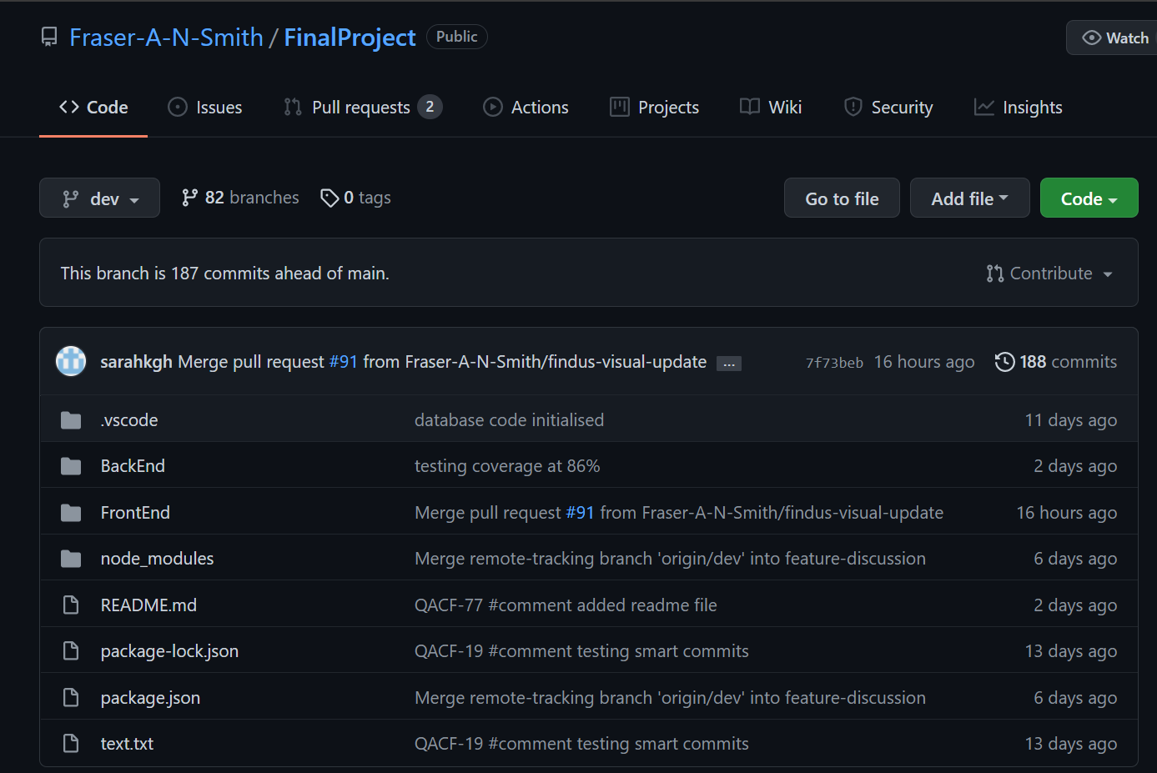
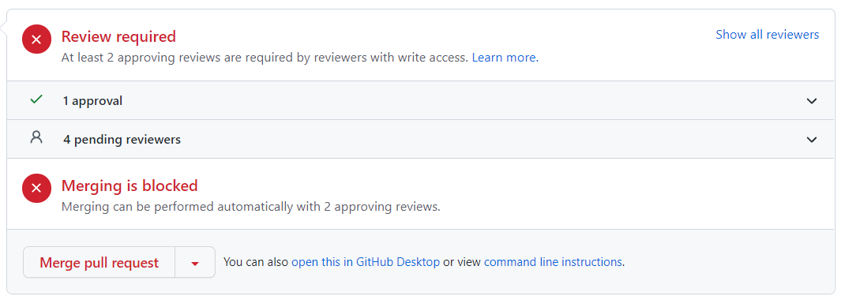
Version Control
Github

Slide 6
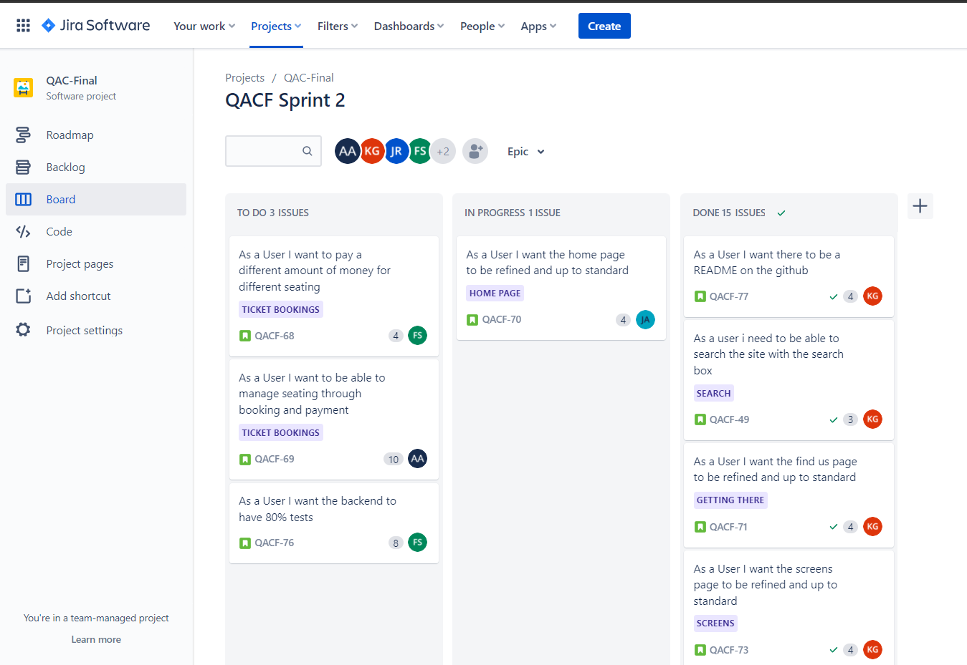
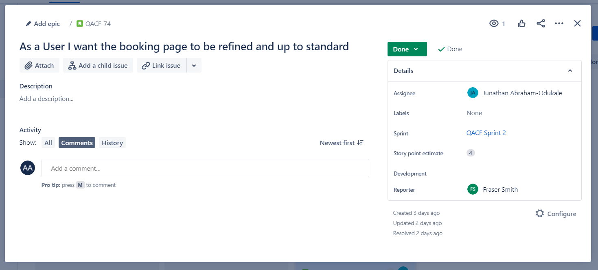
Scrum
Jira

Slide 7
Code

Slide 8
MongoDB
A document-oriented database used to store the application data
We were required to use MongoDB in order to create multiple databases for certain features within our website:
Movies Schema: A database storing data on movie information
Mongo Bookings Schema: A database storing data on booking information.
Discussion Schema: A database storing data on review information.

Slide 9
NodeJS
The JavaScript runtime environment used to run JavaScript on a machine rather than in a browser.
We used the node package manager in order to utilise third party packages and also manage dependencies between them such as:
chai
chai-http
cors
express
istanbul
nocha
mongoose
nodemon
nyc

Slide 10
ExpressJS
A framework layered on top of NodeJS, used to build the backend of a site using NodeJS functions and structures.
We used ExpressJS to build a backend API for the website with the help of Mongoose.

Slide 11
ReactJS
A library used to build UI components that create the user interface of the single page web application.
We used ReactJS with HTML and CSS implemented to build the user interface of the website in order to do so we used multiple libraries such as:
react-bootstrap
react-router-dom
bingmaps-react
react-icons
emailjs-com

Slide 12
Documentation

Slide 13
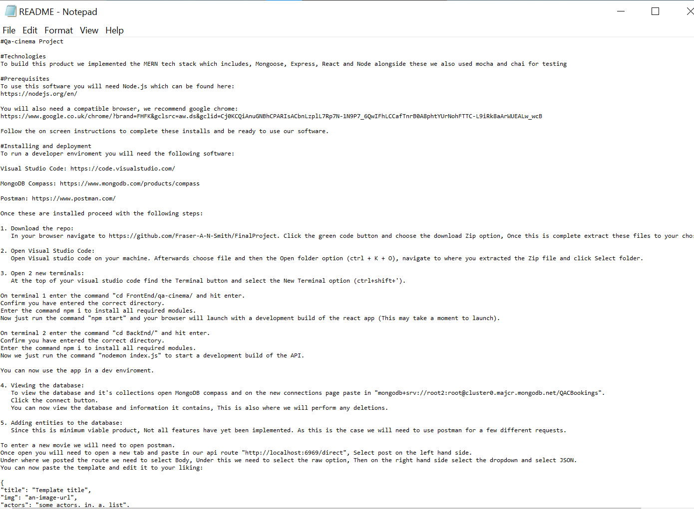
README

Slide 14
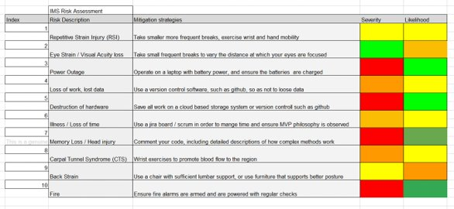
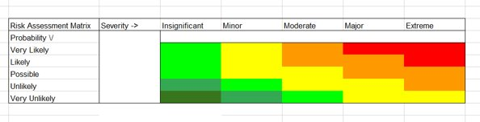
Risk Assessment

Slide 15
Testing

Slide 16
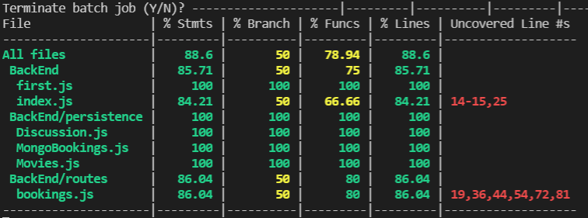
Mocha & Chai

Slide 17
Conclusion
In conclusion we managed to build a functional cinema website with 80% test coverage however there are certain aspects on which we could’ve improved upon:
Discussions page: Better styling of the overall page.
Payment and Bookings page:
Implement adult and child relationships
Use Stripe instead of PayPal api for more functionality.
Front End: Make the website a bit more mobile friendly.

Slide 18
Team Valor
Scrum Master: Fraser Smith
Kieran Goodinson
Jonathan Rabaja
Adam Ateye
Junathan Abraham-Odukale
Sarah Khan

