Slide 1
Hobby Project: Fantasy Wetherspoons
November 21st 2021
Fraser Smith

Slide 2
Task Overview
To write a functional full stack program using the fundamental modules learned during training thus far.
We will use:
-Java 11 / HTML / CSS / JavaScript
-mySQL
-Maven / Spring
- Jira/Github

Slide 3
Project objective:
To construct a fantasy bar management system that could handle tables and orders with a many to one relationship between the two.

Slide 4
Understanding the problem: Jira Epics
Design
Code
Documentation
UML
ERD
FBM
JIRA Board
Domain
Controllers
Services
Repositories
Unit Testing (JUnit / Mockito)
User-Acceptance Testing (Selenium)
README
Risk Assessment

Slide 5
Design:

Slide 6
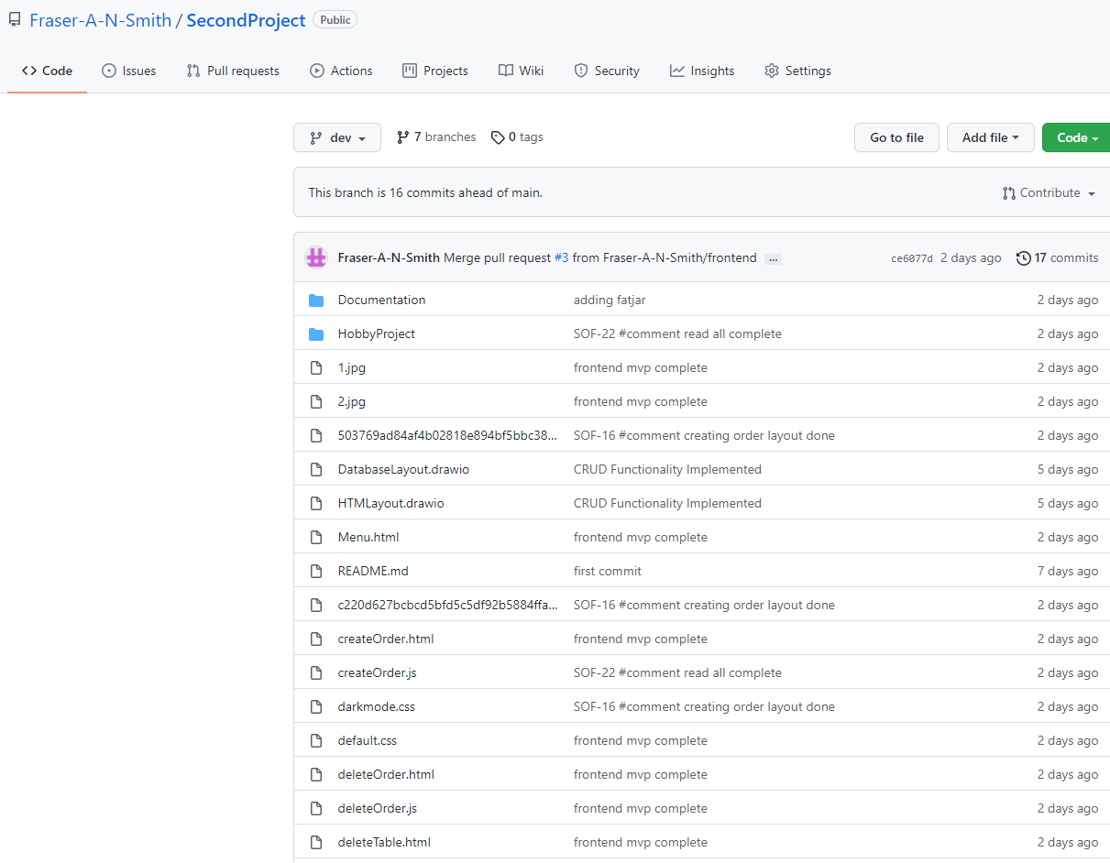
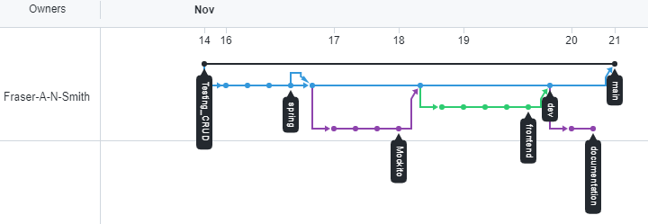
Version Control:
GitHub

Slide 7
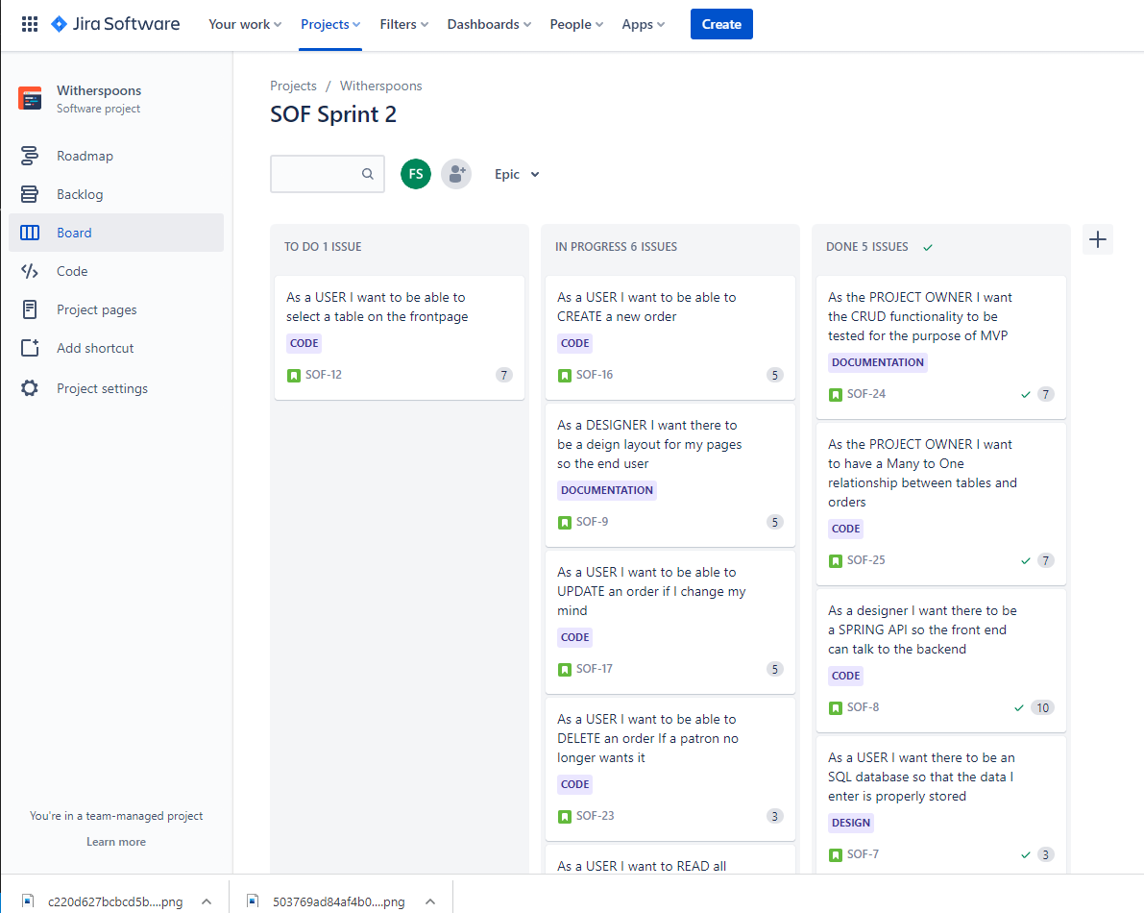
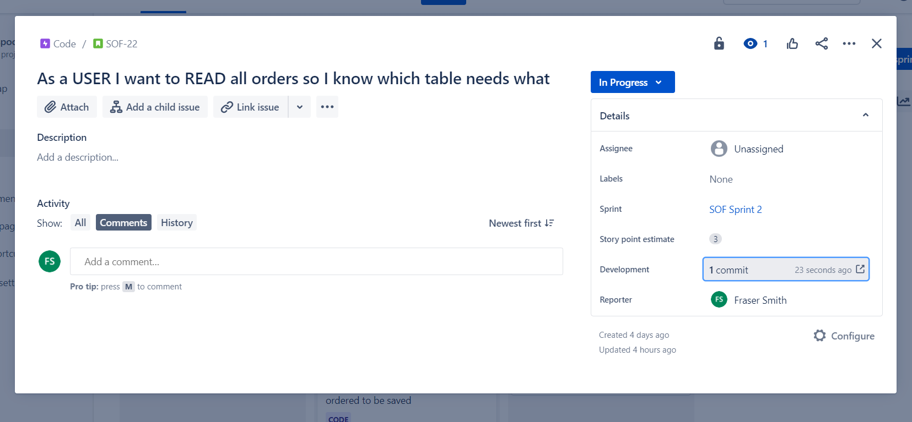
Scrum
Jira

Slide 8
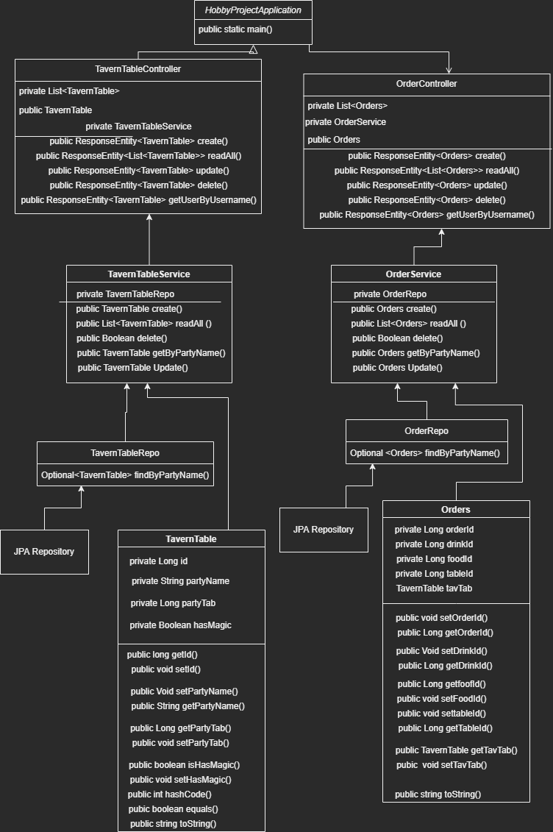
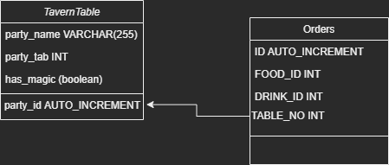
UML & ERD:

Slide 9
Code:

Slide 10
Domain:
TavernTable.java
Id AUTO_INCREMENT
PartyName String
PartyTab Int
Has_Magic Boolean
Orders.java
Id AUTO_INCREMENT
FoodId INT
DrinkId INT
TableNumber INT

Slide 11
Services:
Service Setup -2 Methods
Create
ReadAll
Read
Update
Delete

Slide 12
Repositories:
Interfaces which extend the JpaRepository for use by SPRING

Slide 13
Controllers:
TavernTable + Orders
Sent fetch requests to the API which connected our frontend to our backend

Slide 14
Documentation:

Slide 15
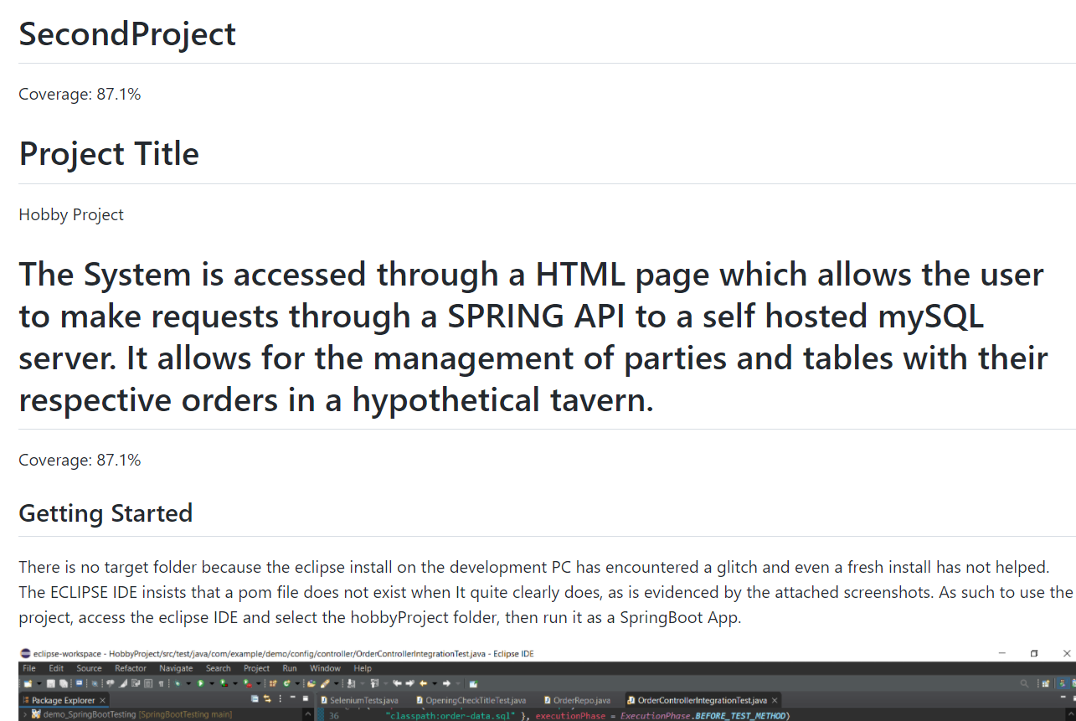
README:

Slide 16
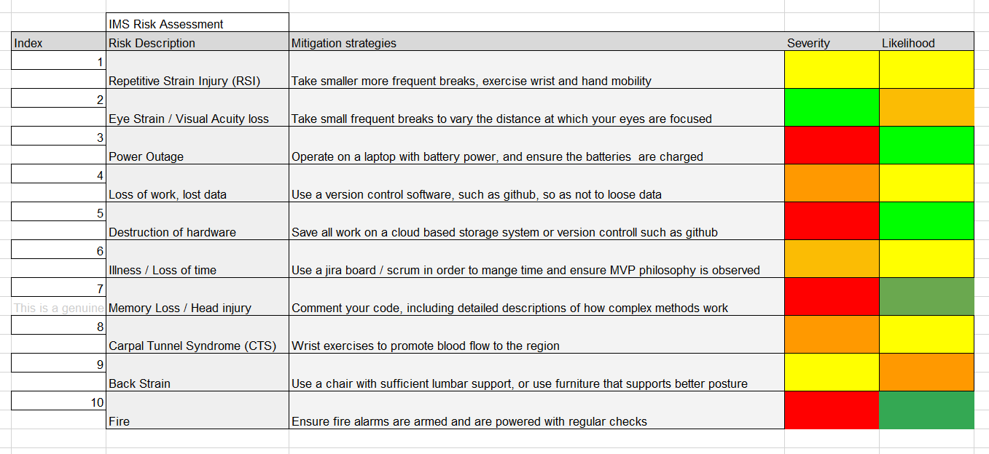
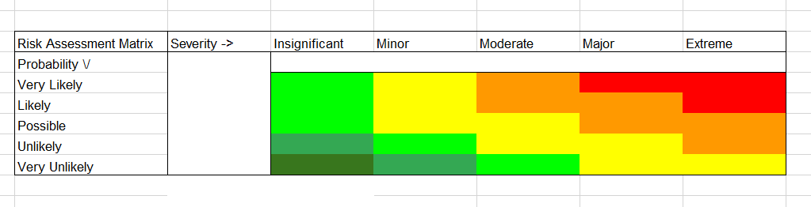
Risk Assessment:

Slide 17
Testing:

Slide 18
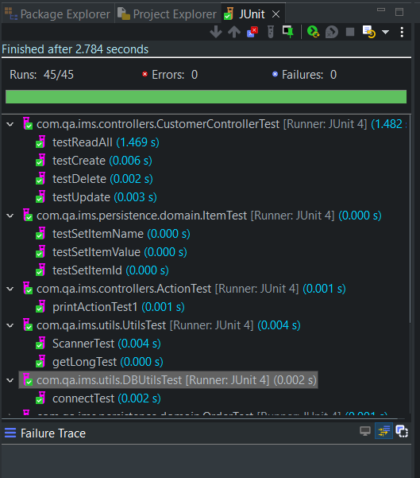
JUnit Tests:

Slide 19
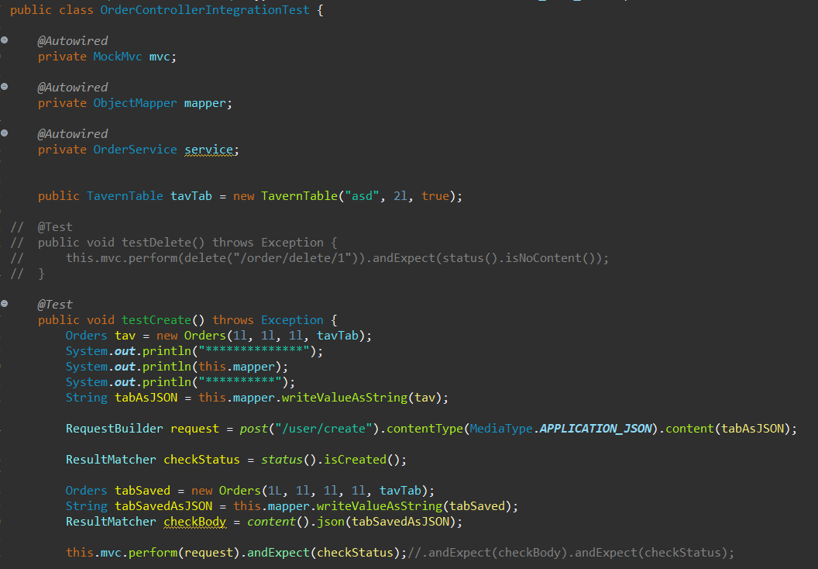
Mockito Tests:

Slide 20
Sprint Review

Slide 21
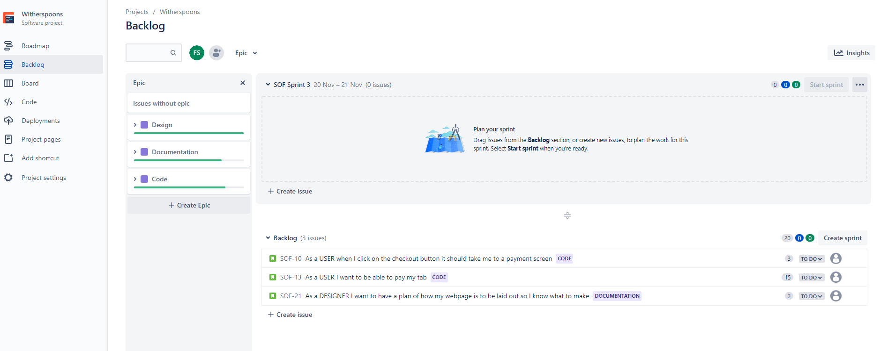
Sprint Retrospective

Slide 22
Conclusion
Improvements
Failings
Future Steps

Slide 23
Further Questions?

