Slide 1
Hobby Project: Fantasy Wetherspoons
November 21st 2021
Fraser Smith

Slide 2
Task Overview
To write a functional full stack program using the fundamental modules learned during training thus far.
We will use:
-Java 11 / HTML / CSS / JavaScript
-mySQL
-Maven / Spring
- Jira/Github

Slide 3
Project objective:
To construct a fantasy bar management system that could handle tables and orders with a many to one relationship between the two.

Slide 4
Understanding the problem: Jira Epics
Design
Code
Documentation
UML
ERD
FBM
JIRA Board
Domain
Controllers
Services
Repositories
Unit Testing (JUnit / Mockito)
User-Acceptance Testing (Selenium)
README
Risk Assessment

Slide 5
Design:

Slide 6
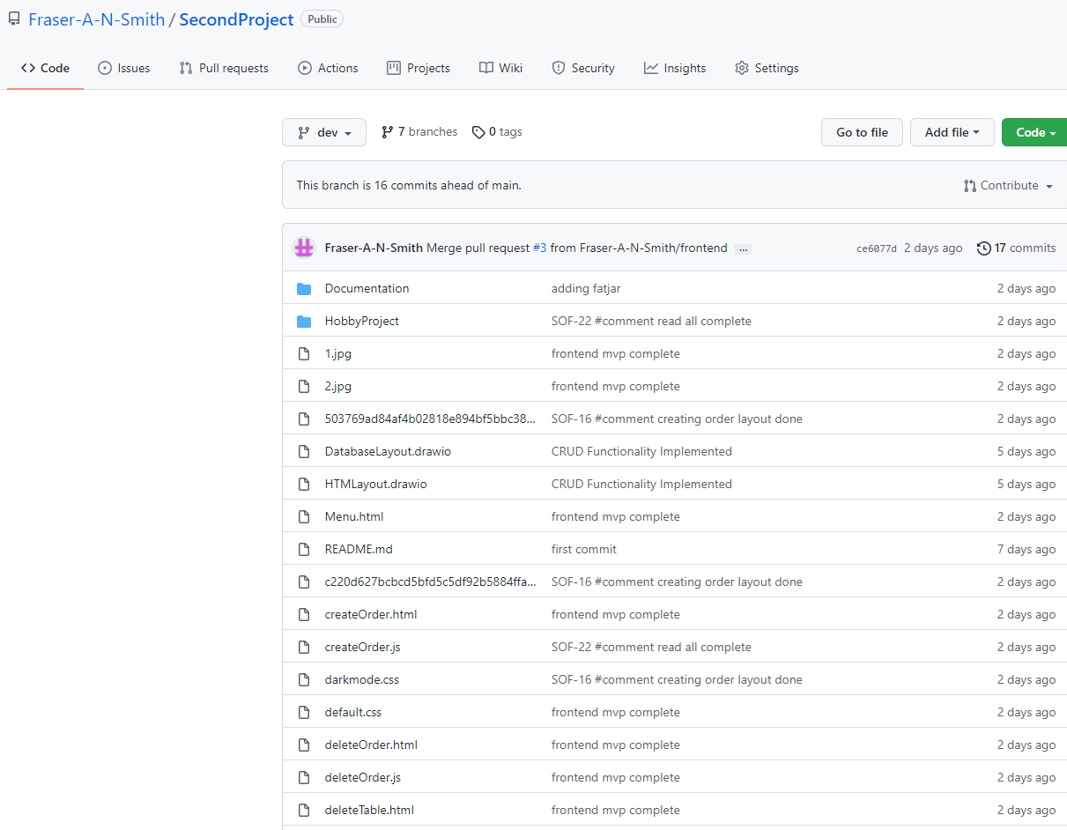
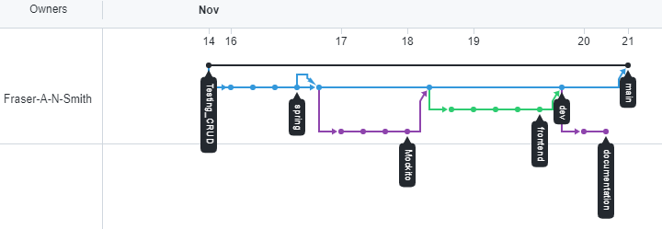
Version Control:
GitHub

Slide 7
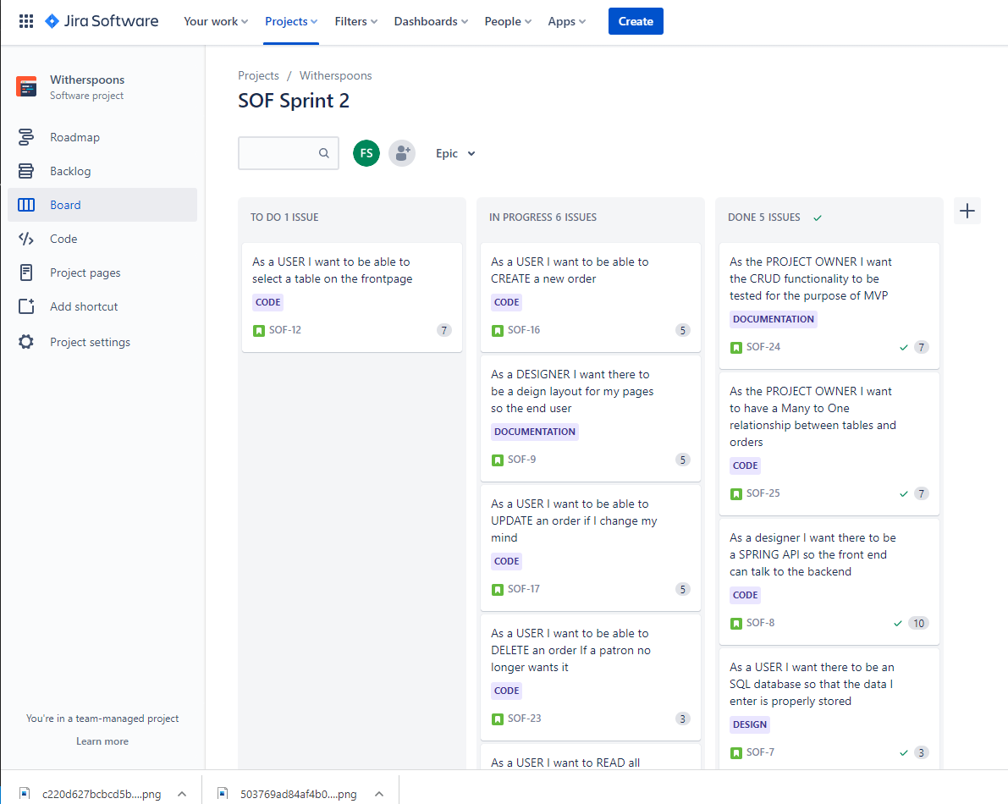
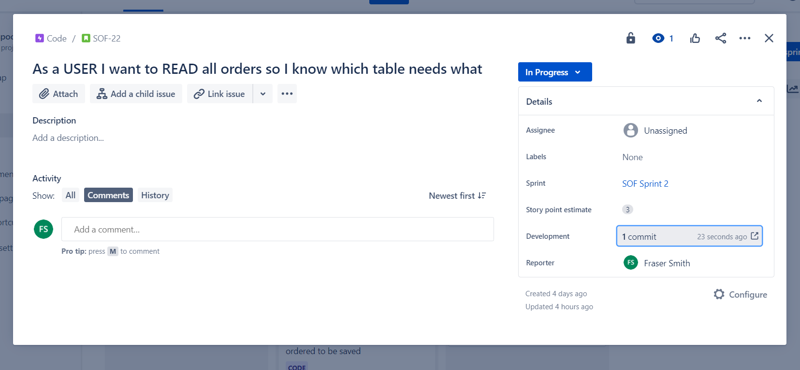
Scrum
Jira

Slide 8
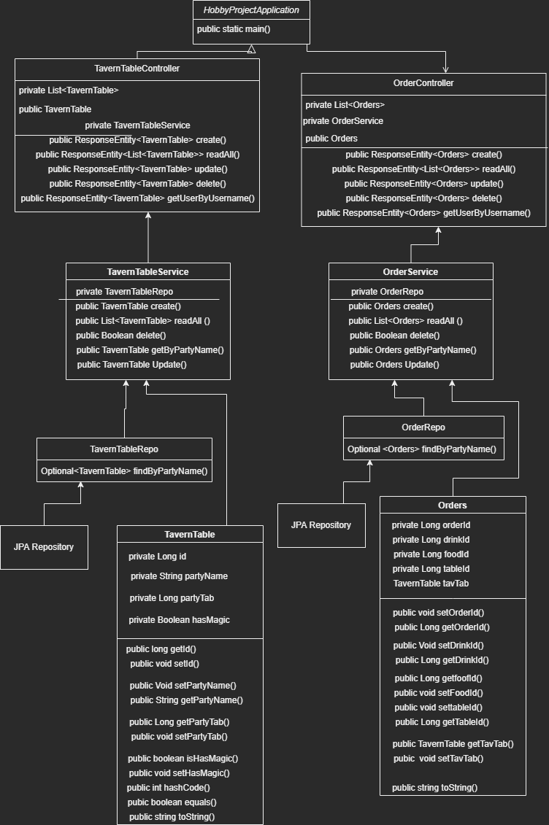
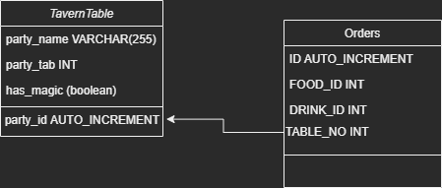
UML & ERD:

Slide 9
Code:

Slide 10
Domain:
TavernTable.java
Id AUTO_INCREMENT
PartyName String
PartyTab Int
Has_Magic Boolean
Orders.java
Id AUTO_INCREMENT
FoodId INT
DrinkId INT
TableNumber INT

Slide 11
Services:
Service Setup -2 Methods
Create
ReadAll
Read
Update
Delete

Slide 12
Repositories:
Interfaces which extend the JpaRepository for use by SPRING

Slide 13
Controllers:
TavernTable + Orders
Sent fetch requests to the API which connected our frontend to our backend

Slide 14
Documentation:

Slide 15
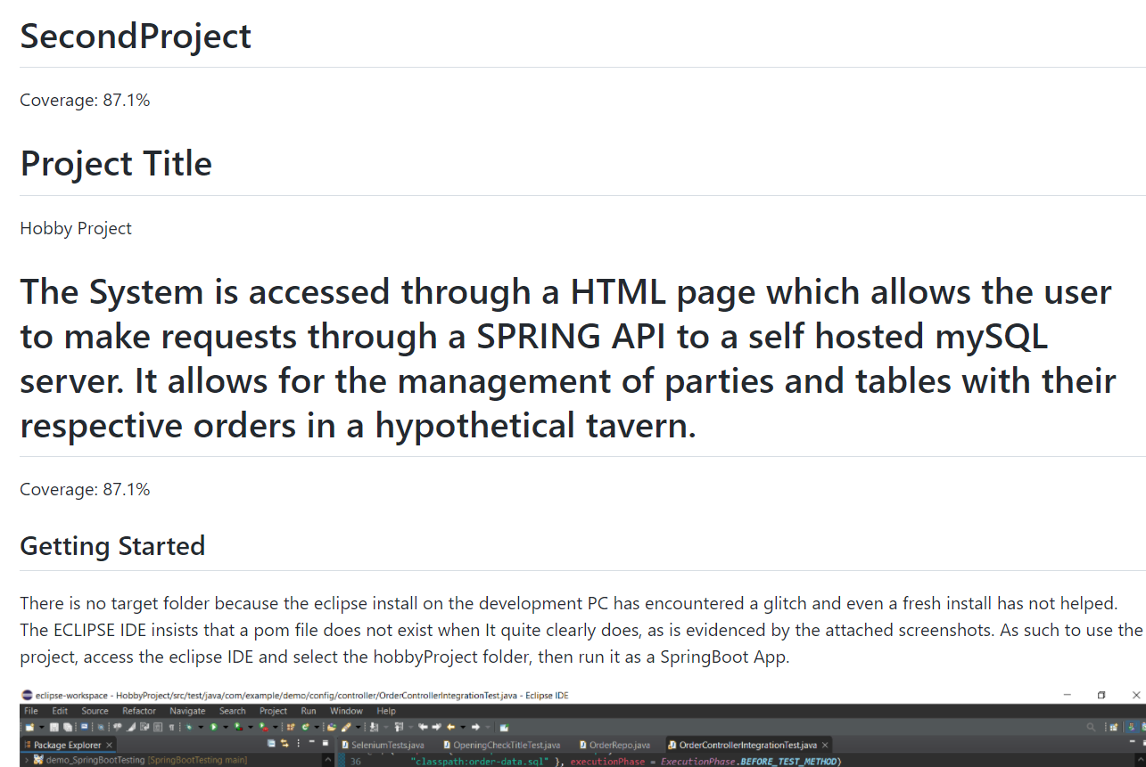
README:

Slide 16
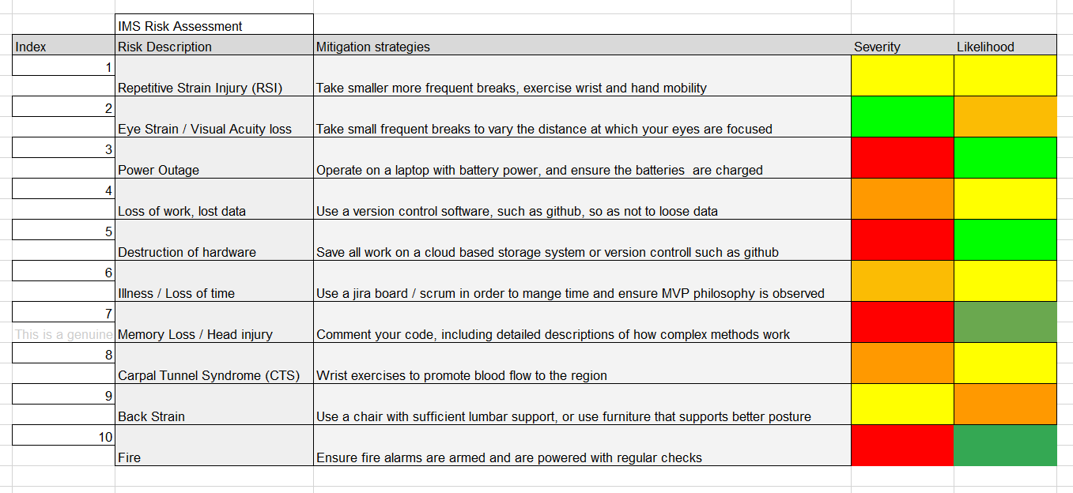
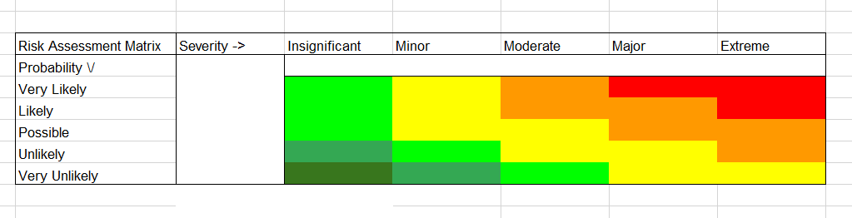
Risk Assessment:

Slide 17
Testing:

Slide 18
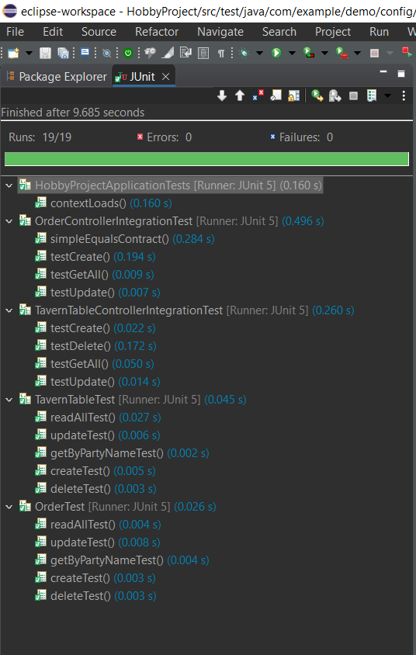
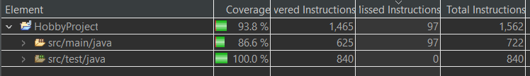
JUnit Tests:

Slide 19
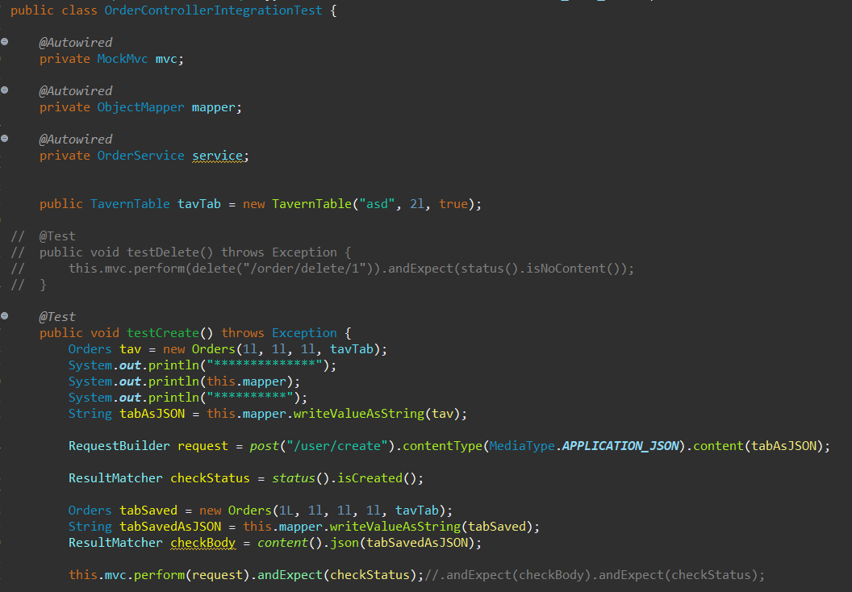
Mockito Tests:

Slide 20
Sprint Review

Slide 21
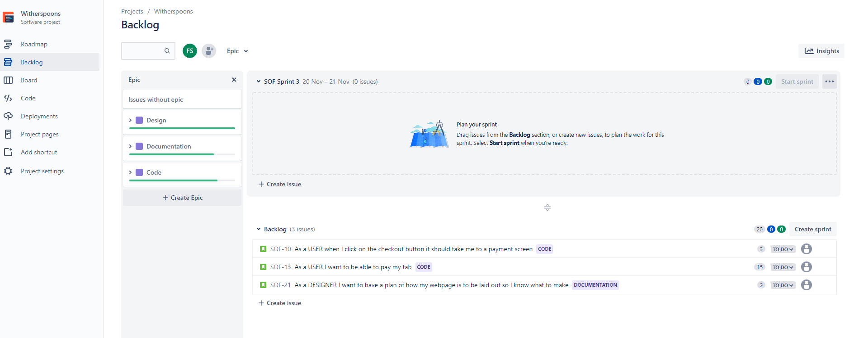
Sprint Retrospective

Slide 22
Conclusion
Improvements
Failings
Future Steps

Slide 23
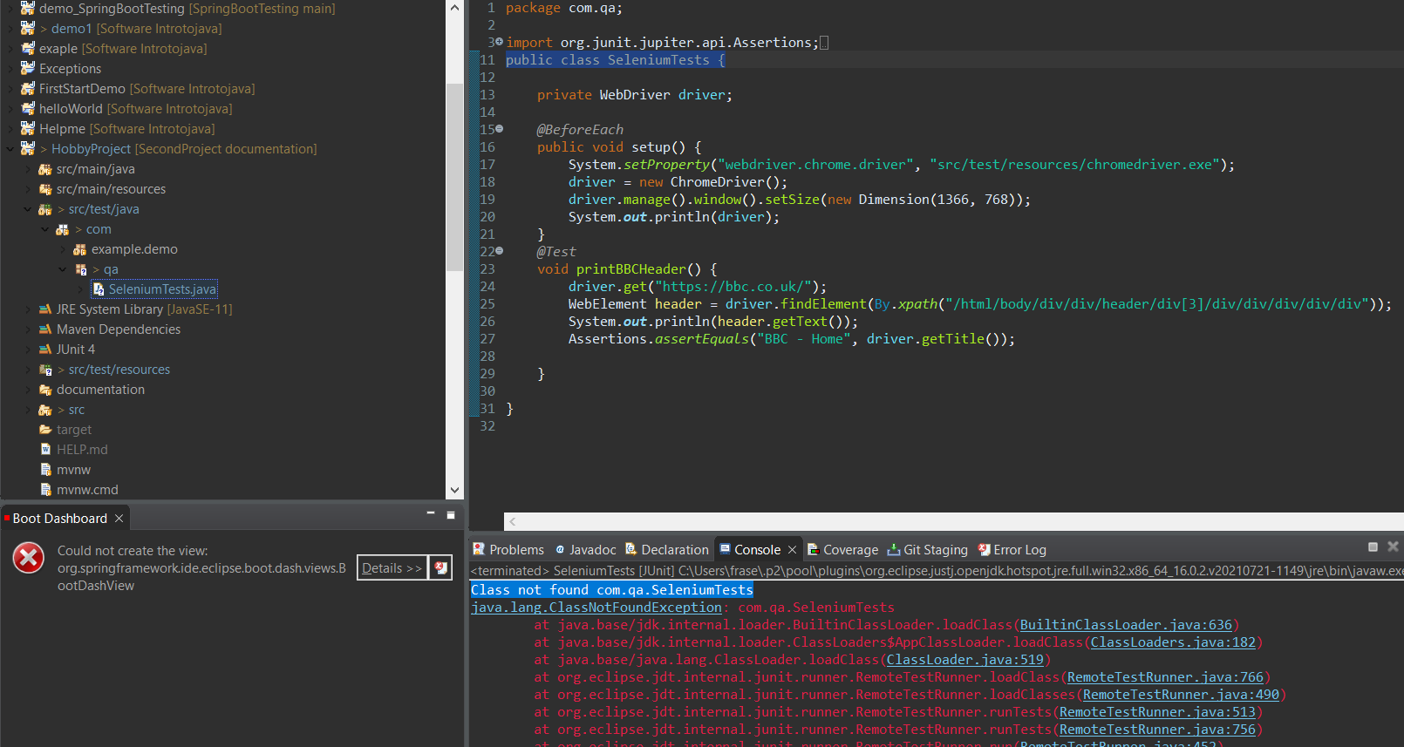
Evidence of Eclipse Malfunctioning

Slide 24
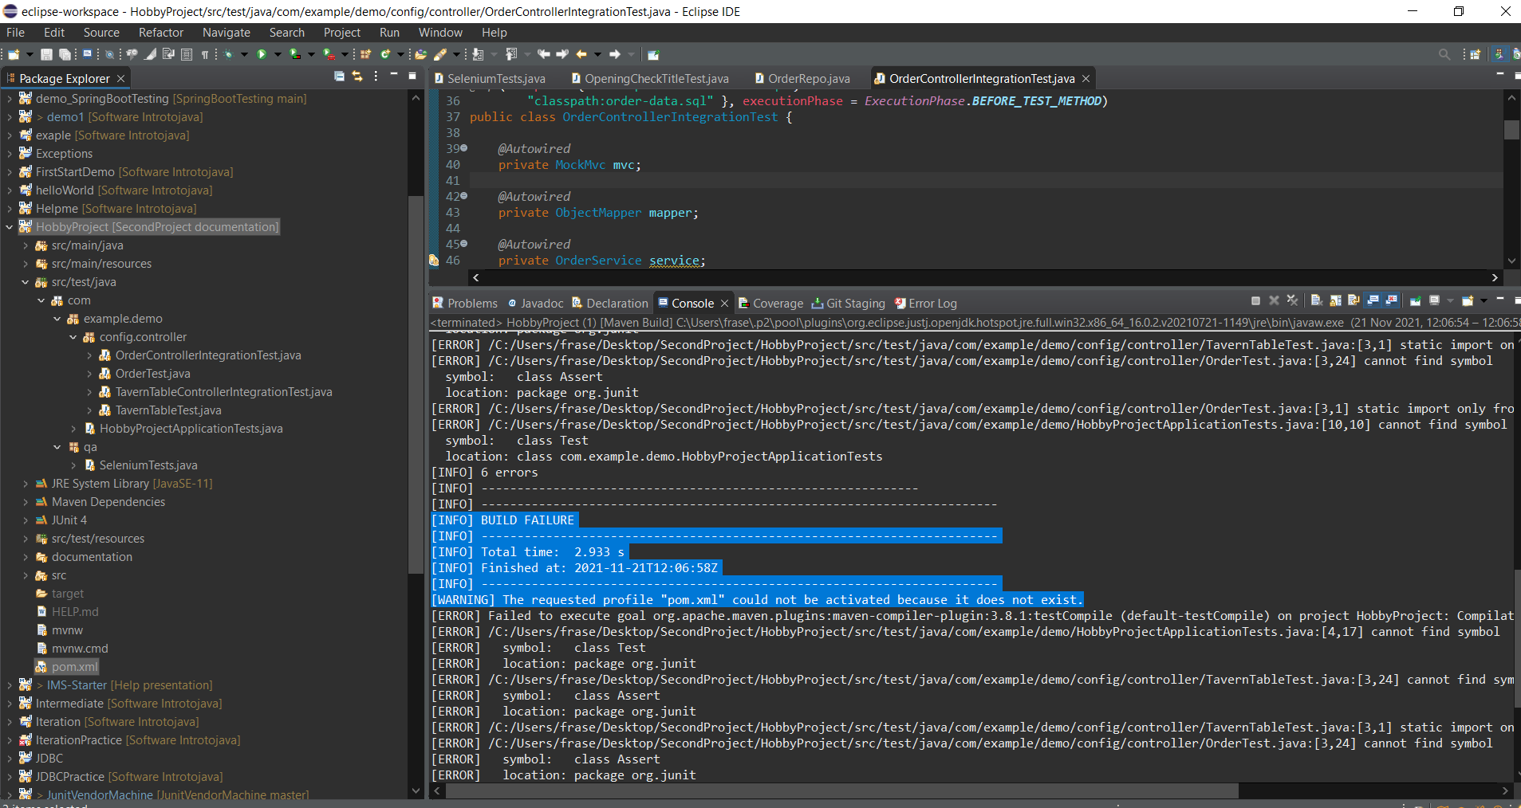
Evidence of Eclipse Malfunctioning

Slide 25
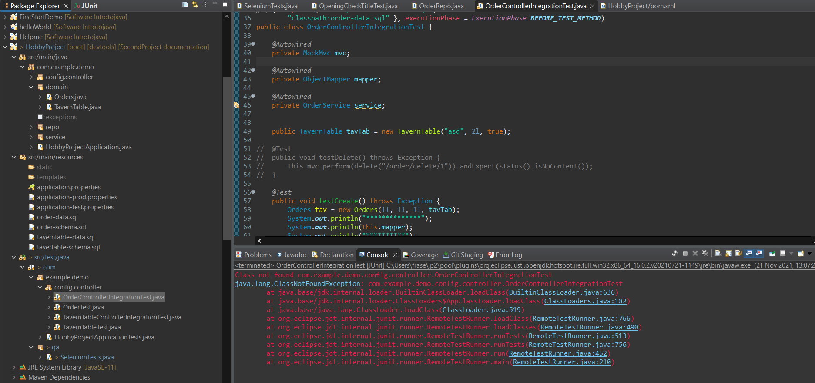
Evidence of Eclipse Malfunctioning

Slide 26
Further Questions?

