Slide 1
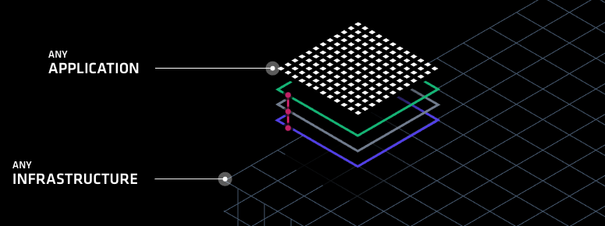
HashiCorp Solutions Suite
Fraser Pollock

Slide 2

Who Am I?
Chef Software Inc. Solutions Architect – 2 years
Open Text – 1 year
Blackberry Inc. (previously Research in Motion) – 5 years
My goal is to make it easy to do your job
Striving to reduce the technology gap
Notes:
http://www.un.org/apps/news/story.asp?NewsID=23283

Slide 3
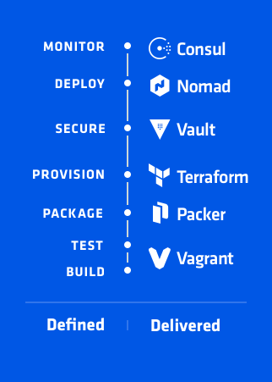
Agenda
Introduction
What is Dev Ops
DevOps Defined
Build/Test
Package
Provision
Secure
Monitor
Questions
Notes:
https://www.hashicorp.com/devops-defined/#done-right

Slide 4
What is DevOps
What are our challenges

Slide 5
DevOps is about minimizing the challenges of shipping, rapidly iterating, and securing software applications.
Notes:
Simply put DevOps is about minimizing the challenges of shipping, rapidly iterating, and securing software applications.
https://newrelic.com/navigating-devops?content=eBook
https://stelligent.com/2017/06/29/devops-benefits-of-infrastructure-as-code/
https://www.cloudtp.com/doppler/wannacry-wake-call-need-devops-cloud/

Slide 6

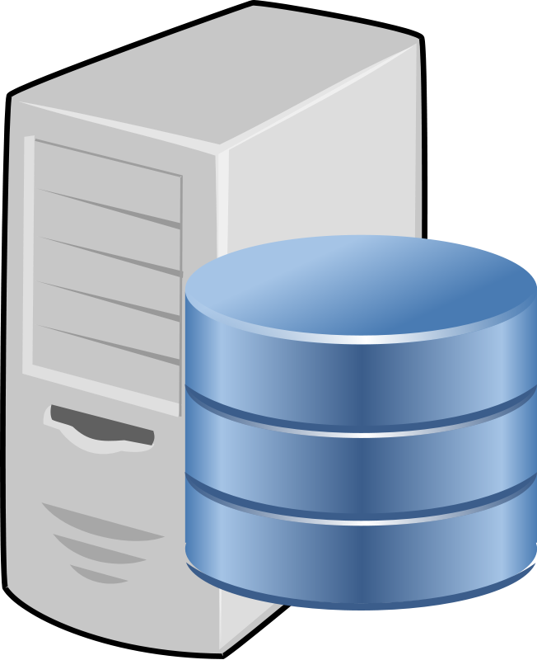

Traditional Waterfall
Wait Time
Dev
Wait Time
Ops
Wait Time
Sec
Notes:
Traditional waterfall methodology has a lot of wait times included in the process. Waiting for requirements, waiting for infrastructure and waiting for security reviews. If at any point in the cycle there’s an issue the entire cycle needs to restart, for example if Security scans and finds a vulnerability, the application and infrastructure need to be returned to the teams and reviewed before being resubmitted for scanning and approval.

Slide 7
Dev Ops Defined
Dev
Ops
?
Sec
Notes:
Rather than serial progression what if we could all work together and collaborate on requirements and deliver value to the end customer. If just one these organizations started increasing the velocity at which they work how much faster could we deliver value to our customers whether they be internal or external or part of the Dev Ops cycle.

Slide 8
Why Dev Ops

Slide 9
Dev Ops
Allowing everyone to work in parallel to deliver business value to the customer
Prioritizes agility, time to value and a more continuous integrated and continuous delivery model of all components
Hashicorp focuses on this by deconstructing the essential elements of an application delivery process and providing a solution best suited for each participant in the task.

Slide 10
Dev
Customer
Ops
Sec
Notes:
But who and where are our customers? They are globally distributed so we need to be as well.

Slide 11
Gartner predicts that “…by 2020, 90 percent of organizations will adopt hybrid infrastructure”
Notes:
http://www.gartner.com/newsroom/id/3666917 - Gartner predicts that by 2020, 90 percent of organizations will adopt hybrid infrastructure management capabilities.
https://www.technative.io/90-of-organizations-will-adopt-hybrid-it-infrastructure-by-2020/ - 90% of Organizations Will Adopt Hybrid IT Infrastructure by 2020

Slide 12
Gartner predicts that “…through 2020, 99% of vulnerabilities exploited will continue to be ones known by security and IT professionals for at least one year”
Notes:
Why is this?
We either don’t have enough time to address the vulnerabilities, can’t rapidly update our underlying technology fast enough or are adverse to change because it will impact application stability
http://www.gartner.com/newsroom/id/3666917 - Gartner predicts that by 2020, 90 percent of organizations will adopt hybrid infrastructure management capabilities.
https://www.technative.io/90-of-organizations-will-adopt-hybrid-it-infrastructure-by-2020/ - 90% of Organizations Will Adopt Hybrid IT Infrastructure by 2020

Slide 13
What will successful IT Organizations Need?
The ability for developers to rapidly iterate over applications in a similar environment to production
Flexibility when it comes to hybrid infrastructure
Access and key management for the cloud and applications
Fault tolerant and focused around multi-datacenter situations

Slide 14
Questions?
Notes:
Demo Slide

Slide 15
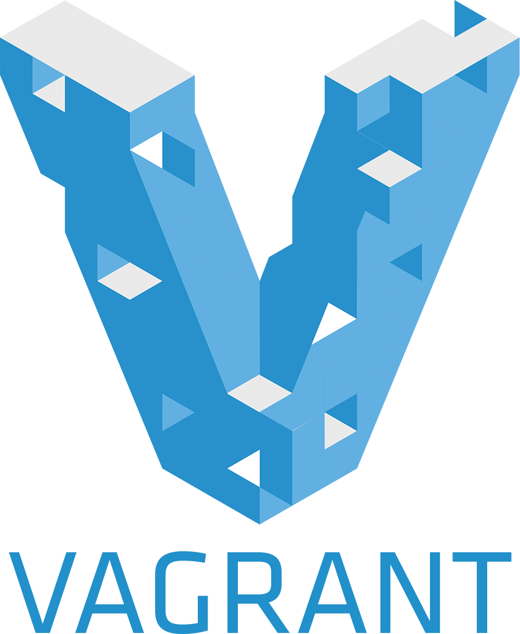
Dev Ops Defined
Build and Test with Vagrant
Workflows, not Technologies

Slide 16
What is Vagrant
Vagrant is a solution for building and managing virtual machine environment in a single workflow
Its easy to configure, reproducible and helps make portable work environments
Its simple, modular and composable
Notes:
https://www.vagrantup.com/intro/index.html - https://www.hashicorp.com/blog/the-tao-of-hashicorp/
Composability is self-contained and modular, stateless and ephemeral

Slide 17
Notes:
Demo Slide

Slide 18
Vagrant
We built up a quick, simple development environment for an application developer, operations person or security expert
We streamlined onboarding of new developers and new applications by creating a repeatable consumable artifact
Enabled Operations and Security to set standards by building ‘box’ files that can be used as part of development
Used infrastructure as code to build a version-able, testable repeatable artifact
Notes:
https://www.vagrantup.com/intro/index.html
https://www.hashicorp.com/blog/the-tao-of-hashicorp/

Slide 19
Infrastructure as Code
Iterative, Testable, Repeatable, Consumable

Slide 20

Infrastructure as Code
Dev
Define everything from
Network requirements
Ingress/egress
Protocol
Vpc
Routing
Server specifications
RAM/CPU
Middleware specifications
Middleware version
Env variables
User accounts
Ops
Sec

Slide 21
Dev
Ops
Sec

Slide 22
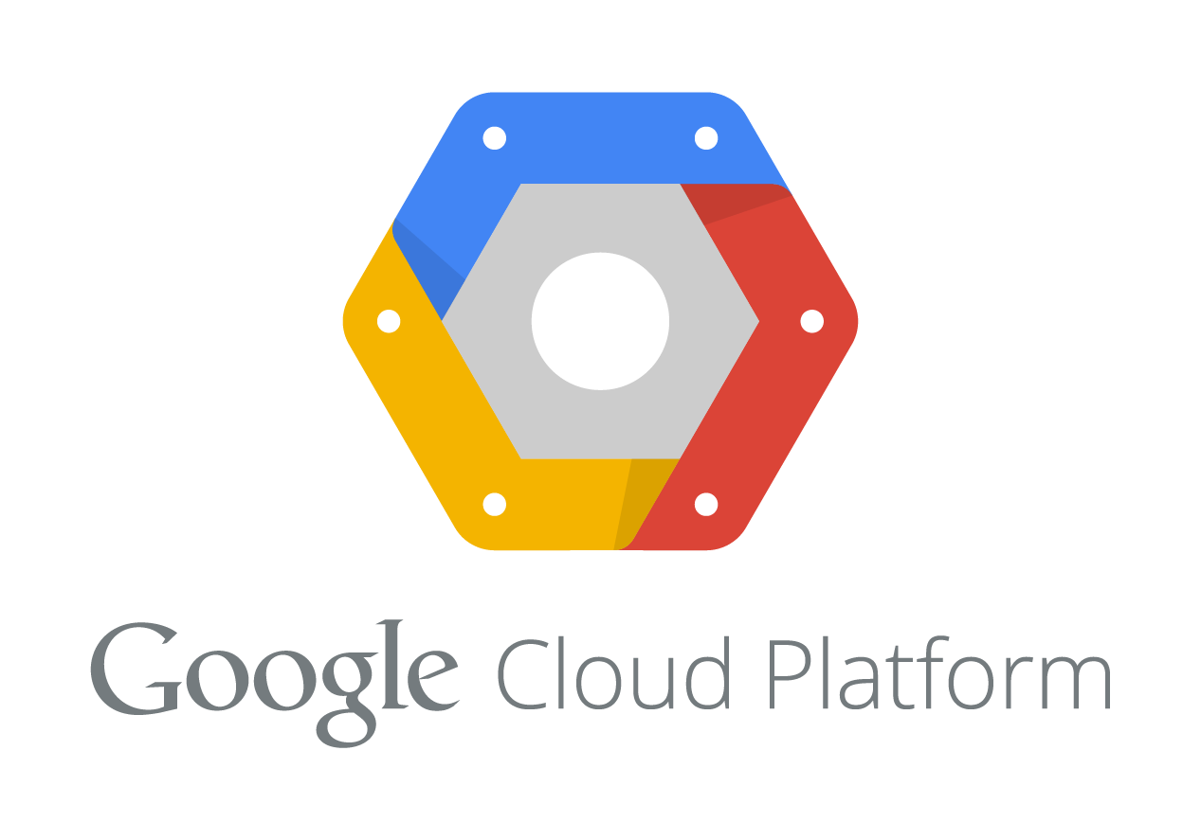
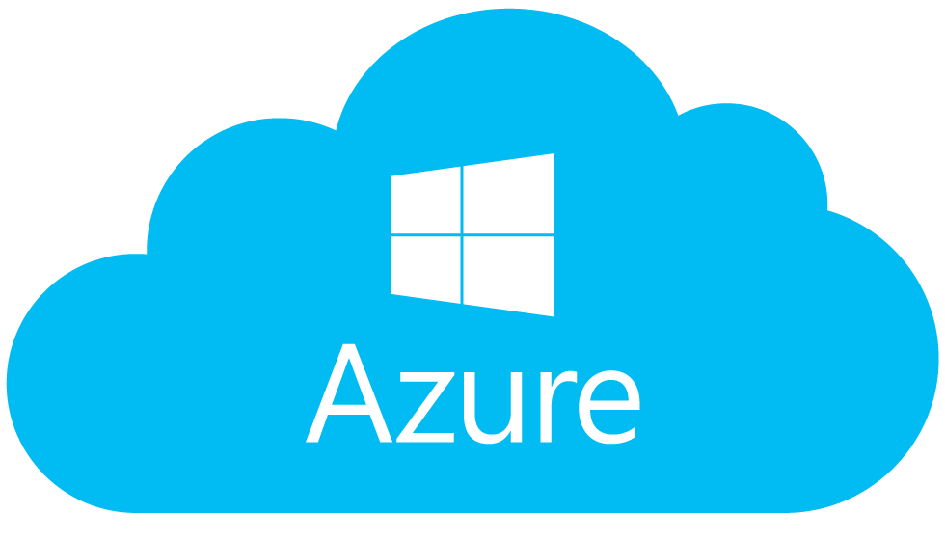

EU Data Center
NA Data Center

Slide 23

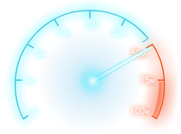

Infrastructure as Code at a Glance
Reduces the people effort by allowing collaboration and unified direction, freeing resources to work on other enterprise tasks
Enables easy review of resources, allocated cost and consumption
Significantly speeds up application and infrastructure development by automating tasks
Gives visibility to all stakeholders
Enable faster iteration over artifacts through composable and ephemeral infrastructure
Reduces the risk of human error through automation
Allows for Security to be injected into any portion of the development life cycle
“Uniqueness breeds vulnerability”
Notes:
https://en.wikipedia.org/wiki/Infrastructure_as_Code

Slide 24

Infrastructure as Code
Build Automated Machine Images
Uniqueness is Vulnerability

Slide 25
What is Packer
Packer is a workflow for creating identical machine images
Its easy to configure, reproducible and helps make portable work environments
Its simple, modular and composable
Notes:
https://www.vagrantup.com/intro/index.html - https://www.hashicorp.com/blog/the-tao-of-hashicorp/
Composability is self-contained and modular, stateless and ephemeral

Slide 26
What is Packer
Define a builder
AWS
Azure
Google Cloud
{ "builders": [ // ... one or more builder definitions here ] }
{"type": "amazon-ebs",}
{"type": "vmware-vmx",}
{"type": "googlecompute",}

Slide 27
What is Packer
Define a provisioner
What do I want to do?
{ ”provisioners": [ // ... one or more provisioners here ] }
{"type": ”file",}
{"type": ”shell",}
{"type": ”script",}
{"type": ”chef",}
{"type": ”puppet",}
…

Slide 28
What is Packer
Customize with Variables
"access_key": "{{user `aws_access_key`}}",
"secret_key": "{{user `aws_secret_key`}}",
{{isotime \"2006-01-02\"}}

Slide 29
Notes:
Demo Slide

Slide 30
Packer
We built a share-able and customizable image that anyone can use
Built a standard image that can be used across hybrid infrastructure
Included patches, middleware and sizing definitions into the build process
Produced a coded artifact that can be used to collaborate, review and inspect easily the state of infrastructure
Notes:
https://www.vagrantup.com/intro/index.html - https://www.hashicorp.com/blog/the-tao-of-hashicorp/
Composability is self-contained and modular, stateless and ephemeral

Slide 31
Ops
Notes:
Any Questions

Slide 32

Infrastructure as Code
Write, Plan, Create, Change
Change Automation

Slide 33
What is Terraform
Terraform is a workflow for designing, planning, building and changing infrastructure and its topology
Designed to be modular and variable defined
Cloud agnostic, with orchestration and large-scale built in mind
Terraform uses the concept of Infrastructure as Code to define desired state
Notes:
https://www.vagrantup.com/intro/index.html - https://www.hashicorp.com/blog/the-tao-of-hashicorp/
Composability is self-contained and modular, stateless and ephemeral

Slide 34
Infrastructure as Code
Dev
Define everything from
Network requirements
Ingress/egress
Protocol
Vpc
Routing
Server specifications
RAM/CPU
Middleware specifications
Middleware version
Env variables
User accounts
Ops
Sec

Slide 35
Dev
Ops
Sec

Slide 36
EU Data Center
NA Data Center

Slide 37
Infrastructure as Code at a Glance
Reduces the people effort by allowing collaboration and unified direction, freeing resources to work on other enterprise tasks
Enables easy review of resources, allocated cost and consumption
Significantly speeds up application and infrastructure development by automating tasks
Gives visibility to all stakeholders
Enable faster iteration over artifacts through composable and ephemeral infrastructure
Reduces the risk of human error through automation
Allows for Security to be injected into any portion of the development life cycle
“Uniqueness breeds vulnerability”
Notes:
https://en.wikipedia.org/wiki/Infrastructure_as_Code

Slide 38
What is Terraform
Pick a provider (or multiple)
AWS
Azure
Google Cloud
provider “my-cloud” {…}
provider "azure"
publish_settings = "${file("credentials.publishsettings")}”
provider "aws"
access_key = "${var.aws_access_key}"
secret_key = "${var.aws_secret_key}”
region = "us-east-1"
provider "google"
credentials = "${file("account.json")}"
project = "my-gce-project”
region = "us-central1"

Slide 39
What is Terraform
Define a provisioner
What do I want to do
What is the desired state
Ask for output
Output “all_web_ips”{ “$(aws_instance.web.*.public_ip}”
Set up a connection
type = "ssh"
user = "root"
password = "${var.root_password}"
provisioner
File
Local-exec
Remote-exec

Slide 40
What is Terraform
Customize with variables
variable "platform" { default = "ubuntu" description = "The OS Platform"}
variable "instance_type" { default = "t2.micro" description = "AWS Instance type"}
variable "servers" { default = "1" description = ”# of servers to launch"}

Slide 41
Notes:
Demo Slide

Slide 42
Terraform
Orchestrated the deployment of web infrastructure to a cloud
Used a module which is a re-usable definition of infrastructure
This helps set standards and security
Ie; ingress/egress rules
Mapped out resource dependencies
VMs depend on Security Group depends on VPC
Dynamically scaled our infrastructure
Made a change ‘in-flight’ to our existing cluster
Used `terraform plan` to review impact
Enacted that plan after review
Notes:
https://www.vagrantup.com/intro/index.html - https://www.hashicorp.com/blog/the-tao-of-hashicorp/
Composability is self-contained and modular, stateless and ephemeral

Slide 43
EU Data Center
NA Data Center
Notes:
Any Questions?

Slide 44

Secrets Management
Storage, Key Rolling, Built in Audit
Integrated Security

Slide 45
What is Vault
Terraform is a workflow for designing, planning, building and changing infrastructure and its topology
Designed to be modular and variable defined
Cloud agnostic, with orchestration and large-scale built in mind
Notes:
https://www.vagrantup.com/intro/index.html - https://www.hashicorp.com/blog/the-tao-of-hashicorp/
Composability is self-contained and modular, stateless and ephemeral

