Slide 1
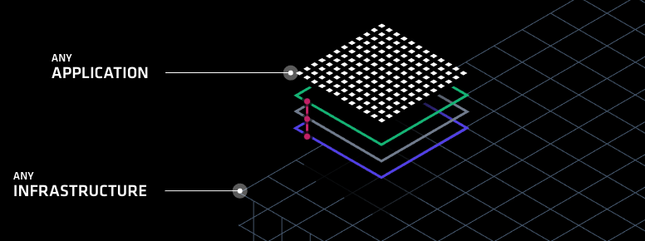
HashiCorp Solutions Suite
Fraser Pollock

Slide 2

Who Am I?
Chef Software Inc. Solutions Architect – 2 years
Customers include 2 of the Fortune 10
Vertical – Big Pharma, Fin Serve, Banks
Blackberry Inc. (previously Research in Motion) – 5 years
My goal is to make it easy to do your job
Striving to reduce the technology gap
Notes:
http://www.un.org/apps/news/story.asp?NewsID=23283

Slide 3
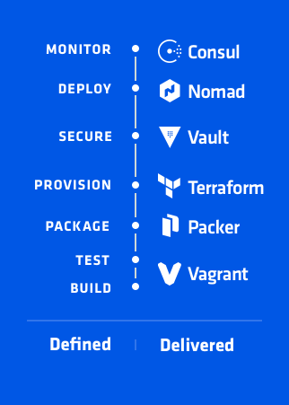
Agenda
Introduction
What is Dev Ops Culture
DevOps Defined
Build/Test
Package
Provision
Secure
Monitor
Questions
Notes:
Intro which we’ve already covered
What is Dev Ops Culture and why we’re focused on enabling it
Then talk about each of the individual Hashicorp solutions
https://www.hashicorp.com/devops-defined/#done-right

Slide 4
What is DevOps Culture
What are our challenges

Slide 5
DevOps is about minimizing the challenges of shipping, rapidly iterating, and securing software applications.
Notes:
Simply put DevOps is about minimizing the challenges of shipping, rapidly iterating, and securing software applications.
https://newrelic.com/navigating-devops?content=eBook
https://stelligent.com/2017/06/29/devops-benefits-of-infrastructure-as-code/
https://www.cloudtp.com/doppler/wannacry-wake-call-need-devops-cloud/

Slide 6

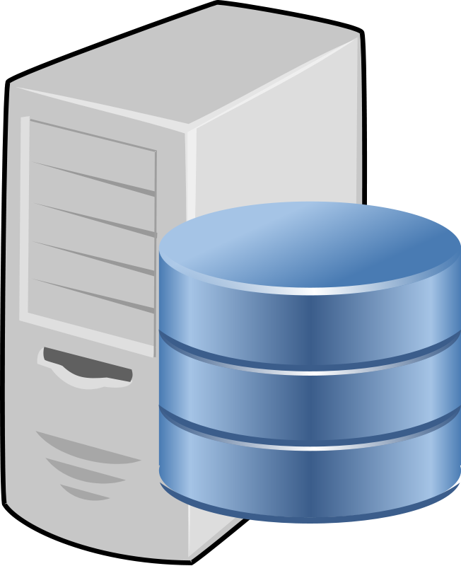

Traditional Waterfall
Wait Time
Dev
Wait Time
Ops
Wait Time
Sec
Notes:
Where a lot of companies are is the Traditional waterfall methodology which has a lot of wait times included in the process. Waiting for requirements, waiting for infrastructure and waiting for feedback. If at any point in the cycle there’s an issue the entire cycle needs to restart, for example if Security scans and finds a vulnerability in pre-production, the application and infrastructure need to be returned to the teams and reviewed again before being resubmitted for scanning and approval.
This is a very serial methodology, each group is focused on delivering their requirements but none are focused on delivering value to the customer

Slide 7
Dev Ops Culture Defined
Dev
Ops
?
Sec
Notes:
Rather than serial progression what if we could all work together and collaborate on requirements and deliver value to the end customer. If just one these organizations started increasing the velocity at which they work how much faster could we deliver value to our customers whether they be internal or external or even part of the Dev Ops cycle.

Slide 8
Why Dev Ops Culture

Slide 9
Dev Ops Culture
Allows everyone to work in parallel to deliver business value to the customer
Prioritizes agility, time to value and a more continuous integrated and continuous delivery model of all components
Firms with high performing IT organizations were twice as likely to exceed profitability, market share and productivity goals
Hashicorp helps enable this culture by deconstructing the essential elements of an application delivery process and providing a solution best suited for each participant in the task.
Notes:
of all components – whether it be application features, infrastructure upgrades or security requirements.
And when it comes down to ROI
So simply put shifting towards a Dev Ops culture will make your company more profitable.
https://devops.com/the-roi-of-enterprise-devops/

Slide 10
Dev
Customer
Ops
Sec
Notes:
So instead of the traditional waterfall methodology we have a continuous cycle of collaborating and delivering features and value to our customers. But who and where are our customers? They are globally distributed so we need to be as well.

Slide 11
Gartner predicts that “…by 2020, 90 percent of organizations will adopt hybrid infrastructure”
Notes:
This means that they will have a private and public cloud footprint, possibly even multiple public clouds.
http://www.gartner.com/newsroom/id/3666917 - Gartner predicts that by 2020, 90 percent of organizations will adopt hybrid infrastructure management capabilities.
https://www.technative.io/90-of-organizations-will-adopt-hybrid-it-infrastructure-by-2020/ - 90% of Organizations Will Adopt Hybrid IT Infrastructure by 2020

Slide 12


What will successful IT Organizations Need?
The ability to rapidly provision and update environments
Flexibility when it comes to hybrid infrastructure
Security standards around access and credential management for the cloud and applications
Autoscaling and AutoHealing
Automation and Workflows
DevOps Culture
Flexible Infrastructure on Demand
Notes:
Need – in this new model
Environments – if we focus on feature driven outcomes that means significantly more deployments to handle
Hybrid infrastructure – if 90% of the world companies are going to transition to this model, solutions will need to support this requirement.
Applications – given this is a new frontier for many large organizations the same practices or products we had in our datacenters may not fit the public cloud model and slow us down
Autoscaling to react to demand and Autohealing to handle issues

Slide 13
Questions?
Notes:
So before we continue any further I want to ask if there is any questions

Slide 14
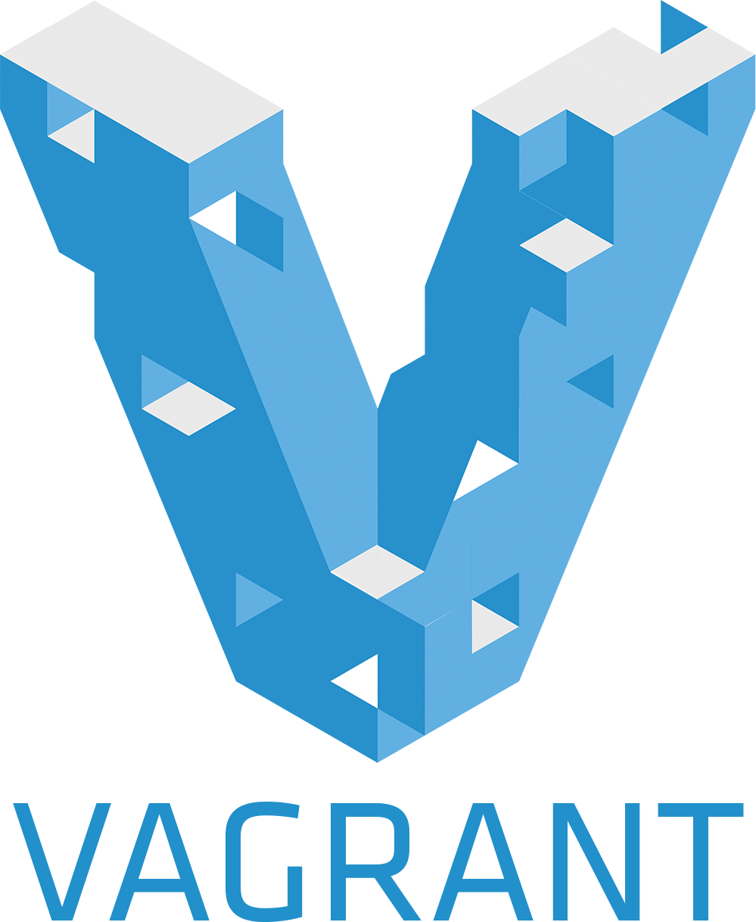
Dev Ops Defined
Build and Test with Vagrant
Workflows, not Technologies

Slide 15
What is Vagrant
Vagrant is a solution for building and managing virtual machine environment in a single workflow
Its easy to configure, reproducible and helps make portable work environments
Its simple, modular and composable
Notes:
https://www.vagrantup.com/intro/index.html - https://www.hashicorp.com/blog/the-tao-of-hashicorp/
Composability is self-contained and modular, stateless and ephemeral

Slide 16
Notes:
Demo Slide

Slide 17
Vagrant
We built up a quick, simple development environment for an application developer, operations person or security expert
We streamlined onboarding of new developers and new applications by creating a repeatable consumable artifact
Enabled Operations and Security to set standards by building ‘box’ files that can be used as part of development
Used infrastructure as code to build a version-able, testable repeatable artifact
Notes:
https://www.vagrantup.com/intro/index.html
https://www.hashicorp.com/blog/the-tao-of-hashicorp/

Slide 18
Infrastructure as Code
Iterative, Testable, Repeatable, Consumable

Slide 19

Infrastructure as Code
Dev
Codification of everything from
Network requirements
Ingress/egress
Protocol
Vpc
Routing
Server specifications
RAM/CPU
Middleware specifications
Middleware version
Env variables
User accounts
Ops
Sec
Notes:
Codification of everything from Network requirements to Server specifications to Middleware requirements. We’re trying to extrapolate the desired state of our end goal infrastructure into a repeatable, testable artifact. This artifact can then be templated and used across multiple clouds in a multitude of environments.

Slide 20
Dev
Ops
Sec
Notes:
Each stakeholder contributes their knowledge and their requirements to the infrastructure as code artifact which is then used to orchestrate the build of the infrastructure in the provider.
This approach focuses on giving increased visibility into the build process for our environments.

Slide 21
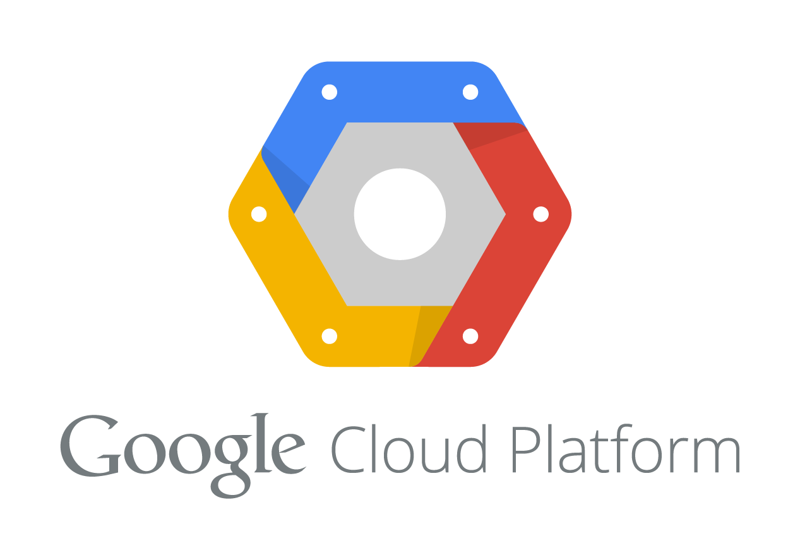
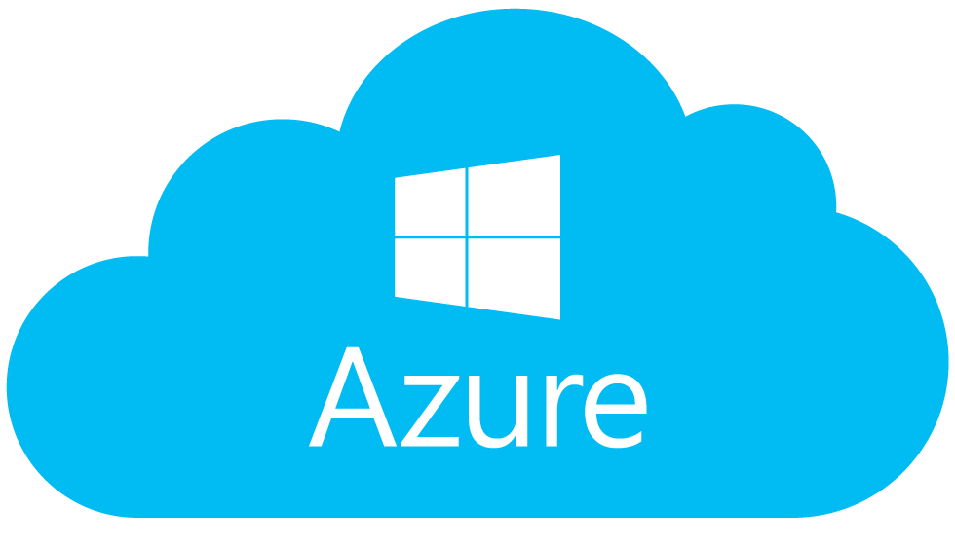

EU Data Center
NA Data Center
Notes:
and when executed correct allows us to rapidly provision to any location, on any framework, with any requirements. Remember multi-cloud deployments can be very challenging as many existing tools for infrastructure management are cloud-specific. Terraform is cloud-agnostic and allows a single configuration to be used to manage multiple providers, and to even handle cross-cloud dependencies. This simplifies management and orchestration, helping operators build large-scale multi-cloud infrastructures.

Slide 22

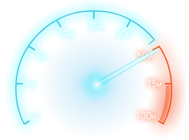

Infrastructure as Code at a Glance
Automate your deployment and recovery process
Enables easy review of resources, allocated cost and consumption
Significantly speeds up application and infrastructure development by automating tasks
Focus on Mean Time to Recovery
Enable faster iteration over artifacts through composable and an ephemeral code base
Reducing human errors through automation
Allows for Security to be injected into any portion of the development life cycle
“Uniqueness breeds vulnerability”
Notes:
So when we look at Infrastructure as code at a glance we really focus on 3 main returns on investment, reducing cost, speeding up feature delivery and reducing risk. And we can demonstrate those in a myriad of ways;
Recovery process – for example this allows us to easily manage and orchestrate a blue/green or ‘canary’ style deployment. For a particular set of nodes we can target a new application release. Also if our deployments and changes are automated it frees our administrators and developers to contribute value else-where.
Focus on Mean time to Recovery – applications fail, servers fail, this is part of IT. A failed component means a loss of revenue for the company and mean time to recovery is the focus on getting that component operationalized again.
composable means we focus on the fact that Terraform can be deployed independently or in conjecture with the rest of the Hashicorp suite which will discuss later.
And the ephemeral code base provides value by being versionable, allowing rollback and roll forwards. You can inspect and write code atomically. Using versions enables auditing and creates a clear history of how the current state was reached. When something breaks, the origin of the error can be determined using the version history.
Practice makes perfect - Reduces the risk of human error through automation
https://stelligent.com/2017/06/29/devops-benefits-of-infrastructure-as-code/
https://en.wikipedia.org/wiki/Infrastructure_as_Code

Slide 23

Infrastructure as Code
Build Automated Machine Images
Uniqueness is Vulnerability

Slide 24
What is Packer
Packer is a workflow for creating identical machine images
Its easy to configure, reproducible and helps make portable work environments
Its simple, modular and composable
Notes:
https://www.vagrantup.com/intro/index.html - https://www.hashicorp.com/blog/the-tao-of-hashicorp/
Composability is self-contained and modular, stateless and ephemeral

Slide 25
What is Packer
Define a builder
AWS
Azure
Google Cloud
{ "builders": [ // ... one or more builder definitions here ] }
{"type": "amazon-ebs",}
{"type": "vmware-vmx",}
{"type": "googlecompute",}

Slide 26
What is Packer
Define a provisioner
What do I want to do?
{ ”provisioners": [ // ... one or more provisioners here ] }
{"type": ”file",}
{"type": ”shell",}
{"type": ”script",}
{"type": ”chef",}
{"type": ”puppet",}
…

Slide 27
What is Packer
Customize with Variables
"access_key": "{{user `aws_access_key`}}",
"secret_key": "{{user `aws_secret_key`}}",
{{isotime \"2006-01-02\"}}

Slide 28
Notes:
Demo Slide

Slide 29
Packer
We built a share-able and customizable image that anyone can use
Built a standard image that can be used across hybrid infrastructure
Included patches, middleware and sizing definitions into the build process
Produced a coded artifact that can be used to collaborate, review and inspect easily the state of infrastructure
Notes:
https://www.vagrantup.com/intro/index.html - https://www.hashicorp.com/blog/the-tao-of-hashicorp/
Composability is self-contained and modular, stateless and ephemeral

Slide 30
Ops
Notes:
Any Questions

Slide 31

Infrastructure as Code
Write, Plan, Create, Change
Change Automation
HashiCorp
Terraform
Notes:
So what I’d like to do now is introduce some of the Hashicorp workflows, the first is Terraform

Slide 32
Terraform is…
Terraform is a workflow for designing, planning, building and changing infrastructure and its topology
Designed to be modular
Customized via variables
Cloud agnostic
Terraform uses the concept of Infrastructure as Code to define desired state
Notes:
And the reason we’re starting with Terraform is it’s the basis of all of your infrastructure
Modular – each piece of the infrastructure definition can be run separately, or used in another project.
Variables – which means that to go from Dev to Qa to Production means swapping in a different variable file and the infrastructure definitions remain the same
Cloud Agnostic – With minor changes in the provider you can build for AWS or Azure or even private cloud solutions
https://www.vagrantup.com/intro/index.html - https://www.hashicorp.com/blog/the-tao-of-hashicorp/

Slide 33
Infrastructure as Code
Dev
Codification of everything from
Network requirements
Ingress/egress
Protocol
Vpc
Routing
Server specifications
RAM/CPU
Middleware specifications
Middleware version
Env variables
User accounts
Ops
Sec
Notes:
Codification of everything from Network requirements to Server specifications to Middleware requirements. We’re trying to extrapolate the desired state of our end goal infrastructure into a repeatable, testable artifact. This artifact can then be templated and used across multiple clouds in a multitude of environments.
Think of an example weblogic node. Everything from the weblogic to the java to the firewall configuration and the virtual machine its living on can be defined in code

Slide 34
Dev
Ops
Sec
Notes:
Each stakeholder contributes their knowledge and their requirements to the infrastructure as code artifact which is then used to orchestrate the build of the infrastructure in the provider.
This approach focuses on giving increased visibility into the build process for our environments.

Slide 35
EU Data Center
NA Data Center
Notes:
and when executed correct allows us to rapidly provision to any location, on any framework, with any requirements. Terraform is cloud-agnostic and allows a single configuration to be used to manage multiple providers, and to even handle cross-cloud dependencies. This simplifies management and orchestration, helping operators build large-scale multi-cloud infrastructures.

Slide 36
Infrastructure as Code at a Glance
Automate your deployment and recovery process
Enables easy review of resources, allocated cost and consumption can be visualized and quantified
Significantly speeds up application and infrastructure development by automating tasks
Focus on Mean Time to Recovery
Enable faster iteration over artifacts through an ephemeral code base
Reducing human errors through automation
Allows for Security to be injected into any portion of the development life cycle
“Uniqueness breeds vulnerability”
Notes:
So when we look at Infrastructure as code at a glance we really focus on 3 main returns on investment, reducing cost, speeding up feature delivery and reducing risk. And we can demonstrate those in a myriad of ways;
Recovery process – for example this allows us to easily manage and orchestrate a blue/green or ‘canary’ style deployment. For a particular set of nodes we can target a new application release. Also if our deployments and changes are automated it frees our administrators and developers to contribute value else-where.
When we address speed Infrastructure as code
It allows us to focus on Mean time to Recovery – applications fail, servers fail, this is part of IT. A failed component means a loss of revenue for the company and mean time to recovery is the focus on getting that component operationalized again.
And the ephemeral code base provides value by being versionable, allowing rollback and roll forward. Using versions enables auditing and creates a clear history of how the current state was reached. When something breaks, the origin of the error can be determined using the version history.
and when we talk about reducing risk, we talk about reducing the human factor that contributes towards errors by increasing automation.
Infrastructure as code also allows for security to be codified into any portion of the development cycle
If we use a template based language we have less unique snowflakes to manage
Practice makes perfect - Reduces the risk of human error through automation
https://stelligent.com/2017/06/29/devops-benefits-of-infrastructure-as-code/
https://en.wikipedia.org/wiki/Infrastructure_as_Code

Slide 37
Infrastructure as Code with Terraform

Slide 38
Provider
Pick a provider (or multiple)
AWS
Azure
Google Cloud
provider “my-cloud” {…}
provider "azure"
publish_settings = "${file("credentials.publishsettings")}”
provider "aws"
access_key = "${var.aws_access_key}"
secret_key = "${var.aws_secret_key}”
region = "us-east-1"
provider "google"
credentials = "${file("account.json")}"
project = "my-gce-project”
region = "us-central1"

Slide 39
Function
Define a provisioner
What do I want to do
What is the desired state
Ask for output
Output “all_web_ips”{ “$(aws_instance.web.*.public_ip}”
Set up a connection
type = "ssh"
user = "root"
password = "${var.root_password}"
provisioner
File
Local-exec
Remote-exec

Slide 40
Customize
Customize with variables
variable "platform" { default = "ubuntu" description = "The OS Platform"}
variable "instance_type" { default = "t2.micro" description = "AWS Instance type"}
variable "servers" { default = "1" description = ”# of servers to launch"}

Slide 41
Questions?
Notes:
Demo Slide

Slide 42
Terraform
Orchestrated the deployment of web infrastructure to a cloud
Used a module which is a re-usable definition of infrastructure
This helps set standards and security
Ie; ingress/egress rules
Mapped out resource dependencies
VMs depend on Security Group depends on VPC
Dynamically scaled our infrastructure
Made a change ‘in-flight’ to our existing cluster
Used `terraform plan` to review impact
Enacted that plan after review
Notes:
https://www.vagrantup.com/intro/index.html - https://www.hashicorp.com/blog/the-tao-of-hashicorp/
Composability is self-contained and modular, stateless and ephemeral

Slide 43
EU Data Center
NA Data Center
Notes:
So you can see how as a Terraform user with some small changes you can build out the exact same infrastructure in all your environments and cloud by customizing some variables and modifying the provider. This allows us to easily provision and orchestrate large changes across data centers, be cloud agnostic in our a technology choices and rapidly introduce changes safety.

Slide 44

Service Discovery and Configuration
Failure Detection, Global Focus, KV Storage
Discovery Made Easy
HashiCorp
Consul
Notes:
So next I’d like to introduce you to Consul

Slide 45
Consul is…
Service Discovery
Health Checking
Key Value Storage
Access Control List
Can be used a storage backend for other Hashicorp solutions!
Notes:
Service Discovery – by configuring a simple check Consul is able to provide another Consul Client a DNS or HTTP API to query that services.
Health Checking – either as part of a service configuration for discovery or a separate check for something like memory consumption Consul can be used to monitor and manage cluster health
Consul can also supports a KV store that can be used by applications for dynamic configuration, feature flagging, coordination, and even leader election.
Consul can also implement an access control list which will be used by vault later in this demo

Slide 46
Service Discovery
JSON Format
{"service": {"name": "web", "tags": ["rails"], "port": 80}}
Placed inside the Consul Config Directory
Consul is reloaded and ‘syncs’ the service
[INFO] agent: Synced service 'web’
The service information is then able to be queried over DNS or HTTP API
This will return all nodes in the cluster that have that service enabled
Notes:
So lets talk about each of the individual features in more depth….
When you query the DNS or HTTP API it will return all the nodes in the cluster that have that service and their advertised address. This is an extremely useful feature when you’re thinking of globally distributed applications and multi-datacenter use cases. It allows for more dynamic real time discovery of services, easy scaling and provisioning as well as a self building CMBD

Slide 47
Health Checking
JSON Format
{"check": {"script": "curl localhost >/dev/null 2>&1", "interval": "10s"}}
Can be used independently or with the Service Discovery
Consul is reloaded and ‘syncs’ the service
[INFO] agent: Synced service 'web’
The status information is then able to be queried over DNS or HTTP API, filtered and consumed
[INFO] agent: Synced service 'web’
[WARN] Check 'service:web' is now critical
Notes:
Health checks can be associated with a service or can be run independently as well.
The checks be used to ensure proper service discovery and ensure no down services are responding to valid requests
You could add a health check independantly to verify resource consumption (CPU/RAM) as a trigger for a dynamically scaling cluster
Another great use of these health checks is with an additional utility called Consul Template which we’ll introduce later

Slide 48
Key Value Storage
As easy as `put` and `get`
Can query individual values or entire pre-fixes
consul kv get -detailed redis/config/minconns CreateIndex 207 Flags 0 Key redis/config/minconns LockIndex 0 ModifyIndex 207 Session - Value 1

Slide 49

Template Rendering and Supervisor
Notes:
Similair to https://github.com/coreos/etcd

Slide 50
Consul Template is…
Service discovery
Template Rendering
Notifier
Supervisor
Integrates directly with Consul and Vault
Notes:
Service discovery – all it needs is a consul agent running on the node to join the consul cluster and it can report back all the information from that cluster to the template service
and given a template it can dynamically generate configuration files for everything from load balancer configuration to databases

Slide 51
Traditional HA Proxy Cfg
option forwardfor bind *:8000 server nychost1 52.91.48.254
server nychost2 52.91.48.255
server nychost3 52.91.48.256
Notes:
So here’s a really great example of where this would be useful

Slide 52
Traditional HA Proxy Cfg
option forwardfor bind *:8000 server nychost1 52.91.48.254
server nychost2 52.91.48.255
server nychost3 52.91.48.256
server ???????? ??????????
?
Notes:
Adding a new host means a slew of updates, we have to update the load balancer, and add in the database information for the back ends that could have changed from our initial set up.
There could be multiple configuration files we have to update across all the hosts to rebalance this cluster.
when we’re talking about an individual cluster it’s a lot of work but possible, but across multiple clouds it becomes unmanageable
So what we need is a way to easily discover new nodes and services to the cluster

Slide 53
Questions?

Slide 54
Consul and Consul Template
Consul used a gossip protocol to rebalance the cluster and communicate messages to each node
We left and re-joined a cluster simulating maintenance and growth
Consul Template updated and automatically responded to failure in our cluster
We automated the process of scaling our cluster and configuring the new and old infrastructure

Slide 55

Secrets Management
Storage, Key Rolling, Built in Audit
Integrated Security
HashiCorp
Vault
Notes:
Cyberarc is retroactively trying to go to the cloud

Slide 56
What is Vault
Vault is a secret management tool built for everyone in mind
Has an API access point for developers
“Uniqueness breeds vulnerability” – it’s a software solution that can run without complex add-ons or hardware for operations
Full audit trail
Access control lists
…and its built into the process for security
Built in key rolling
Dynamic secrets!
Notes:
For developers – so they can write functions and libraries to call Vault to retrieve secrets. For example database connection information, cloud credential storage or even generic secrets.
It simple and easy to install and manage. So there’s little overhead in administrating it.
For security, so security isn't an after thought after a production release

Slide 57
Dynamic Secrets!
Store and generate secrets
Create secrets on demand!
Applications and appliances can have built in key rolling
Example;
Mount the backend
Write the policy
vault read database/creds/readonly Key Value --- ----- lease_id database/creds/readonly/2f6a614c-4aa2-7b19-24b9-ad944a8d4de6 lease_duration 1h0m0s lease_renewable true password 8cab931c-d62e-a73d-60d3-5ee85139cd66 username v-root-e2978cd0-
Notes:
So lets talk a little about dynamic dynamic secrets
All we need to do to implement this is mount the dynamic secret inside of vault
write a policy definition (who the user is, what they can do, how long they can do it) and then everytime we read that mount we provided a new set of credentials with those values dynamically generated and with a lease time.

Slide 58
EU Data Center
NA Data Center
Notes:
This is designed to addresses the scale problem of managing secrets. Think of each of the individual operators, applications and utilities that need access to other portions of your infrastructure.
Now imagine managing each of those components manually and individually. Its not scalable. We need to address the people scaling issue as well as the technology scaling issue and Vault does that.

Slide 59
Questions?
Notes:
Demo Vault

Slide 60
EU Data Center
NA Data Center
Notes:
So what did we achieve today.
We rapidly provisioned out new infrastructure to the cloud and enabled it to be reproduced in any other cloud using Terraform
We enabled dynamic service discovery and monitoring with Consul and automated cluster management with Consul Template
We secured the management and distribution of our Cloud access credentials using vault and provided a full audit trail of consumption and usage

Slide 61
Thank You
Notes:
In conclusion I want to thank you all for your time.
If there’s any final questions please feel free to ask.
If there’s anything you expected to see today that you didn’t or there’s something you want me to go into more depth around I’d be happy to do that

