Slide 1

HashiCorp Solutions Suite
Fraser Pollock

Slide 2
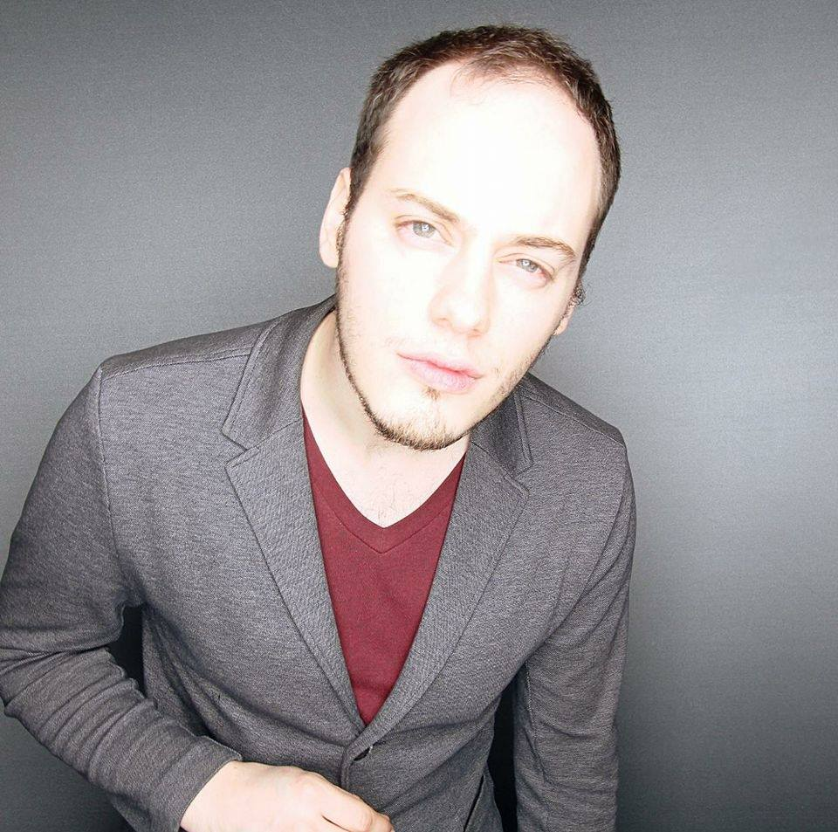
Who Am I?
Chef Software Inc. Solutions Architect – 2 years
Open Text – 1 year
Blackberry Inc. (previously Research in Motion) – 5 years
My goal is to make it easy to do your job
Striving to reduce the technology gap
Notes:
http://www.un.org/apps/news/story.asp?NewsID=23283

Slide 3
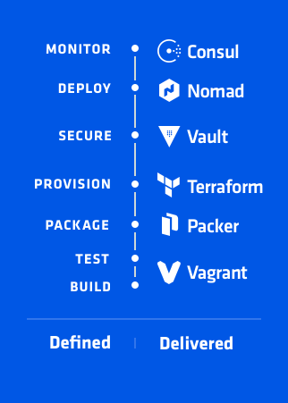
Agenda
Introduce
Dev Ops
Infrastructure as Code
DevOps Defined
Build/Test
Package
Provision
Secure
Deploy
Monitor
Questions
Demo

