Slide 1
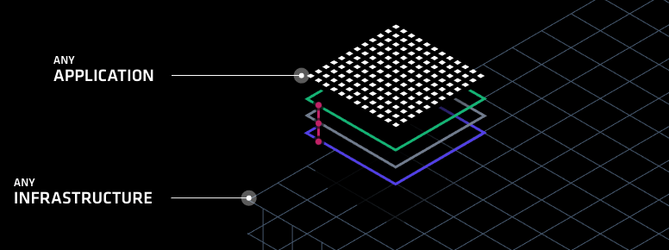
HashiCorp Solutions Suite
Fraser Pollock

Slide 2

Who Am I?
Chef Software Inc. Solutions Architect – 2 years
Sold to 2 of the Fortune 10
Blackberry Inc. (previously Research in Motion) – 5 years
My goal is to make it easy to do your job
Striving to reduce the technology gap
Notes:
http://www.un.org/apps/news/story.asp?NewsID=23283

Slide 3
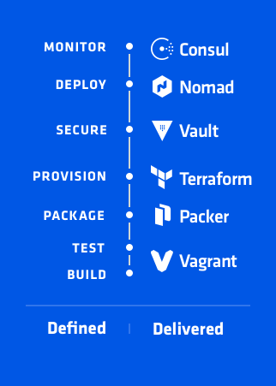
Agenda
Introduction
What is Dev Ops Culture
DevOps Defined
Build/Test
Package
Provision
Secure
Monitor
Questions
Notes:
https://www.hashicorp.com/devops-defined/#done-right

Slide 4
What is DevOps Culture
What are our challenges

Slide 5
DevOps is about minimizing the challenges of shipping, rapidly iterating, and securing software applications.
Notes:
Simply put DevOps is about minimizing the challenges of shipping, rapidly iterating, and securing software applications.
https://newrelic.com/navigating-devops?content=eBook
https://stelligent.com/2017/06/29/devops-benefits-of-infrastructure-as-code/
https://www.cloudtp.com/doppler/wannacry-wake-call-need-devops-cloud/

Slide 6

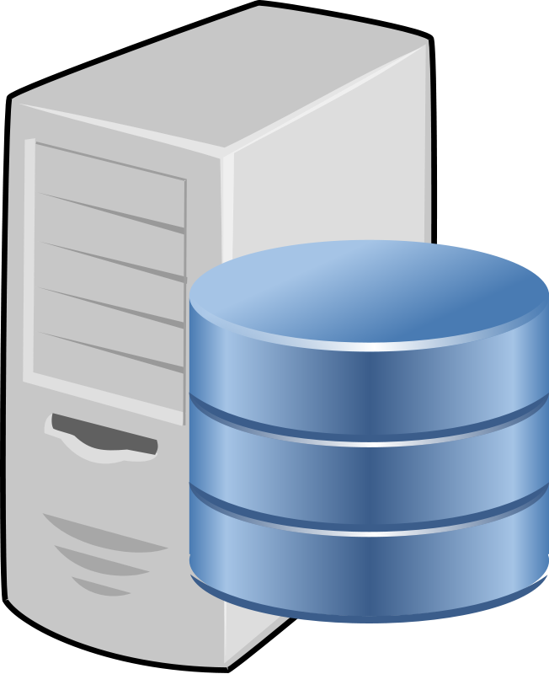

Traditional Waterfall
Wait Time
Dev
Wait Time
Ops
Wait Time
Sec
Notes:
Traditional waterfall methodology has a lot of wait times included in the process. Waiting for requirements, waiting for infrastructure and waiting for security reviews. If at any point in the cycle there’s an issue the entire cycle needs to restart, for example if Security scans and finds a vulnerability, the application and infrastructure need to be returned to the teams and reviewed again before being resubmitted for scanning and approval.

Slide 7
Dev Ops Culture Defined
Dev
Ops
?
Sec
Notes:
Rather than serial progression what if we could all work together and collaborate on requirements and deliver value to the end customer. If just one these organizations started increasing the velocity at which they work how much faster could we deliver value to our customers whether they be internal or external or even part of the Dev Ops cycle.

Slide 8
Why Dev Ops Culture

Slide 9
Dev Ops Culture
Allows everyone to work in parallel to deliver business value to the customer
Prioritizes agility, time to value and a more continuous integrated and continuous delivery model of all components
Firms with high performing IT organizations were twice as likely to exceed profitability, market share and productivity goals
Hashicorp help enable this culture by deconstructing the essential elements of an application delivery process and providing a solution best suited for each participant in the task.
Notes:
of all components – whether it be application features, infrastructure upgrades or security requirements.
And when it comes down to ROI
So simply put shifting towards a Dev Ops culture will make your company more profitable.
https://devops.com/the-roi-of-enterprise-devops/

Slide 10
Dev
Customer
Ops
Sec
Notes:
So instead of the traditional waterfall methodology we have a continuous cycle of delivering features and value to our customers. But who and where are our customers? They are globally distributed so we need to be as well.

Slide 11
Gartner predicts that “…by 2020, 90 percent of organizations will adopt hybrid infrastructure”
Notes:
This means that they will have a private and public cloud footprint, possibly even multiple public clouds.
http://www.gartner.com/newsroom/id/3666917 - Gartner predicts that by 2020, 90 percent of organizations will adopt hybrid infrastructure management capabilities.
https://www.technative.io/90-of-organizations-will-adopt-hybrid-it-infrastructure-by-2020/ - 90% of Organizations Will Adopt Hybrid IT Infrastructure by 2020

Slide 12
What will successful IT Organizations Need?
The ability to rapidly provision and update Dev and QA environments
Flexibility when it comes to hybrid infrastructure
Security standards around access and credential management for the cloud and applications
Solutions designed to be fault tolerant and focused around multi-datacenter situations
Notes:
Need – in this new model
Environments – if we focus on feature driven outcomes that means significantly more deployments to handle
Hybrid infrastructure – if 90% of the world companies are going to transition to this model, solutions will need to support this requirement.
Applications – given this is a new frontier for many large organizations the same standards we had in our private clouds may not fit the public cloud model.
Datacenter situations – this means that its imperative that solutions provide service discovery and high availability built into the product

Slide 13
Questions?
Notes:
Demo Slide

Slide 14
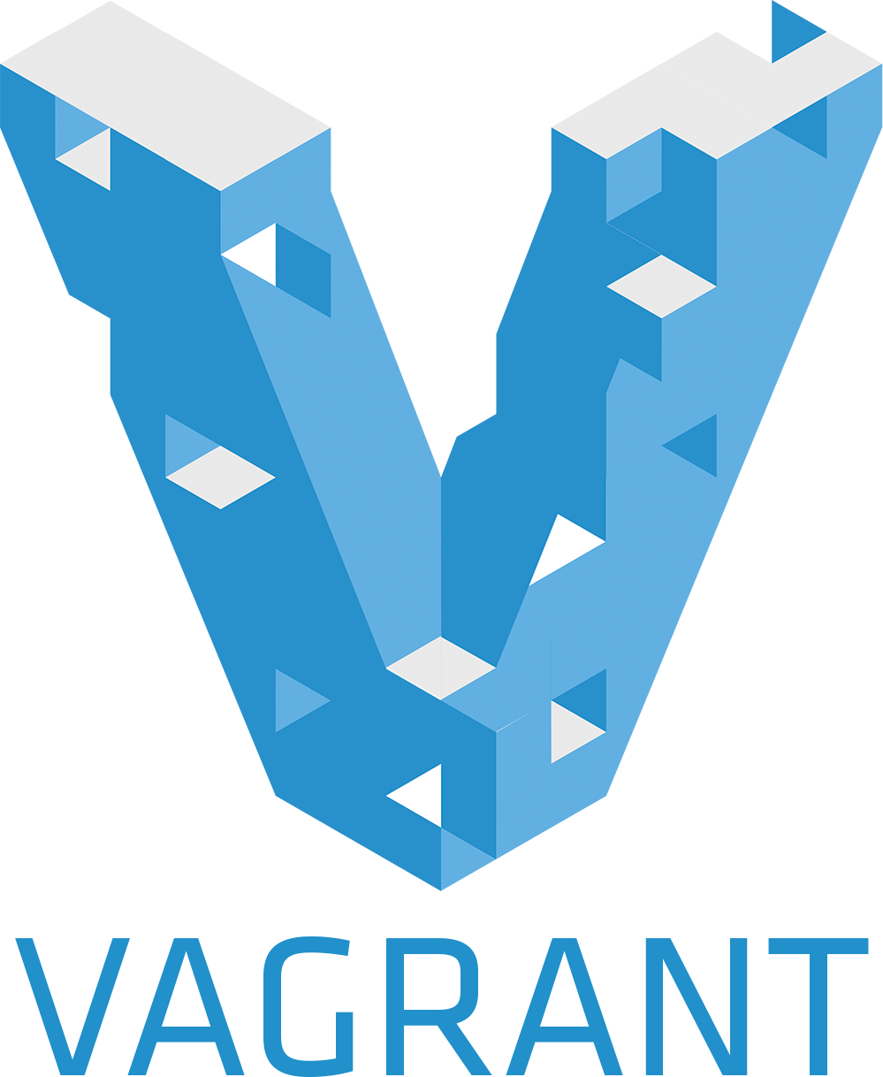
Dev Ops Defined
Build and Test with Vagrant
Workflows, not Technologies

Slide 15
What is Vagrant
Vagrant is a solution for building and managing virtual machine environment in a single workflow
Its easy to configure, reproducible and helps make portable work environments
Its simple, modular and composable
Notes:
https://www.vagrantup.com/intro/index.html - https://www.hashicorp.com/blog/the-tao-of-hashicorp/
Composability is self-contained and modular, stateless and ephemeral

Slide 16
Notes:
Demo Slide

Slide 17
Vagrant
We built up a quick, simple development environment for an application developer, operations person or security expert
We streamlined onboarding of new developers and new applications by creating a repeatable consumable artifact
Enabled Operations and Security to set standards by building ‘box’ files that can be used as part of development
Used infrastructure as code to build a version-able, testable repeatable artifact
Notes:
https://www.vagrantup.com/intro/index.html
https://www.hashicorp.com/blog/the-tao-of-hashicorp/

Slide 18
Infrastructure as Code
Iterative, Testable, Repeatable, Consumable

Slide 19

Infrastructure as Code
Dev
Codification of everything from
Network requirements
Ingress/egress
Protocol
Vpc
Routing
Server specifications
RAM/CPU
Middleware specifications
Middleware version
Env variables
User accounts
Ops
Sec
Notes:
Codification of everything from Network requirements to Server specifications to Middleware requirements. We’re trying to extrapolate the desired state of our end goal infrastructure into a repeatable, testable artifact. This artifact can then be templated and used across multiple clouds in a multitude of environments.

Slide 20
Dev
Ops
Sec
Notes:
Each stakeholder contributes their knowledge and their requirements to the infrastructure as code artifact which is then used to orchestrate the build of the infrastructure in the provider.
This approach focuses on giving increased visibility into the build process for our environments.

Slide 21
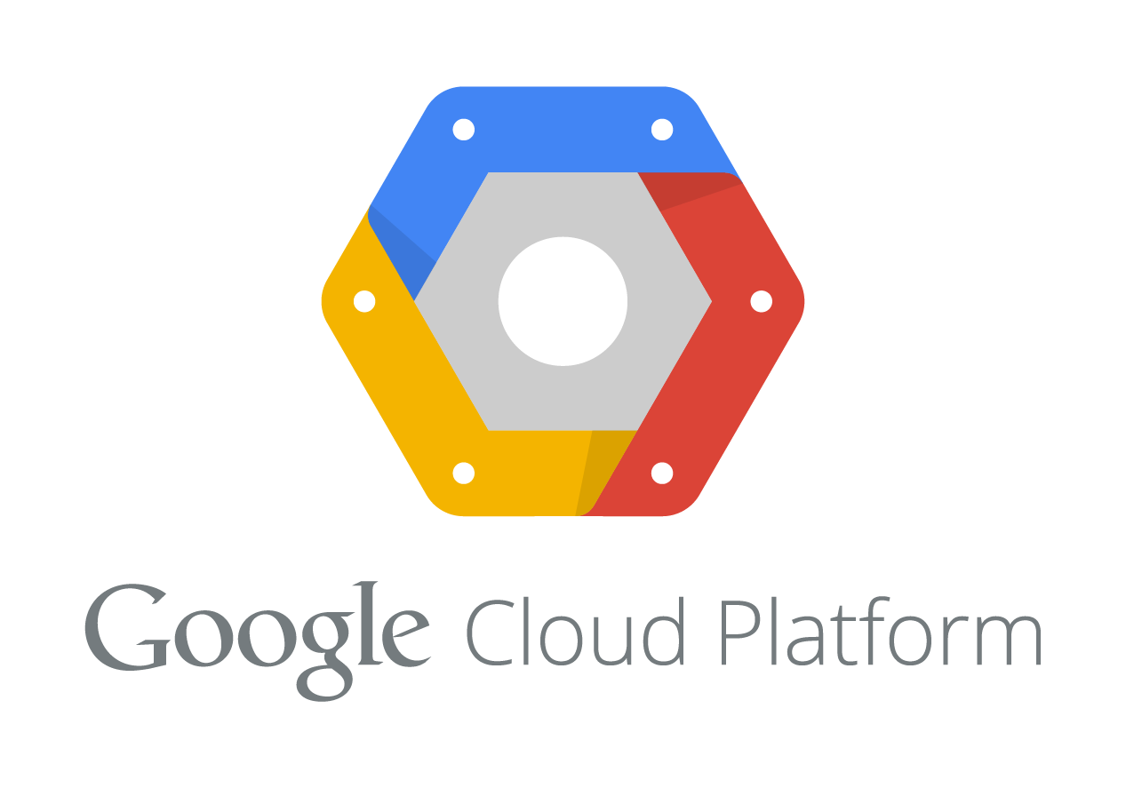
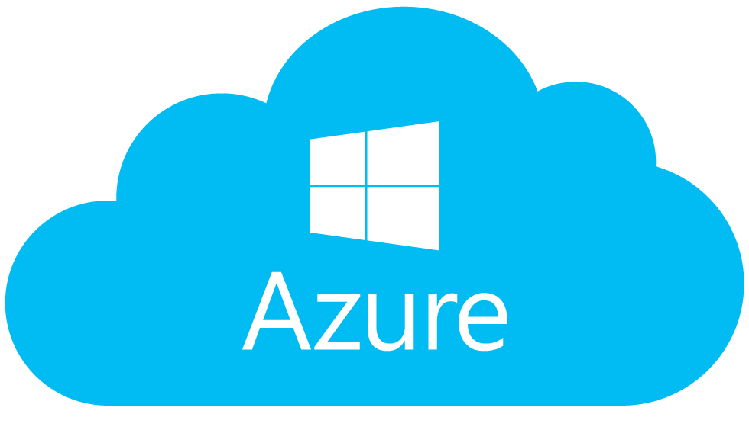

EU Data Center
NA Data Center
Notes:
and when executed correct allows us to rapidly provision to any location, on any framework, with any requirements. Remember multi-cloud deployments can be very challenging as many existing tools for infrastructure management are cloud-specific. Terraform is cloud-agnostic and allows a single configuration to be used to manage multiple providers, and to even handle cross-cloud dependencies. This simplifies management and orchestration, helping operators build large-scale multi-cloud infrastructures.

Slide 22

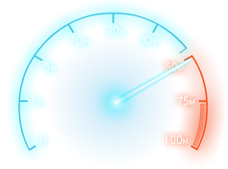

Infrastructure as Code at a Glance
Automate your deployment and recovery process
Enables easy review of resources, allocated cost and consumption
Significantly speeds up application and infrastructure development by automating tasks
Focus on Mean Time to Recovery
Enable faster iteration over artifacts through composable and an ephemeral code base
Reducing human errors through automation
Allows for Security to be injected into any portion of the development life cycle
“Uniqueness breeds vulnerability”
Notes:
So when we look at Infrastructure as code at a glance we really focus on 3 main returns on investment, reducing cost, speeding up feature delivery and reducing risk. And we can demonstrate those in a myriad of ways;
Recovery process – for example this allows us to easily manage and orchestrate a blue/green or ‘canary’ style deployment. For a particular set of nodes we can target a new application release. Also if our deployments and changes are automated it frees our administrators and developers to contribute value else-where.
Focus on Mean time to Recovery – applications fail, servers fail, this is part of IT. A failed component means a loss of revenue for the company and mean time to recovery is the focus on getting that component operationalized again.
composable means we focus on the fact that Terraform can be deployed independently or in conjecture with the rest of the Hashicorp suite which will discuss later.
And the ephemeral code base provides value by being versionable, allowing rollback and roll forwards. You can inspect and write code atomically. Using versions enables auditing and creates a clear history of how the current state was reached. When something breaks, the origin of the error can be determined using the version history.
Practice makes perfect - Reduces the risk of human error through automation
https://stelligent.com/2017/06/29/devops-benefits-of-infrastructure-as-code/
https://en.wikipedia.org/wiki/Infrastructure_as_Code

Slide 23

Infrastructure as Code
Build Automated Machine Images
Uniqueness is Vulnerability

Slide 24
What is Packer
Packer is a workflow for creating identical machine images
Its easy to configure, reproducible and helps make portable work environments
Its simple, modular and composable
Notes:
https://www.vagrantup.com/intro/index.html - https://www.hashicorp.com/blog/the-tao-of-hashicorp/
Composability is self-contained and modular, stateless and ephemeral

Slide 25
What is Packer
Define a builder
AWS
Azure
Google Cloud
{ "builders": [ // ... one or more builder definitions here ] }
{"type": "amazon-ebs",}
{"type": "vmware-vmx",}
{"type": "googlecompute",}

Slide 26
What is Packer
Define a provisioner
What do I want to do?
{ ”provisioners": [ // ... one or more provisioners here ] }
{"type": ”file",}
{"type": ”shell",}
{"type": ”script",}
{"type": ”chef",}
{"type": ”puppet",}
…

Slide 27
What is Packer
Customize with Variables
"access_key": "{{user `aws_access_key`}}",
"secret_key": "{{user `aws_secret_key`}}",
{{isotime \"2006-01-02\"}}

Slide 28
Notes:
Demo Slide

Slide 29
Packer
We built a share-able and customizable image that anyone can use
Built a standard image that can be used across hybrid infrastructure
Included patches, middleware and sizing definitions into the build process
Produced a coded artifact that can be used to collaborate, review and inspect easily the state of infrastructure
Notes:
https://www.vagrantup.com/intro/index.html - https://www.hashicorp.com/blog/the-tao-of-hashicorp/
Composability is self-contained and modular, stateless and ephemeral

Slide 30
Ops
Notes:
Any Questions

Slide 31

Infrastructure as Code
Write, Plan, Create, Change
Change Automation
HashiCorp
Terraform

Slide 32
Terraform is…
Terraform is a workflow for designing, planning, building and changing infrastructure and its topology
Designed to be modular
Customized via variables
Cloud agnostic
Terraform uses the concept of Infrastructure as Code to define desired state
Notes:
Modular – each piece of the infrastructure definition can be run separately, or used in another project.
Variables – which means that to go from Dev to Qa to Production means swapping in a different variable file and the infrastructure definitions remain the same
Cloud Agnostic – With minor changes in the provider you can build for AWS or Azure or GCP.
https://www.vagrantup.com/intro/index.html - https://www.hashicorp.com/blog/the-tao-of-hashicorp/

Slide 33
Infrastructure as Code
Dev
Codification of everything from
Network requirements
Ingress/egress
Protocol
Vpc
Routing
Server specifications
RAM/CPU
Middleware specifications
Middleware version
Env variables
User accounts
Ops
Sec
Notes:
Codification of everything from Network requirements to Server specifications to Middleware requirements. We’re trying to extrapolate the desired state of our end goal infrastructure into a repeatable, testable artifact. This artifact can then be templated and used across multiple clouds in a multitude of environments.

Slide 34
Dev
Ops
Sec
Notes:
Each stakeholder contributes their knowledge and their requirements to the infrastructure as code artifact which is then used to orchestrate the build of the infrastructure in the provider.
This approach focuses on giving increased visibility into the build process for our environments.

Slide 35
EU Data Center
NA Data Center
Notes:
and when executed correct allows us to rapidly provision to any location, on any framework, with any requirements. Remember multi-cloud deployments can be very challenging as many existing tools for infrastructure management are cloud-specific. Terraform is cloud-agnostic and allows a single configuration to be used to manage multiple providers, and to even handle cross-cloud dependencies. This simplifies management and orchestration, helping operators build large-scale multi-cloud infrastructures.

Slide 36
Infrastructure as Code at a Glance
Automate your deployment and recovery process
Enables easy review of resources, allocated cost and consumption
Significantly speeds up application and infrastructure development by automating tasks
Focus on Mean Time to Recovery
Enable faster iteration over artifacts through composable and an ephemeral code base
Reducing human errors through automation
Allows for Security to be injected into any portion of the development life cycle
“Uniqueness breeds vulnerability”
Notes:
So when we look at Infrastructure as code at a glance we really focus on 3 main returns on investment, reducing cost, speeding up feature delivery and reducing risk. And we can demonstrate those in a myriad of ways;
Recovery process – for example this allows us to easily manage and orchestrate a blue/green or ‘canary’ style deployment. For a particular set of nodes we can target a new application release. Also if our deployments and changes are automated it frees our administrators and developers to contribute value else-where.
Focus on Mean time to Recovery – applications fail, servers fail, this is part of IT. A failed component means a loss of revenue for the company and mean time to recovery is the focus on getting that component operationalized again.
composable means we focus on the fact that Terraform can be deployed independently or in conjecture with the rest of the Hashicorp suite which will discuss later.
And the ephemeral code base provides value by being versionable, allowing rollback and roll forwards. You can inspect and write code atomically. Using versions enables auditing and creates a clear history of how the current state was reached. When something breaks, the origin of the error can be determined using the version history.
Practice makes perfect - Reduces the risk of human error through automation
https://stelligent.com/2017/06/29/devops-benefits-of-infrastructure-as-code/
https://en.wikipedia.org/wiki/Infrastructure_as_Code

Slide 37
How it Works

Slide 38
Platform
Pick a provider (or multiple)
AWS
Azure
Google Cloud
provider “my-cloud” {…}
provider "azure"
publish_settings = "${file("credentials.publishsettings")}”
provider "aws"
access_key = "${var.aws_access_key}"
secret_key = "${var.aws_secret_key}”
region = "us-east-1"
provider "google"
credentials = "${file("account.json")}"
project = "my-gce-project”
region = "us-central1"

Slide 39
Function
Define a provisioner
What do I want to do
What is the desired state
Ask for output
Output “all_web_ips”{ “$(aws_instance.web.*.public_ip}”
Set up a connection
type = "ssh"
user = "root"
password = "${var.root_password}"
provisioner
File
Local-exec
Remote-exec

Slide 40
Customize
Customize with variables
variable "platform" { default = "ubuntu" description = "The OS Platform"}
variable "instance_type" { default = "t2.micro" description = "AWS Instance type"}
variable "servers" { default = "1" description = ”# of servers to launch"}

Slide 41
Questions?
Notes:
Demo Slide

Slide 42
Terraform
Orchestrated the deployment of web infrastructure to a cloud
Used a module which is a re-usable definition of infrastructure
This helps set standards and security
Ie; ingress/egress rules
Mapped out resource dependencies
VMs depend on Security Group depends on VPC
Dynamically scaled our infrastructure
Made a change ‘in-flight’ to our existing cluster
Used `terraform plan` to review impact
Enacted that plan after review
Notes:
https://www.vagrantup.com/intro/index.html - https://www.hashicorp.com/blog/the-tao-of-hashicorp/
Composability is self-contained and modular, stateless and ephemeral

Slide 43
EU Data Center
NA Data Center
Notes:
So you can see how as a Terraform user with some small changes you can build out the exact same infrastructure in all your environments and cloud by customizing some variables and modifying the provider. This allows us to easily provision and orchestrate large changes across data centers, be cloud agnostic in our a technology choices and rapidly introduce change safetly.

Slide 44

Service Discovery and Configuration
Failure Detection, Global Focus, KV Storage
Discovery Made Easy
HashiCorp
Consul
Notes:
Similair to https://github.com/coreos/etcd

Slide 45
Consul is…
Service Discovery
Health Checking
KV Store
Cloud agnostic
Can be used a storage backend for other Hashicorp solutions!
Notes:
Service Discovery – by configuring a simple check Consul is able to provide another Consul Client a DNS or HTTP API to query that services.
Health Checking – either as part of a service configuration for discovery or a separate check for something like memory consumption Consul can be used to monitor and manage cluster health
Consul can also supports a KV store that can be used by applications for dynamic configuration, feature flagging, coordination, and even leader election will be specifically called out in the demo.

Slide 46
Service Discovery
JSON Format
{"service": {"name": "web", "tags": ["rails"], "port": 80}}
Placed inside the Consul Config Directory
Consul is reloaded and ‘syncs’ the service
[INFO] agent: Synced service 'web’
The service information is then able to be queried over DNS or HTTP API
This will return all nodes in the cluster that have that service enabled
Notes:
So lets talk about each of the individual features in more depth.
When you query the DNS or HTTP API it will return all the nodes in the cluster that have that service and their advertised address. This is extremely useful when it comes to clustering applications,

Slide 47

Template Rendering and Supervisor
Notes:
Similair to https://github.com/coreos/etcd

Slide 48

Secrets Management
Storage, Key Rolling, Built in Audit
Integrated Security
HashiCorp
Vault

Slide 49
What is Vault
Terraform is a workflow for designing, planning, building and changing infrastructure and its topology
Designed to be modular and variable defined
Cloud agnostic, with orchestration and large-scale built in mind
Notes:
https://www.vagrantup.com/intro/index.html - https://www.hashicorp.com/blog/the-tao-of-hashicorp/
Composability is self-contained and modular, stateless and ephemeral

