Slide 1
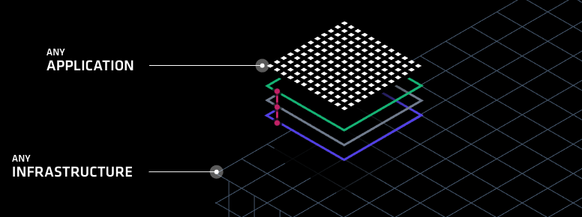
HashiCorp Solutions Suite
Fraser Pollock

Slide 2

Who Am I?
Chef Software Inc. Solutions Architect – 2 years
Open Text – 1 year
Blackberry Inc. (previously Research in Motion) – 5 years
My goal is to make it easy to do your job
Striving to reduce the technology gap
Notes:
http://www.un.org/apps/news/story.asp?NewsID=23283

Slide 3
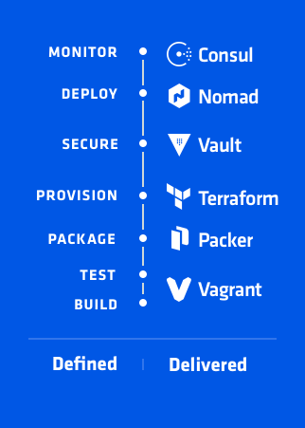
Agenda
Introduce
Dev Ops
DevOps Defined
Build/Test
Package
Provision
Secure
Deploy
Monitor
Questions
Demo

Slide 4
What is DevOps
What are our challenges

Slide 5
Traditional Waterfall
Dev
Receive and scope requirements
Build application
Write run book requirements
Ops
Receive run book and package
Build and run infrastructure
Manage deployment
Sec
Ensure compliance with company requirements
Review that best practices are follow
Scan, report and audit

Slide 6

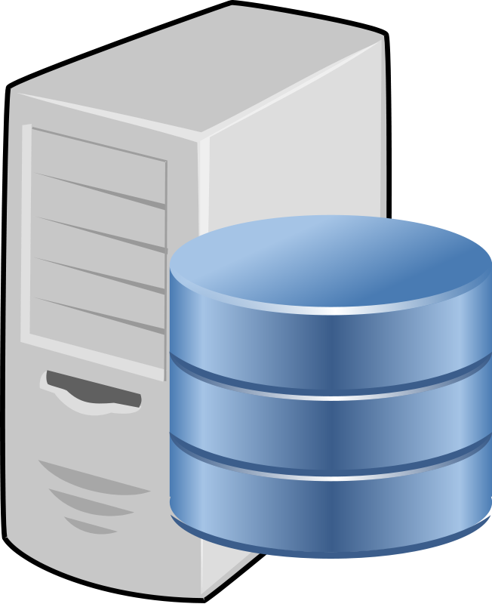

Traditional Waterfall
Dev
Ops
Sec

Slide 7
Traditional Waterfall
Pros
Prioritizes minimizing risk
Adds ‘checkpoints’ to each phase or state in the process
Cons
Doesn’t maximize agility
Restricts individual autonomy
Slows the feedback loop
Even minor changes require all teams involvement
Significant “wait time”
Stakeholder is next person in line
Notes:
https://www.hashicorp.com/devops-defined/#done-right

Slide 8
Dev Ops Defined
Wait Time
Dev
Wait Time
Ops
Wait Time
Sec

Slide 9
Dev Ops Defined
Dev
Ops
Sec

Slide 10
Dev Ops
Allowing everyone to work in parallel to deliver business value to the customer
Prioritizes agility, time to value and a more continuous integrated and continuous delivery model
Minimize the challenges of shipping, rapidly iterating and securing software applications
Hashicorp focuses on this by deconstructing the essential elements of an application delivery process and providing a solution best suited for each participant in the task.

Slide 11
Dev
Customer
Ops
Sec

Slide 12

Dev Ops Defined
Build and Test with Vagrant
Workflows, not Technologies

Slide 13
What is Vagrant
Vagrant is a tool for building and managing virtual machine environment in a single workflow
Its easy to configure, reproducible and helps make portable work environments
Its simple, modular and composable
Notes:
https://www.vagrantup.com/intro/index.html
https://www.hashicorp.com/blog/the-tao-of-hashicorp/

Slide 15
Vagrant at Face Value
We built up a quick, simple development environment for an application developer, operations person or security expert
We streamlined onboarding of new developers and new applications by creating a repeatable consumable artifact
Enabled Operations and Security to set standards by building ‘box’ files that can be used as part of development
Notes:
https://www.vagrantup.com/intro/index.html
https://www.hashicorp.com/blog/the-tao-of-hashicorp/

Slide 16
Infrastructure as Code
Iterative, Testable, Repeatable, Consumable

Slide 17
Infrastructure as Code
Notes:
https://www.terraform.io/

