Slide 1
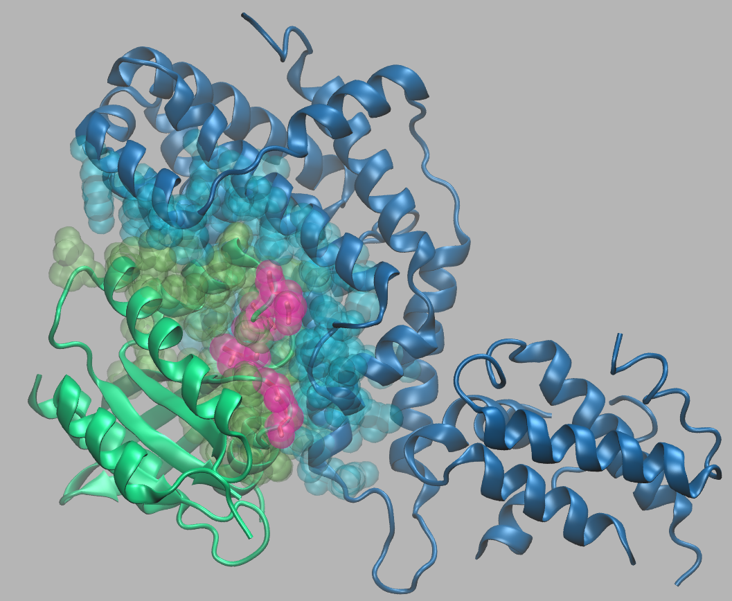
Example 1. HRAS – RASGRP4 heterodimer
PDB : 6AXG
Chain A: RASGRP4
Chain B : HRAS
SNPs : G12, G13, T58, Q61, E63
Interfaces (surfaces in light green (HRAS) and light blue (RASGRP4)) predicted by POPSCOMP

Slide 2
SNPs information from PinSNPs Harvey rat sarcoma viral (v-Ha-ras) oncogene homolog (OMIM #190020)
dbSNP rs# | Position | Residue | Codon | Region | PROVEAN/SIFT Prediction | PolyPhen2 Prediction | mCSM-Stability Prediction | mCSM-PPI Stability Prediction
104894229 | 12 | G/S/R/C | GGC/AGC/CGC/TGC | Interface | G->S:Deleterious/ Damaging; G->R:Deleterious/ Damaging; G->C:Deleterious/ Damaging; | G->S:possibly damaging; G->R:possibly damaging; G->C:possibly damaging; | G->S:Destabilizing; G->R:Destabilizing; G->C:Destabilizing; | G->S:Stabilizing; G->R:Destabilizing; G->C:Stabilizing;
104894230 | 12 | G/D/A/V | GGC/GAC/GCC/GTC | Interface | G->D:Deleterious/ Damaging; G->A:Deleterious/ Damaging; G->V:Deleterious/ Damaging; | G->D:possibly damaging; G->A:possibly damaging; G->V:possibly damaging; | G->D:Destabilizing; G->A:Destabilizing; G->V:Destabilizing; | G->D:Stabilizing; G->A:Destabilizing; G->V:Destabilizing;
104894226 | 13 | G/D/V | GGT/GAT/GTT | Interface | G->D:Deleterious/ Damaging; G->V:Deleterious/ Damaging; | G->D:benign; G->V:probably damaging; | G->D:Destabilizing; G->V:Destabilizing; | G->D:Stabilizing; G->V:Stabilizing;
104894228 | 13 | G/S/R/C | GGT/AGT/CGT/TGT | Interface | G->S:Deleterious/ Damaging; G->R:Deleterious/ Damaging; G->C:Deleterious/ Damaging; | G->S:possibly damaging; G->R:probably damaging; G->C:possibly damaging; | G->S:Destabilizing; G->R:Destabilizing; G->C:Destabilizing; | G->S:Stabilizing; G->R:Stabilizing; G->C:Stabilizing;
121917758 | 58 | T/I | ACC/ATC | Interface | Deleterious/ Damaging | probably damaging | Destabilizing | Destabilizing
28933406 | 61 | Q/K | CAG/AAG | Interface | Deleterious/ Damaging | benign | Destabilizing | Destabilizing
121917756 | 63 | E/K | GAG/AAG | Interface | Deleterious/ Damaging | probably damaging | Stabilizing | Destabilizing
* The table is reproduced from PinSNPs except for the last column (yellow).

Slide 3
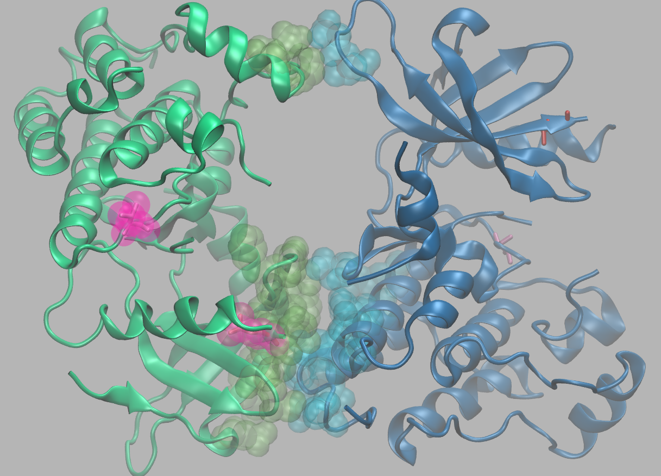
Example 2. ERBB2 (HER2) homodimer
PDB : 3RCD (ERBB2 homodimer)
Chain D : ERBB2
Chain B : ERBB2
SNPs : L755 (interface), V842
Interfaces (surfaces) predicted by POPSCOMP

Slide 4
SNPs information from PinSNPs L755 (interface) from OMIM and V842 from COSMIC
dbSNP rs# | Position | Residue | Codon | OMIM # | Disease Name | Region | PROVEAN/SIFT Prediction | PolyPhen2 Prediction | mCSM-Stability Prediction | mCSM-PPI Stability Prediction
121913469 | 755 | L/P | TTG/CCG | 164870 | Avian erythroblastic leukemia viral (v-erb-b2) oncogene homolog 2 (neuro/glioblastoma derived oncogene homolog) | Interface | Deleterious/ Damaging | probably damaging | Destabilizing | Destabilizing
Mutation ID (COSM) | Primary Site | Somatic Status | Instances | Residue change | Region | PROVEAN/SIFT Prediction | PolyPhen2 Prediction | mCSM-Stability Prediction | mCSM-PPI Stability Prediction
COSM14065 | stomach | Confirmed somatic variant | 4 | V842I | Surface | Neutral/ Damaging | probably damaging | Destabilizing | Destabilizing
COSM14065 | large_intestine | Confirmed somatic variant | 6
COSM14065 | endometrium | Reported in another cancer sample as somatic | 2
COSM14065 | small_intestine | Confirmed somatic variant | 1
COSM14065 | biliary_tract | Confirmed somatic variant | 2
COSM14065 | breast | Confirmed somatic variant | 2

Slide 5
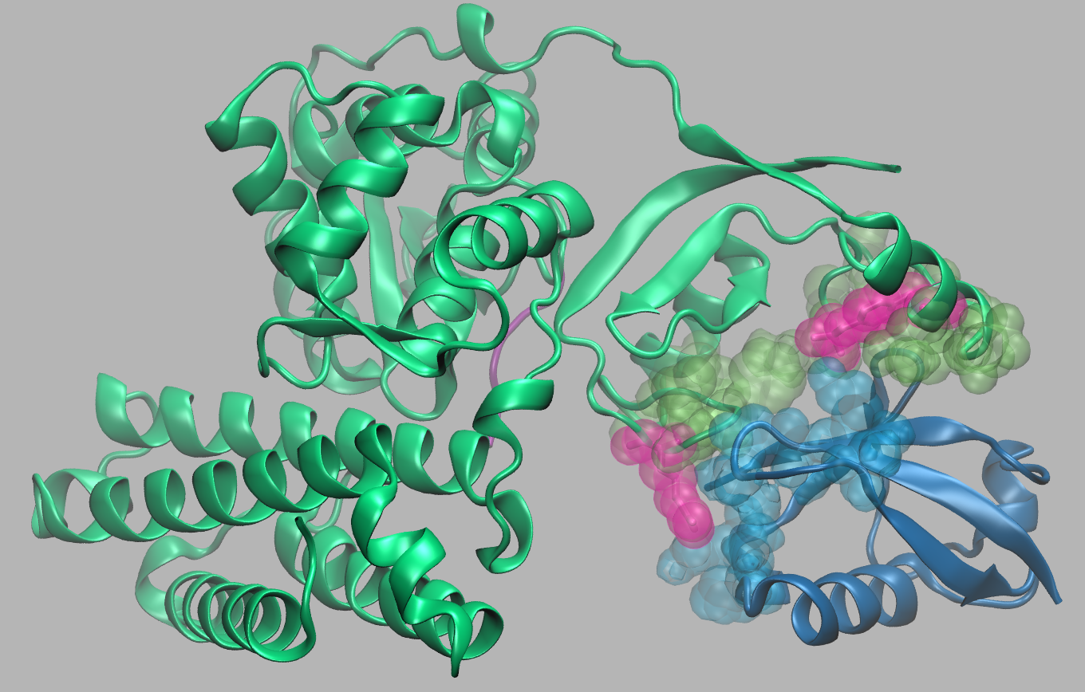
Example 3. CBL – UbV.pCBL ubiquitin variant
PDB : 5O76
Chain A : CBL
Chain E: UbV.pCBL ubiquitin variant
SNPs : Y371, R420
Interfaces (surfaces) predicted by POPSCOMP

Slide 6
SNPs information from PinSNPs COSMIC
Mutation ID (COSM) | Primary Site | Residue change | Somatic Status | Instances | Region | PROVEAN/SIFT Prediction | PolyPhen2 Prediction | mCSM-Stability Prediction | mCSM-PPI Stability Prediction
COSM34077 | haematopoietic_and_lymphoid_tissue | R420Q | Reported in another cancer sample as somatic | 13 | Interface | Deleterious/ Damaging | probably damaging | Destabilizing | Destabilizing
COSM34077 | central_nervous_system | R420Q | Confirmed somatic variant | 1
COSM34077 | large_intestine | R420Q | Reported in another cancer sample as somatic | 1
COSM3444160 | skin | R420G | Confirmed somatic variant | 1 |  | Deleterious/ Damaging | probably damaging | Destabilizing | Destabilizing

