Slide 1

EPIC-ARES 2023, September 01, 2023
Stefan Tatschner
Sebastian N. Peters
David Emeis
John Morris
Thomas Newe
—
A Quic(k) Security Overview: A Literature Research on Implemented Security Recommendations

Slide 2
Overview
Meta
Introduction
Related Work
Methodology
Results
Discussion

Slide 3


Meta
About Me
Stefan Tatschner
Security Researcher
G92P+P4 Berlin, Germany
Google Search: “Homer Donut”
Github
Matrix
Mastodon
LinkedIn
@rumpelsepp
@rumpelsepp:hackbrettl.de
@rumpelsepp@mastodon.social
in/stefan-tatschner

Slide 4
Meta
About QUIC
QUIC: A UDP-Based Multiplexed and Secure Transport
QUIC provides applications with flow-controlled streams for structured communication, low-latency connection establishment, and network path migration. QUIC includes security measures that ensure confidentiality, integrity, and availability in a range of deployment circumstances.
https://datatracker.ietf.org/doc/html/rfc9000

Slide 5
Meta
About RFCs
Request for Comments
A Request for Comments (RFC) is a publication in a series from the principal technical development and standards-setting bodies for the Internet, most prominently the Internet Engineering Task Force (IETF).
https://en.wikipedia.org/wiki/Request_for_Comments

Slide 6
Meta
About RFCs
Security Consideration
In RFC documentation, sections called “Security Consideration” are used to discuss conceptional weaknesses in published network protocols according to the attacker model explained in RFC3552. If necessary, follow-up RFC documents are published to keep the older documents up-to-date.

Slide 7
Meta
About RFCs
RFC2119: Key words for use in RFCs to Indicate Requirement Levels
Requirement: MUST, MUST NOT
Recommendation: SHOULD, SHOULD NOT
Optional: MAY

Slide 8
Introduction
QUIC
Introduction

Slide 9
Introduction
QUIC: A UDP-Based Multiplexed and Secure Transport
designed by Google (2012)
submitted to IETF (2015): published as RFC9000 (2021)
overcomes multiple limitations in TCP+TLS: nickname TCP/2
HTTP/3 is based on QUIC: highly integrated in the modern web
located in user space: enables rapid iterations of the protocol

Slide 10
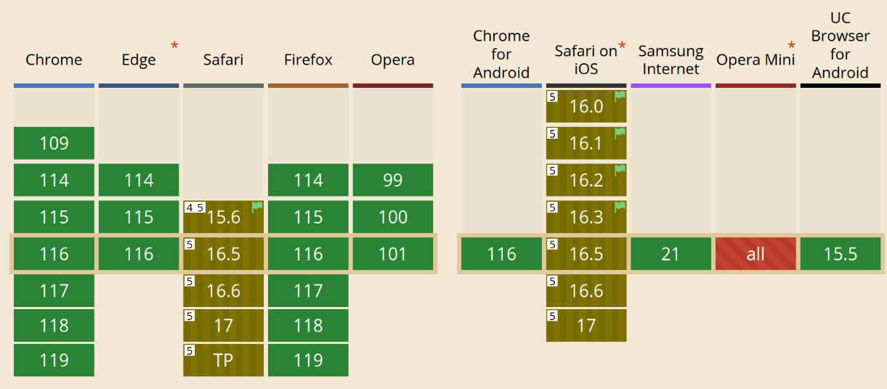
Introduction
HTTP/3 and QUIC Support
https://caniuse.com/http3

Slide 11
Introduction
Research Question
located in user space:
enables rapid iterations of the protocol

Slide 12
Introduction
Research Question
QUIC: 13 popular production ready implementations*
RFC 9000: 115 pages
RFC 9000: 10 Optional Security Considerations
RFC 9000: half of the RFC2119 keywords: SHOULD or SHOULD NOT
RQ: Does the complexity of the RFC standard on the one hand and the large number of different QUIC implementations on the other hand lead to an insecure QUIC ecosystem?
_______________________________________
*: We found 29, but we filtered…

Slide 13
Related Work
Related Work

Slide 14
Related Work
Key Takeaways
analyzed six papers from 2005 — 2023
misbehaving receivers can cause major impact on infrastructures
differences in low-level design choices between QUIC implementations → half of the keywords are SHOULD/SHOULD NOT
no setup available to compare those at runtime
fragmented ecosystem which is not yet mature enough

Slide 15
Methodology
Methodology

Slide 16
Methodology
Identification of relevant RFC documents: RFC 9000 ✓
Analysis of “Security Considerations”: ten sections ✓
Online search for QUIC implementations: 13 implementations ✓
Evaluation of implemented measures: next slide…

Slide 17
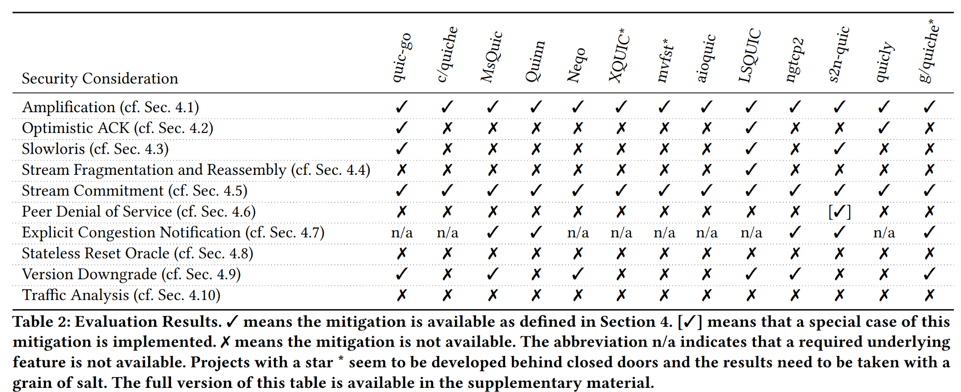
Results

Slide 18
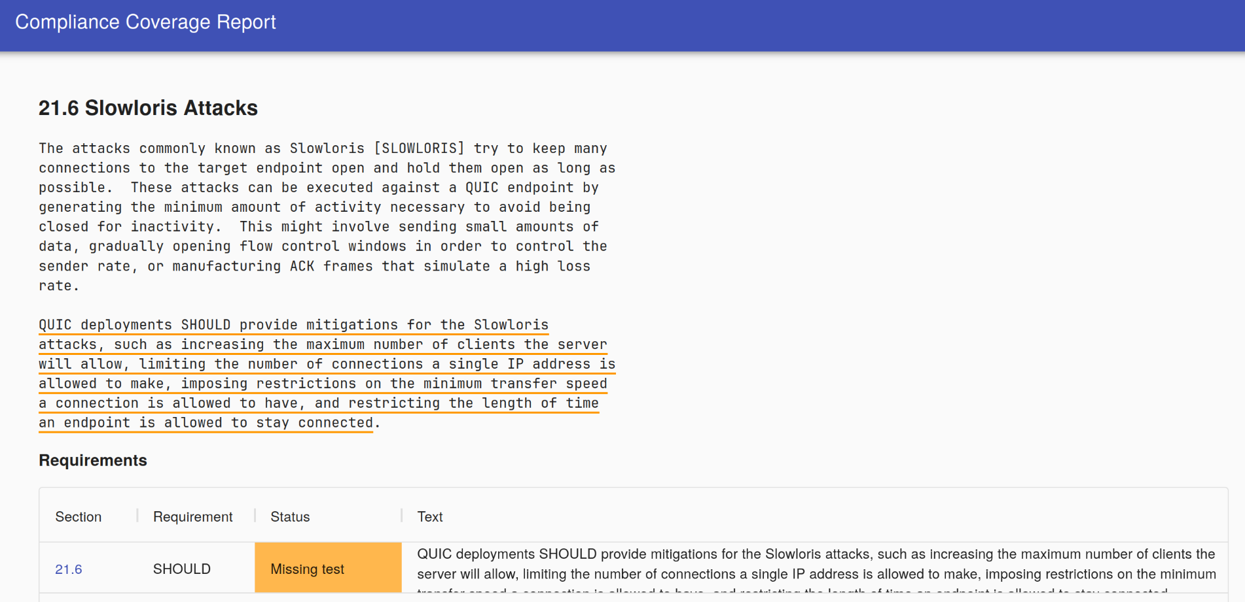
Results

Slide 19
Discussion
Discussion

Slide 20
Discussion
approach is sensitive to human error and not trivial to repeat
implementations of certain SCs might overlap
some SCs are not specific enough
governance differs strongly (big players maintain their own stack):
  very open: quic-go, quiche, s2n-quic
  very closed: mvfst, google/quiche, XQUIC

Slide 21
Discussion
RQ: Does the complexity of the RFC standard on the one hand and the large number of different QUIC implementations on the other hand lead to an insecure QUIC ecosystem?
→ empatic yes

Slide 22
Discussion
we propose:
include QUIC in major, open software stacks (e.g. stdlibs, kernels, …)
work on a test setup for comparing implementations at runtime
better track status of RFC2119 keywords

Slide 23
Meta
Contact
G92P+P4 Berlin, Germany
Thank you!
https://github.com/Fraunhofer-AISEC/quic-overview
Stefan Tatschner
Github
Matrix
Mastodon
LinkedIn
@rumpelsepp
@rumpelsepp:hackbrettl.de
@rumpelsepp@mastodon.social
in/stefan-tatschner
@rumpelsepp
@rumpelsepp:hackbrettl.de
@rumpelsepp@mastodon.social
in/stefan-tatschner
https://www.aisec.fraunhofer.de/

