Slide 1
Tensor Methods for Neural Network Compression
Lokesh Veeramacheneni
Fraunhofer SCAI
M.Sc Moritz Wölter
Prof. Dr. Jochen Garcke

Slide 2
Table of contents
Tensors
Tensor unfolding
Candecomp/PARAFAC decomposition
AlexNet architecture
CP decomposition on AlexNet
Results
Tensor Methods for Neural Network Compression

Slide 3
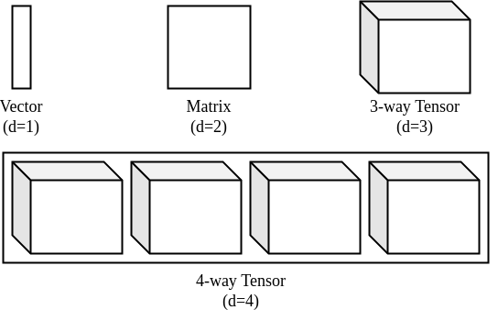
What is a Tensor?
Tensor is a d-dimensional array
Tensor Methods for Neural Network Compression

Slide 4

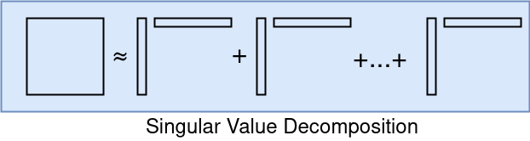
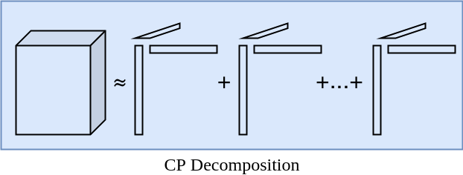
Candecomp/PARAFAC (CP) decomposition
CP-decomposition can be viewed as matrix SVD generalized to tensors
Unlike SVD, no orthogonality constraints are required
It is defined as sum of d-dimensional outer products
Tensor Methods for Neural Network Compression

Slide 5

CP Decomposition
Computed using Alternating Least Squares(ALS) method
In 3-way decomposition, A, B and C are optimized sequentially
In ALS, we minimize the cost function ||X-M||
Tensor Methods for Neural Network Compression

Slide 6
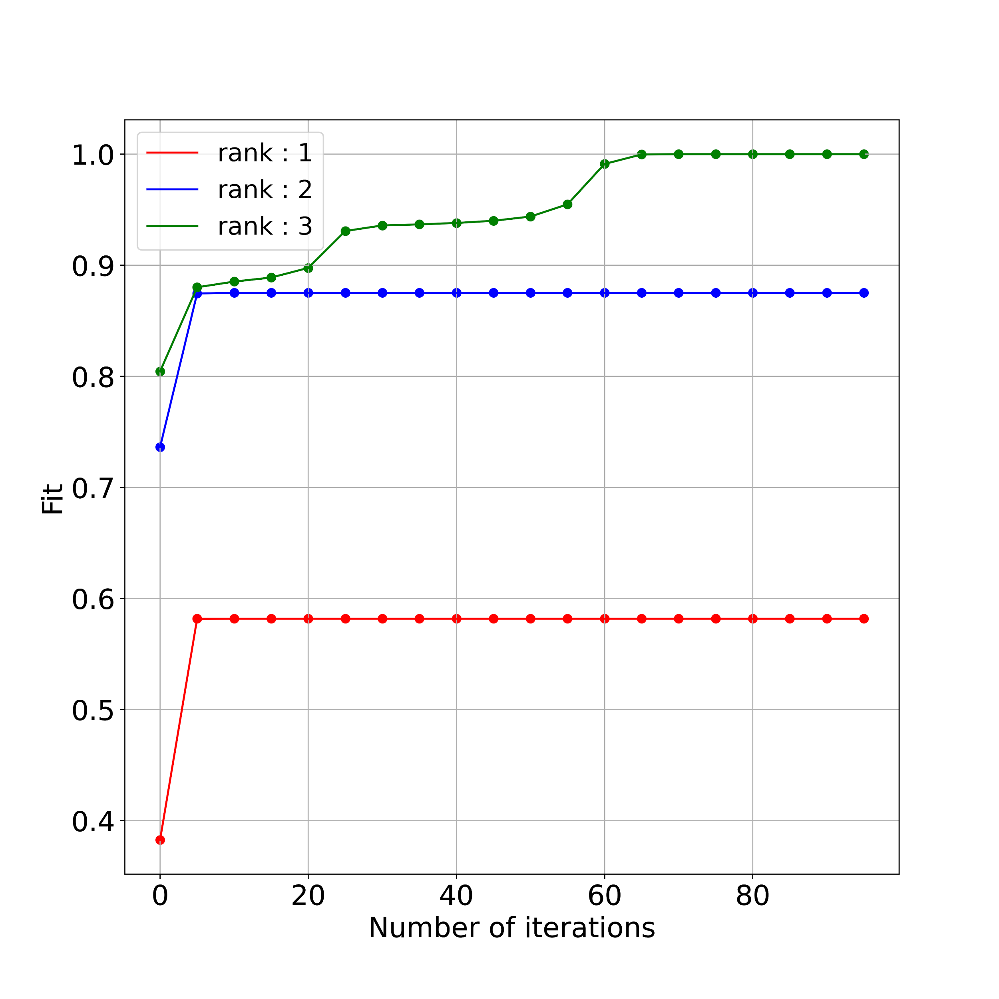
CP Decomposition
Input tensor shape (2 x 3 x 3)
Approximation by various ranks
Tensor Methods for Neural Network Compression

Slide 7
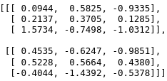
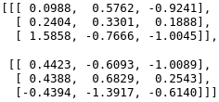
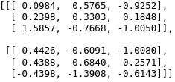
CP Decomposition
Unit tested with tensorly implementation
Parameters
Rank : 2
Maximum iterations : 100
Tensor Methods for Neural Network Compression

Slide 8
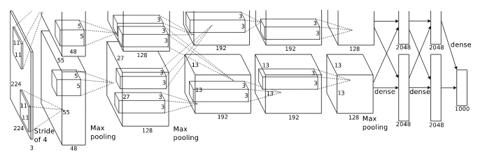
AlexNet
Convolutional Neural Network (CNN)
First five convolutional layers
Last three fully connected layers act as classifier
Tensor Methods for Neural Network Compression

Slide 9
AlexNet
Convolutional Neural Network (CNN)
First five convolutional layers
Last three fully connected layers act as classifier
Tensor Methods for Neural Network Compression

Slide 10
AlexNet Results
Classification task on CIFAR 10 dataset
Fine tuning over 10 epochs
Learning rate : 0.002
Rank : 45
Maximum iterations : 100
 | Without CP Decomposition | With CP Decomposition
Accuracy | 84% | 65%
Tensor Methods for Neural Network Compression

