Slide 1
Application of Candecomp/PARAFAC decomposition on AlexNet
Lokesh Veeramacheneni
Fraunhofer SCAI
M.Sc Moritz Wölter
Dr. Jochen Garcke

Slide 2
Table of contents:
Tensors
Tensor unfolding
Types of tensor products
Candecomp/PARAFAC decomposition
AlexNet architecture
CP decomposition on AlexNet
Results

Slide 3
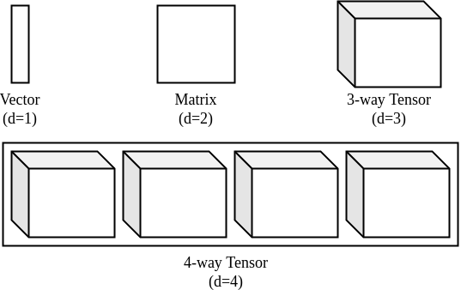
What is a Tensor?
Tensor is a d-dimensional array

Slide 4
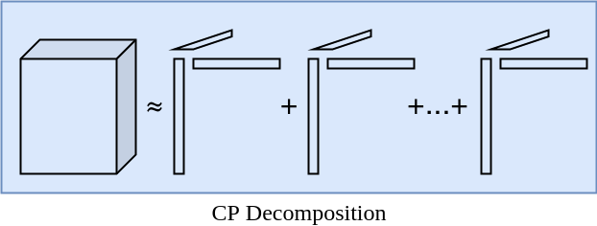
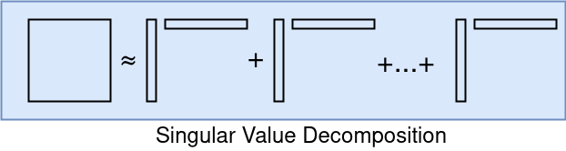
Candecomp/PARAFAC (CP) decomposition:
CP-decomposition can be viewed as matrix SVD generalized to tensors
Unlike SVD, no orthogonality constraints are required
It is defined as sum of d-dimensional outer products

