Slide 1
Tensor Methods for Neural Network Compression
Lokesh Veeramacheneni
Fraunhofer SCAI
Moritz Wolter
Prof. Jochen Garcke

Slide 2
Table of contents
Why tensor decomposition?
What are tensors?
Candecomp/PARAFAC decomposition
AlexNet architecture
CP decomposition on AlexNet
Results
Tensor Methods for Neural Network Compression

Slide 3
Why tensor decomposition?
Training a CNN on low end hardware
Memory constraint
Computational Speed
Power intensive
FPGA based ConvNet [1]
Inapplicability on high end architectures
Change in architecture requires complete redesigning
Early attempts made using tensor decomposition [2]
CP Decomposition - Nonlinear Least Squares (NLS)
Performed on second layer of AlexNet and CharNet
Rank 140 approximation
Tensor Methods for Neural Network Compression

Slide 4
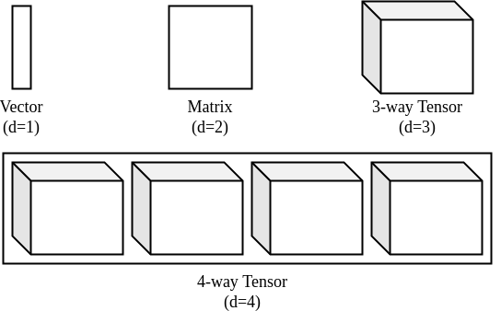
What is a Tensor?
Tensor is a d-dimensional array
Figure 1: Representation of tensor upto four dimensions [3]
Tensor Methods for Neural Network Compression

Slide 5
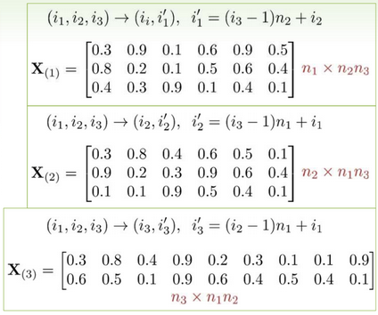
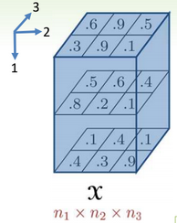
Unfolding a tensor (3D)
Figure 2: Illustration of unfolding a 3d tensor [4]
Tensor Methods for Neural Network Compression

Slide 6
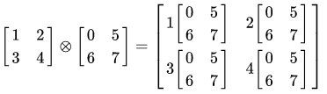
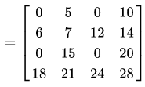
Kronecker Product
Generalization of outer product of vectors to matrices
Denoted by Ⓧ
Figure 3: Illustration of kronecker product over matrices [5]
Tensor Methods for Neural Network Compression

Slide 7

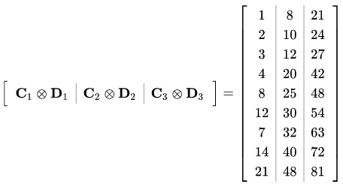
Khatri-Rao Product
Column wise kronecker product
Denoted by ⊙
Figure 4: Illustration of khatri-rao product over matrices [5]
Tensor Methods for Neural Network Compression

Slide 8

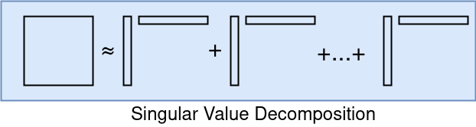
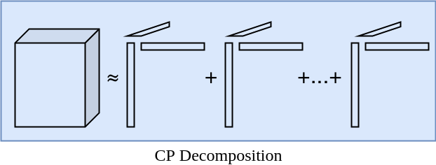
Candecomp/PARAFAC (CP) decomposition
CP-decomposition can be viewed as matrix SVD generalized to tensors
Unlike SVD, no orthogonality constraints are required
It is defined as sum of d-dimensional outer products
Tensor Methods for Neural Network Compression

Slide 9


CP Decomposition
Computed using Alternating Least Squares(ALS) method
In 3-way decomposition, A, B and C are optimized sequentially [1]
In ALS, we minimize the cost function ||X-M||²
Equation representing the optimization of variables in ALS method [1]
Tensor Methods for Neural Network Compression

Slide 10
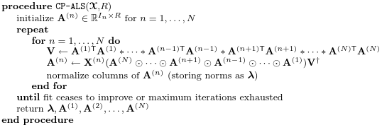
CP-ALS algorithm
Algorithm 1: ALS algorithm to compute decomposition factors [3]
Tensor Methods for Neural Network Compression

Slide 11
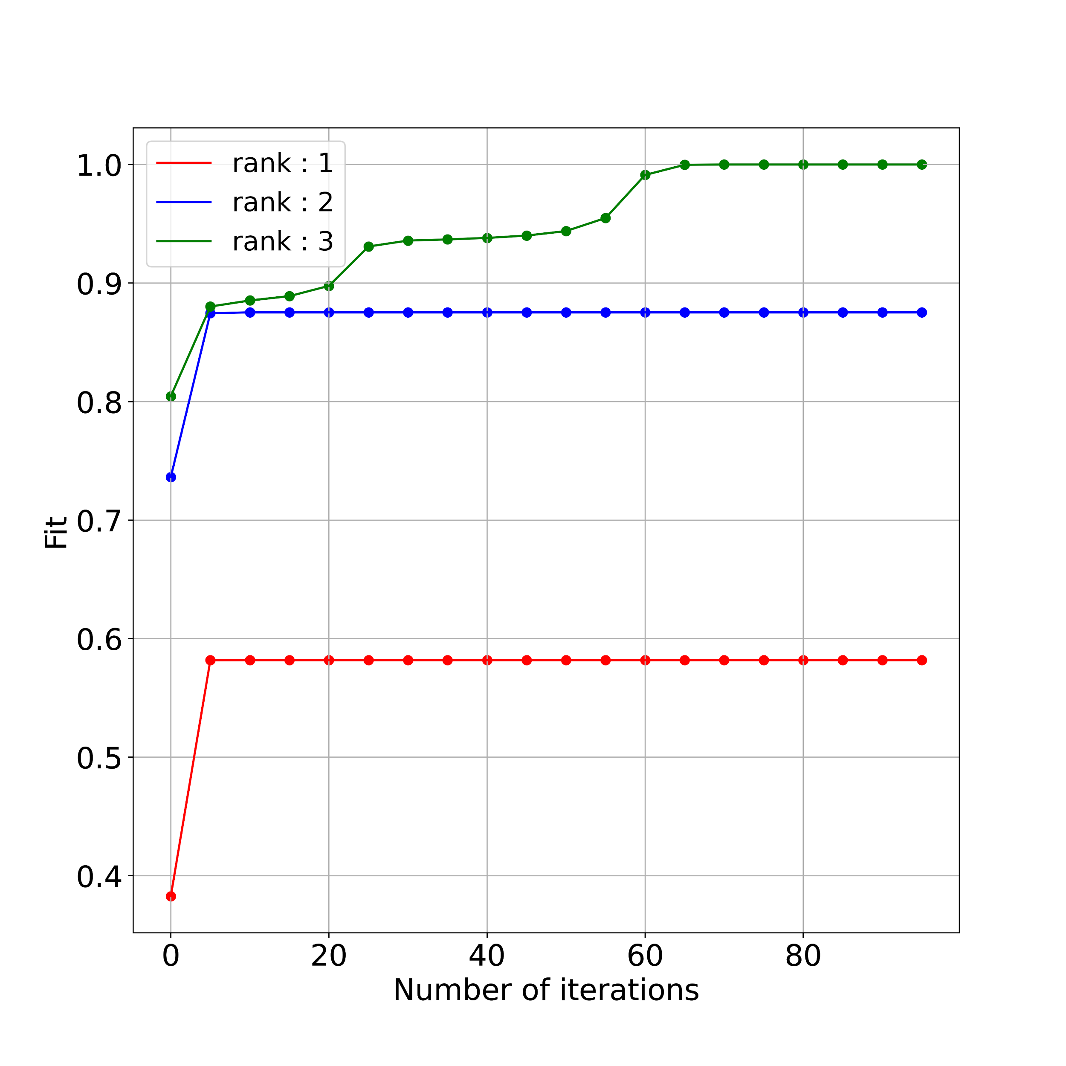
CP Decomposition
Input tensor shape (2 x 3 x 3)
Approximation by various ranks
Figure 2: Convergence of ALS method with different ranks
Tensor Methods for Neural Network Compression

Slide 12
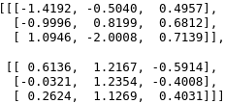
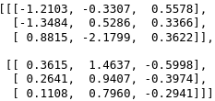
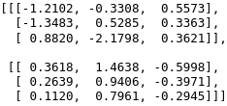
CP Decomposition
Unit tested with tensorly implementation
Parameters
Rank : 2
Maximum iterations : 100
Reconstruction error | 0.315 | 0.591
Input Tensor
Reconstruction from ALS method
Reconstruction from tensorly
Tensor Methods for Neural Network Compression
Notes:
Add reconstruction error

Slide 13
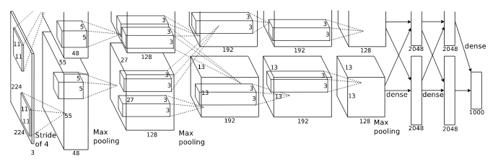
AlexNet
Convolutional Neural Network (CNN)
First five convolutional layers
Last three fully connected layers act as classifier
Figure 3: AlexNet architecture [6]
Tensor Methods for Neural Network Compression

Slide 14
AlexNet
Convolutional Neural Network (CNN)
First five convolutional layers
Last three fully connected layers act as classifier
Figure 3: AlexNet architecture [6]
Tensor Methods for Neural Network Compression

Slide 15
AlexNet Results
Classification task on CIFAR 10 dataset
Learning rate : 0.002
Original rank : 256
Approximated rank : 45
Maximum iterations : 10
 | Without CP Decomposition | With CP Decomposition
Classification accuracy | 84% | 65%
Tensor Methods for Neural Network Compression

Slide 16
Future Work
Perform hyper parameter tuning over AlexNet
Investigate vanishing gradient problem on increase of learning rate
Tensor Methods for Neural Network Compression
Notes:
Add future work

Slide 17
References
[1] Farabet, Clément, Yann LeCun, Koray Kavukcuoglu, Eugenio Culurciello, Berin Martini, Polina Akselrod, and Selcuk Talay. "Large-scale FPGA-based convolutional networks." Scaling up Machine Learning: Parallel and Distributed Approaches (2011): 399-419.
[2] Lebedev, Vadim, Yaroslav Ganin, Maksim Rakhuba, Ivan Oseledets, and Victor Lempitsky. "Speeding-up convolutional neural networks using fine-tuned cp-decomposition." arXiv preprint arXiv:1412.6553 (2014).
[3] Kolda, Tamara G., and Brett W. Bader. "Tensor decompositions and applications." Society for Industrial and Applied Mathematics (SIAM) review 51, no. 3 (2009): 455-500.
[4] The Canonical Polyadic Tensor Decomposition and Variants for Mining Multi-Dimensional Data, https://drive.google.com/file/d/1l7GmqErogAnEeNJycvOw7IhA70A9Mcn6/view, Accessed 25-October-2020.
[5] Kronecker Product, https://en.wikipedia.org/wiki/Kronecker_product, Accessed 25-October-2020.
[6] Krizhevsky, Alex, Ilya Sutskever, and Geoffrey E. Hinton. "Imagenet classification with deep convolutional neural networks." In Advances in neural information processing systems, pp. 1097-1105. 2012.
Tensor Methods for Neural Network Compression

