Slide 1
Tensor Methods for Neural Network Compression
Lokesh Veeramacheneni
Fraunhofer SCAI
M.Sc Moritz Wölter
Prof. Dr. Jochen Garcke

Slide 2
Table of contents
Tensors
Candecomp/PARAFAC decomposition
AlexNet architecture
CP decomposition on AlexNet
Results
Tensor Methods for Neural Network Compression

Slide 3
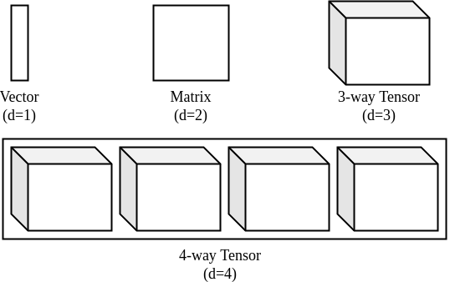
What is a Tensor?
Tensor is a d-dimensional array
Figure 1: Representation of tensor upto four dimensions [1]
Tensor Methods for Neural Network Compression

Slide 4

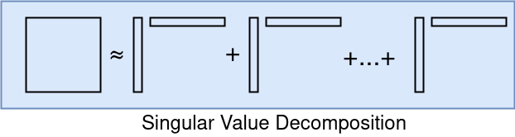
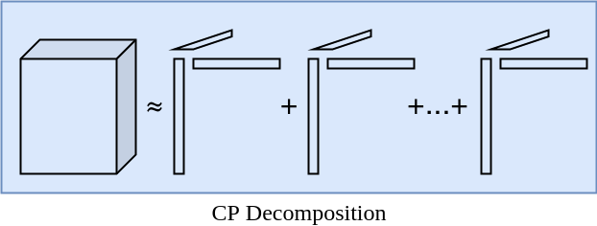
Candecomp/PARAFAC (CP) decomposition
CP-decomposition can be viewed as matrix SVD generalized to tensors
Unlike SVD, no orthogonality constraints are required
It is defined as sum of d-dimensional outer products
Tensor Methods for Neural Network Compression

Slide 5


CP Decomposition
Computed using Alternating Least Squares(ALS) method
In 3-way decomposition, A, B and C are optimized sequentially [1]
In ALS, we minimize the cost function ||X-M||
Equation representing the optimization of variables in ALS method [1]
Tensor Methods for Neural Network Compression

Slide 6
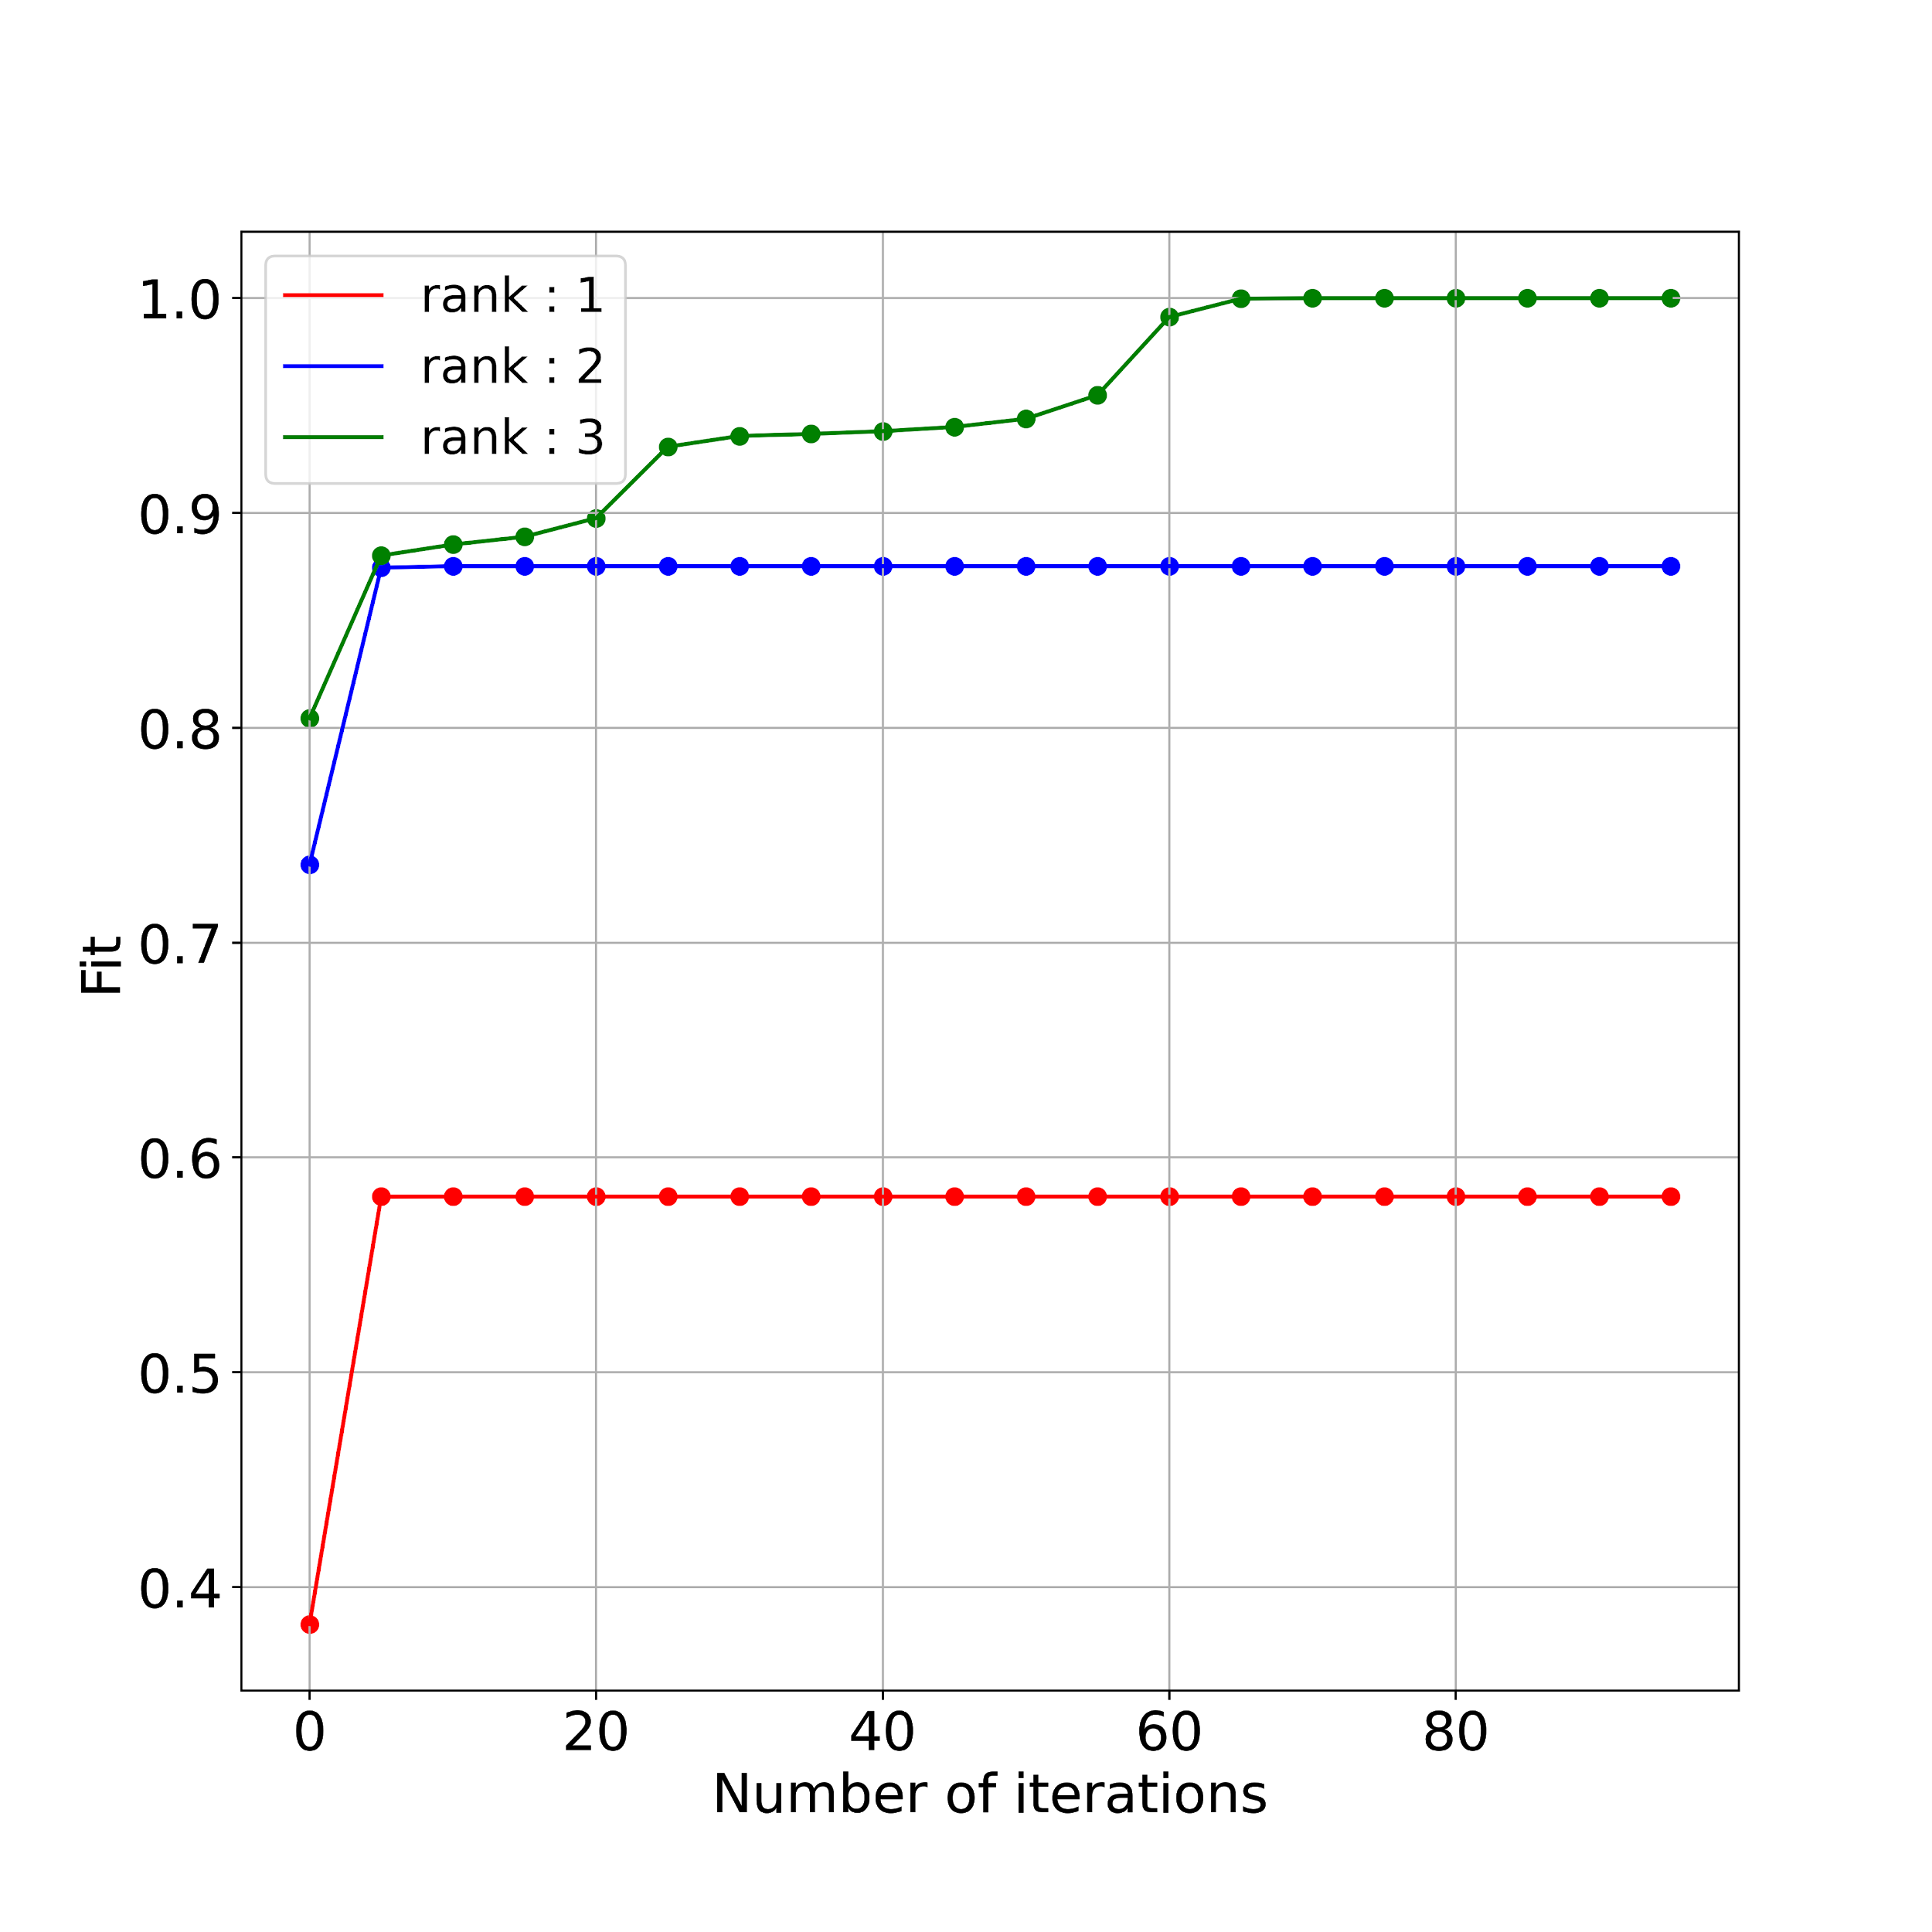
CP Decomposition
Input tensor shape (2 x 3 x 3)
Approximation by various ranks
Figure 2: Convergence of ALS method with different ranks
Tensor Methods for Neural Network Compression

Slide 7
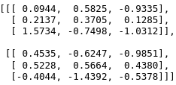
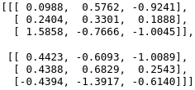
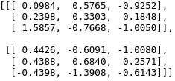
CP Decomposition
Unit tested with tensorly implementation
Parameters
Rank : 2
Maximum iterations : 100
Input Tensor
Reconstruction from ALS method
Reconstruction from tensorly
Tensor Methods for Neural Network Compression

Slide 8
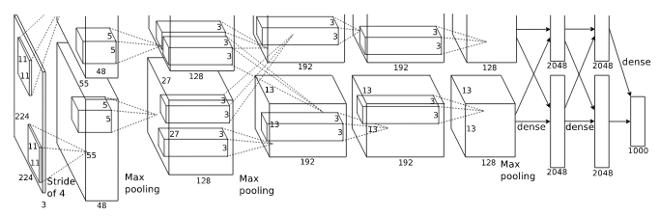
AlexNet
Convolutional Neural Network (CNN)
First five convolutional layers
Last three fully connected layers act as classifier
Figure 3: AlexNet architecture [2]
Tensor Methods for Neural Network Compression

Slide 9
AlexNet
Convolutional Neural Network (CNN)
First five convolutional layers
Last three fully connected layers act as classifier
Figure 3: AlexNet architecture [2]
Tensor Methods for Neural Network Compression

Slide 10
AlexNet Results
Classification task on CIFAR 10 dataset
Fine tuning over 10 epochs
Learning rate : 0.002
Rank : 45
Maximum iterations : 100
 | Without CP Decomposition | With CP Decomposition
Classification accuracy | 84% | 65%
Tensor Methods for Neural Network Compression

Slide 11
References
[¹] Kolda, Tamara G., and Brett W. Bader. "Tensor decompositions and applications." Society for Industrial and Applied Mathematics (SIAM) review 51, no. 3 (2009): 455-500.
[²] Krizhevsky, Alex, Ilya Sutskever, and Geoffrey E. Hinton. "Imagenet classification with deep convolutional neural networks." In Advances in neural information processing systems, pp. 1097-1105. 2012.
Tensor Methods for Neural Network Compression

