Slide 1
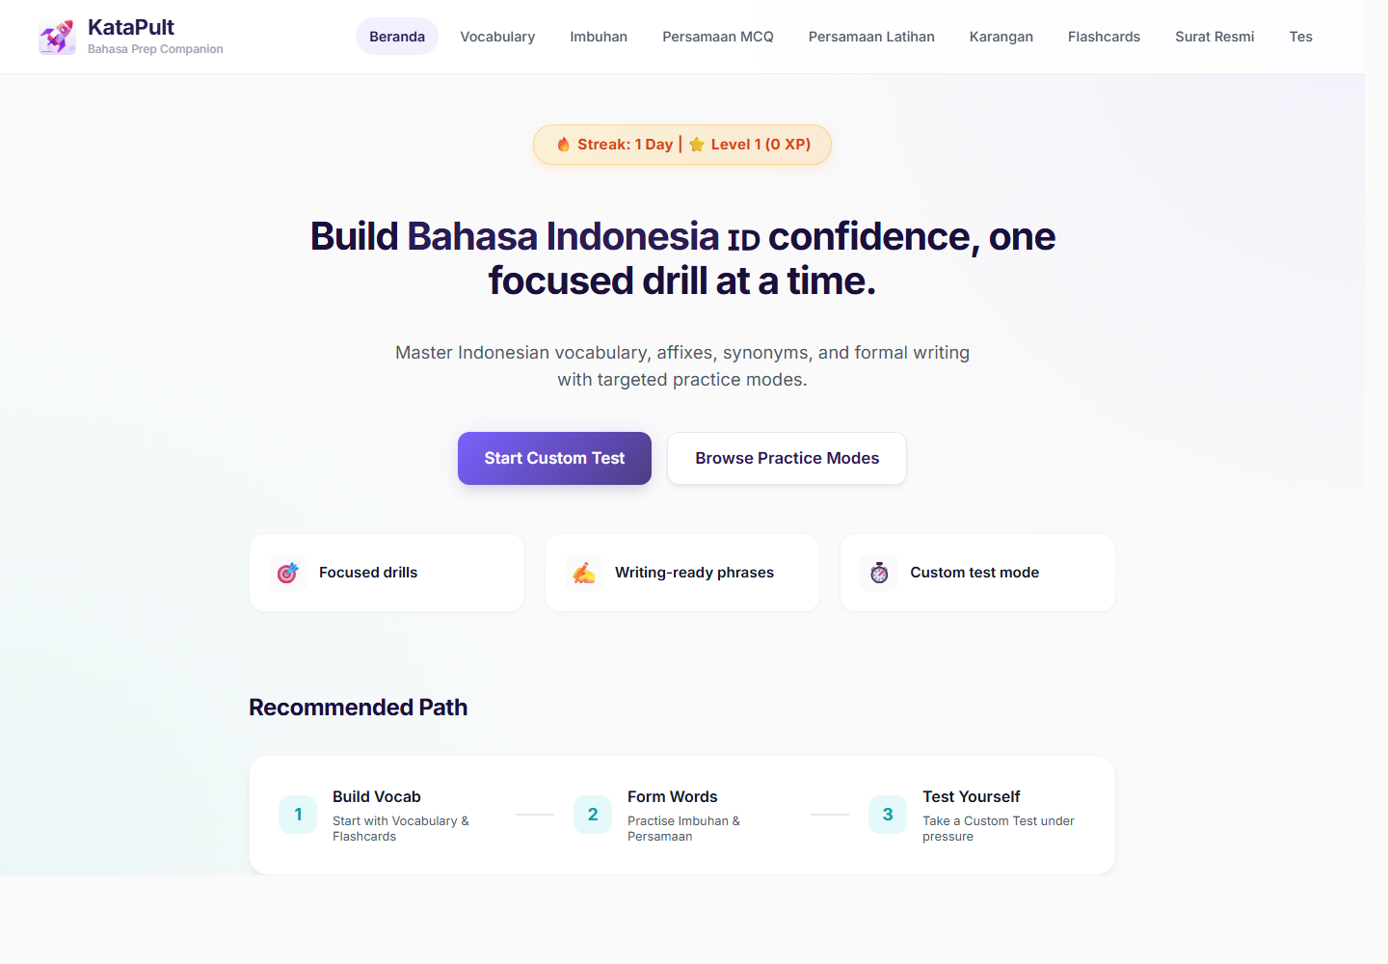
KataPult
Bahasa Prep Companion
From scattered exam notes to measurable daily practice
A modular, gamified platform built to help learners prepare for Bahasa Indonesia I2 through focused drills, active recall, and learning analytics.
Innovation Award Demo
Live app
01

Slide 2
PROBLEM STATEMENT
The exam-prep gap was not content availability. It was practice quality.
What made prep hard
Personal trigger
Team-level need
Materials were scattered across notes, screenshots, links, and ad hoc quizzes.
Weak spots like imbuhan, persamaan, and formal-writing phrases need repeated retrieval, not passive reading.
Busy learners needed 5-10 minute drills that fit around work, not long study blocks.
Preparing for I2 felt like collecting resources, not building readiness.
I wanted one place to practise vocabulary, affixes, synonyms, karangan phrases, and formal-letter patterns.
The missing medium was a repeatable routine with feedback and visible progress.
Multiple colleagues were preparing independently, duplicating effort.
There was no shared way to see which sections people actually used or where time was being spent.
A reusable platform could turn individual prep into a team learning asset.
02

Slide 3
SOLUTION
KataPult turns exam readiness into a daily practice loop.
1 Choose module
2 Practise actively
3 Get feedback
4 Track progress
Instead of one long course, KataPult is split into exam-relevant practice surfaces: build vocabulary, form words, recognise synonyms, rehearse writing phrases, then test under pressure.
03

Slide 4
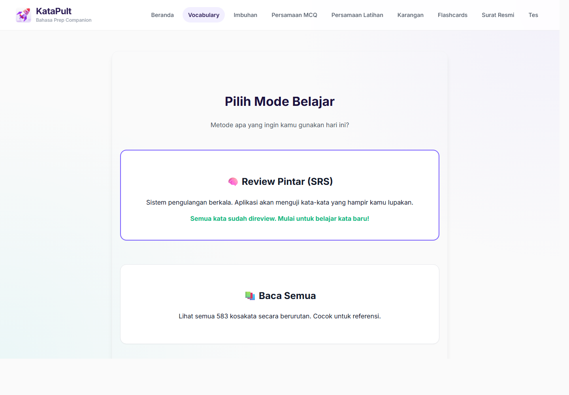
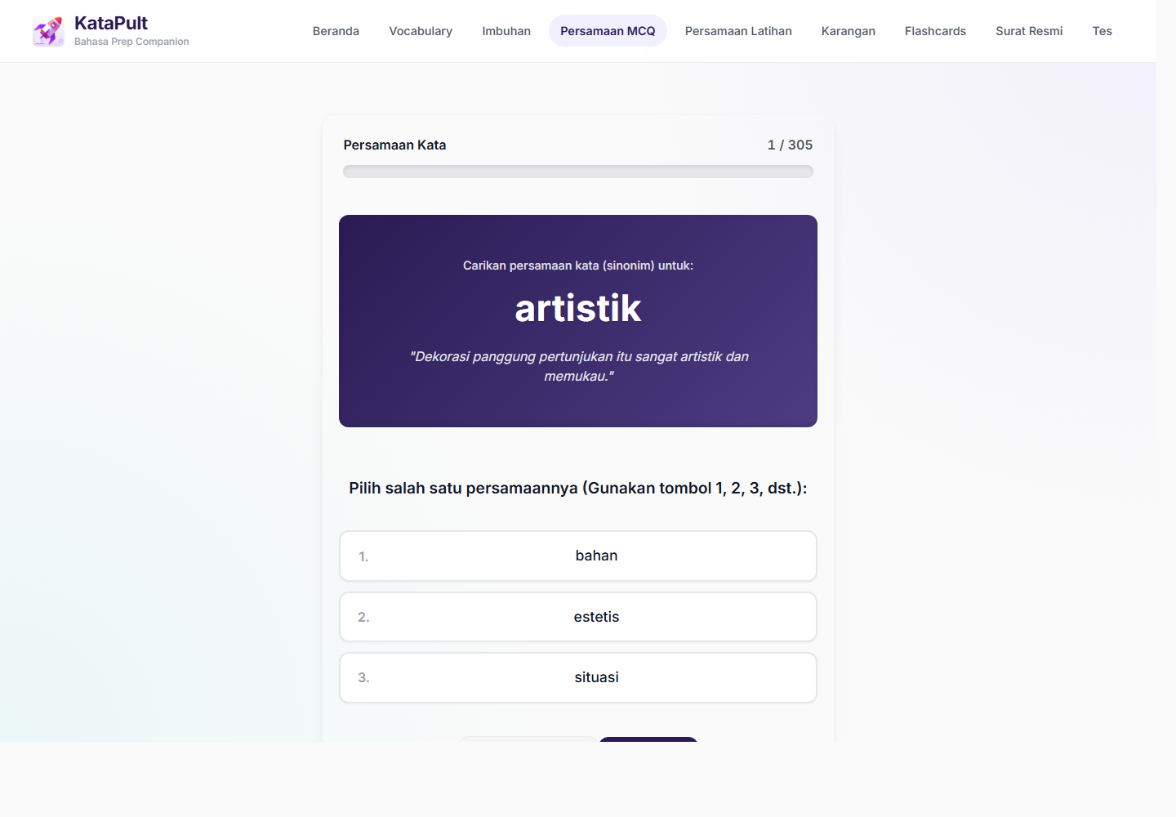
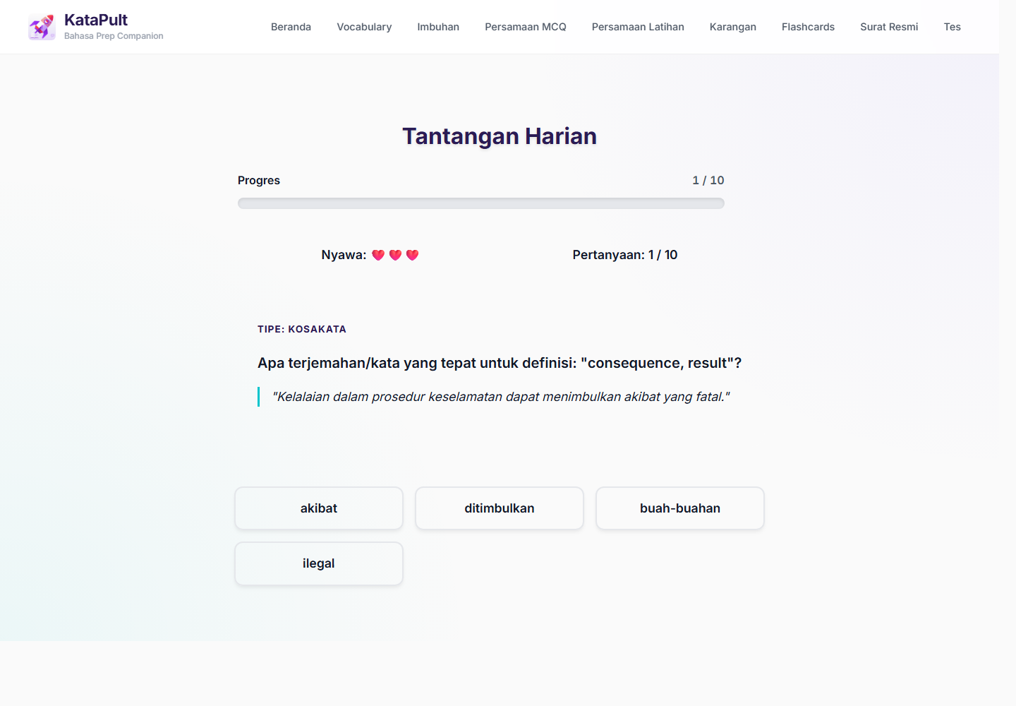
FEATURE HIGHLIGHTS
Four design choices make it award-worthy
01 Modular by exam skill
02 Active recall + feedback
03 Gamified momentum
04 Measurable usage
Per-user events
Section visited
Time per section
Total session time
Learners jump straight into the section they need: vocabulary, imbuhan, persamaan, karangan, surat rasmi, flashcards, and custom tests.
The app asks users to retrieve answers, not just read lists. Immediate correctness feedback helps convert weak recall into exam readiness.
Daily challenge, XP, levels, streaks, and limited lives make practice feel like a habit, not homework.
04

Slide 5
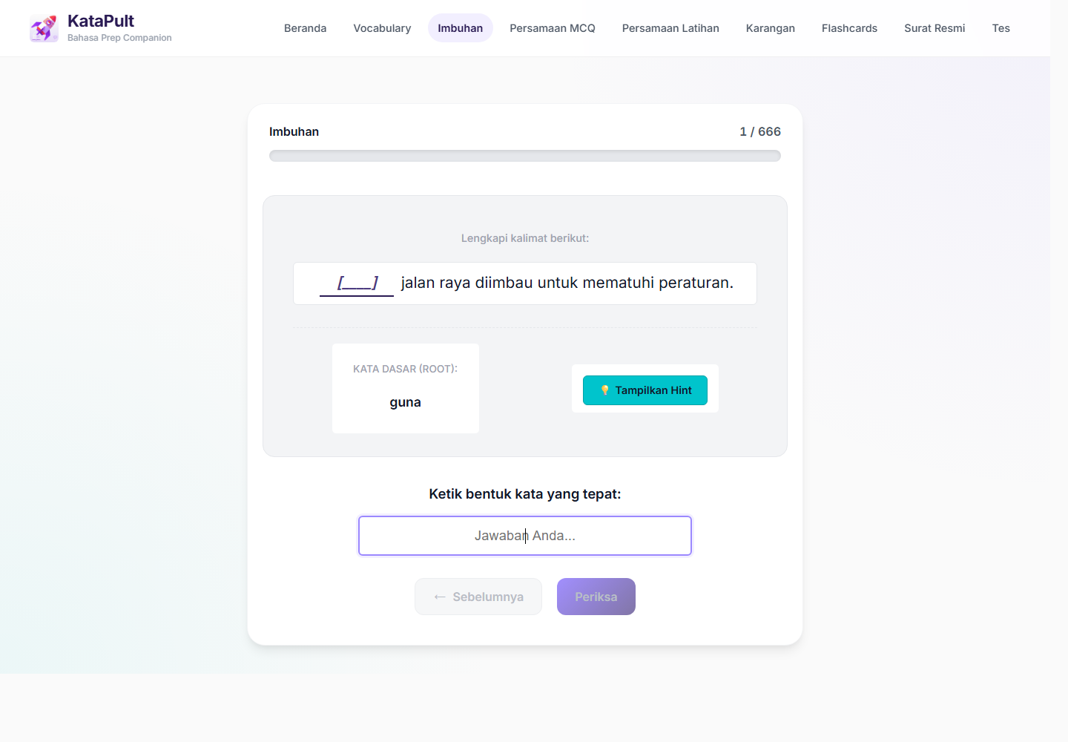
DEMO: THE LEARNING SURFACE
A learner can move from discovery to focused practice in seconds.
Vocabulary: examples + recall
Imbuhan: word formation drills
Persamaan: synonym MCQ practice
Demo angle: show that this is not generic language learning. It targets Bahasa exam sub-skills that learners repeatedly struggle with: word formation, synonym precision, formal phrasing, and timed recall.
05

Slide 6
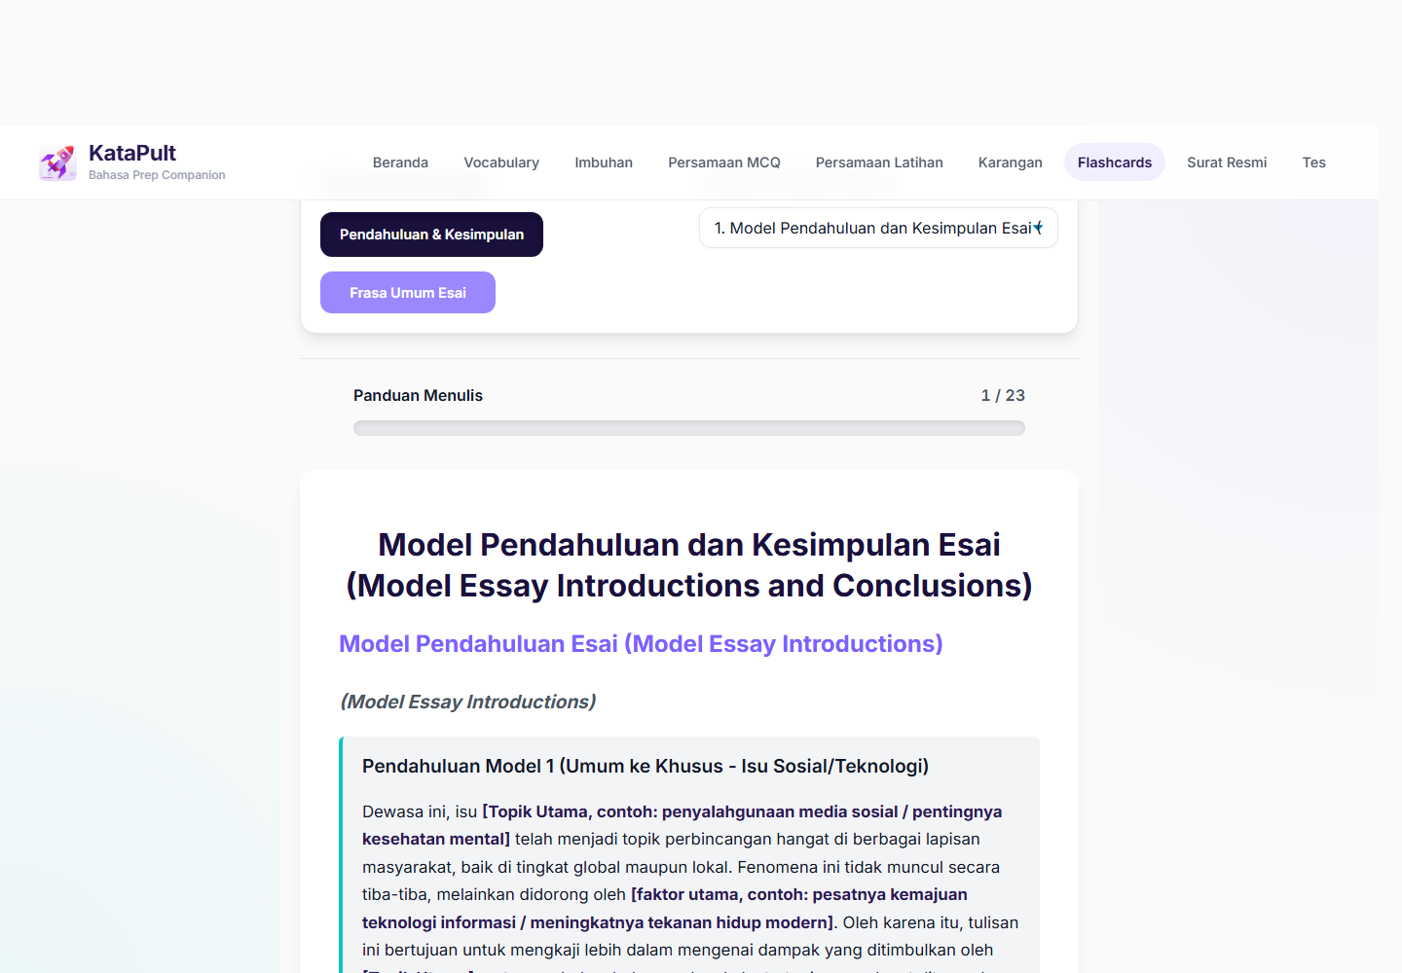
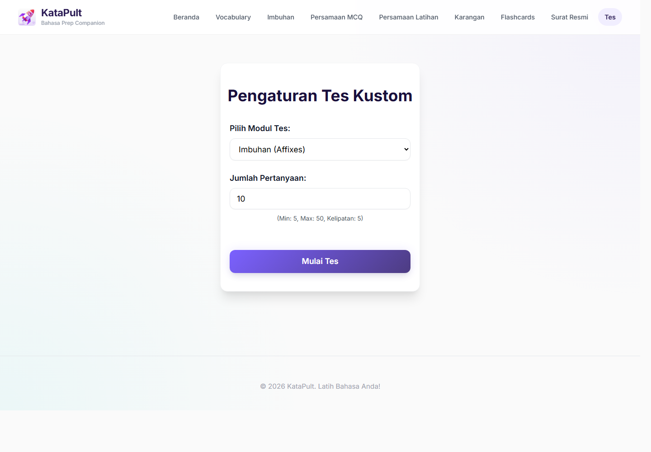
DEMO: RETENTION + ASSESSMENT
KataPult combines spaced review, lightweight games, and custom testing.
Flashcards + SRS
Custom test mode
Review key phrases and bring due items back at the right time instead of rereading everything.
Let learners generate focused practice under pressure, closer to the way they will be assessed.
06

Slide 7
MEASURABLE LEARNING LOOP
The app now measures not just visits, but learning behaviour.
Section_Visited section + route
Time_Spent_Section duration_seconds
Total_Session_Time whole visit
Distinct ID stable browser
This lets the team answer: which sections are used, which learners return, where time is spent, and whether adoption is spreading beyond the creator.
Award framing: KataPult is not only a content app; it is a learning system with feedback loops for both learners and programme owners.
The analytics layer turns anecdotal adoption into evidence: people, sections, total time, and section-level engagement.
07

Slide 8
IMPACT + ADOPTION
Early adoption shows the idea solves a real prep problem.
Observed impact
Evidence to include
Why it scales
Colleagues from different teams have started using the app for Bahasa learning and exam preparation.
It creates one shared prep surface instead of duplicated personal notes.
The app supports short, repeatable practice routines.
# unique learners
# teams represented
# sessions / active days
Top sections by time spent
Example learner feedback quote
Web-based: no installation needed.
Modular: new content sets can be added without changing the product concept.
Measurable: adoption and learning behaviour can be tracked over time.
08

Slide 9
DEMO STORYBOARD
Recommended 3-minute demo flow
1. Start on Home: show learning path, XP/streak, and the idea of short daily practice.
2. Open Vocabulary: show example sentences and translation, then frame it as exam-ready recall.
3. Open Imbuhan or Persamaan: show targeted weakness practice that static notes do not provide.
4. Open Flashcards / Custom Test: show retention and assessment under pressure.
5. End on PostHog: show section-level events and time spent per user as impact evidence.
Close with: reusable, self-serve, measurable learning.
09

Slide 10
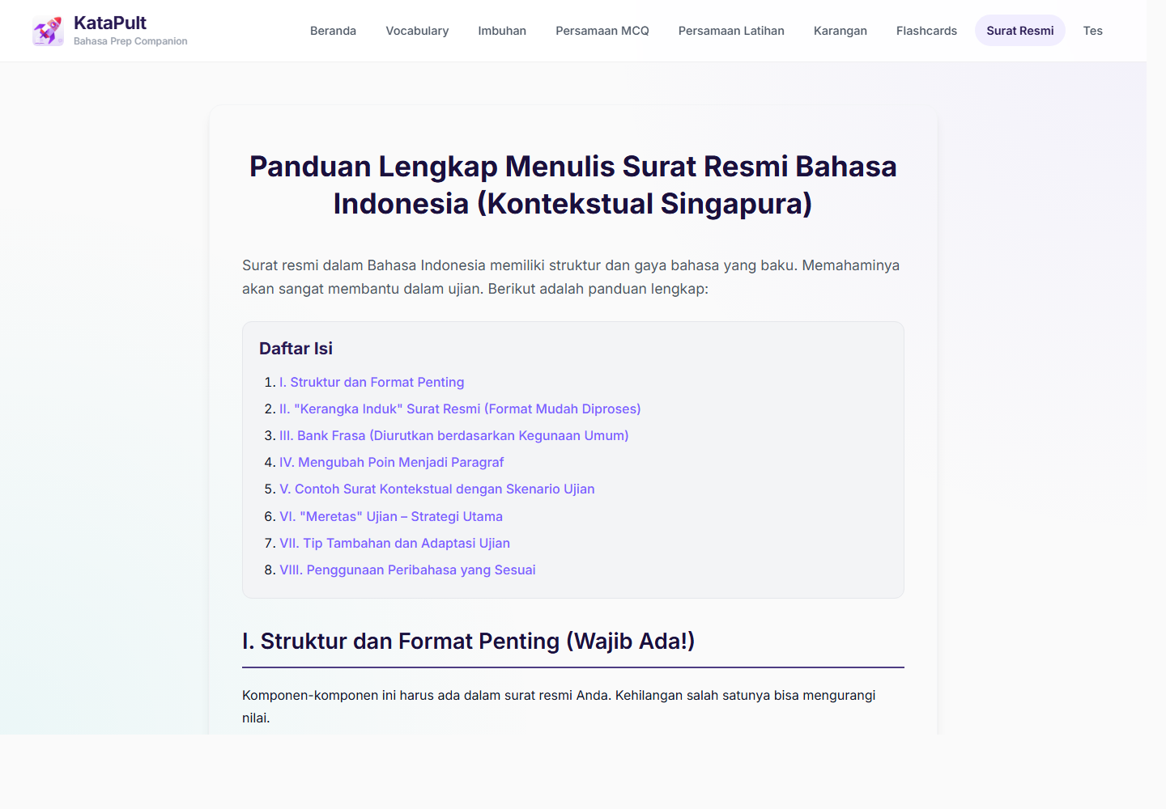
CLOSING
KataPult is an innovation because it makes exam preparation more accessible, habitual, and measurable.
Built from an authentic learner pain point.
Designed around specific Bahasa I2 exam sub-skills.
Adopted by colleagues beyond the original creator.
Instrumented to show usage, section visits, and time spent.
From personal pain point to team learning platform
10

