Slide 1
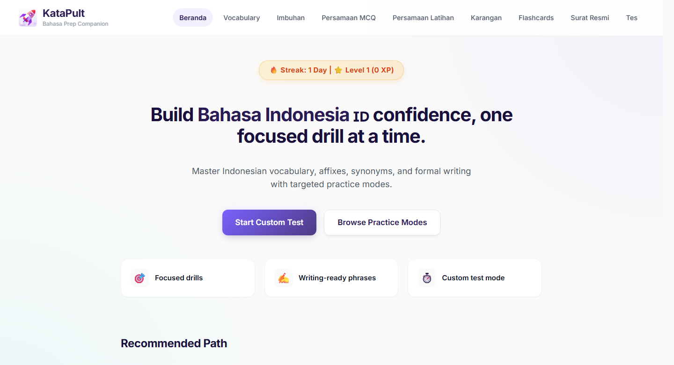
KataPult
Bahasa I2 Prep Companion
01
PRODUCT CASE STUDY
Structured Bahasa I2 practice, not another folder of notes.
KataPult turns collected materials into short, repeatable drills by exam component.
Simple claim
Pick a component. Practise. Review. Continue later.

Slide 2
KataPult
Problem
02
PREPARATION REALITY
The friction was restarting practice consistently.
The content was already there. The missing part was a structured way to turn it into repeatable exam practice.
Notes
What kept breaking
PDFs
No fixed practice path
Screenshots
Learners had to decide where to restart each time.
Links
Weak areas needed drilling
Imbuhan, persamaan and formal writing require retrieval.
Quizlet
Progress was invisible
LLM prompts
There was no consistent log of sections, time or attempts.

Slide 3
KataPult
Solution Model
03
PRODUCT MODEL
A practice layer over scattered materials.
KataPult organises prep by what the learner needs to practise, not by where the source material came from.
Inputs
Modules
Practice
Signals
Notes, PDFs, links, prompts
->
Vocabulary, imbuhan, persamaan, writing
->
Drills, flashcards, custom tests
->
Section visits, time spent, active days

Slide 4
KataPult
Coverage
04
PRACTICE BANK
1,554 drill-ready questions.
How to read the numbers
1,554
Top-line question pool
This is the top-line question pool for active drills and daily challenge.
All active question items available for drills/daily challenge.
583
666
305
971
Custom-test bank
Vocabulary
Imbuhan
Persamaan
Subset of the question pool: imbuhan + persamaan only.
583 vocabulary + 666 imbuhan + 305 persamaan = 1,554 drill-ready questions
Used by: component drills and daily challenge
separate
Revision resources
Useful learning material, but not counted as custom-test questions.
Custom-test subset: 971 questions
666 imbuhan + 305 persamaan. Vocabulary is not part of custom-test mode.
Separate revision resources
Karangan: 297 phrases | Surat rasmi: 8 sections | Flashcards: 23 sets

Slide 5
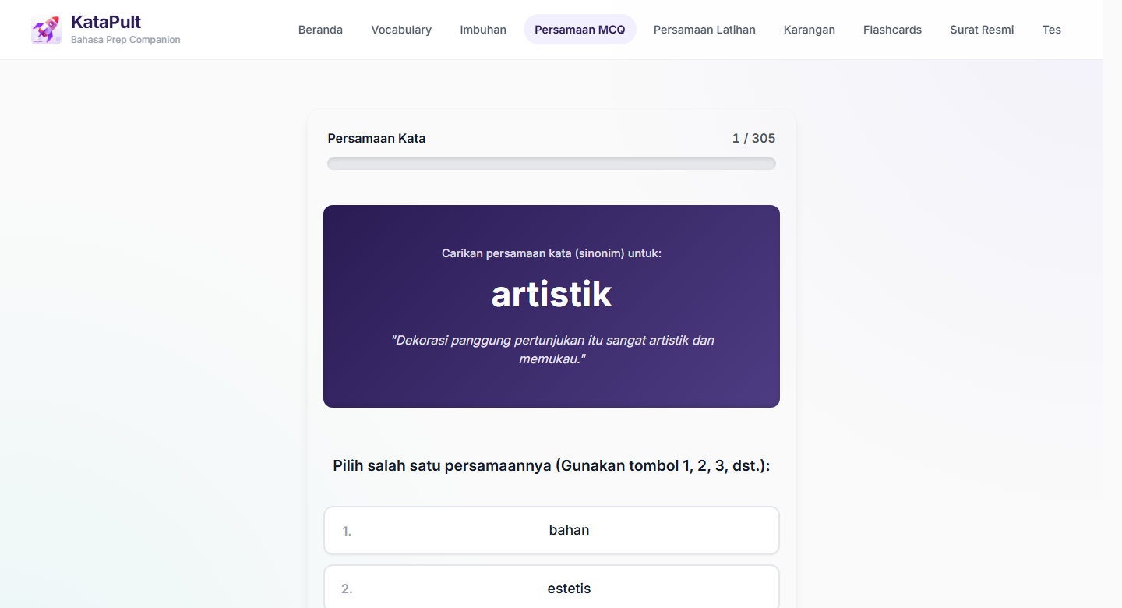
KataPult
Feature 1
05
COMPONENT PRACTICE
Each module has a clear practice job.
The app separates question drills, writing support and recall practice.
Component
Practice focus
Scale
Vocabulary
Meaning and usage drills
583 items
Imbuhan
Word formation and affixes
666 items
Persamaan
Synonym precision
305 items
Karangan
Formal writing phrases
297 phrases
Surat rasmi
Structure and tone reference
8 sections
Flashcards
Recall and spaced review
23 sets
Example shown
Persamaan requires synonym retrieval, not rereading.

Slide 6
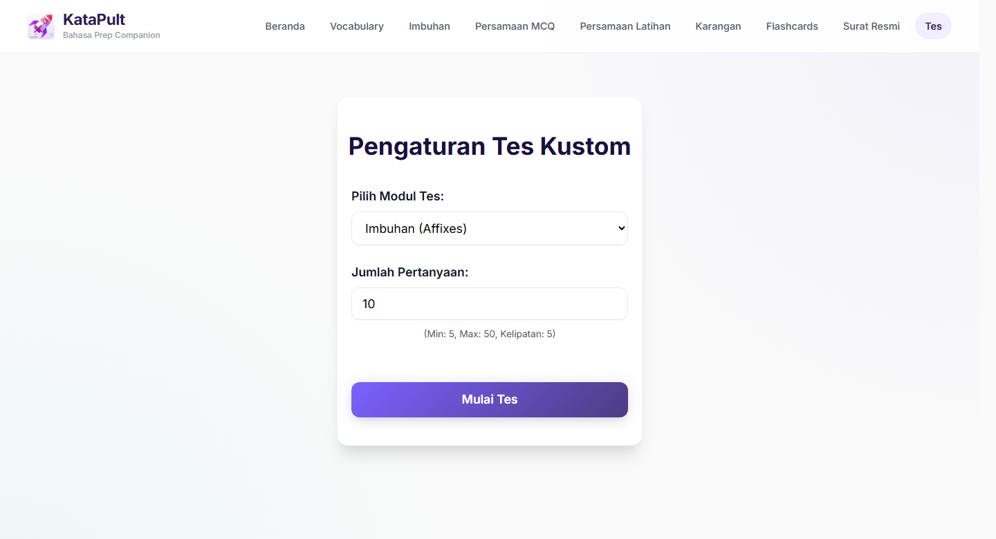
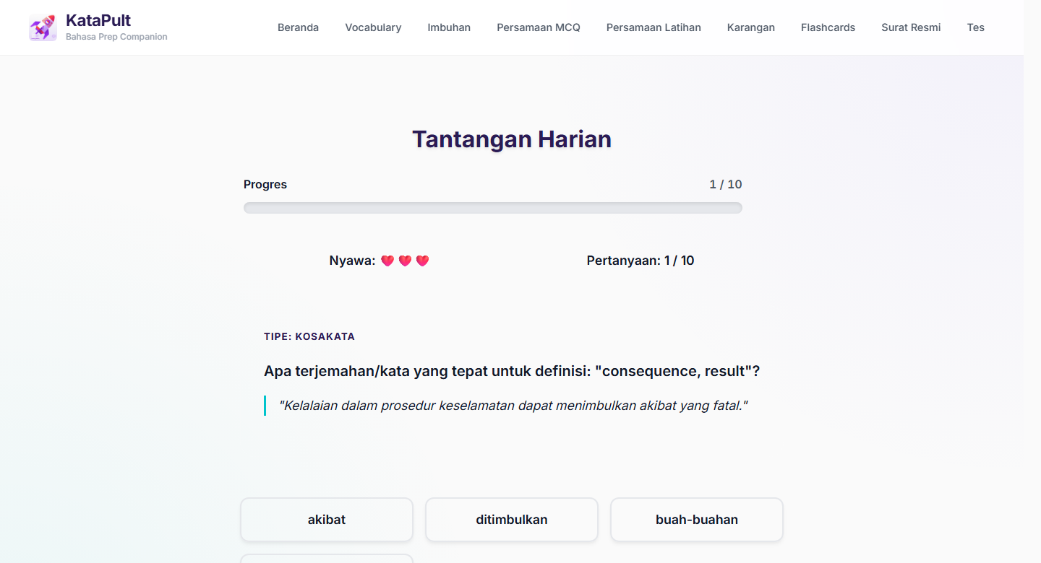
KataPult
Features 2-3
06
FOCUSED DRILLS
Custom tests and daily recall, side by side.
Two practical workflows: targeted weak-area practice and repeatable 5 to 10 minute sessions.
Custom test bank
Daily challenge
971 question items.
10 questions from the 1,554-item pool.
The point is not more content. It is easier repetition of the right practice task.

