Slide 1
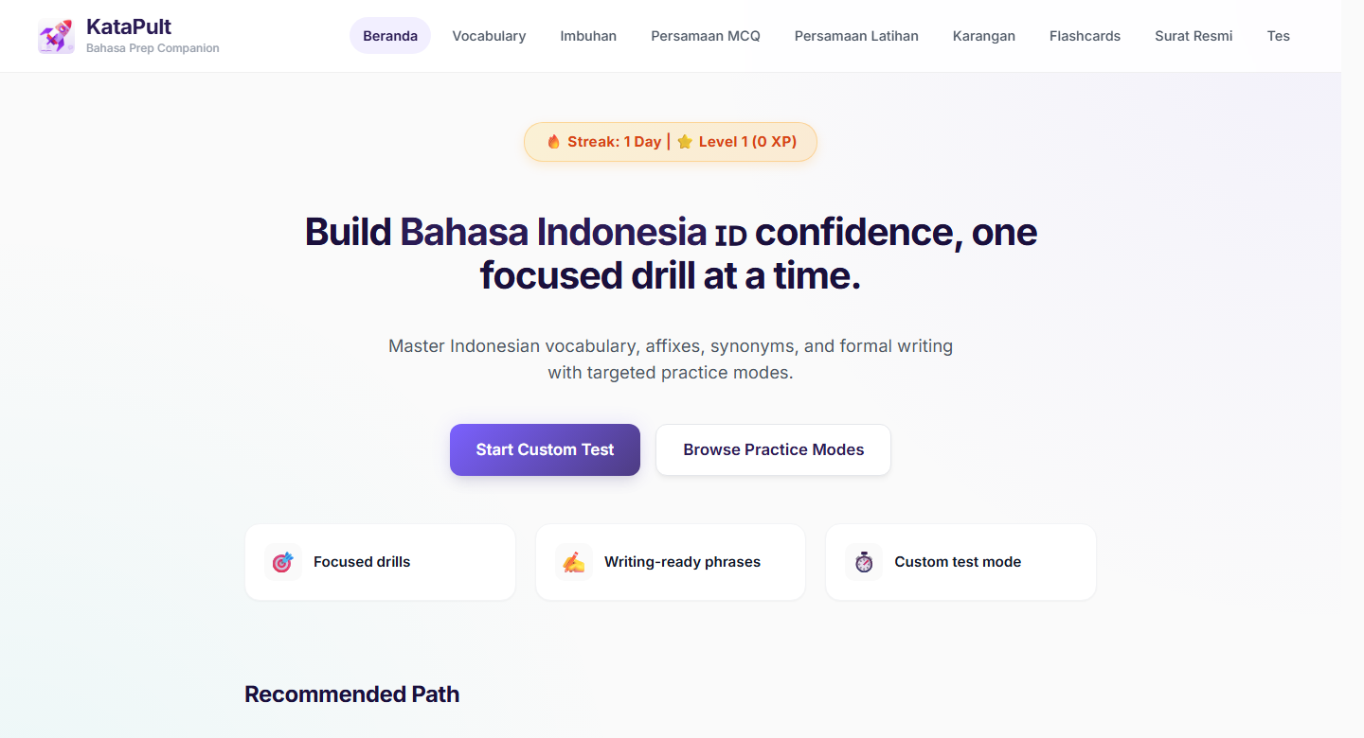
KataPult
Bahasa Indo Prep Companion
01
SHOWCASE DECK
Bahasa Indo practice, made structured and repeatable.
KataPult turns collected notes, online material, Quizlet-style recall sets and generated practice content into modular exam prep.
Core loop
Pick a module. Practise briefly. Review. Keep the streak alive.

Slide 2
KataPult
Problem
02
PREPARATION REALITY
The friction was restarting practice consistently.
The content was already there. The missing part was a structured way to turn it into repeatable exam practice.
Online refs
What kept breaking
Notes
No fixed practice path
Screenshots
Learners had to decide where to restart each time.
Quizlet
Weak areas needed drilling
Imbuhan, persamaan and formal writing require retrieval.
LLM prompts
Progress was invisible
Raw lists
There was no consistent log of sections, time or attempts.

Slide 3
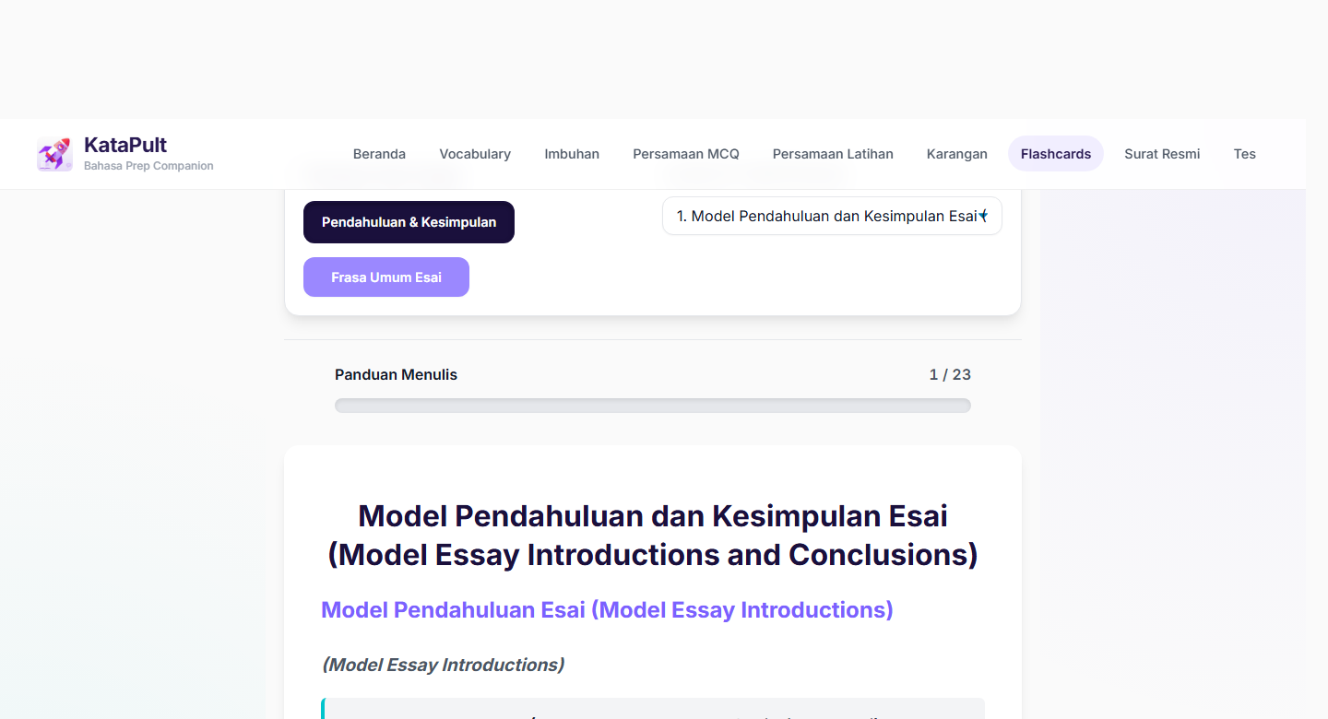
KataPult
Source Weave
03
CONTENT PROVENANCE
The deck is clearer when the sources are named.
The app combines collected online materials, Quizlet-style recall content and LLM-generated expansions, then exposes them as practice modules.
Online / collected lists
Vocabulary and karangan seed banks
583 vocab + 297 karangan
Quizlet-style recall
Flashcard sets for essays and useful phrases
23 sets
LLM-generated expansions
Synonyms, model points, practice phrasing
Needs review
App logic
Modules, tests and daily challenge
1,554 pool
Important framing
Counts describe app content banks; source quality still needs human review where raw data says generated.

Slide 4
KataPult
Coverage
04
PRACTICE BANK
1,554 drill-ready questions.
How to read the numbers
1,554
Top-line question pool
This is the top-line question pool for active drills and daily challenge.
All active question items available for drills/daily challenge.
583
666
305
971
Custom-test bank
Vocabulary
Imbuhan
Persamaan
Subset of the question pool: imbuhan + persamaan only.
583 vocabulary + 666 imbuhan + 305 persamaan = 1,554 drill-ready questions
Used by: component drills and daily challenge
separate
Revision resources
Essay, letter and flashcard material supports writing practice outside test mode.
Custom-test subset: 971 questions
666 imbuhan + 305 persamaan. Vocabulary is not part of custom-test mode.
Separate revision resources
Karangan: 297 vocab/synonym items | Surat resmi: 8 sections | Flashcards: 23 sets

Slide 5
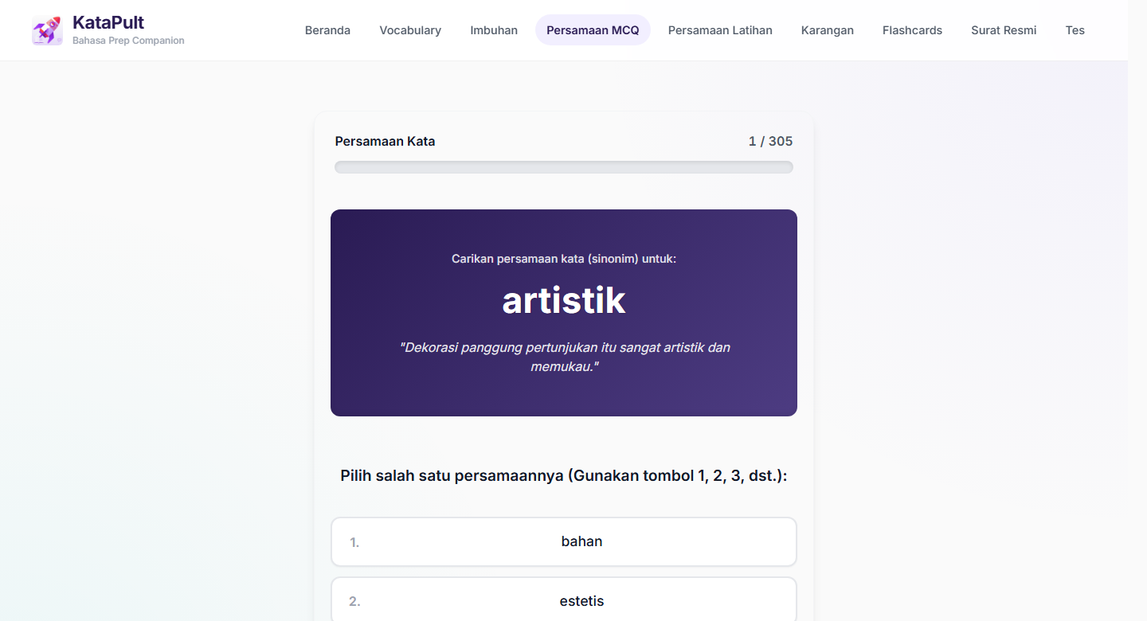
KataPult
Feature 1
05
MODULAR PRACTICE
Each module has a clear job.
Learners can work on meaning, affixes, synonym precision, essay vocabulary, formal letters or recall without mixing all content into one giant list.
Component
Practice focus
Scale
Vocabulary
Meaning and usage drills
583 items
Imbuhan
Word formation and affixes
666 items
Persamaan
Synonym precision
305 items
Karangan
Essay vocabulary and synonyms
297 items
Surat resmi
Structure, tone and examples
8 sections
Flashcards
Recall and spaced review
23 sets
Example shown
Persamaan requires synonym retrieval, not rereading.

Slide 6
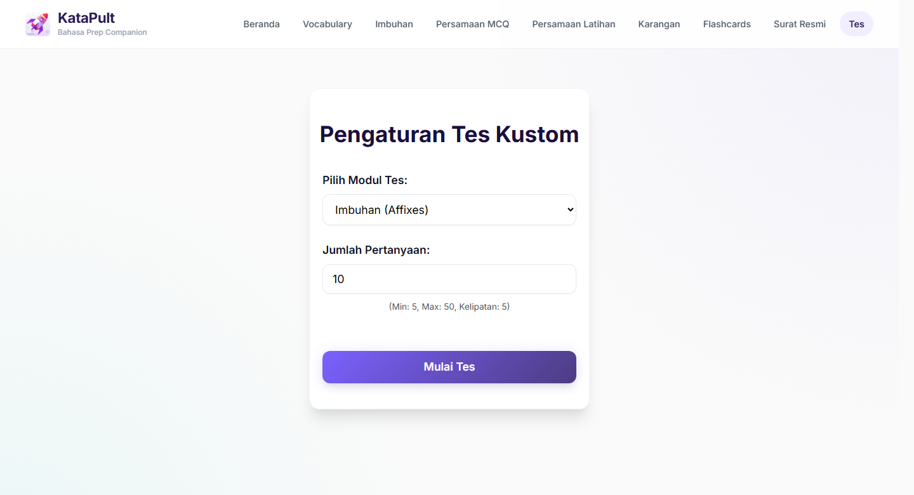
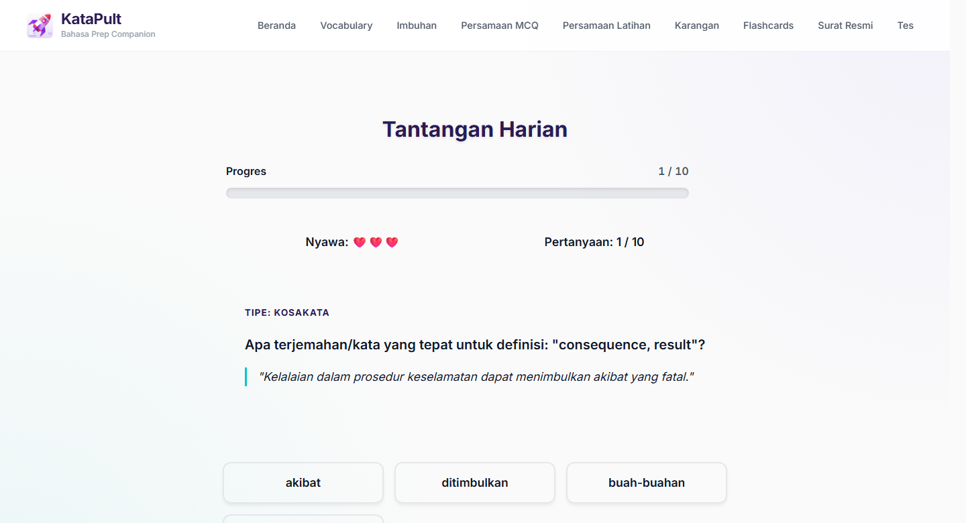
KataPult
Gamified Practice
06
GAMIFIED ELEMENTS
Short loops make practice easier to restart.
The app adds streaks, XP, levels, daily challenge and custom tests so revision feels modular and repeatable.
Custom test bank
Daily challenge
971 question items for targeted weak-area practice.
10 questions from the 1,554-item pool.
Gamification is lightweight: enough feedback to encourage return visits without distracting from exam practice.

Slide 7
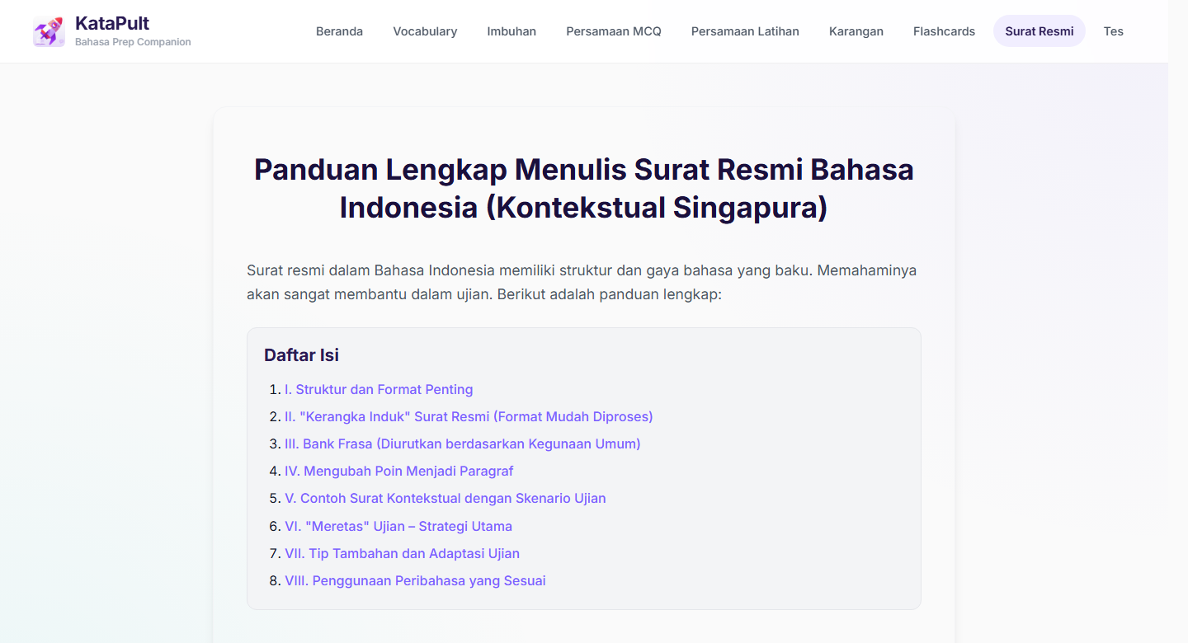
KataPult
Content Diversity
07
EXAMPLES
Not just questions: writing support is built in too.
Flashcards include full essay-topic sets; karangan and surat modules add vocabulary, structures and ready-to-adapt writing examples.
Flashcards
Karangan
Surat resmi
21 essay-topic sets + 2 scaffold sets
297 vocab/synonym items
8 guide sections + 10 contextual examples
Topics include population growth, dengue, clean energy, online scams, AI, climate change and inflation.
Examples: alam -> lingkungan; ancaman -> bahaya; berkelanjutan -> berkesinambungan.
Examples include complaint, permission request, funding request, speaker invitation, job application and apology.
How this should be described
Questions are not all from one source: the app weaves online/collected material, Quizlet-style flashcards and LLM-generated practice expansions into modules.

