Slide 1
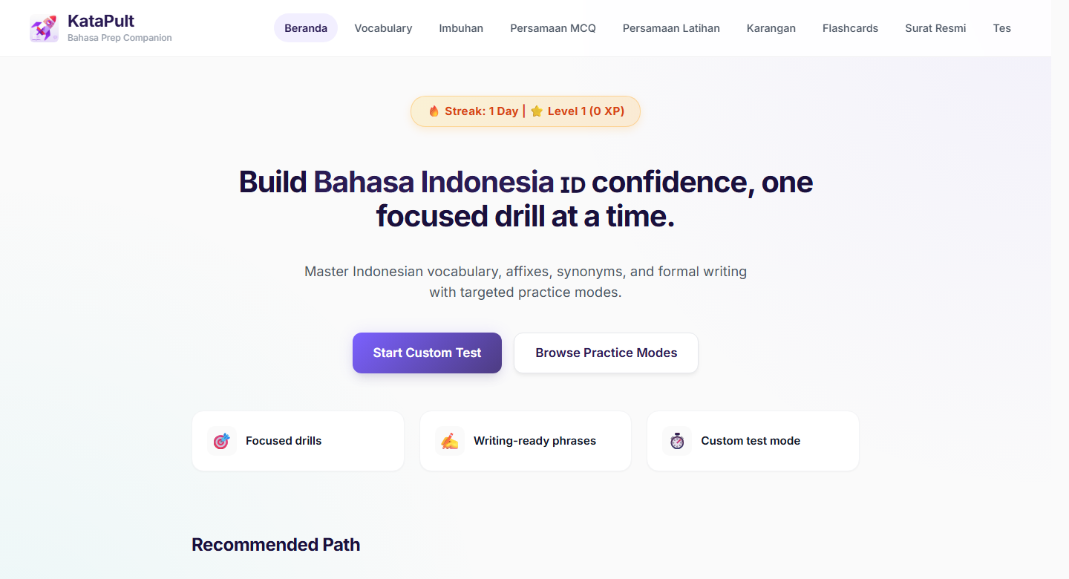
KataPult
Practice Companion
01
WORKING PROTOTYPE
KataPult: Bahasa Indo Practice Companion
A working prototype for short, structured Bahasa Indo revision.
Relevant Bahasa Indo learning materials centralised into one practice companion.

Slide 2
KataPult
Problem
02
PREPARATION REALITY
The hard part was not finding content. It was restarting practice.
Scattered inputs
• Notes
• Screenshots
• Online references
• Recall packs
• Generated practice material
Learners had notes, screenshots, online references, recall packs and generated practice material, but no clear place to continue after a break.
No clear next step
"Where do I continue?"
Each session started with deciding what to revise.
Weak areas were hard to isolate
Imbuhan, persamaan and formal writing need repeated practice.
Too much setup before practice
Progress was hard to see
Attempts, mistakes and return points were not easy to track.

Slide 3
KataPult
What Changes
03
WHAT KATAPULT CHANGES
Scattered materials become short practice flows.
KataPult centralises relevant learning materials in one place, then routes them into drills, tests, feedback and writing-support pages.
Notes
Daily challenge
Online references
Component drills
KataPult
Screenshots
organises content
Custom tests
Recall packs
Feedback explanations
Generated practice material
Writing guides and examples
Review note: AI-assisted practice items are flagged for human review before being treated as validated material.

Slide 4
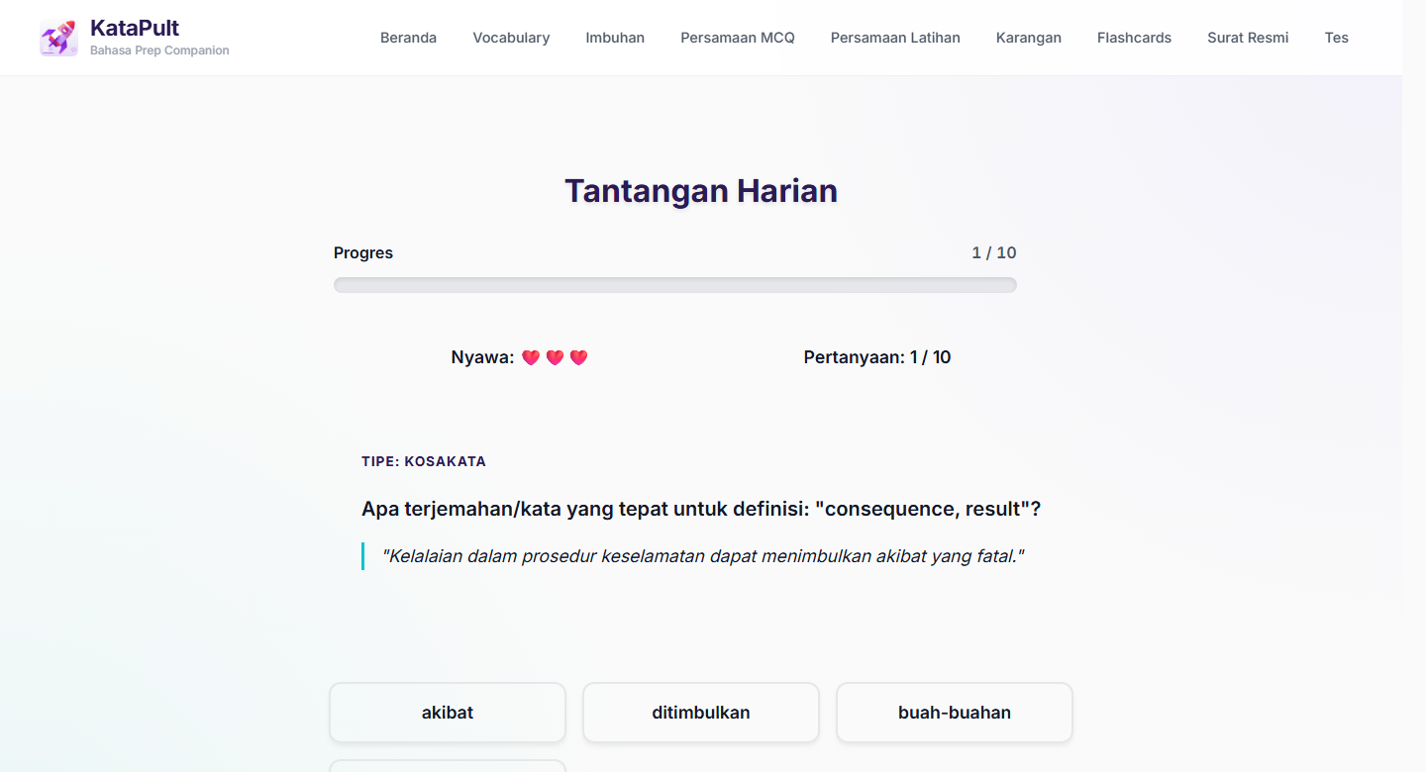
KataPult
Product Loop
04
PRACTICE LOOP
A simple loop keeps practice moving.
Learners can pick a module, practise briefly, understand the answer and return through daily challenge, XP or streaks.
Start a short drill
Track progress
Understand answers
1
Pick a module
2
Practise briefly
3
Get feedback
4
Review mistakes
5
Return later
Start with the area that needs work.
Use a daily challenge or focused test.
Right/wrong + LLM explanation.
Repeat missed items or continue.
Use daily challenge, XP or streaks.

Slide 5
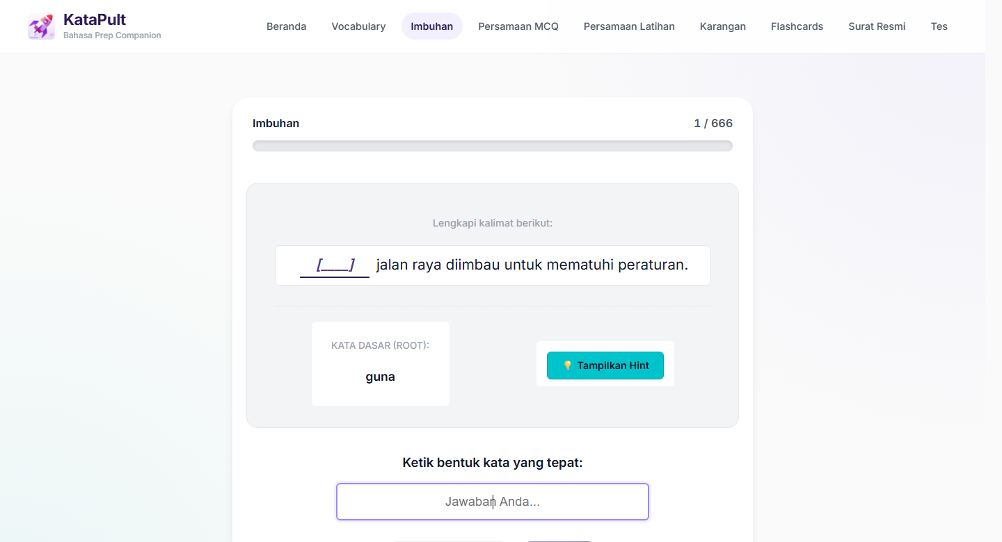
KataPult
Feature Walkthrough
05
FEATURE WALKTHROUGH
Each component has a specific learning job.
The app separates browsing, typed practice, recall, writing guides and focused tests so learners do not revise from one giant list.
Vocabulary
Meanings, examples and translations for core word building.
Imbuhan
Affix practice: apply prefixes, suffixes and word-form rules correctly.
Persamaan MCQ
Synonym recognition through sentence-context questions.
Persamaan Latihan
Typed synonym practice with immediate feedback.
Karangan
Essay vocabulary, phrase banks and definitions for composition writing.
Essay Recall Packs
Fast recall of openings, conclusions, examples and useful essay phrases.
Surat Resmi
Formal letter structure, tone, standard phrases and sample responses.
Custom Test
Configurable drills for focused revision on selected components.
Progress
Streaks, XP and levels that make return practice visible.
Shown action
Learner answers, checks feedback, and can read an LLM-generated explanation.

Slide 6
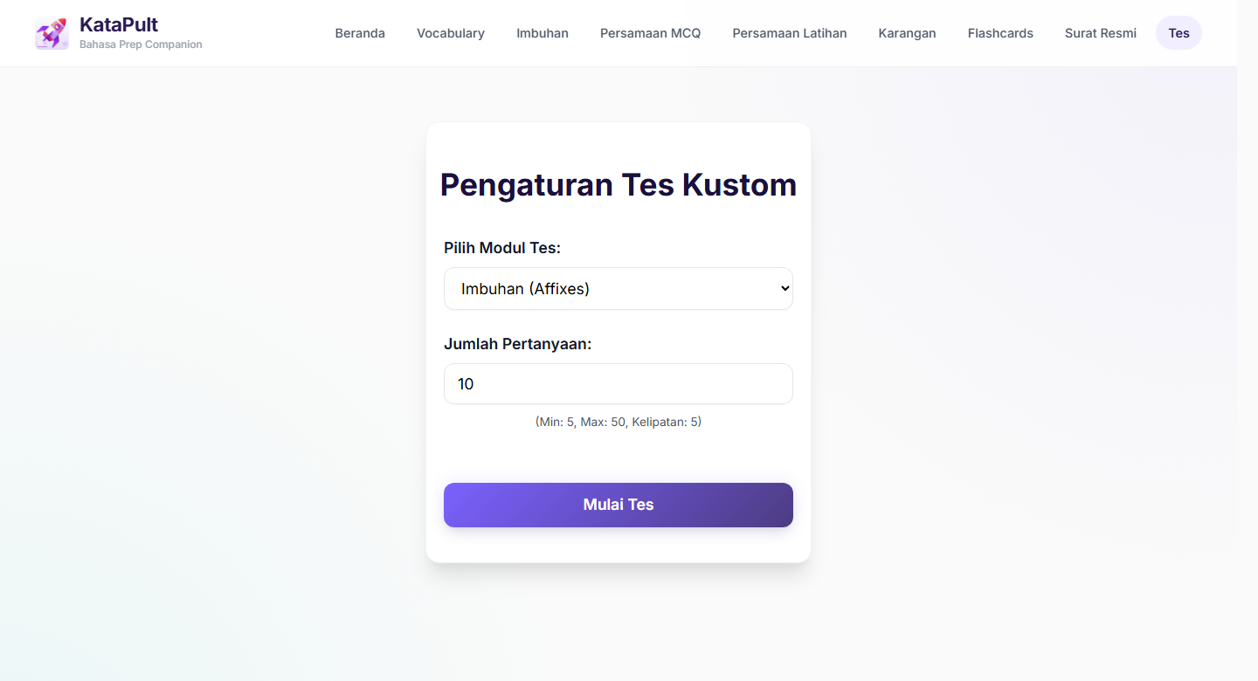
KataPult
Current State
06
CURRENT SCALE
Current state: useful enough to trial, still early enough to improve.
The current numbers show coverage and informal trial use. Stronger learning claims should come after content review and usage analysis.
1,554
971
active drill-ready items
current custom-test items
Vocabulary, imbuhan and persamaan question pool.
Custom Test currently covers imbuhan + persamaan.
10++
Multiple
early informal trial users
practice modes
Enough early use to keep improving.
Drills, recall, writing guides and tests.
Footnote: These numbers describe content coverage and informal trial usage. Learning impact should be validated through future review.

Slide 7
KataPult
Next Steps
07
NEXT REFINEMENT STEPS
The app helps learners restart practice more easily.
It centralises relevant learning materials, gives learners a clear place to continue, and explains answers after practice.
Content quality
User feedback
Iterative refinement
Review collected items and generated explanations before treating them as validated material.
Collect what learners find useful, confusing or missing during real use.
Use feedback and usage patterns to improve the most-used modules first.
KataPult should keep improving through continuous user feedback, content review and small product refinements based on real practice behaviour.

