Slide 1
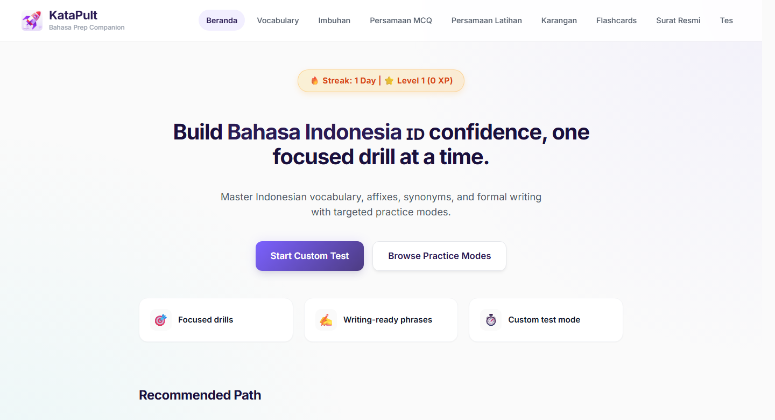
KataPult
Practice Companion
01
WORKING PROTOTYPE
KataPult: Bahasa Indo Practice Companion
A working prototype for short, structured Bahasa Indo revision.
Bahasa Indo learning materials centralised into one practice companion.

Slide 2
KataPult
Problem
02
PREPARATION REALITY
The hard part was not finding content. It was gathering relevant materials for practice.
Scattered inputs
• Study Notes
• Screenshots
• Online references
• Generated practice material
Learners had notes, screenshots, online references, recall packs and generated practice material, but no centralised place to learn in bite-sized manner.
"Where do I start?"
Weak areas were hard to isolate
Imbuhan, persamaan and formal writing need repeated practice.
Too much setup before practice
Progress was hard to see
Attempts and mistakes were not easy to track.

Slide 3
KataPult
What Changes
03
WHAT KATAPULT CHANGES
Scattered materials become short practice flows.
KataPult centralises relevant learning materials in one place, then routes them into drills, tests, answer feedback and writing-support pages.
Notes
Daily challenge
Online references
Component drills
KataPult
Screenshots
organises content
Custom tests
Recall packs
Answer feedback and explanations
Generated practice material
Writing guides and examples

Slide 4
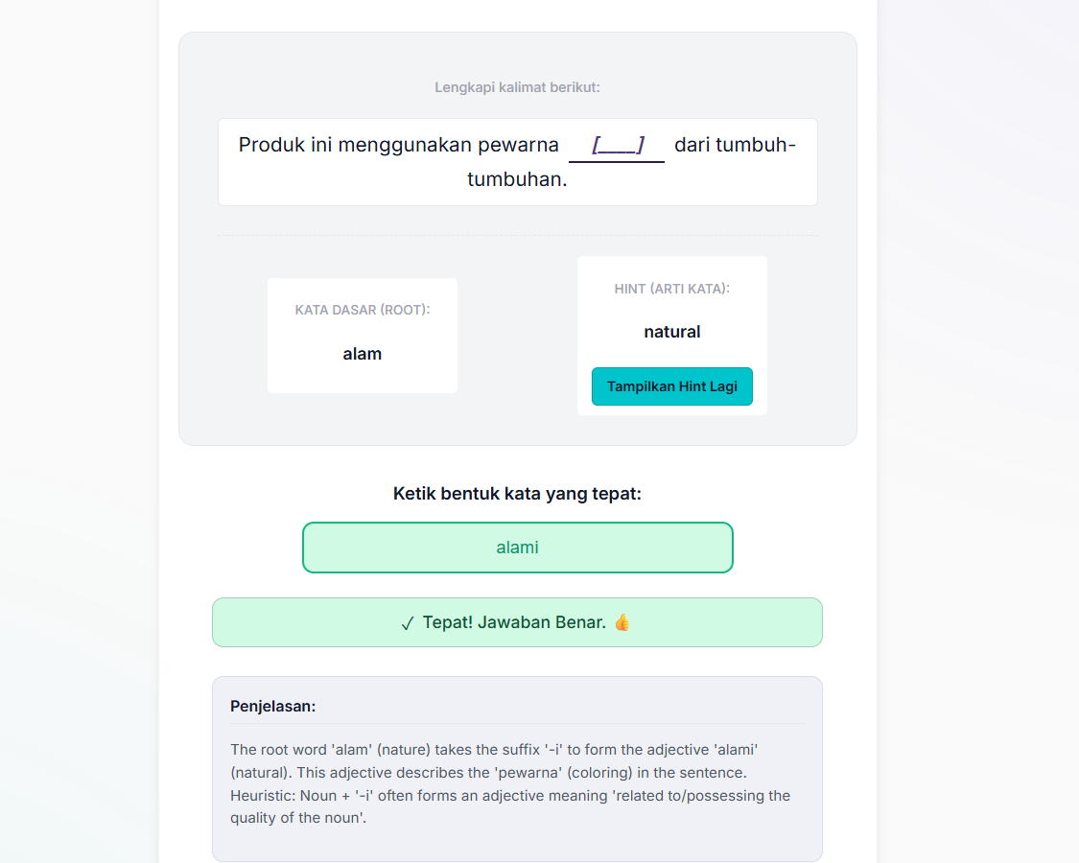
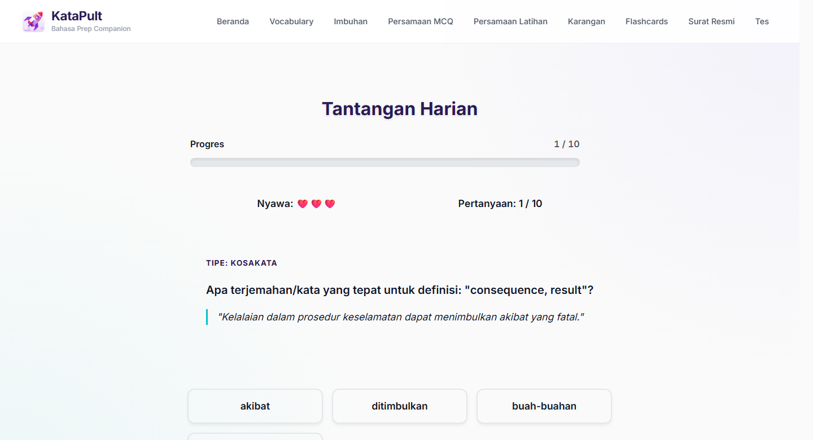
KataPult
Product Loop
04
PRACTICE LOOP
A simple loop keeps practice accessible.
Learners can pick a module, practise briefly, see right-or-wrong feedback with an AI-assisted explanation, then return through daily challenge, XP or streaks.
Actual Imbuhan answer state: feedback plus full explanation
Pick a module
2
Practise briefly
3
Get feedback
4
Review mistakes
5
Return later
Start with the area that needs work.
Use a daily challenge or focused test.
Feedback plus AI explanation.
Repeat missed items or continue.
Use daily challenge, XP or streaks.

Slide 5
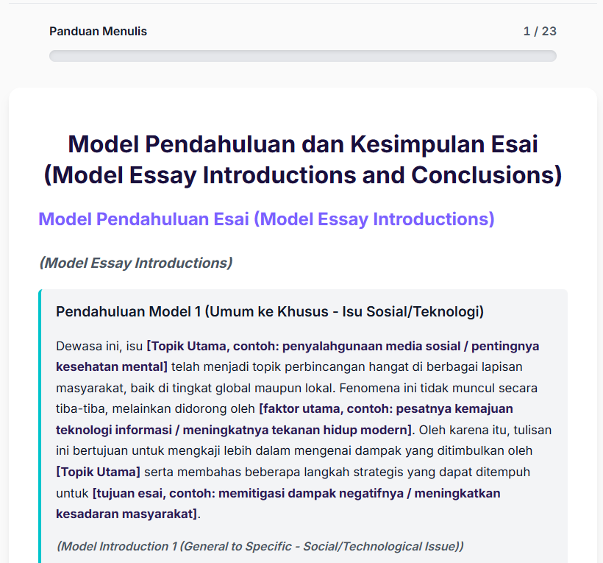
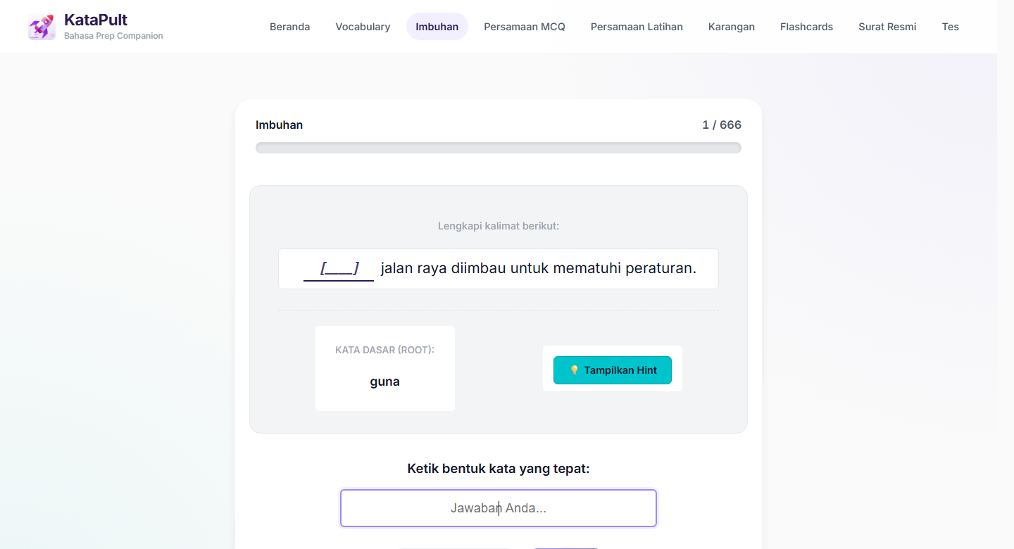
KataPult
Component Walkthrough
05
COMPONENT SUMMARY
Each component has a specific learning job.
The app separates browsing, typed practice, recall, writing guides and focused tests so learners do not revise from one giant list.
Vocabulary
Meanings, examples and translations for core word building.
Imbuhan
Affix practice: apply prefixes, suffixes and word-form rules correctly.
Persamaan MCQ
Synonym recognition through sentence-context questions.
Persamaan Latihan
Typed synonym practice with immediate feedback.
Karangan
Essay vocabulary, phrase banks and definitions for composition writing.
Essay Recall Packs
Fast recall of openings, conclusions, examples and useful essay phrases.
Surat Resmi
Formal letter structure, tone, standard phrases and sample responses.
Custom Test
Configurable drills for focused revision on selected components.
Progress
Streaks, XP and levels that make return practice visible.
Essay recall packs show reusable phrases and examples

Slide 6
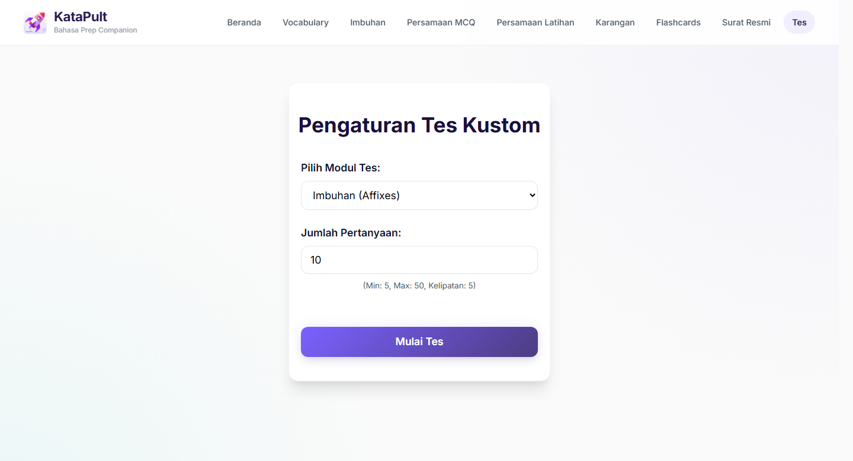
KataPult
Current State
06
CURRENT PROGRESS & FUTURE PLANS
Current state: trialling with users and collecting feedback
The current numbers show content coverage and early informal use.
1,554
10++
active drill-ready items
early informal trial users
Vocabulary, imbuhan and persamaan question pool.
Enough early use to keep improving.
Content quality
User feedback
Iterative refinement
Review collected items and AI-assisted explanations before treating them as validated material.
Collect what learners find useful, confusing or missing during real use.
Use learner feedback and usage patterns to improve the most-used modules first.

