Slide 1
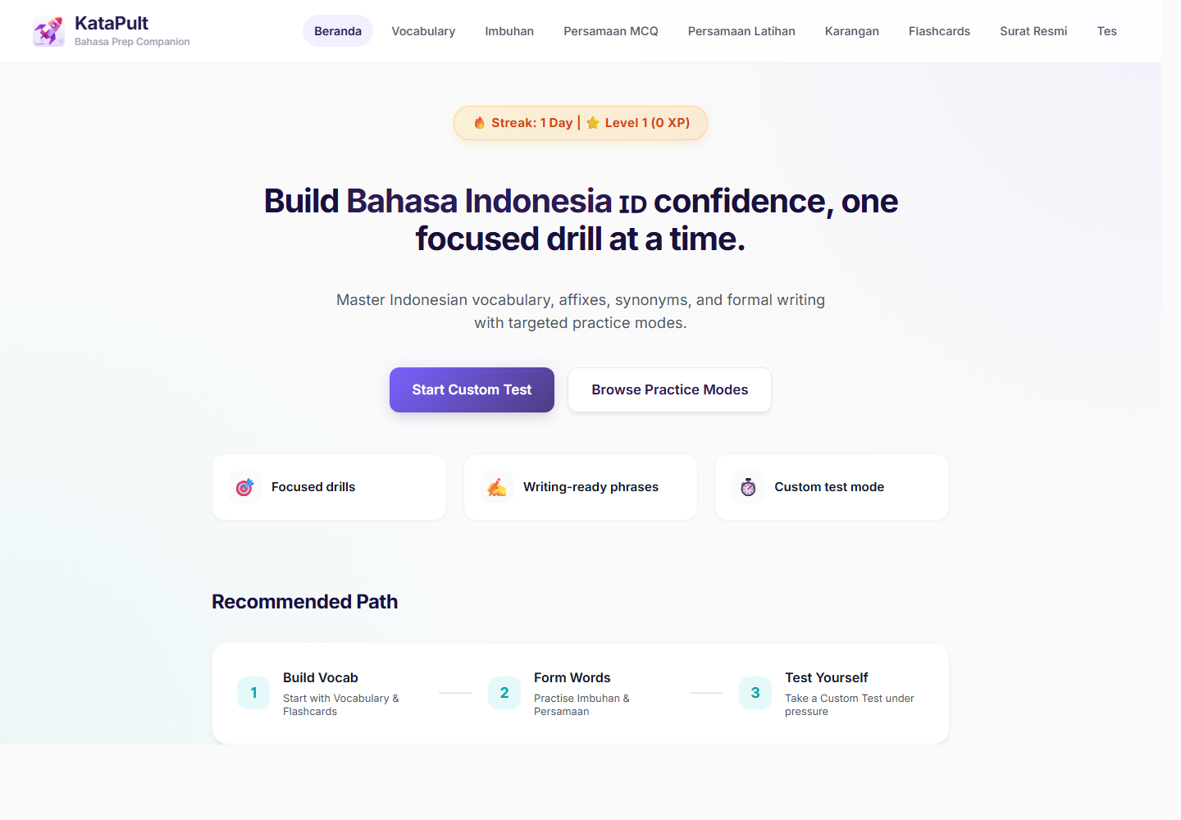
KataPult
Executive Summary
01
PRODUCT OVERVIEW
Bahasa I2 practice,
structured by component.
KataPult helps learners move from scattered resources to targeted, repeatable practice.
1,554*
971**
40++
drill / daily pool
custom-test bank
learners
Vocabulary + imbuhan + persamaan
Imbuhan + persamaan only
Across at least 4 entities
* Drill pool excludes revision-only modules. ** Custom tests draw from question-form components.

Slide 2
KataPult
Problem
02
CONTEXT
The issue was not content.
It was practice quality.
Operational problem
Each learner could prepare independently, but the organisation did not get a reusable practice surface or usage signal from that effort.
Useful material existed, but preparation was spread across notes, PDFs, screenshots, links, Quizlet sets and LLM prompts.
Scattered inputs
Passive revision
No shared visibility
Resources lived in separate places, making it hard to restart quickly.
Reading and collecting examples did not force retrieval.
There was no easy way to see what was practised or where time was spent.

Slide 3
KataPult
Solution Model
03
WORKFLOW
One repeatable practice loop.
The app is organised around what a learner does in a short session.
1
Choose component
2
Practise actively
Vocabulary, imbuhan, persamaan, writing, surat rasmi or flashcards.
Answer targeted questions instead of rereading long notes.
3
Review feedback
4
Track usage
See what to repeat and which weak area to revisit.
Capture section visits and time spent as adoption evidence.

Slide 4
KataPult
Practice Bank
04
SCALE AND DEFINITIONS
The numbers are counted by
use case.
Component
Scale
Use
Vocabulary
583
Drill / daily pool
Imbuhan
666
Drill / daily + custom tests
This slide prevents the common confusion between total drill pool, custom-test bank and revision modules.
Persamaan
305
Drill / daily + custom tests
1,554*
971**
3
Karangan
297
Writing phrases / revision
drill / daily pool
custom-test bank
revision surfaces
Surat rasmi
8 sections
Templates and structure
583 vocabulary + 666 imbuhan + 305 persamaan
666 imbuhan + 305 persamaan
Karangan phrases, surat rasmi and flashcards
Flashcards
23 sets
Recall and review
* 583 + 666 + 305 = 1,554. ** 666 + 305 = 971.
Karangan, surat rasmi and flashcards are shown separately because they are revision surfaces, not custom-test question banks.

Slide 5
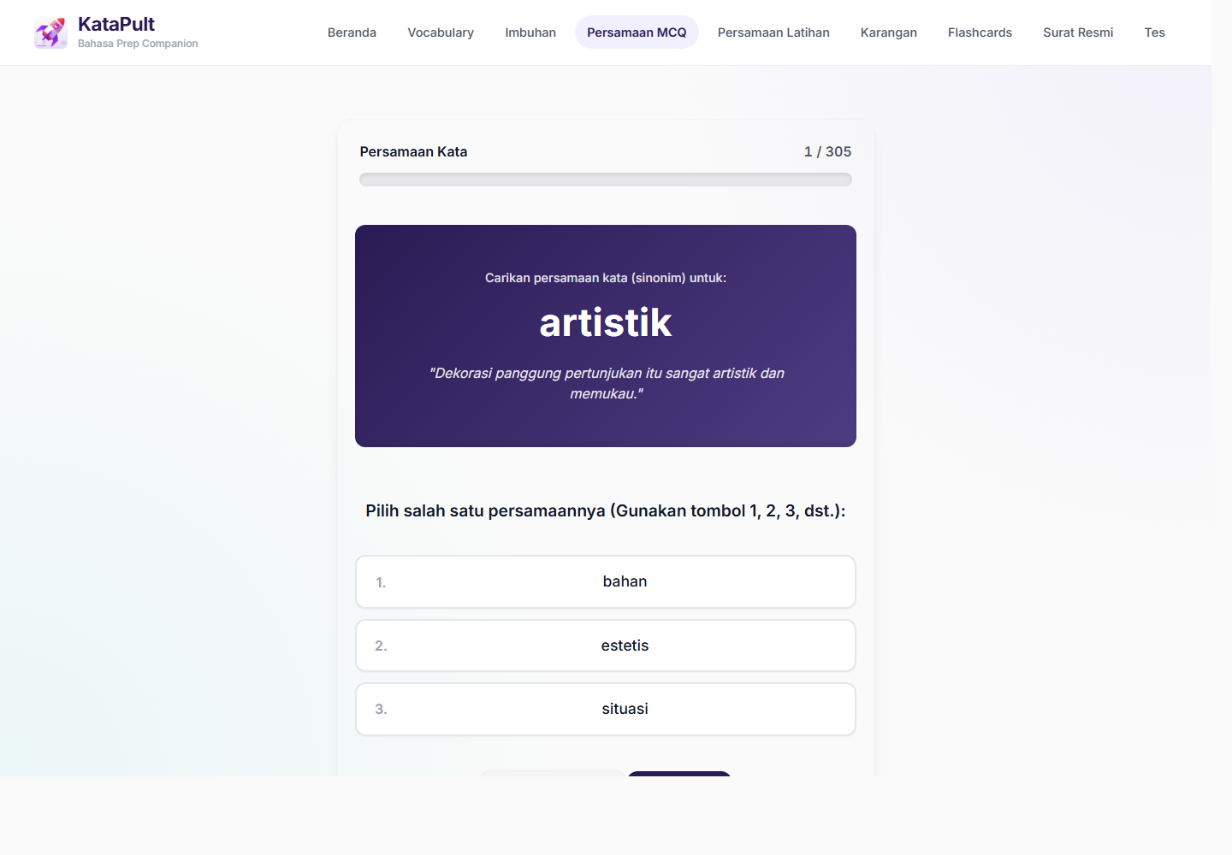
KataPult
Feature 1
05
EXAM-SKILL MODULES
Learners practise the exact
weak area.
This is not a generic language app: each section maps to an I2-relevant practice need.
Vocabulary
Imbuhan
Meaning and usage
583 items
Word formation
666 items
Persamaan
Karangan
Synonym precision
305 items
Ready phrases
297 phrases
Surat rasmi
Flashcards
Structure and tone
8 sections
Recall and review
23 sets

Slide 6
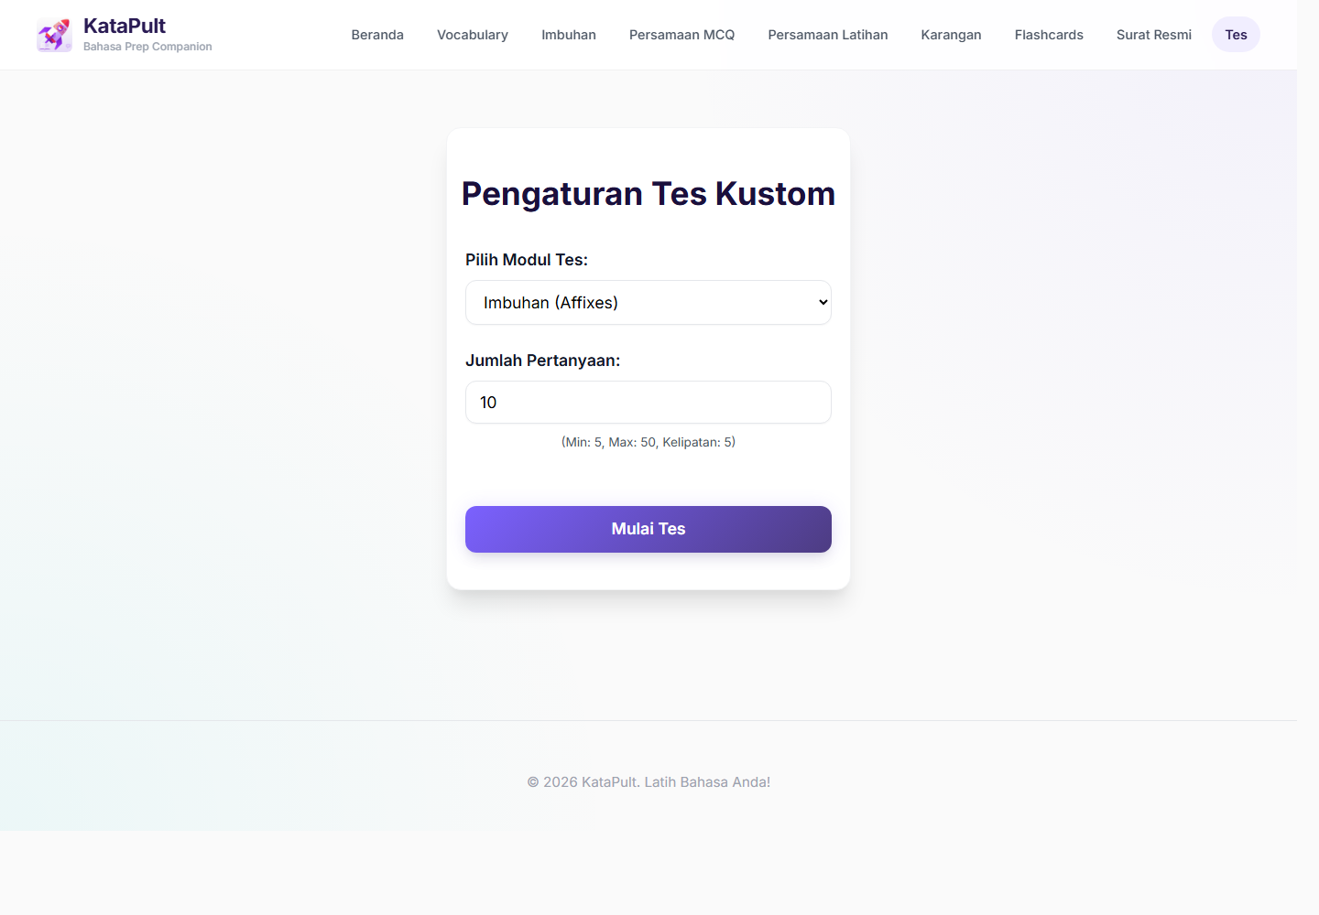
KataPult
Feature 2
06
FOCUSED CUSTOM DRILLS
A weak area becomes a
short test.
Custom tests use the 971-item bank from imbuhan and persamaan question items.
Custom-test math
666 imbuhan items + 305 persamaan items = 971 custom-test items.
Choose
Set length
Review
Select imbuhan or persamaan.
Run 5, 10 or 20 questions depending on available time.
Use mistakes to decide what to repeat next.

Slide 7
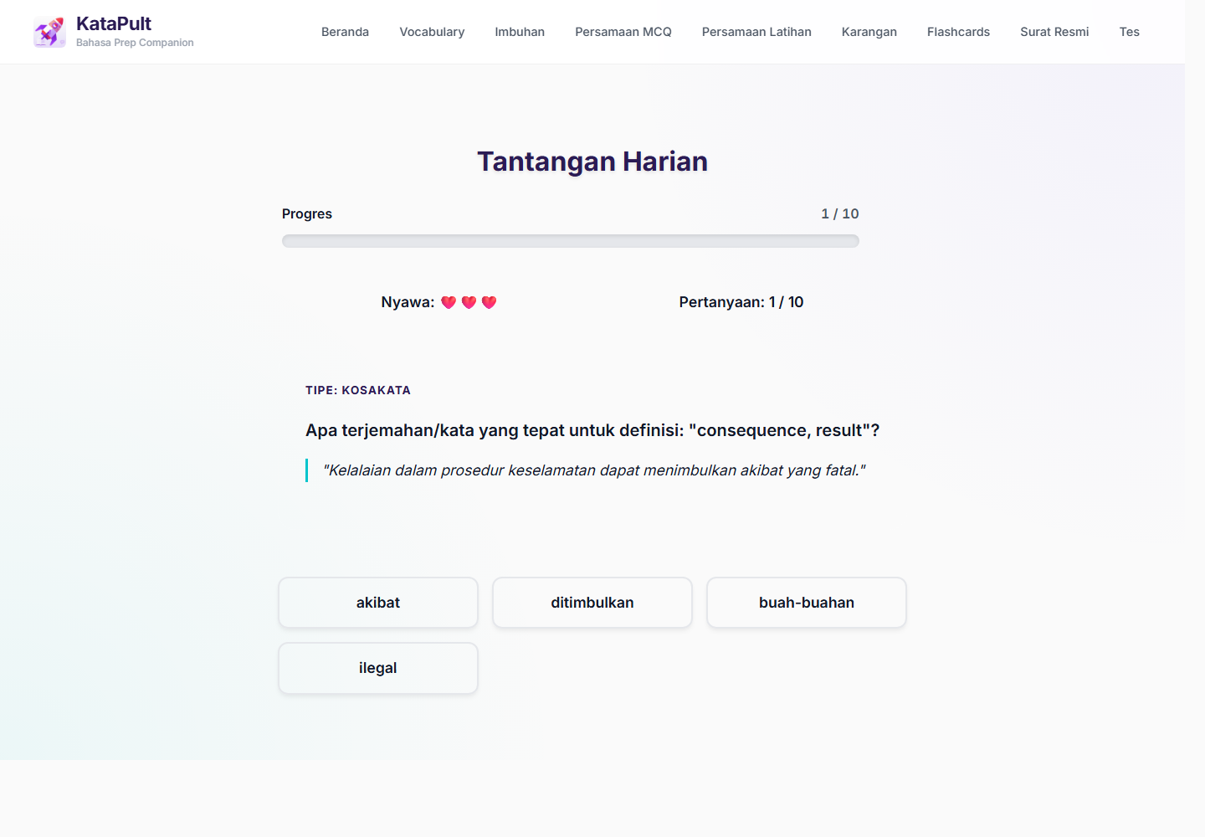
KataPult
Feature 3
07
DAILY PRACTICE AND USAGE
Keep sessions small. Make
behaviour visible.
Daily challenge draws from the 1,554-item pool; tracking records what users actually visit and practise.
10
1,554*
5-10
daily questions
daily pool
minutes
Small enough for a quick session
Vocabulary + imbuhan + persamaan
Designed around pockets of time
What can be observed
Section visits, time spent by section, total session duration, active days and adoption across entities.

Slide 8
KataPult
Demo and Value
08
HOW TO PRESENT IT
Demo the learner flow, then
show the evidence.
A clean 10-minute prep path, followed by the usage signal.
1
Open dashboard
Shows all practice paths in one place.
2
Pick weak area
Jump straight to vocabulary, imbuhan or persamaan.
3
Run custom drill
Turn a weak area into a short test.
40++
4+
Ready
4
Check usage
learners
entities
analytics
Show section and time tracking once enough data accumulates.
Known adoption signal
Cross-team use
Usage evidence as logging matures

