Slide 1
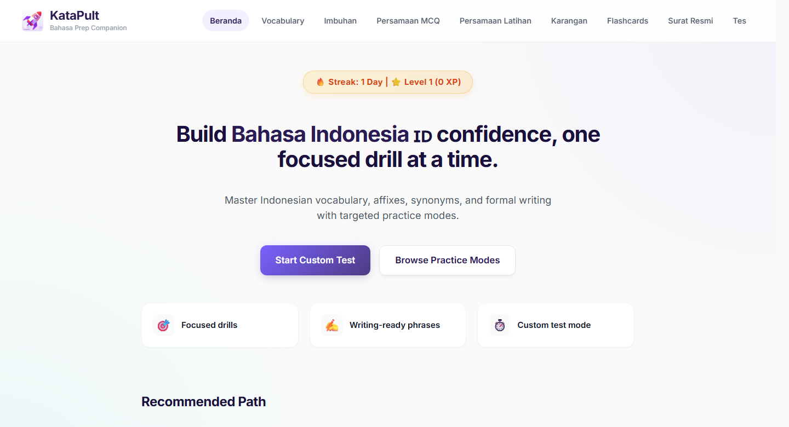
KataPult
Bahasa I2 Prep Companion
01
PRODUCT CASE STUDY
Structured Bahasa I2 practice, not another folder of notes.
KataPult turns collected materials into short, repeatable drills by exam component.
Simple claim
Pick a component. Practise. Review. Continue later.

Slide 2
KataPult
Problem
02
PREPARATION REALITY
The friction was restarting practice consistently.
The content was already there. The missing part was a structured way to turn it into repeatable exam practice.
Notes
What kept breaking
PDFs
No fixed practice path
Screenshots
Learners had to decide where to restart each time.
Links
Weak areas needed drilling
Imbuhan, persamaan and formal writing require retrieval.
Quizlet
Progress was invisible
LLM prompts
There was no consistent log of sections, time or attempts.

Slide 3
KataPult
Solution Model
03
PRODUCT MODEL
A practice layer over scattered materials.
KataPult organises prep by what the learner needs to practise, not by where the source material came from.
Inputs
Modules
Practice
Signals
Notes, PDFs, links, prompts
->
Vocabulary, imbuhan, persamaan, writing
->
Drills, flashcards, custom tests
->
Section visits, time spent, active days

Slide 4
KataPult
Coverage
04
PRACTICE BANK
The pools are separated by purpose.
Component
Scale
Use
Vocabulary
583
Drill / daily
This is the clean way to explain the question-count math without making the total look inflated.
Imbuhan
666
Drill / daily + custom test
Persamaan
305
Drill / daily + custom test
1,554*
971**
3
Karangan
297
Writing phrases
drill / daily pool
custom-test bank
revision surfaces
583 vocabulary + 666 imbuhan + 305 persamaan
666 imbuhan + 305 persamaan
Karangan, surat rasmi and flashcards
Surat rasmi
8 sections
Templates / structure
Flashcards
23 sets
Recall / review
* 583 + 666 + 305 = 1,554. ** 666 + 305 = 971.
Custom tests are smaller because they only use components already structured as question items.

Slide 5
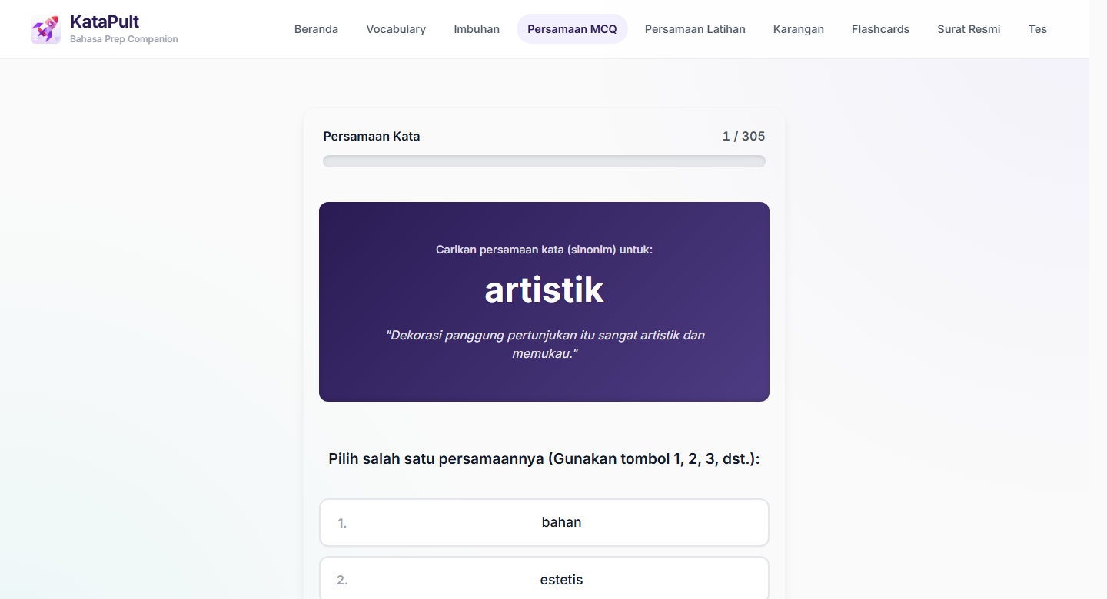
KataPult
Feature 1
05
COMPONENT PRACTICE
Learners can go straight to the weak area.
The home screen is a routing surface: each path maps to a specific Bahasa I2 prep need.
Vocabulary
Meaning and usage
583 items
Imbuhan
Word formation
666 items
Persamaan
Synonym precision
305 items
Karangan
Formal phrases
297 phrases
Surat rasmi
Structure and tone
8 sections
Flashcards
Recall
23 sets

Slide 6
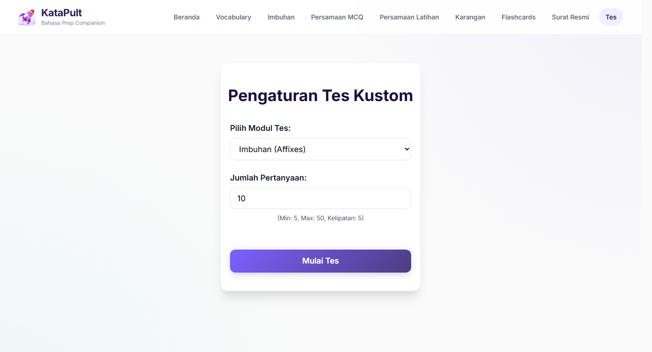
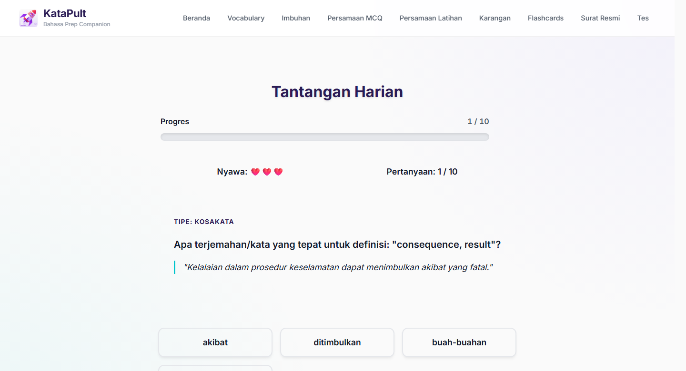
KataPult
Features 2-3
06
FOCUSED DRILLS
Custom tests and daily recall, side by side.
Two practical workflows: targeted weak-area practice and repeatable 5 to 10 minute sessions.
Custom test bank
Daily challenge
971 question items.
10 questions from the 1,554-item pool.
The point is not more content. It is easier repetition of the right practice task.

Slide 7
KataPult
Demo and Measurement
07
DEMO PLAN
A short demo, with measured follow-up.
Keep it practical: one learner, one weak area, one short practice session.
1
Open dashboard
Show modules, streak and recommended path.
2
Pick a weak area
Use imbuhan or persamaan to make the flow concrete.
3
Run a short drill
Use 5 or 10 questions; show feedback.
4
Review flashcards or phrases
Show how revision continues outside test mode.
Check tracking
Use measured evidence carefully
5
For now, keep impact language modest. Report actual usage after a defined tracking window rather than overstating adoption.
Show section visits and time spent once data accumulates.

