Slide 1
CI/CD
Monitoring
CONFIDENTIAL | © 2020 EPAM Systems, Inc.

Slide 2
Overview

Slide 3
General Concept
Lifecycle management
Management System
Object

Slide 4
Service Level
An SLI is a service level indicator—a carefully defined quantitative measure of some aspect of the level of service that is provided: - request latency - system throughput - availability
- etc.
An SLO is a service level objective: a target value or range of values for a service level that is measured by an SLI. A natural structure for SLOs is thus SLI ≤ target, or lower bound ≤ SLI ≤ upper bound.
SLAs are service level agreements: an explicit or implicit contract with your users that includes consequences of meeting (or missing) the SLOs they contain.

Slide 5
Definitions
Monitoring
Collecting, processing, aggregating, and displaying real-time quantitative data about a system, such as query counts and types, error counts and types, processing times, and server lifetimes.
White-box monitoring
Monitoring based on metrics exposed by the internals of the system, including logs, interfaces like the Java Virtual Machine Profiling Interface, or an HTTP handler that emits internal statistics.
Black-box monitoring
Testing externally visible behavior as a user would see it.
Dashboard
An application (usually web-based) that provides a summary view of a service’s core metrics. A dashboard may have filters, selectors, and so on, but is prebuilt to expose the metrics most important to its users. The dashboard might also display team information such as ticket queue length, a list of high-priority bugs, the current on-call engineer for a given area of responsibility, or recent pushes.

Slide 6
Definitions
Alert
A notification intended to be read by a human and that is pushed to a system such as a bug or ticket queue, an email alias, or a pager. Respectively, these alerts are classified as tickets, email alerts, and pages.
Root cause
A defect in a software or human system that, if repaired, instills confidence that this event won’t happen again in the same way. A given incident might have multiple root causes: for example, perhaps it was caused by a combination of insufficient process automation, software that crashed on bogus input, and insufficient testing of the script used to generate the configuration. Each of these factors might stand alone as a root cause, and each should be repaired.
Node and Machine
Used interchangeably to indicate a single instance of a running kernel in either a physical server, virtual machine, or container. There might be multiple services worth monitoring on a single machine. The services may either be:
Related to each other: for example, a caching server and a web server
Unrelated services sharing hardware: for example, a code repository and a master for a configuration system like Puppet or Chef

Slide 7
Why monitor?
Analyzing long-term trends
Comparing over time or experiment groups
Alerting
Building dashboards
Conducting ad hoc retrospective analysis (i.e., debugging)

Slide 8
The Four Golden Signals
Latency
Traffic
Errors
Saturation

Slide 9
Prometheus

Slide 10
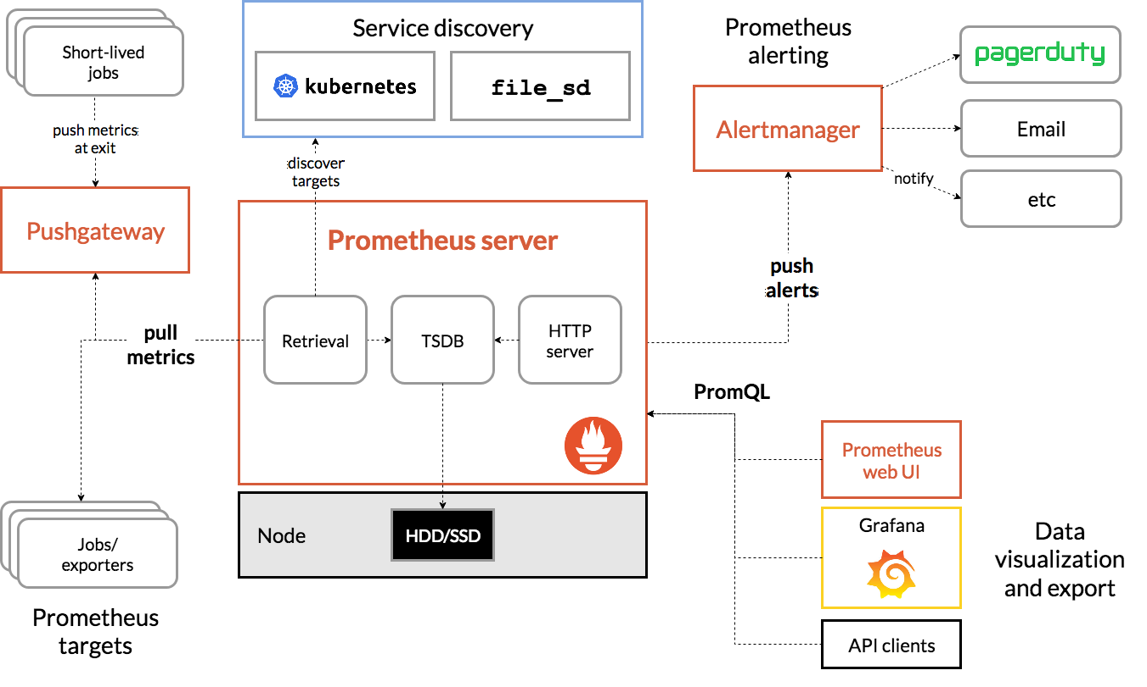
Architecture

Slide 11
Prometheus - Installation

Slide 12
Prometheus - Configuration

Slide 13
Grafana

Slide 14
Grafana
Grafana allows you to query, visualize, alert on and understand your metrics no matter where they are stored. Create, explore, and share dashboards with your team and foster a data driven culture:
Visualize: Fast and flexible client side graphs with a multitude of options. Panel plugins for many different way to visualize metrics and logs.
Dynamic Dashboards: Create dynamic & reusable dashboards with template variables that appear as dropdowns at the top of the dashboard.
Explore Metrics: Explore your data through ad-hoc queries and dynamic drilldown. Split view and compare different time ranges, queries and data sources side by side.
Explore Logs: Experience the magic of switching from metrics to logs with preserved label filters. Quickly search through all your logs or streaming them live.
Alerting: Visually define alert rules for your most important metrics. Grafana will continuously evaluate and send notifications to systems like Slack, PagerDuty, VictorOps, OpsGenie.
Mixed Data Sources: Mix different data sources in the same graph! You can specify a data source on a per-query basis. This works for even custom datasources.

Slide 15
Grafana - Installation

Slide 16
Grafana - Configuration

Slide 17
Thank you

