Slide 1
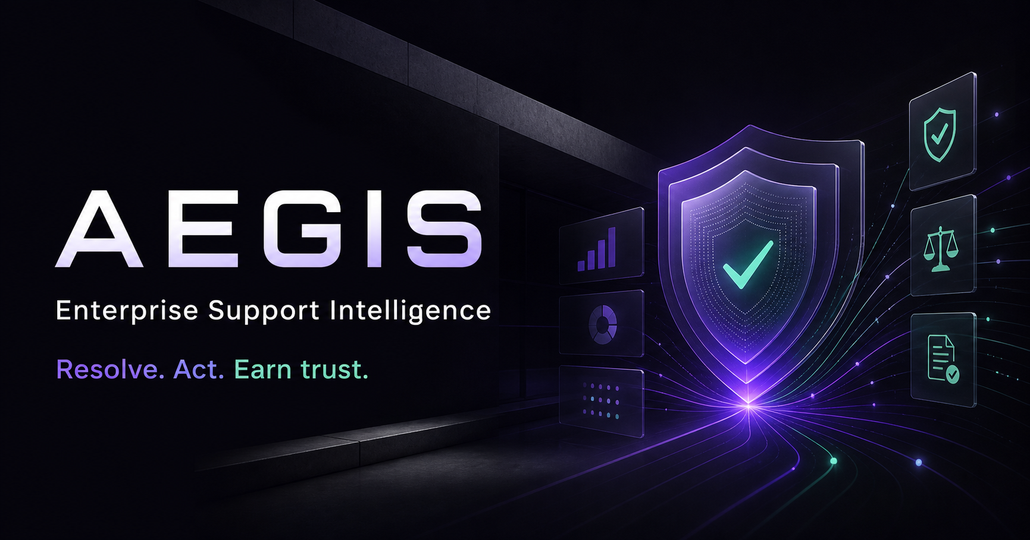
CAPSTONE SELECTION · 2026
Notes:
Open with one sentence: Most AI support projects stop at a chatbot. Aegis proves its evidence, takes approved action, protects enterprise data, and knows when a human must take over.
[Sources]
- OpenAI-generated Aegis social card; project asset public/og.png.

Slide 2
AEGIS · CAPSTONE SELECTION
02
THE PROBLEM
A chatbot is the smallest part of enterprise support.
The real challenge is making answers trustworthy enough to change an outcome.
01
KNOW
Find the current policy across thousands of changing sources.
02
PROVE
Show exactly which evidence supports every customer-facing claim.
03
ACT
Complete a workflow without crossing an authorization boundary.
04
LEARN
Measure failures and turn them into a stronger knowledge system.
Notes:
Frame the problem as an enterprise systems problem, not a chat-interface problem. This establishes why retrieval, authorization, safety and evaluation all belong in the capstone.
[Sources]
- Aegis selection prototype; synthetic product data.

Slide 3
AEGIS · CAPSTONE SELECTION
03
THE PRODUCT THESIS
Aegis closes the resolution loop.
One governed system moves from customer language to evidence, action and continuous improvement.
01
02
03
04
UNDERSTAND
→
PROVE
→
ACT
→
IMPROVE
Classify intent, urgency, language and customer context.
Retrieve, rerank and cite active enterprise evidence.
Use approved tools to resolve the customer’s real problem.
Evaluate outcomes and expose the next knowledge gap.
Not another answer box.
A complete support operating system.
Notes:
Walk left to right. Emphasize that Aegis uses agentic behavior only where it adds value; predictable retrieval remains the default for ordinary support questions.
[Sources]
- Aegis selection prototype; synthetic product data.

Slide 4
AEGIS · CAPSTONE SELECTION
04
THE LIVE PROOF
A wrong answer can become a safety incident.
A swollen battery turns a routine support chat into a safety, policy and authorization test.
1
Identity
PRIYA · NOVA X1
Order and serial verified
“My phone is overheating and the battery is swelling. Order AEG-48291. What should I do?”
2
Eligibility
9 months into a 24-month safety program
3
Evidence
Manual p.12 + warranty §4.2
✓
Resolution
Safety-critical · identity-linked · policy-dependent
Priority replacement, explicit approval
Notes:
Switch to the live product after this slide. Show the conversation, exact citations and answer-intelligence panel. Do not discuss the technology stack yet.
[Sources]
- Aegis selection prototype; synthetic product data.

Slide 5
AEGIS · CAPSTONE SELECTION
05
TRUST ARCHITECTURE
Every answer arrives with an evidence trail.
Confidence is earned through retrieval, reranking, policy checks and citation—not model tone.
97
1
Intent classified
18 ms
PRIMARY EVIDENCE
/100
2
Hybrid retrieval
211 ms
PDF
Nova X1 Safety Manual
Page 12 · 94% match
3
Evidence reranked
48 ms
GROUNDEDNESS
DOC
Global Warranty Policy
All answer claims supported by active enterprise evidence.
Policy guardrails
Section 4.2 · 91% match
4
31 ms
API
Order AEG-48291
Answer + citations
Verified live · 100% match
✓
1.34 s
Notes:
Point to the four distinct trust signals: groundedness score, reasoning trace, exact evidence and latency. Explain that insufficient evidence triggers refusal or escalation.
[Sources]
- Aegis selection prototype; synthetic product data.
- LangChain RAG evaluation concepts: https://docs.langchain.com/langsmith/evaluate-rag-tutorial

Slide 6
AEGIS · CAPSTONE SELECTION
06
CONTROLLED ACTION
Human control stays at the risk boundary.
Aegis can investigate and recommend autonomously; consequential actions still require authority.
1
2
✓
4
AI
AI
HUMAN
SYSTEM
VERIFY
RECOMMEND
APPROVE
EXECUTE
Identity, order and policy
Priority replacement
Explicit confirmation
RMA-2084 + audit trace
When judgment is needed, the agent receives the verified context—not an empty ticket.
Notes:
In the live product, select Approve action, then open Live conversations. Show the AI handoff brief, urgency, sentiment, evidence and recommended next action.
[Sources]
- Aegis selection prototype; synthetic product data.

Slide 7
AEGIS · CAPSTONE SELECTION
07
DEFENSE IN DEPTH
Security acts before the model can fail.
Aegis inspects the request, retrieved content and proposed action at three separate boundaries.
01
INPUT FIREWALL
Block jailbreaks, abuse and PII exposure before orchestration.
02
EVIDENCE GATE
Ignore malicious document instructions and reject unsupported claims.
03
ACTION CONTROL
Enforce roles, limits and approvals before external side effects.
PROMPT INJECTION BLOCKED
Request quarantined · customer data protected · audit trace retained
Notes:
Open Trust & Security. Read only the first fragment of the malicious prompt, then focus on the three outcomes: quarantine, data protection and an inspectable audit trace.
[Sources]
- Aegis selection prototype; synthetic product data.

Slide 8
AEGIS · CAPSTONE SELECTION
08
EVALUATION
Prove superiority with a benchmark—not a claim.
The selection prototype visualizes the exact test discipline the final capstone will implement.
96.8
OVERALL QUALITY
150
curated cases
Illustrative prototype benchmark. Final capstone results will be generated from a reviewed evaluation dataset.
Notes:
Be transparent: these are illustrative selection-prototype values. The capstone contribution is the reproducible evaluation pipeline and measured comparison across standard, multilingual, conflicting, unanswerable and adversarial cases.
[Sources]
- Aegis selection prototype benchmark visualization; synthetic values, not production results.
- LangChain RAG evaluation concepts: https://docs.langchain.com/langsmith/evaluate-rag-tutorial

Slide 9
AEGIS · CAPSTONE SELECTION
09
EXECUTION
Four weeks turns this build into a complete capstone.
The product story is proven; the next milestone is replacing every simulation with measured, deployable intelligence.
WEEK 1
WEEK 2
WEEK 3
WEEK 4
FOUNDATION
INTELLIGENCE
CONTROL
PROOF
FastAPI · identity · document ingestion · baseline RAG
Hybrid retrieval · reranking · citations · multilingual
Agent tools · approvals · security · human handoff
150-case benchmark · load tests · deployment · final demo
Selection-ready tonight.
Production-evaluated in four weeks.
Notes:
Commit to the four-week execution plan. Clarify that tonight’s deliverable is the selection-ready product experience, demo narrative and architecture foundation—not a claim of overnight production readiness.
[Sources]
- Aegis selection prototype; synthetic product data.

Slide 10
AEGIS
We are ready to show,
not just promise.
RESOLVE.
ACT.
Give us the project. We will build the evidence-grounded, action-capable support system—and measure whether it deserves your trust.
EARN
TRUST.
AEGIS · 2026
LIVE PRODUCT DEMO
Notes:
End by requesting the project directly, then move into the live demo. Do not end on a thank-you slide. The product itself is the final evidence.
[Sources]
- Aegis selection prototype; synthetic product data.

