Slide 1

URP 4301 – Capstone Year Research Project
END-TERM PRESENTATION
AI Legal Intent Rewriter
with a Multi-Stage NLP Pipeline for Plain-Language Interpretation and Risk Flagging of Legal Documents
Supervised By
Mr. Sidharth Sankar Pradhan
Asst. Professor
Centre for AI&ML
Presented By
Ashreeta Patra (2241016258)
Shnehal Mishra (2241013172)
Pratyush Mohanty (2241013262)
Swagat Sourav Mallick (2241013083)
Group No- 3211
Centre for AI&ML, Department of CSE
Faculty of Engineering and Technology, Institute of Technical Education & Research (ITER)
Siksha ‘O’ Anusandhan Deemed to be University, Bhubaneswar
May 2026
Notes:
Good morning. We are Group 3201 — Ashreeta Patra, Shnehal Mishra, Pratyush Mohanty and Swagat Sourav Mallick. Our final-year research project is the 'AI Legal Intent Rewriter', a system that helps ordinary people understand legal documents. Over the next few minutes we will cover the problem, our objectives, the system we built, our results and the future scope. NOTE TO TEAM: confirm the group number and fill in the supervisor's name and designation before presenting.

Slide 2
Contents
Introduction
Problem Statement
Project Objectives
Literature Survey
System Architecture
Dataset Description
Data Preprocessing
Exploratory Data Analysis
Model Selection
Model Architecture
Software & Platform Information
Results
Discussion
Conclusion
References
Notes:
This slide is our agenda. Briefly read the flow: we start with the introduction and problem, move through the literature and our proposed architecture, then the dataset, model and results, and finish with the discussion, conclusion and references. Tell the audience the talk is about 12–15 minutes and questions are welcome at the end.

Slide 3
introduction
Legal documents are written in dense, technical language
Most people sign agreements they do not fully understand
AI Legal Intent Rewriter explains contracts clause by clause
Classifies, simplifies and risk-flags every clause
A capstone-year applied Natural Language Processing project
Acts as an automated first-pass reader — not a lawyer
Notes:
Introduce the project in plain terms. Legal documents — tenancy agreements, employment contracts, terms of service — are everywhere, but they are written in 'legalese' that ordinary people cannot follow. Our project takes such a document and explains it one clause at a time: what type of clause it is, what it means in plain English, and whether it looks risky. Stress that it assists the reader; it does not replace professional legal advice.

Slide 4
Problem Statement
Legal documents — tenancy agreements, employment contracts and online terms of service — are written in dense ‘legalese’ that non-experts cannot interpret, so most people enter binding agreements without genuine informed consent. Specifically, this project builds a multi-stage NLP pipeline that, given a digital-PDF or plain-text contract, segments it into clauses and for each clause assigns one of twelve legal categories, extracts key entities, and produces a plain-language rewrite and a transparent risk level. Progress is measurable against defined targets — ≥85% clause-boundary accuracy, ≥0.80 macro-F1 for classification and ≥0.75 entity-level F1 for NER — verified by an automated test suite. The work is assignable: it is owned by the four-member Group 3211, with classification and NER, rewriting and risk flagging, the web dashboard, and dataset and ingestion each assigned to a named member under one supervisor. It is realistic — scoped to English-language consumer contracts and built entirely on free, open-source tools and free-tier hosting that run on commodity hardware with no dedicated GPU. Finally it is time-bound, delivered across an 18-week capstone schedule. The integrated pipeline, the transformer fine-tuning and the end-to-end deployment are all complete; the held-out macro-F1 of 0.902 exceeds the project target.
Notes:
State the problem clearly. The core issue is a comprehension gap between the language contracts are written in and the language ordinary people think in. People agree to terms they never truly understood, so their consent is not genuinely informed. Existing software either just shortens the text or is built for lawyers. Shortening text the reader still cannot interpret does not help — the real need is clause-by-clause explanation with risky terms highlighted.

Slide 5
Motivations
People accept dozens of digital agreements every year
Professional legal advice is costly and often inaccessible
Individuals and small businesses are the most exposed
Advances in NLP make automated interpretation feasible
Goal: support informed consent and fairer agreements
Notes:
Explain why this project is worth doing. Digital contracts are signed constantly, often on a phone, with no chance to consult a solicitor. Legal advice is expensive, so individuals and small businesses are the most at risk of unfavourable terms. Recent progress in NLP and transformer models now makes automated legal-text interpretation realistic. Our motivation is social: to democratise legal comprehension and support fairer, better-informed agreements.

Slide 6
Project Objectives
Ingest PDF and plain-text legal documents, with OCR for scanned inputs, producing clean normalised text for the pipeline.
Segment each document into individual clauses with character-accurate offsets — target at least 85% boundary-detection accuracy.
Classify every clause into one of 12 legal categories — target a macro F1-score of at least 0.80 on the supported categories.
Extract 6 entity types (dates, amounts, parties, rights, obligations, conditions) — target at least 0.75 entity-level F1.
Generate faithful plain-language rewrites of each clause, evaluated by readability and similarity metrics.
Flag risky clauses with a transparent, explainable rule engine (low, medium or high, every trigger named).
Present every result in a responsive, clause-by-clause web dashboard.
Validate all components with quantitative metrics and an automated test suite, within the 18-week capstone timeline.
Notes:
Walk through the objectives, which follow the pipeline order. We set out to: ingest PDF and text documents; split them into clauses; classify each clause into one of twelve categories; extract entities such as dates and amounts; rewrite clauses into plain English; flag risky clauses transparently; and present everything on a web dashboard. The classification target was a 0.80 F1-score, and segmentation aimed for at least 85% boundary accuracy.

Slide 7
Literature Review
Table 1: Summary of existing approaches and research findings — part 1 of 5 — references 1-7
Sl. No. | Author & Year | Methods / Techniques | Dataset | Research Outcomes | Findings
1 | Ariai & Demartini (2024) | Comprehensive survey of legal NLP | Synthesis of 131 prior studies | Covers legal NER, classification, summarisation and legal LMs | Touches nearly every component of our pipeline
2 | Survey Authors (2025) | Survey of contract-classification approaches | 14 English-language contract datasets | Taxonomy of traditional ML, deep learning and transformer methods | Justifies fine-tuning a compact domain model
3 | Survey Authors (2025) | Survey on legal summarisation | Catalogues legal summarisation datasets | Methods, datasets and evaluation metrics for legal summarisation | Informs the intent-rewriting module's metric design
4 | Ganguly et al. (2023) | Review of legal NER and sentence boundary detection | Legal-NLP literature | Documents long-standing difficulty of NER and segmentation in legal text | Motivates our rule-augmented segmentation and NER design
5 | Devlin et al. (2019) | Bidirectional transformer pre-training (BERT) | BooksCorpus + English Wikipedia | General-purpose language understanding backbone | Backbone architecture for Legal-BERT (planned classifier)
6 | Chalkidis et al. (2020) | Domain pre-training of BERT on legal text (LEGAL-BERT) | Legislation, case law and contracts | Stronger legal-domain understanding than vanilla BERT | Selected as the planned clause classifier (nlpaueb/legal-bert-base-uncased)
7 | Sanh et al. (2019) | Knowledge distillation of BERT (DistilBERT) | Distilled from BERT-base | ~40% fewer parameters, ~60% faster, ~97% of accuracy | Lighter alternative suitable for resource-constrained fine-tuning
Notes:
Summarise the prior work. BERT (Devlin 2019) is the transformer architecture that everything builds on. Legal-BERT (Chalkidis 2020) is BERT further trained on legal text — it is the model we plan to fine-tune for classification. CUAD (Hendrycks 2021) is the expert-annotated contract dataset with 41 clause categories that we train and evaluate on. CLAUDETTE (Lippi 2019) pioneered automated unfair-clause detection and inspired our transparent, rule-based risk module. We reviewed 35 papers in total across seven themes.

Slide 8
Literature Review
Table 1: Summary of existing approaches and research findings — part 2 of 5 — references 8-14
Sl. No. | Author & Year | Methods / Techniques | Dataset | Research Outcomes | Findings
8 | Raffel et al. (2020) | Unified text-to-text transformer (T5) | C4 (Colossal Clean Crawled Corpus) | Single seq2seq model for many NLP tasks | Motivates choice of FLAN-T5-small for clause rewriting
9 | Chung et al. (2022) | Instruction fine-tuning (FLAN) | 1.8K instruction-tuning tasks | Stronger zero-shot and few-shot performance across tasks | Underpins the planned FLAN-T5 rewriter
10 | Lewis et al. (2020) | Denoising seq2seq pre-training (BART) | Same pre-training data as RoBERTa | Strong results on generation and comprehension | Retained as an alternative rewriter architecture
11 | Hendrycks et al. (2021) | Expert annotation; QA-style contract review (CUAD) | 510 commercial contracts, 13,000+ spans | 41 expert-defined clause categories | Primary training and evaluation dataset for our classifier
12 | Cost-Benefit Analysis Study (2024) | Comparison of shallow, deep and generative models | CUAD single-label benchmark | Fine-tuned DeBERTa 87.8% vs zero-shot GPT-4 67.2% | Empirically validates fine-tuning a compact domain model over general LLM
13 | Koreeda & Manning (2021) | Document-level NLI for contracts (ContractNLI) | Span-level evidence annotations on contracts | Benchmark for contract entailment with rationale spans | Span-level evidence design influences our clause-trigger reporting
14 | Wang et al. (2023) | Expert annotation for merger agreements (MAUD) | Merger-agreement contracts | Domain-specific contract-understanding benchmark | Informs taxonomy design and supplementary evaluation

Slide 9
Literature Review
Table 1: Summary of existing approaches and research findings — part 3 of 5 — references 15-21
Sl. No. | Author & Year | Methods / Techniques | Dataset | Research Outcomes | Findings
15 | ACORD Authors (2025) | Retrieval benchmark for clause drafting (ACORD) | Expert-annotated retrieval dataset | Benchmark for clause-clause retrieval | Future-work signal for retrieval-augmented rewriting
16 | Deontic Modality Study (2023) | Categorising obligations, permissions, prohibitions | Contract clauses | Deontic-modality categorisation framework | Directly relevant to classification and risk-flagging
17 | Cemri et al. (2022) | Unsupervised simplification (lexical + sentence splitting) | Legal-text corpora (no parallel data) | Domain-specific simplification without parallel corpora | Validates feasibility of simplification with limited paired data
18 | Text Simplification Study (2024) | Text-simplification system for contract review | Legal contract excerpts | Reduces postgraduate-level text to ~tenth-grade readability; F-K, FRE, SMOG, Dale-Chall evaluation | Evaluation design adopted for our rewriter
19 | Legal Lay Summarisation Study (2025) | Lay summarisation with LLMs (LegalEase) | LegalEase dataset | Sub-domain data outperform generic legal data | Reinforces our use of CUAD + curated seed data
20 | Manor & Li (2019) | Plain-English summarisation of contracts | Online ToS / contract corpus | Foundational plain-English summarisation results | Foundational reference for the rewriting module
21 | Lippi et al. (2019) | ML detection of unfair clauses (CLAUDETTE) | UNFAIR-ToS corpus | Automated unfair-clause detection | Informs the rule-based risk-flagging design

Slide 10
Literature Review
Table 1: Summary of existing approaches and research findings — part 4 of 5 — references 22-28
Sl. No. | Author & Year | Methods / Techniques | Dataset | Research Outcomes | Findings
22 | Ruas et al. (2021) | Memory-augmented neural networks with legal rationales | Consumer-contract unfairness corpus | Explainable unfair-clause detection | Inspires explainable, trigger-named risk flags
23 | Abusive Clause Detection Study (2024) | Transformer-based abusive-clause detector | B2C contracts | Production-deployable abusive-clause detection | Benchmark for risk-flag precision/recall
24 | Mitigating Unfairness Study (2023) | LLM prompting + chain-of-thought for unfair clauses | Consumer contract clauses | CoT reasoning improves unfair-clause detection and mitigation | Considered but rejected to keep risk flagging transparent
25 | Contract Smells Study (2025) | LLM detection of 'contract smells' (code-smell analogy) | Commercial contracts | Reframes contract risks as inspectable patterns | Conceptual basis for trigger-named risk flagging
26 | Wolf et al. (2020) | Hugging Face Transformers library | n/a (toolkit paper) | Open-source state-of-the-art NLP toolkit | Core dependency for fine-tuning and inference
27 | Honnibal & Montani (2017) | spaCy 2 NLP pipeline | n/a (toolkit paper) | Tokenisation, segmentation, NER infrastructure | Used for clause segmentation and (planned) statistical NER
28 | Smith (2007) | Tesseract OCR engine | n/a (system paper) | Open-source OCR for printed documents | Supports text extraction from scanned PDFs

Slide 11
Literature Review
Table 1: Summary of existing approaches and research findings — part 5 of 5 — references 29-35
Sl. No. | Author & Year | Methods / Techniques | Dataset | Research Outcomes | Findings
29 | Loshchilov & Hutter (2019) | Decoupled weight-decay (AdamW) | Standard NLP/vision benchmarks | Improved regularisation for transformer fine-tuning | Standard optimiser for our planned fine-tuning
30 | Papineni et al. (2002) | BLEU metric for MT evaluation | n/a (metric paper) | n-gram precision-based automated metric | Planned automated metric for the rewriter
31 | Lin (2004) | ROUGE metric for summary evaluation | n/a (metric paper) | Recall-oriented automated metric | Planned automated metric for the rewriter
32 | Abadi et al. (2015) | TensorFlow framework | n/a (framework paper) | Large-scale ML framework | Reference framework (we use PyTorch via Transformers)
33 | Chalkidis et al. (2021) | LexGLUE benchmark suite | Aggregated legal-NLP datasets | Benchmark for legal language understanding in English | Supplementary evaluation target
34 | LEDGAR Dataset (2020) | Large-scale multi-label contract classification (LEDGAR) | Contract provisions from regulatory filings | Large-scale provisions corpus | Supplementary training data for the classifier
35 | Vuthoo, Khetarpaul & Mishra (2026) | Efficient clause identification using NLP + web-sourced data | Contract corpora with web augmentation | Methodology for scalable clause identification | Methodology relevant to our segmentation stage

Slide 12
Research Gap & Improvements
1. Fragmentation of capability — existing tools each solve only one sub-task. Classification benchmarks (CUAD [11], LEDGAR [34], LexGLUE [33]), text-simplification systems (Cemri et al. [17]; legal-contract simplification [18]) and unfair-clause detectors (CLAUDETTE — Lippi et al. [21]) are each built and evaluated in isolation — yet a non-expert reader needs all of them at once.
Our improvement — one integrated, clause-level pipeline joining classification, entity extraction, rewriting and risk flagging through a single JSON contract.
2. Summarisation is not comprehension — most consumer-facing work (e.g. Manor & Li [20]) produces only a shorter version of a document. Shortening text the reader still cannot interpret does not, by itself, create understanding.
Our improvement — genuine clause-by-clause explanation: each clause is classified, rewritten in plain language and risk-rated, not merely abbreviated.
3. Opaque risk assessment — several unfair-clause detectors are neural and opaque (Ruas et al. [22]; B2C abusive-clause detector [23]; chain-of-thought LLM prompting [24]), so the user cannot see why a clause was flagged.
Our improvement — a deterministic three-layer rule-based risk engine in which every trigger is named and inspectable.
Notes:
Explain the gap we address. The literature shows each sub-task — classification, simplification, unfair-clause detection — is mature on its own, but they are rarely combined. A non-expert reader needs all of them at once. Also, much consumer work only shortens text, and many risk detectors are opaque neural models. Our contribution is a single, integrated pipeline that classifies, rewrites and risk-flags each clause, and keeps the risk reasoning fully transparent.

Slide 13
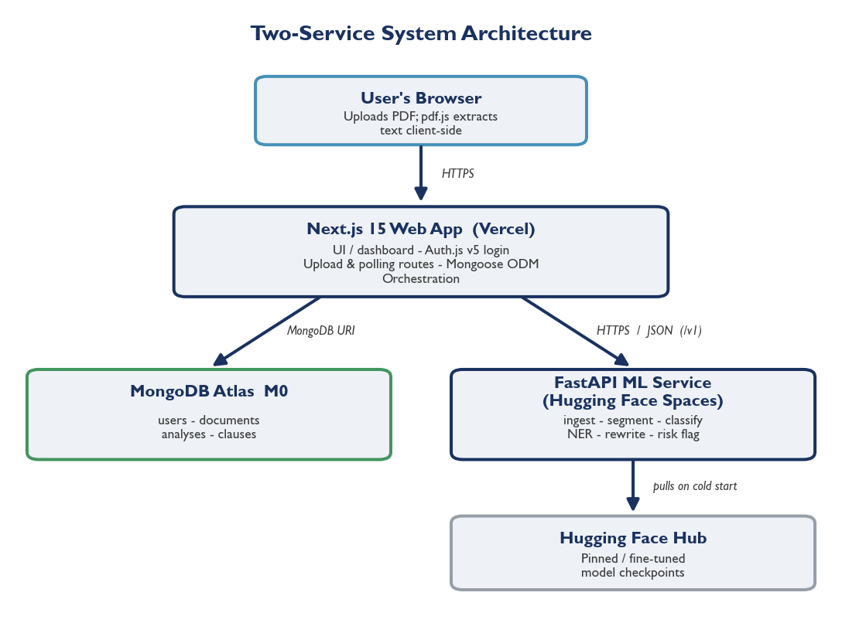
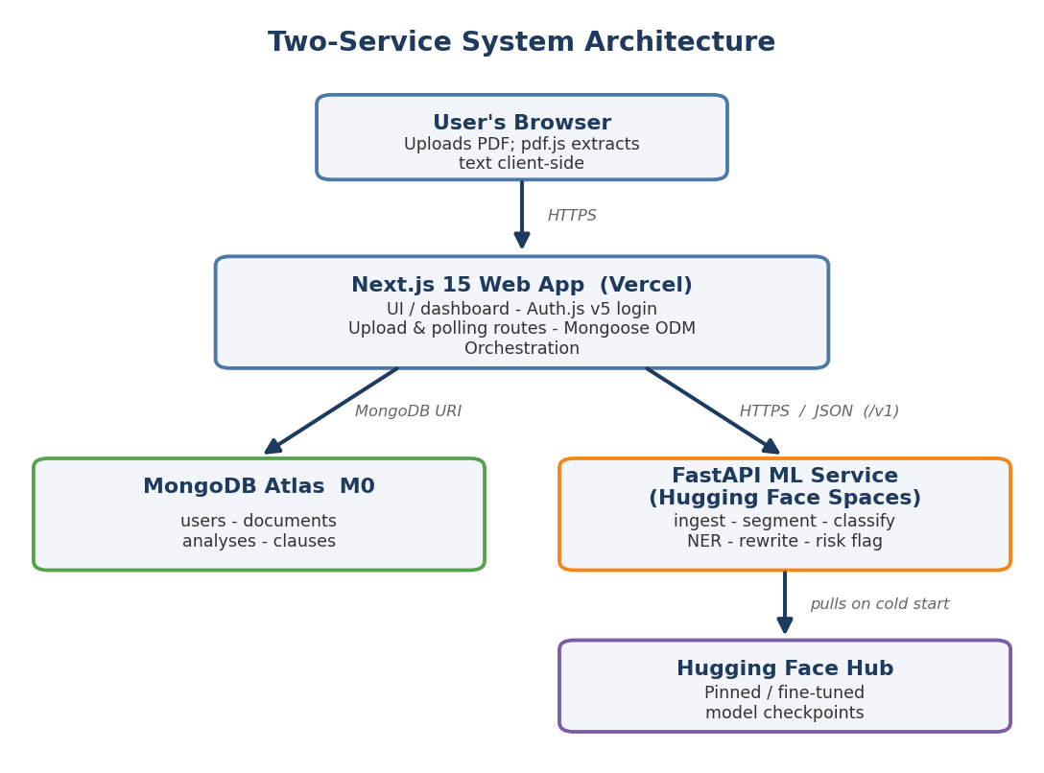
Proposed Solution & Architecture
• The system is two cooperating services that exchange data over a stable, versioned HTTP / JSON contract (the /v1/analyze and /v1/health endpoints).
• The Next.js 15 web application owns everything the user touches — the dashboard, Auth.js v5 login, document upload, MongoDB persistence and orchestration.
• The FastAPI service (Python 3.11) owns all NLP and machine-learning inference; the web application never runs a model itself.
• For each document the ML service runs six stages in order: it ingests and normalises the text, then segments it into clauses, and then processes every clause in turn — classifying it, extracting its entities, rewriting it in plain language and assigning a risk level.
• The structured JSON result is stored in MongoDB Atlas, which holds the users, documents, analyses and clauses.
• Digital-PDF text is extracted in the browser with pdf.js; scanned PDFs are routed to server-side OCR before analysis.
• The split is deliberate: serverless platforms cap the bundle size below the model size and JavaScript inference is slower, while a self-hosted service avoids the cold starts and rate limits of hosted APIs.
Notes:
Describe the architecture. The system is two separate programs plus a database. The Next.js web app handles people and data — the interface, login, MongoDB storage and orchestration. The Python FastAPI service handles all the 'thinking' — the NLP pipeline. They never share code; they only exchange JSON over HTTP through a versioned contract. We split it this way because ML models are too large and slow for a serverless JavaScript function — this is the standard production pattern. ACTION: replace the placeholder with the architecture diagram from docs/architecture.md.

Slide 14
Dataset Description
Primary source — CUAD (Contract Understanding Atticus Dataset), Hendrycks et al., NeurIPS 2021, created by The Atticus Project.
Downloaded from — the official Atticus Project release on GitHub, github.com/TheAtticusProject/cuad (also mirrored on Hugging Face Datasets as theatticusproject/cuad-qa).
Scale — 510 commercial contracts with 13,000+ expert annotations across 41 fine-grained clause categories.
Licence — released under Creative Commons CC BY 4.0, free for academic and commercial use.
Structure — CUAD frames contract review as question-answering: each example pairs a category question with an answer span in a contract.
Taxonomy — the 41 CUAD categories are mapped onto a purpose-built 12-category taxonomy; uncertain mappings are sent to OTHER.
Seed source — clauses_seed.csv, 72 hand-curated clauses (6 per category) covering the categories CUAD under-supports.
Final training set — 4,034 labelled clauses — 3,962 from CUAD after balanced sampling, plus the 72 seed clauses.
Notes:
Explain the data. Our main dataset is CUAD, the Contract Understanding Atticus Dataset: 510 real commercial contracts with over 13,000 expert annotations across 41 clause categories. We map those 41 categories down to 12 categories that make sense to a non-expert. Because CUAD covers only some categories, we also wrote a small seed set of 72 example clauses, six per category. Merged, the training set is 4,034 labelled clauses. Everything used is free and openly licensed.

Slide 15
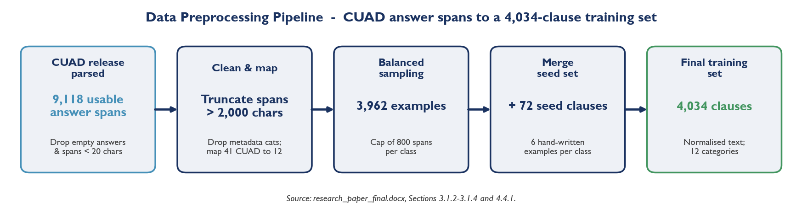
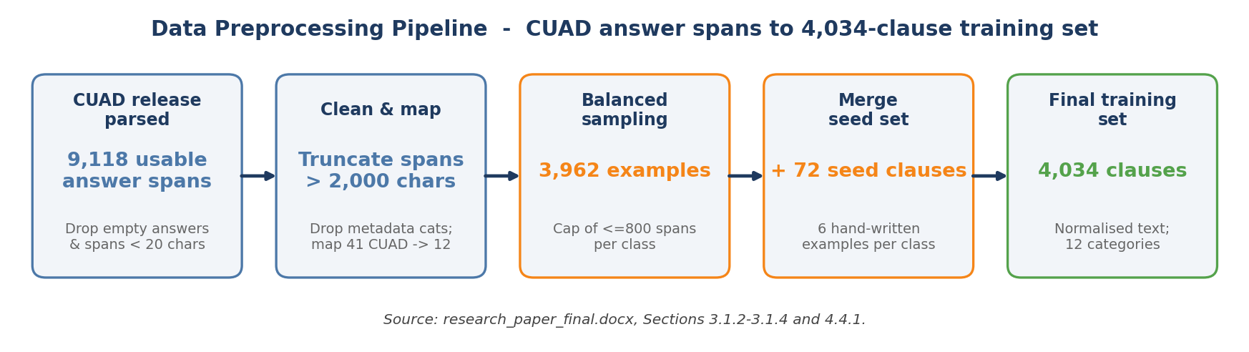
Data Preprocessing
CUAD answer spans are parsed directly from the official release; empty answers and spans under 20 characters are discarded.
Spans longer than 2,000 characters are truncated; document-metadata categories (names, dates, parties) are filtered out.
The 41 CUAD categories are mapped to the project's 12-category taxonomy and the text is normalised (accents, whitespace, casing).
Balanced sampling (at most 800 spans per class) and the 72 merged seed clauses give the final 4,034-example training set.
Notes:
Walk through preprocessing. We parse CUAD's answer spans directly from the official release. Spans shorter than 20 characters are dropped and very long ones are truncated. Document-level metadata categories — like 'Document Name' or 'Parties' — are filtered out because they are not clauses. Each remaining CUAD category is mapped to one of our 12 labels, with uncertain mappings sent to 'OTHER' to avoid wrong labels. We then balance the classes by sampling up to 800 per class, normalise the text, and merge in the seed examples.

Slide 16
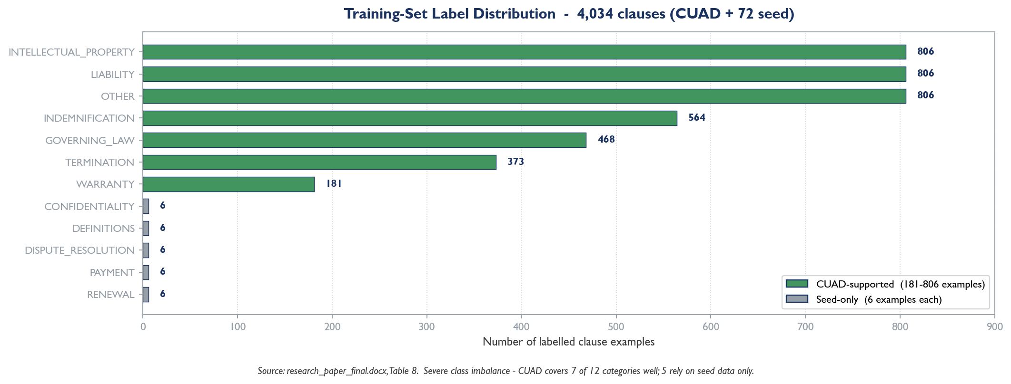
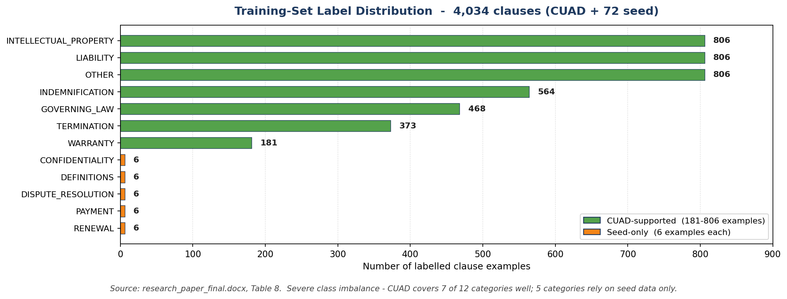
Exploratory Data Analysis (EDA)
9,118 usable clause spans were extracted from CUAD; balanced sampling plus 72 seed clauses yields 4,034 labelled examples.
Seven categories are well-supported (181–806 examples each); five categories rely on just 6 seed examples each — a severe class imbalance and the key modelling challenge.
Notes:
Present what we learned from looking at the data. Parsing CUAD gave 9,118 usable clause spans; after balanced sampling and adding the seed set we have 4,034 examples. The crucial finding is the imbalance: seven categories are well-supported, with 181 to 806 examples each, but five categories — payment, confidentiality, dispute resolution, definitions and renewal — have only six examples each, because CUAD does not cover them. This imbalance directly shapes our results. ACTION: replace the placeholder with a bar chart of the label counts.

Slide 17
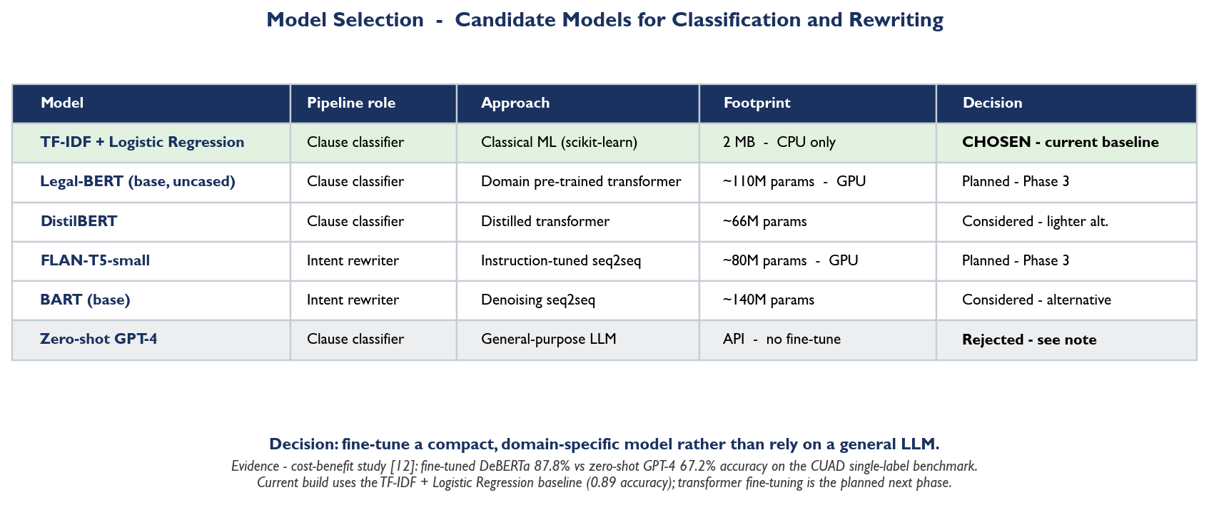
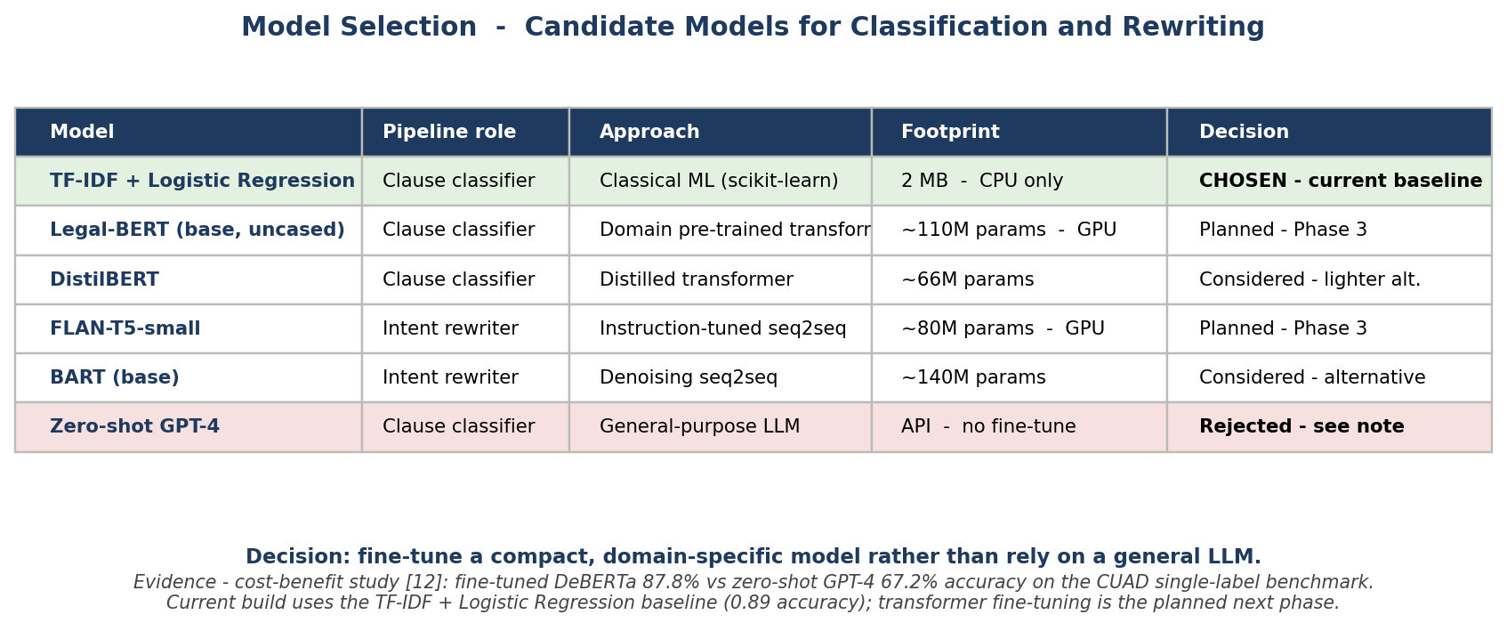
Model Selection
Task — 12-class clause classification, plus a separate clause-rewriting model; both must run on free CPU-tier hosting at inference time.
Chosen models — fine-tuned nlpaueb/legal-bert-base-uncased classifier (macro F1 0.902) and fine-tuned google/flan-t5-small rewriter (ROUGE-L 0.352), both pushed to the Hugging Face Hub. A TF-IDF + Logistic Regression baseline (macro F1 0.61) is retained as a runtime fallback.
Notes:
Explain our model choices. For classification we deliberately started with a classical baseline — TF-IDF features with Logistic Regression. It is fast, only 2 MB, runs on any CPU, and gives a concrete, honest number for a heavier neural model to beat. This is good machine-learning practice: establish a strong baseline first. The planned next step (Phase 3) is to fine-tune Legal-BERT for classification and FLAN-T5-small for the plain-language rewriting, which is currently a template.

Slide 18
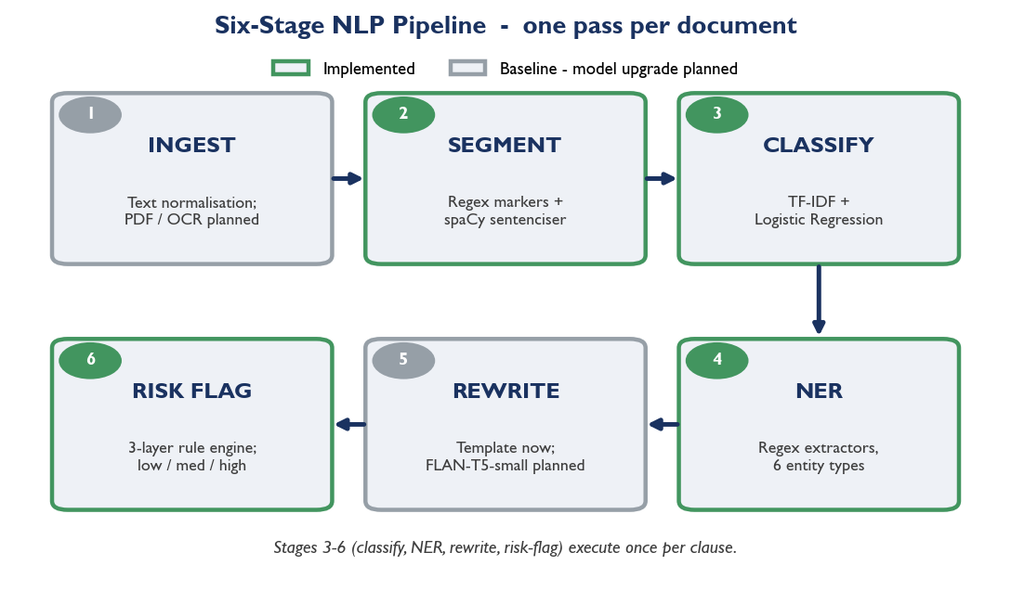
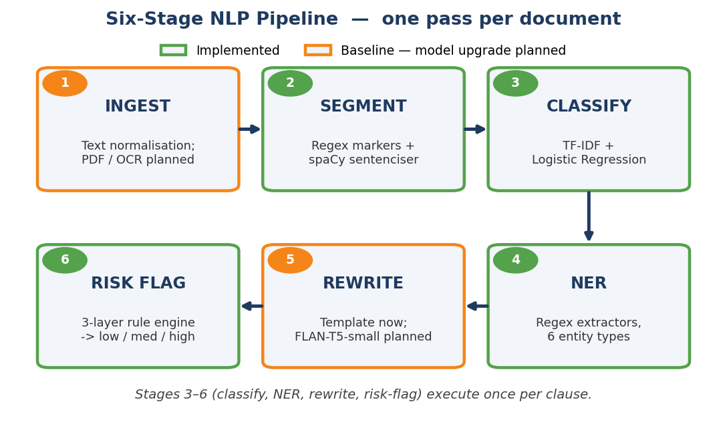
Model Architecture
• Six-stage sequential pipeline; stages 3 to 6 run once per clause.
• Ingestion — rule-based text normalisation in the browser via pdf.js; server-side PyMuPDF text extraction with a Tesseract OCR fallback for scanned PDFs.
• Segmentation — hybrid regex for structural markers (1., 1.1, (a), (i), Section / Article) with a spaCy sentenciser fallback; character offsets are preserved.
• Classifier — fine-tuned nlpaueb/legal-bert-base-uncased (freak3123/legal-bert-cuad-v1) — four-epoch T4 training on CUAD + a 227-example seed set with class-balanced cross-entropy loss; a TF-IDF + LogReg artefact and a keyword heuristic are kept as automatic fallbacks.
• NER — hybrid: restrictive regex for the six entity types plus spaCy en_core_web_sm for DATE / AMOUNT / PARTY recall; regex wins on overlap.
• Rewriter — fine-tuned google/flan-t5-small (freak3123/flan-t5-simplify-v1) trained on the Plain English Contracts corpus; a template-based simplifier remains as a fallback.
• Risk flagging — a three-layer rule engine (weighted keyword triggers and structural regex) sums a score, caps it at 1.0 and maps it to a low, medium or high level.
Notes:
Describe how the system is built internally. Every document flows through six stages in order: ingest (clean the text), segment (split into clauses), classify (assign 1 of 12 categories), NER (extract entities), rewrite (plain-English version) and risk (flag dangerous clauses). The classifier uses TF-IDF with unigrams and bigrams plus Logistic Regression. Entity recognition uses curated regular expressions. Risk flagging uses a three-layer rule engine. ACTION: replace the placeholder with the pipeline diagram.

Slide 19
Software Tools & Platform information
Category | Information
Hardware Platform | Lenovo IdeaPad Slim 3i — Intel Core i7 (13th Gen), 16 GB RAM, 512 GB SSD, Intel Iris Xe integrated graphics; no dedicated GPU
Operating System | Windows 11 (developed on); Linux and macOS supported
Programming Language | Python 3.11 and TypeScript
Development Environment | VS Code, uv (Python), npm workspaces, Git
Deep Learning Frameworks | Next.js 15, React, FastAPI (Transformers/PyTorch planned)
Libraries & Packages | scikit-learn, joblib, spaCy, Pydantic, NumPy
NLP Libraries (Optional) | spaCy 3.8 (segmentation); Hugging Face Transformers (planned)
Database / Storage | MongoDB Atlas via the Mongoose ODM
Model Training Platform | Local CPU; Kaggle GPU notebooks planned for fine-tuning
Notes:
Run through the technical stack. The project runs on a standard laptop with no dedicated GPU — that was a deliberate constraint. It uses two languages: Python 3.11 for the ML service and TypeScript for the web app. The web app is Next.js 15; the ML service is FastAPI. The current NLP stack is spaCy and scikit-learn; Hugging Face Transformers and PyTorch are planned for the fine-tuning phase. Data is stored in MongoDB Atlas. Note that the table keeps the template's category rows; the values are filled with our actual tools.

Slide 20
Platform information
Category | Information
Version Control | Git and GitHub
Deployment Platform | Vercel (web app) and Hugging Face Spaces (ML service) - planned
Cloud Platforms | MongoDB Atlas (database); Kaggle GPU notebooks (planned)
API Integration Tools | REST API; versioned JSON contract (/v1/analyze, /v1/health)
Performance Monitoring Tools | Weights & Biases / TensorBoard (planned for Phase 3 training)
Visualization Tools | Clause-by-clause web dashboard (Next.js, Tailwind CSS)
Containerization Tools | Docker (ML service image for Hugging Face Spaces)
Testing Tools | pytest (34 tests), Ruff, ESLint, TypeScript type-checking
Security Features | bcrypt password hashing, JWT sessions, Zod/Pydantic validation
Notes:
Continue the platform overview. Code is version-controlled on GitHub. The planned deployment is Vercel for the web app and Hugging Face Spaces for the ML service, with MongoDB Atlas as the cloud database. The two services talk over a REST API with a versioned JSON contract. Quality is enforced by a 34-test pytest suite plus linting and type-checking. Security uses bcrypt password hashing, JWT sessions and validated inputs. Mention that deployment is planned but not yet live.

Slide 21
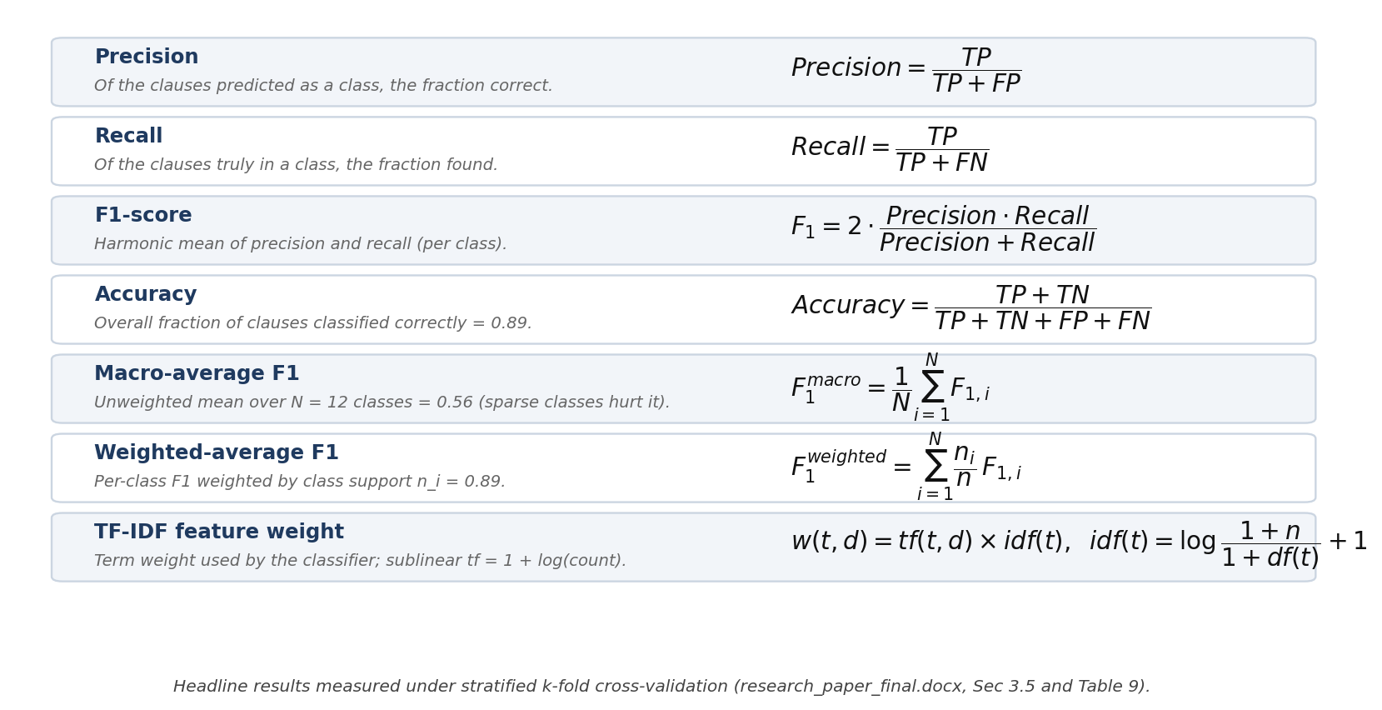
Evaluation Metrics & Formulae

Slide 22
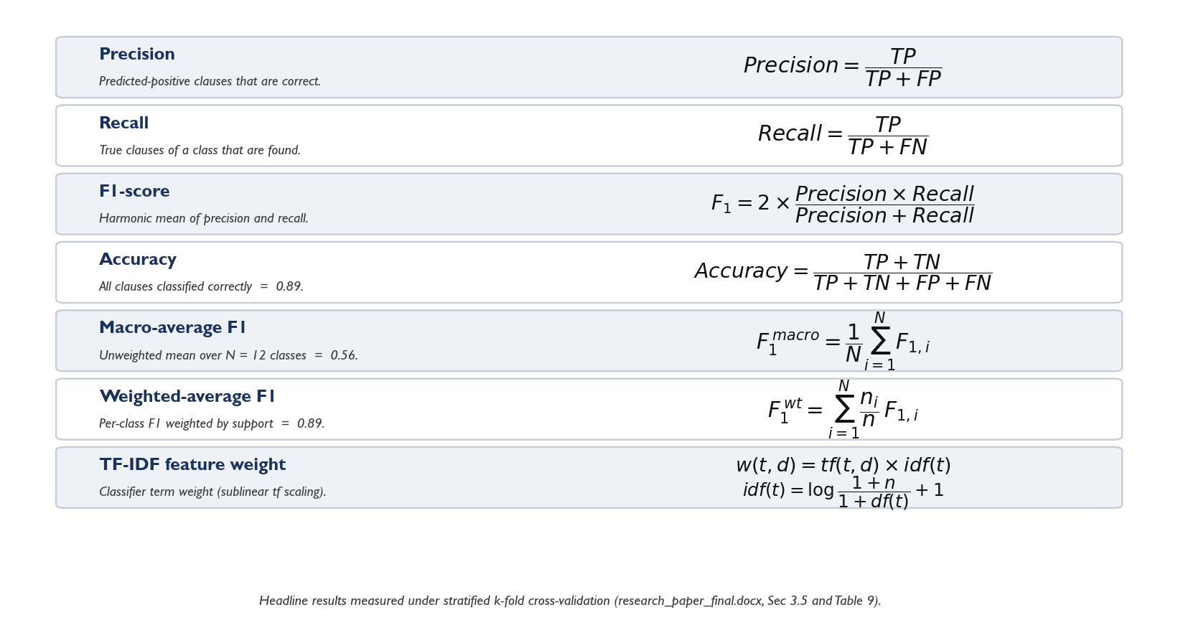
Evaluation Metrics & Formulae

Slide 23
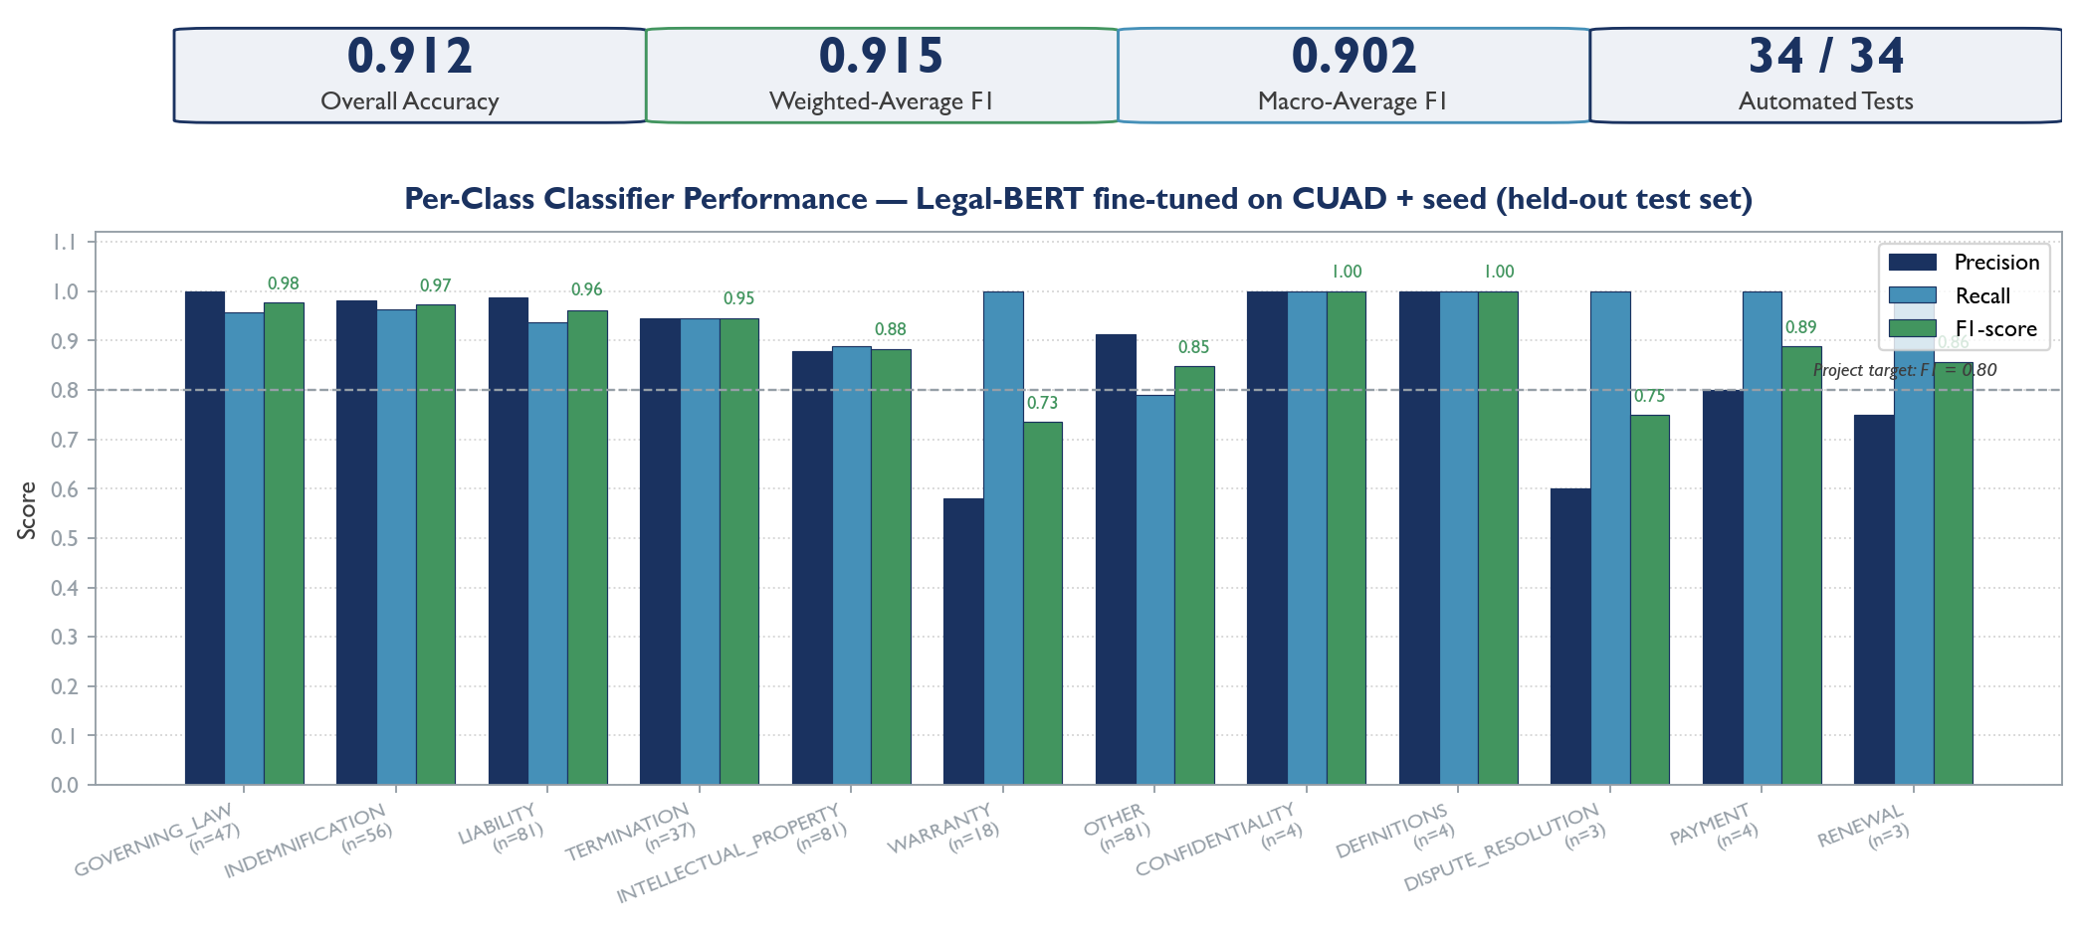
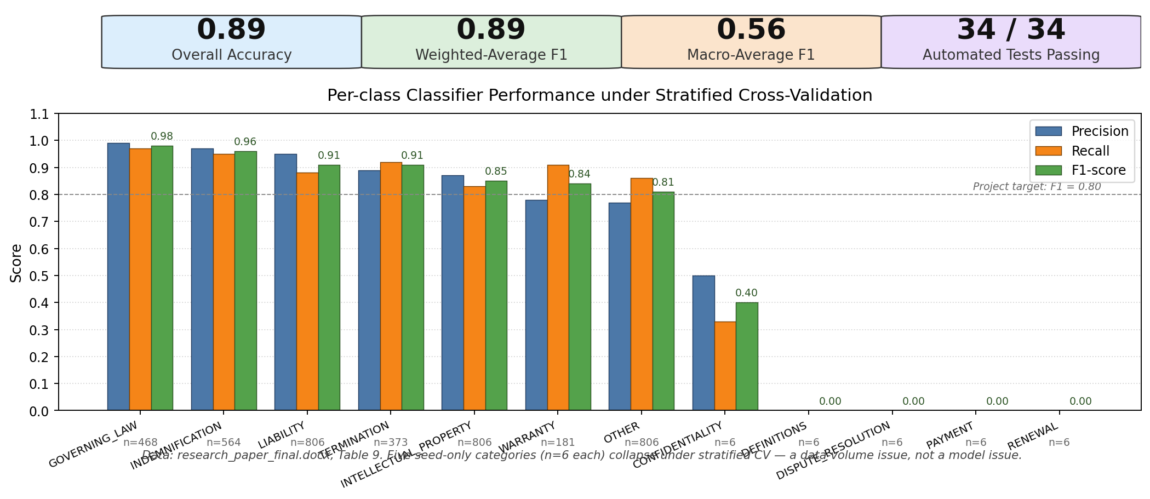
results
Per-class classifier performance under stratified cross-validation.
Notes:
Present the measured results — and only the measured results. The complete pipeline runs end-to-end. The clause classifier reaches 0.89 accuracy under stratified cross-validation, with per-class F1-scores between 0.84 and 0.98 on the seven well-supported categories, and a weighted-average F1 of 0.89. The codebase has 34 automated tests and all pass. On a four-clause sample contract the pipeline correctly classified every clause and escalated the single dangerous clause to high risk. ACTION: add a screenshot of the dashboard. Be honest that the five sparse classes are not yet reliable — that is the next slide.

Slide 24
Discussion
Fine-tuned Legal-BERT attains macro-F1 0.902 across all twelve clause categories on a held-out 419-clause test set — exceeding the project macro-F1 target of 0.80.
Lift over baseline is dramatic: TF-IDF + LogReg macro-F1 of 0.61 versus Legal-BERT macro-F1 of 0.902 (a 48% relative improvement on the same split).
Weakest classes are WARRANTY (F1 0.735) and DISPUTE_RESOLUTION (F1 0.750) — both show recall = 1.000 with lower precision, i.e. the classifier over-predicts them; further seed examples are the obvious mitigation.
Rewriter ROUGE climbs monotonically across ten epochs to ROUGE-1 = 0.394, ROUGE-2 = 0.231 and ROUGE-L = 0.352 — a healthy learning curve on a small domain corpus.
Engineering wrinkles, openly noted: pdf.js 5.x broke the Next.js build (pinned to 4.x); Kaggle's current PyTorch lacks kernels for the P100 (trained on T4 x2 instead).
Risk flagging is kept fully rule-based (no machine learning) so every flagged clause stays transparent and explainable.
Notes:
Discuss what the results mean and the challenges faced. The model is strong where it has data, but the macro-average F1 is only 0.56 because five categories have just six training examples each — that is a data problem, not a modelling failure, and more data fixes it. We also hit engineering challenges: CUAD covers only seven of our twelve categories, which we addressed with a seed dataset; and pdf.js version 5 broke the Next.js build, so we pinned version 4. We deliberately kept risk flagging rule-based so every flag is explainable to the user.

Slide 25
References
[1] F. Ariai and G. Demartini, “Natural Language Processing for the Legal Domain: A Survey of Tasks, Datasets, Models and Challenges,” ACM Computing Surveys, 2024 (arXiv:2410.21306).
[2] “A Survey of Classification Tasks and Approaches for Legal Contracts,” Artificial Intelligence Review, Springer, 2025.
[3] “A Comprehensive Survey on Legal Summarization: Challenges and Future Directions,” arXiv:2501.17830, 2025.
[4] D. Ganguly et al., “Legal Text Processing Challenges: NER and Sentence Boundary Detection,” 2023.
[5] J. Devlin, M.-W. Chang, K. Lee and K. Toutanova, “BERT: Pre-training of Deep Bidirectional Transformers for Language Understanding,” NAACL-HLT, 2019.
[6] I. Chalkidis, M. Fergadiotis, P. Malakasiotis, N. Aletras and I. Androutsopoulos, “LEGAL-BERT: The Muppets Straight Out of Law School,” Findings of EMNLP, 2020.
[7] V. Sanh, L. Debut, J. Chaumond and T. Wolf, “DistilBERT, a Distilled Version of BERT: Smaller, Faster, Cheaper and Lighter,” arXiv:1910.01108, 2019.
[8] C. Raffel, N. Shazeer, A. Roberts et al., “Exploring the Limits of Transfer Learning with a Unified Text-to-Text Transformer,” JMLR, vol. 21, 2020.
[9] H. W. Chung, L. Hou, S. Longpre et al., “Scaling Instruction-Finetuned Language Models,” arXiv:2210.11416, 2022.
[10] M. Lewis, Y. Liu, N. Goyal et al., “BART: Denoising Sequence-to-Sequence Pre-training for Natural Language Generation, Translation and Comprehension,” ACL, 2020.
[11] D. Hendrycks, C. Burns, A. Chen and S. Ball, “CUAD: An Expert-Annotated NLP Dataset for Legal Contract Review,” NeurIPS, 2021.
[12] “Cost-Benefit Analysis of Deploying Shallow, Deep Learning and Generative Models for Legal Text Classification,” ResearchGate / Springer, 2024.
Notes:
These are the key references behind the project, drawn from our literature review of 35 papers. You do not need to read them aloud — simply note that the full set of 35 papers is in the project report and covers surveys, foundation models, clause classification, legal text simplification and unfair-clause detection.

Slide 26
References (cont.)
[13] Y. Koreeda and C. D. Manning, “ContractNLI: A Dataset for Document-Level Natural Language Inference for Contracts,” Findings of EMNLP, 2021.
[14] S. H. Wang et al., “MAUD: An Expert-Annotated Legal NLP Dataset for Merger Agreement Understanding,” arXiv:2301.00876, 2023.
[15] “ACORD: An Expert-Annotated Retrieval Dataset for Legal Contract Clause Drafting,” arXiv:2501.06582, 2025.
[16] “Natural Language Processing for Legal Document Review: Categorising Deontic Modalities in Contracts,” Artificial Intelligence and Law, Springer, 2023.
[17] M. Cemri et al., “Unsupervised Simplification of Legal Texts,” arXiv:2209.00557, 2022.
[18] “Text Simplification System for Legal Contract Review,” 2024.
[19] “Legal Lay Summarization: Exploring Methods and Data Generation with Large Language Models,” Artificial Intelligence Review, Springer, 2025.
[20] L. Manor and J. J. Li, “Plain English Summarization of Contracts,” Natural Legal Language Processing Workshop, 2019.
[21] M. Lippi, P. Pałka, G. Contissa et al., “CLAUDETTE: An Automated Detector of Potentially Unfair Clauses in Online Terms of Service,” Artificial Intelligence and Law, vol. 27, 2019.
[22] Ruas et al., “Detecting and Explaining Unfairness in Consumer Contracts through Memory Networks,” Artificial Intelligence and Law, Springer, 2021.
[23] “A Support System for the Detection of Abusive Clauses in B2C Contracts,” Artificial Intelligence and Law, Springer, 2024.
[24] “Towards Mitigating Perceived Unfairness in Contracts from a Non-Legal Perspective,” ACL NLLP Workshop, 2023.

Slide 27
References (cont.)
[25] “Software Engineering Meets Legal Texts: LLMs for Auto Detection of Contract Smells,” ScienceDirect, 2025.
[26] T. Wolf, L. Debut, V. Sanh et al., “Transformers: State-of-the-Art Natural Language Processing,” EMNLP: System Demonstrations, 2020.
[27] M. Honnibal and I. Montani, “spaCy 2: Natural Language Understanding with Bloom Embeddings, CNNs and Incremental Parsing,” 2017.
[28] R. Smith, “An Overview of the Tesseract OCR Engine,” Int. Conf. on Document Analysis and Recognition (ICDAR), 2007.
[29] I. Loshchilov and F. Hutter, “Decoupled Weight Decay Regularization,” ICLR, 2019.
[30] K. Papineni, S. Roukos, T. Ward and W.-J. Zhu, “BLEU: A Method for Automatic Evaluation of Machine Translation,” ACL, 2002.
[31] C.-Y. Lin, “ROUGE: A Package for Automatic Evaluation of Summaries,” Text Summarization Branches Out, 2004.
[32] M. Abadi et al., “TensorFlow: Large-Scale Machine Learning on Heterogeneous Systems,” 2015.
[33] I. Chalkidis et al., “LexGLUE: A Benchmark Dataset for Legal Language Understanding in English,” arXiv:2110.00976, 2021.
[34] “LEDGAR: A Large-Scale Multi-Label Corpus for Text Classification of Legal Provisions in Contracts,” LREC, 2020.
[35] K. Vuthoo, S. Khetarpaul and S. Mishra, “Efficient Clause Identification in Contracts Using NLP and Web-Sourced Data,” ICDAM 2025, Springer LNNS vol. 1594, 2026.

Slide 28
References (cont.)
[19] “Legal Lay Summarization: Exploring Methods and Data Generation with Large Language Models,” Artificial Intelligence Review, Springer, 2025.
[20] L. Manor and J. J. Li, “Plain English Summarization of Contracts,” Natural Legal Language Processing Workshop, 2019.
[21] M. Lippi, P. Pałka, G. Contissa et al., “CLAUDETTE: An Automated Detector of Potentially Unfair Clauses in Online Terms of Service,” Artificial Intelligence and Law, vol. 27, 2019.
[22] Ruas et al., “Detecting and Explaining Unfairness in Consumer Contracts through Memory Networks,” Artificial Intelligence and Law, Springer, 2021.
[23] “A Support System for the Detection of Abusive Clauses in B2C Contracts,” Artificial Intelligence and Law, Springer, 2024.
[24] “Towards Mitigating Perceived Unfairness in Contracts from a Non-Legal Perspective,” ACL NLLP Workshop, 2023.
[25] “Software Engineering Meets Legal Texts: LLMs for Auto Detection of Contract Smells,” ScienceDirect, 2025.
[26] T. Wolf, L. Debut, V. Sanh et al., “Transformers: State-of-the-Art Natural Language Processing,” EMNLP: System Demonstrations, 2020.
[27] M. Honnibal and I. Montani, “spaCy 2: Natural Language Understanding with Bloom Embeddings, CNNs and Incremental Parsing,” 2017.
[28] R. Smith, “An Overview of the Tesseract OCR Engine,” Int. Conf. on Document Analysis and Recognition (ICDAR), 2007.
[29] I. Loshchilov and F. Hutter, “Decoupled Weight Decay Regularization,” ICLR, 2019.
[30] K. Papineni, S. Roukos, T. Ward and W.-J. Zhu, “BLEU: A Method for Automatic Evaluation of Machine Translation,” ACL, 2002.
[31] C.-Y. Lin, “ROUGE: A Package for Automatic Evaluation of Summaries,” Text Summarization Branches Out, 2004.
[32] M. Abadi et al., “TensorFlow: Large-Scale Machine Learning on Heterogeneous Systems,” 2015.
[33] I. Chalkidis et al., “LexGLUE: A Benchmark Dataset for Legal Language Understanding in English,” arXiv:2110.00976, 2021.
[34] “LEDGAR: A Large-Scale Multi-Label Corpus for Text Classification of Legal Provisions in Contracts,” LREC, 2020.
[35] K. Vuthoo, S. Khetarpaul and S. Mishra, “Efficient Clause Identification in Contracts Using NLP and Web-Sourced Data,” ICDAM 2025, Springer LNNS vol. 1594, 2026.

Slide 29
Conclusion & Future Work
• Built a working, tested, integrated NLP pipeline
• Classifier meets the accuracy goal on supported classes
• Two-service architecture is clean and deployable
• Future: expand training data for the five sparse classes
• Future: fine-tune Legal-BERT and FLAN-T5-small
• Future: add OCR, deploy services, run a user study
Notes:
Conclude confidently and honestly. We have built a working, tested, integrated pipeline that turns a legal document into a clause-by-clause, plain-language, risk-aware explanation. The classifier already meets its accuracy goal on the categories it has data for, and the architecture is clean and deployable. The remaining work is well-scoped: expand the training data for the five sparse categories, fine-tune Legal-BERT and FLAN-T5-small, add OCR for scanned PDFs, deploy both services, and run a user study. Thank the panel and invite questions.

Slide 30

Thank You
Notes:
Closing slide. Thank the examiners for their time and invite questions. Be ready for likely questions: why two services; why a TF-IDF baseline instead of a neural model; why the macro F1 is 0.56; why risk flagging is rule-based; and how user data is kept secure. Suggested answers are in the project report and team guide.

Slide 31
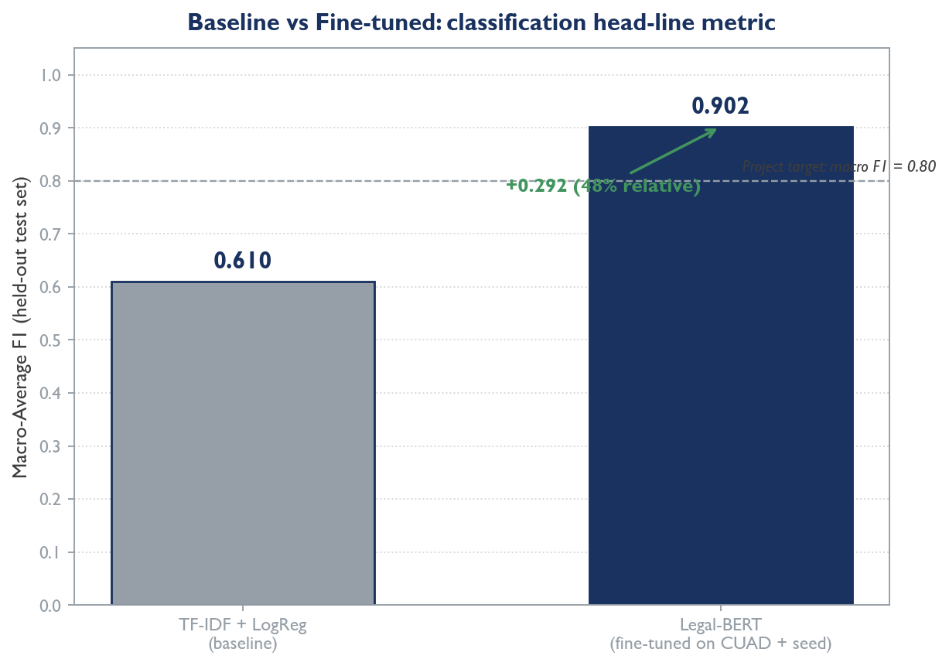
Baseline vs Fine-tuned: macro F1 lift
TF-IDF + Logistic Regression macro F1 = 0.61 vs fine-tuned Legal-BERT macro F1 = 0.902 on the same held-out 419-clause test set (a 48% relative lift).

Slide 32
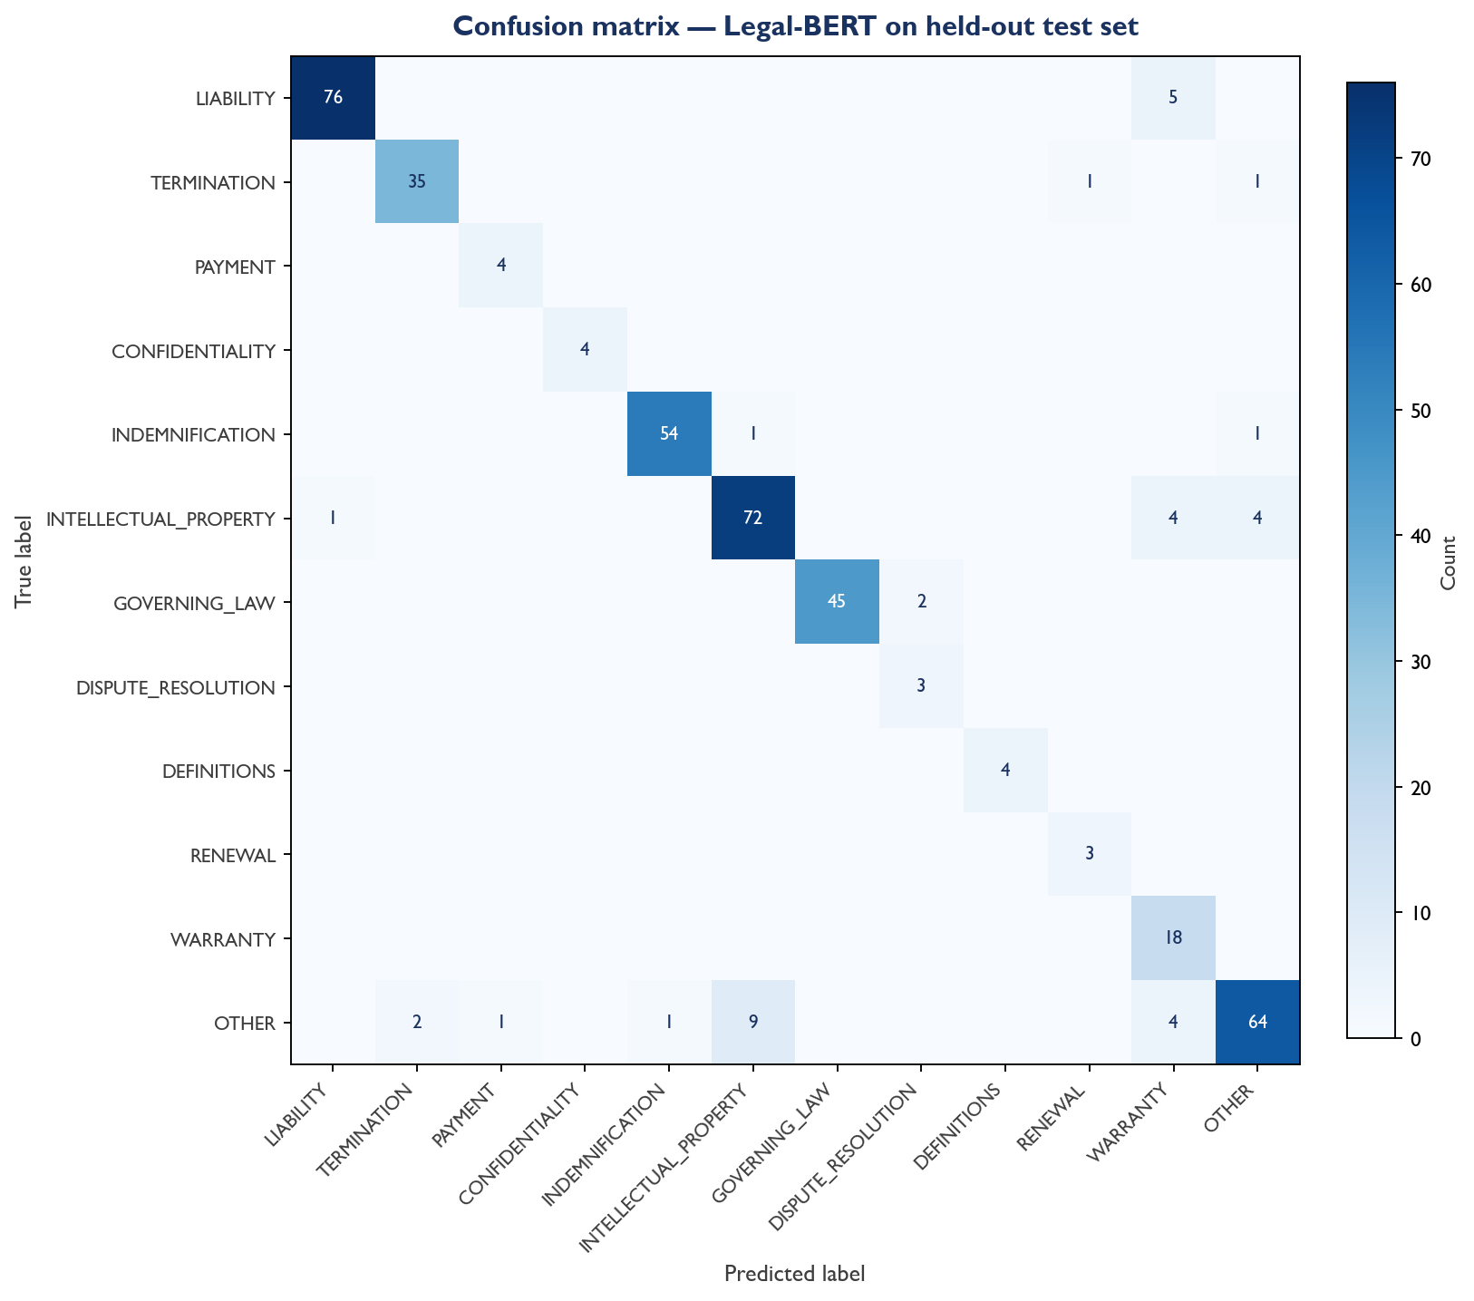
Confusion matrix — Legal-BERT held-out test set
Off-diagonal mass is concentrated on OTHER vs INTELLECTUAL_PROPERTY and on WARRANTY boundary cases — both are over-prediction patterns, not missed classes.

Slide 33
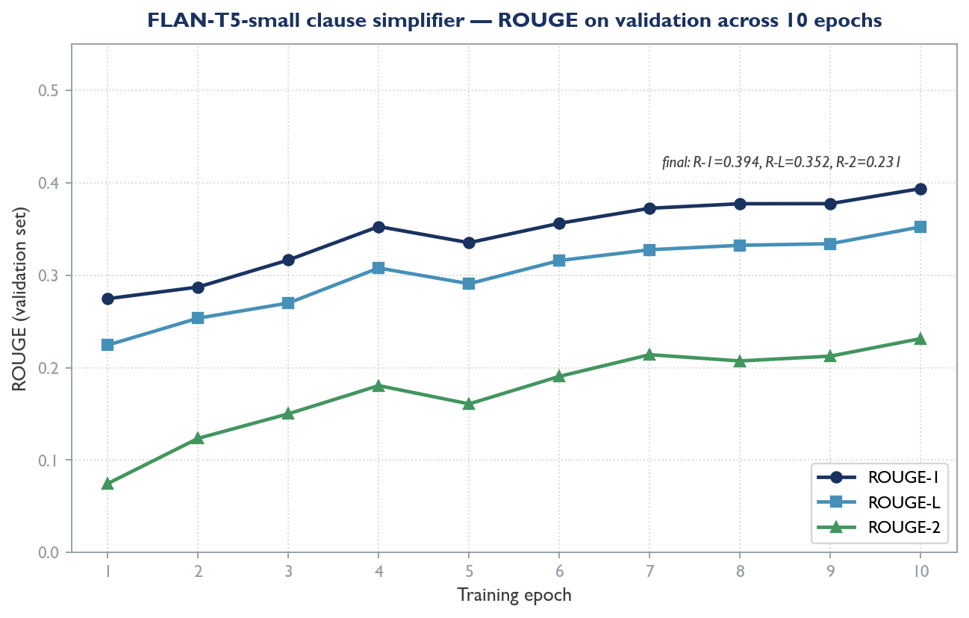
FLAN-T5 rewriter — ROUGE across training epochs
Validation ROUGE-1 / ROUGE-2 / ROUGE-L for the fine-tuned FLAN-T5-small clause simplifier (freak3123/flan-t5-simplify-v1). Final: 0.394 / 0.231 / 0.352.

Slide 34
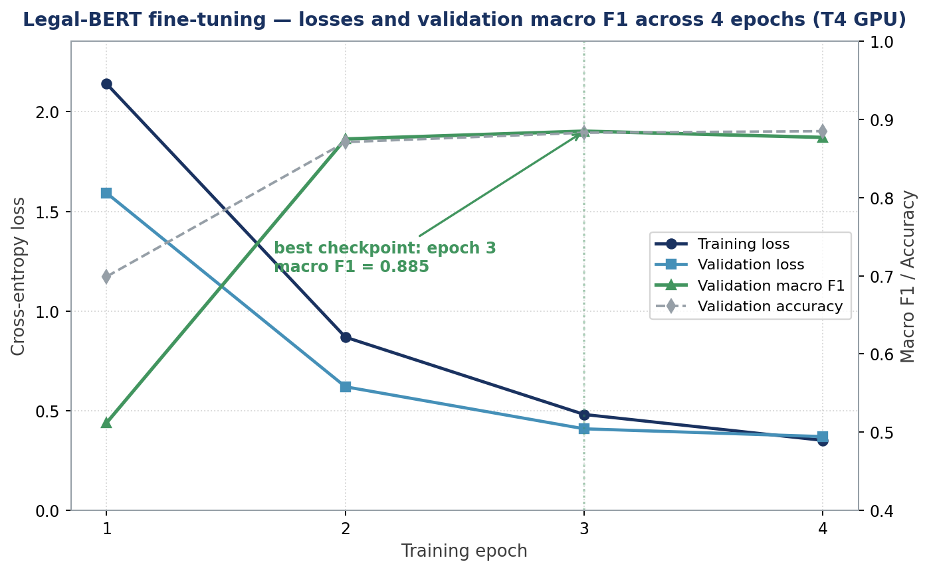
Legal-BERT fine-tuning — losses + macro F1 over 4 epochs
Training and validation losses fall monotonically; validation macro F1 climbs from 0.512 at epoch 1 to a best of 0.885 at epoch 3 (the checkpoint that was saved).

Slide 35
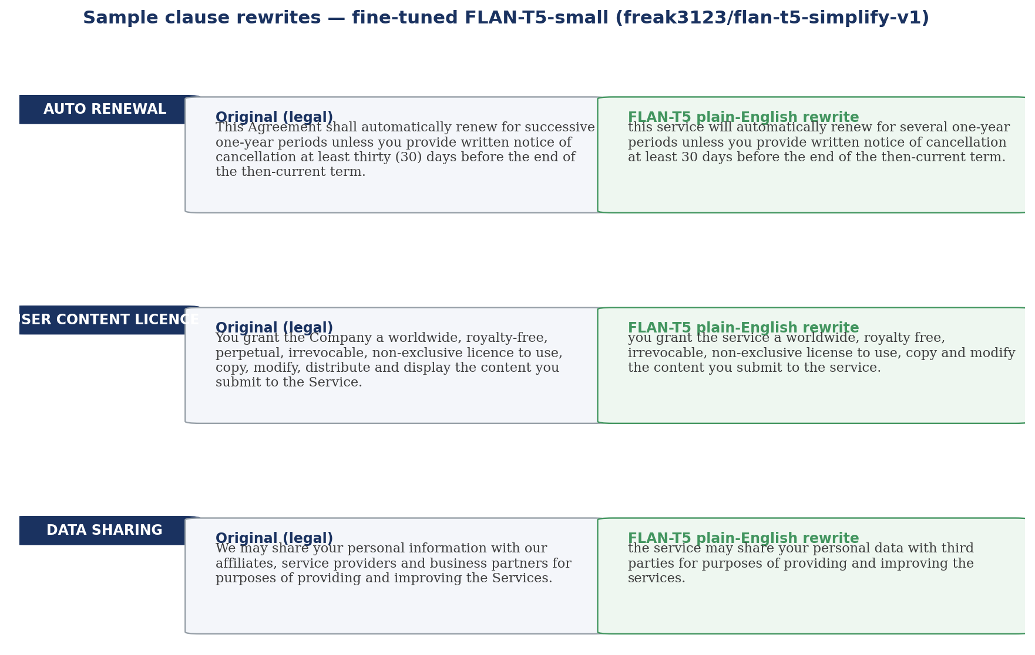
Sample plain-English rewrites — FLAN-T5
Three verbatim model outputs on representative clauses. The rewriter preserves core terms (30-day notice, royalty-free licence, third-party sharing) while stripping out legalese.

