Slide 1
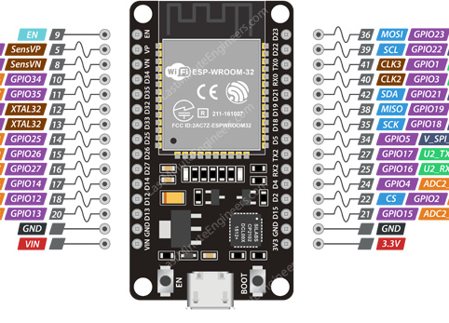
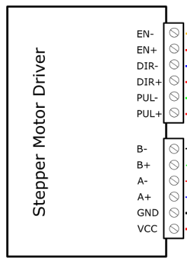

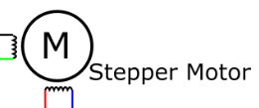
STEP MOTOR 1

Slide 2
STEP MOTOR 2

Slide 3
STEP MOTOR 3

Slide 4
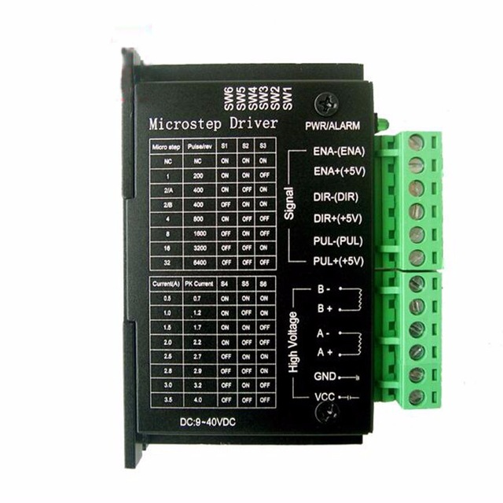
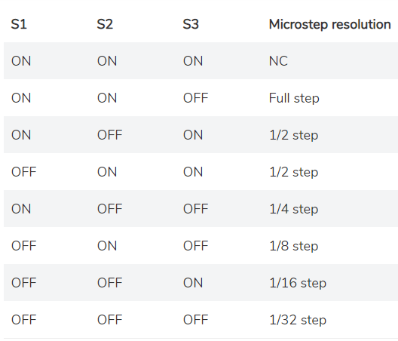
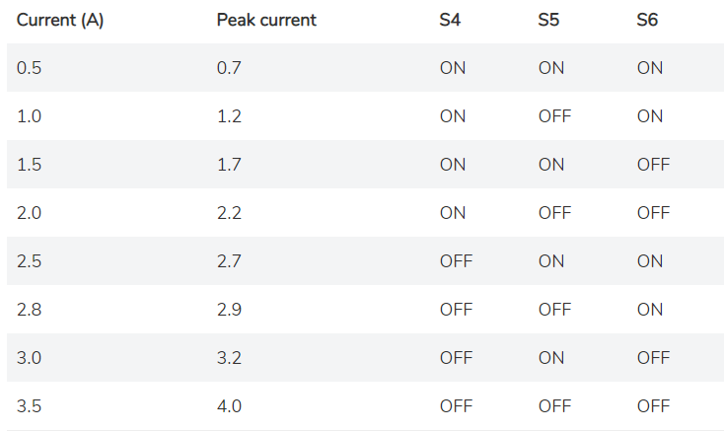
TB 6600 Driver
The configuration of the switches so that the driver can command the NEMA 17 stepper motor is shown in the images shown

Slide 5
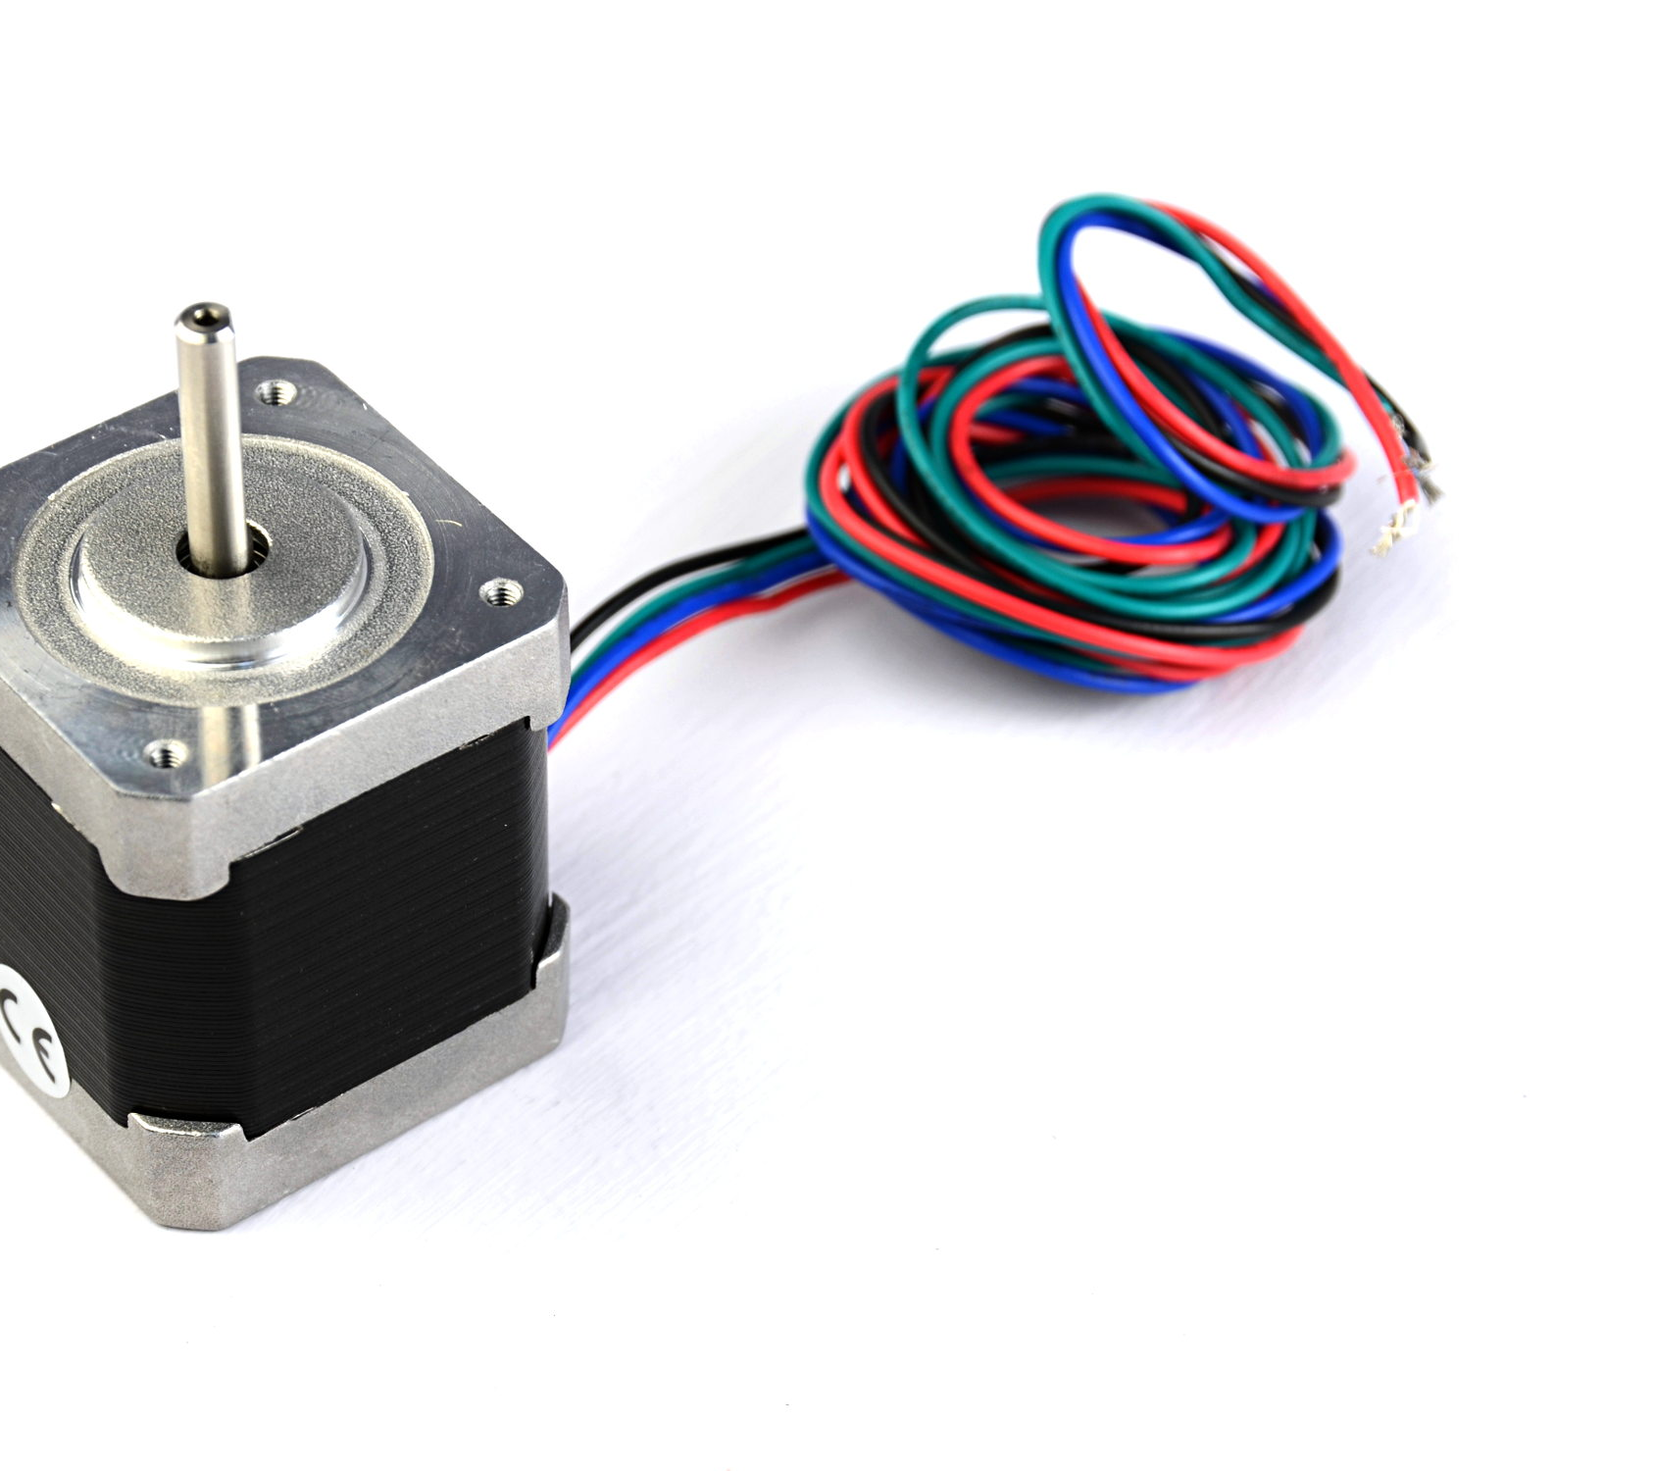
STEP MOTORS
Each motor cable is connected according to the color in the connection diagram

Slide 6
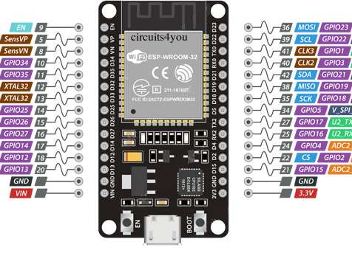
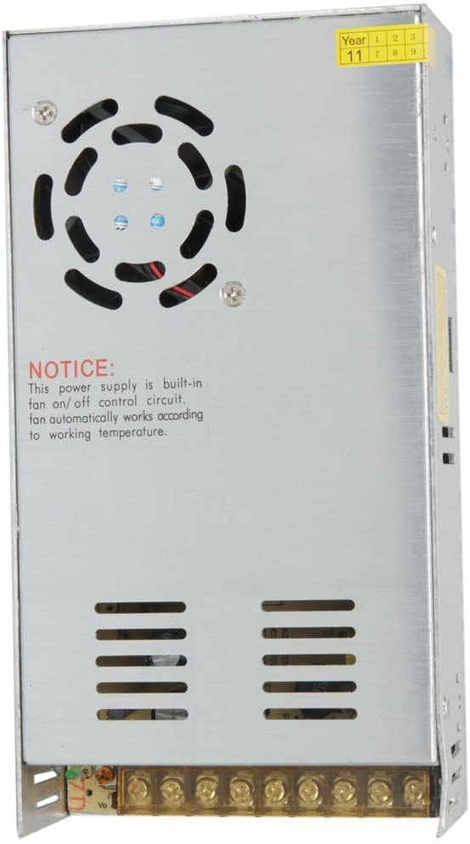
POWER SOURCE
The driver must be connected from 9 to 42V and the ESP-32 Card must be connected with 3.3 V.

Slide 7
SPECIFICATION
Input Current: 0~5A
Output Current: 0.5-4.0A
Control Signal: 3.3~24V
Power (MAX): 160W
Micro Step: 1, 2/A, 2/B, 4, 8, 16, 32
Temperature: -10～45℃
Humidity: No Condensation
Dimension: 96*56*33 mm/ 3.78*2.2*1.3 inches
Weight: 0.2 kg
Drive IC: TB67S109AFTG

Slide 8
Program
The program is configured as indicated by the 30-pin ESP32.
If you already have a connection we only have to change the pins and at the time of adapting it, see that it is actually opening and closing the valve when the instruction is sent if the address must not be changed in the opening and closing functions.
The program is functional.
Ypu must enter the valve to be operated with the angle separated by a comma, Example:
If I want to move valve 2 to the 75-degree position you should send: 2,75.
I think you could increase a safety measure of the maximum degree of opening and closing by looking at the degrees of valve opening.
I can add that when observing the necessary changes once the system has been tested.
If you have the driver connections on other pins than suggested then we should only modify the program.

