Slide 1
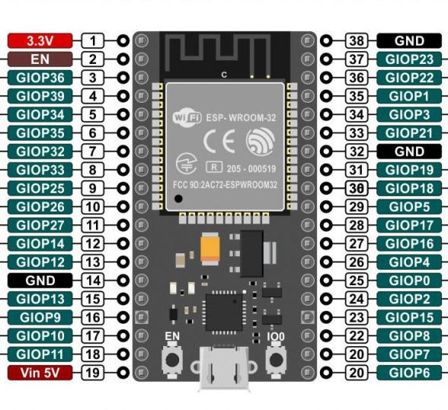
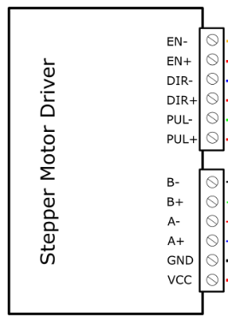

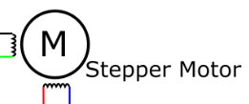
STEP MOTOR 1

Slide 2
STEP MOTOR 2

Slide 3
STEP MOTOR 3

Slide 4
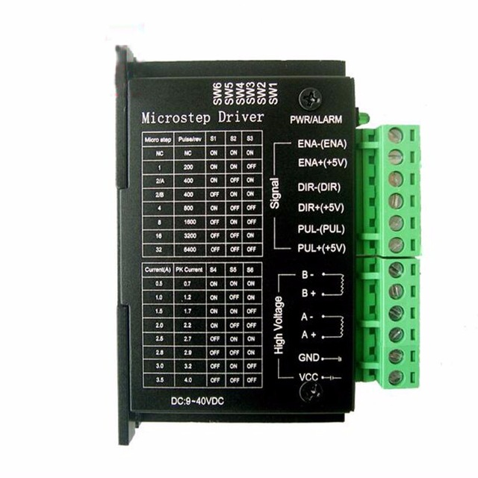
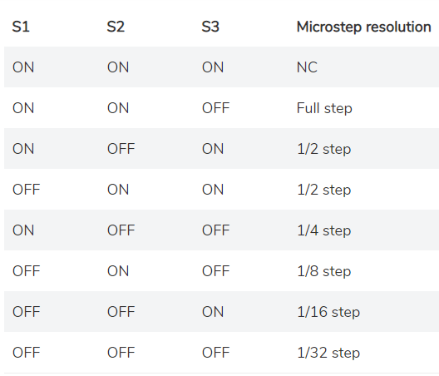
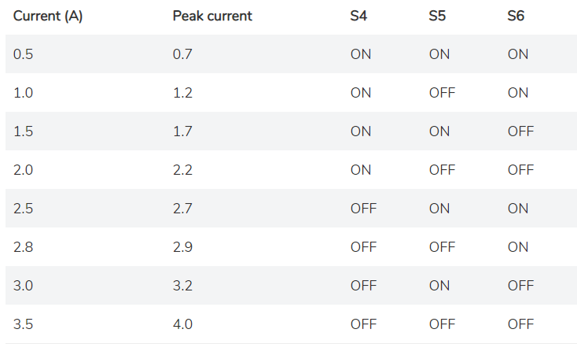
TB 6600 Driver
The configuration of the switches so that the driver can command the NEMA 17 stepper motor is shown in the images shown

Slide 5
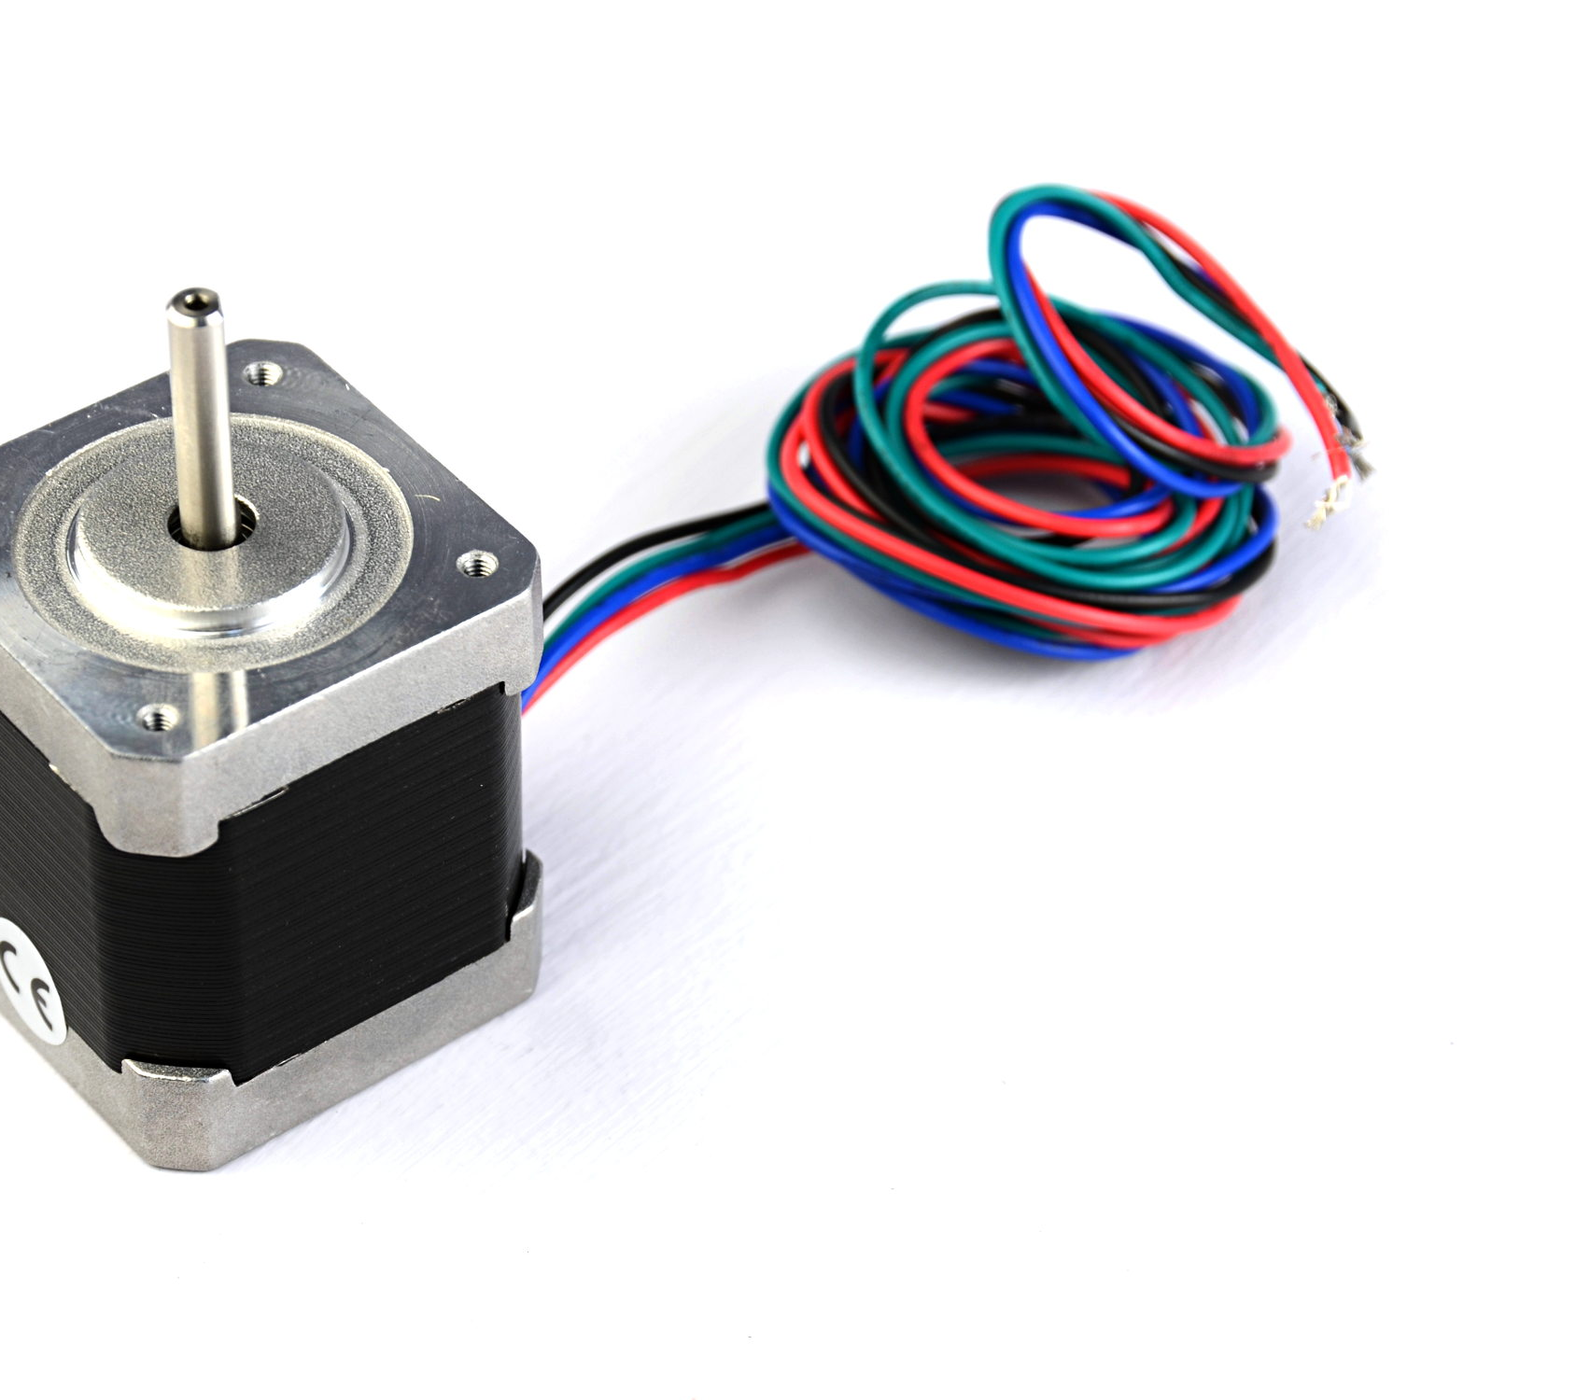
STEP MOTORS
Each motor cable is connected according to the color in the connection diagram

Slide 6
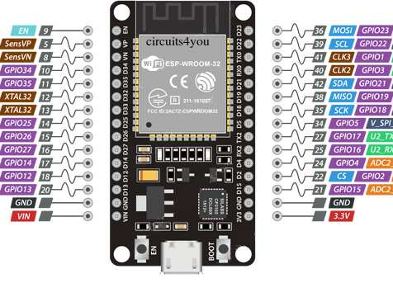
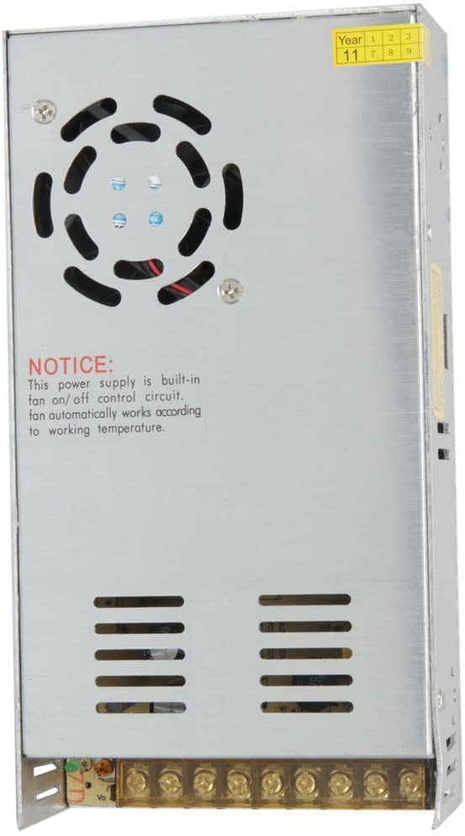
POWER SOURCE
The driver must be connected from 9 to 42V and the ESP-32 Card must be connected with 3.3 V.

Slide 7
SPECIFICATION
Input Current: 0~5A
Output Current: 0.5-4.0A
Control Signal: 3.3~24V
Power (MAX): 160W
Micro Step: 1, 2/A, 2/B, 4, 8, 16, 32
Temperature: -10～45℃
Humidity: No Condensation
Dimension: 96*56*33 mm/ 3.78*2.2*1.3 inches
Weight: 0.2 kg
Drive IC: TB67S109AFTG

