Slide 1
Dear Duilio,
This document specifies both the connection diagram and the assembly scheme of the system according to the photo that you sent me of the valves, considering the averages.
The proof of concept is made for a valve as requested, but I was thinking that a mobile or desktop application could be made to communicate with the ESP-32 since it is a card that works as IoT, I put that suggestion to your criterion.
Do not hesitate to contact me if you have any questions or difficulties, I will be willing to help

Slide 2
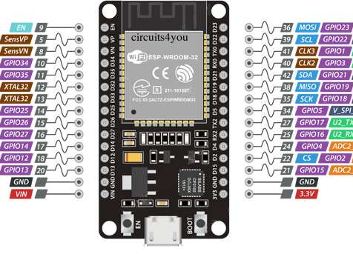
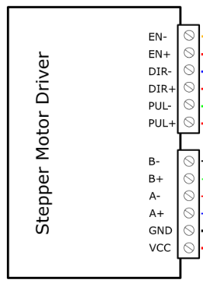
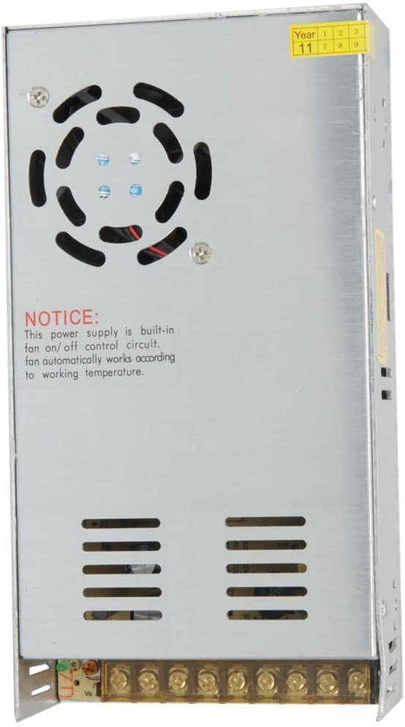

ELEMENTS
SPECIFICATION
Input Current: 0~5A
Output Current: 0.5-4.0A
Control Signal: 3.3~24V
Power (MAX): 160W
Micro Step: 1, 2/A, 2/B, 4, 8, 16, 32
Temperature: -10～45℃
Humidity: No Condensation
Dimension: 96*56*33 mm/ 3.78*2.2*1.3 inches
Weight: 0.2 kg
Drive IC: TB67S109AFTG
The driver must be connected from 9 to 42V and the ESP-32 Card must be connected with 3.3 V.

Slide 3
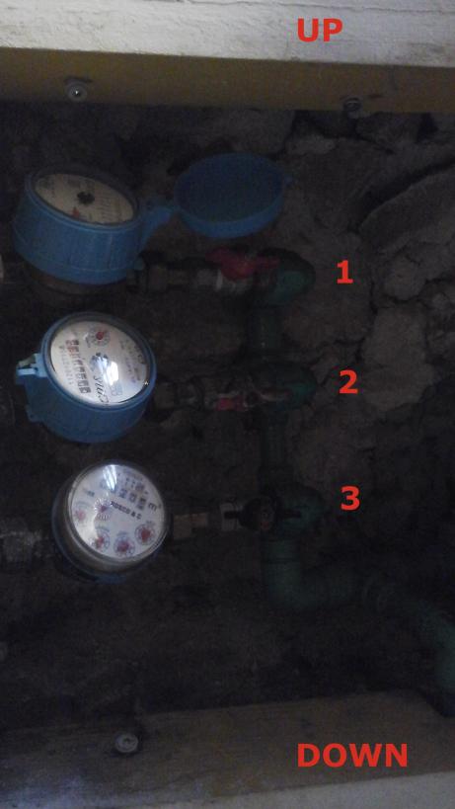
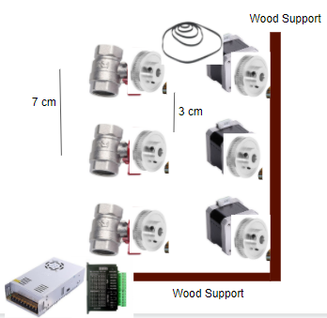

Slide 4
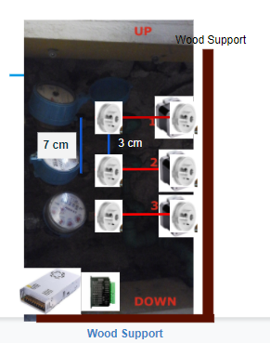

Slide 5
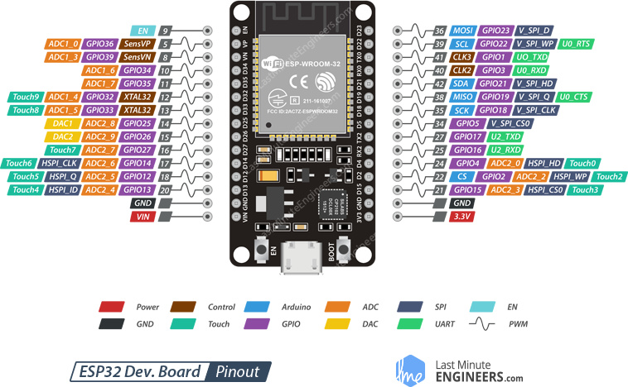
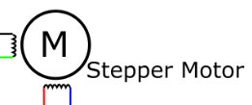
STEP MOTOR

Slide 6
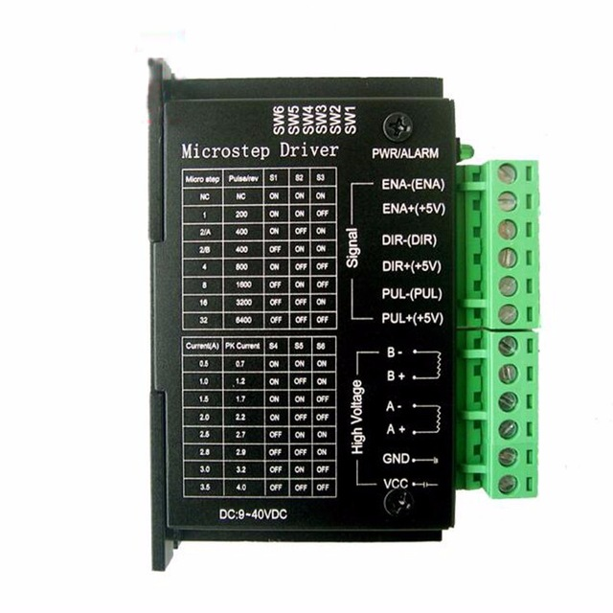
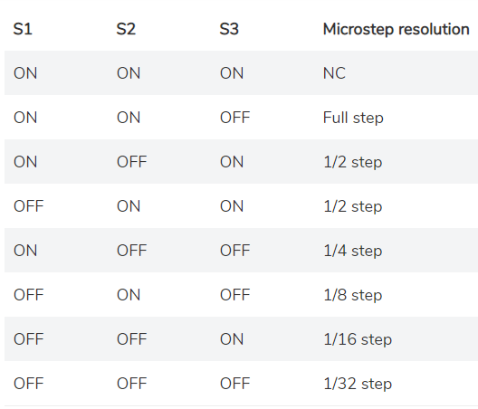
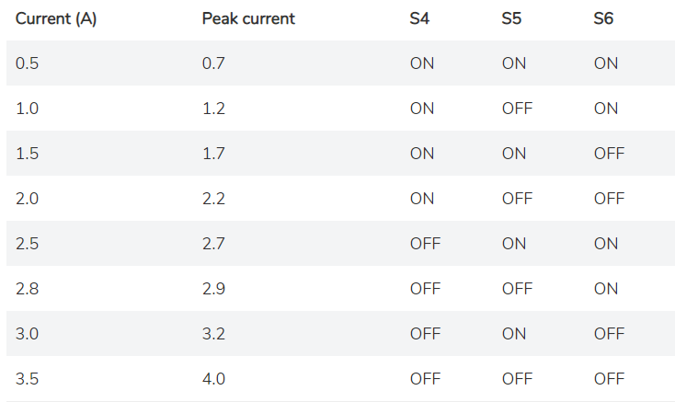
TB 6600 Driver
The configuration of the switches so that the driver can command the NEMA 17 stepper motor is shown in the images shown

Slide 7
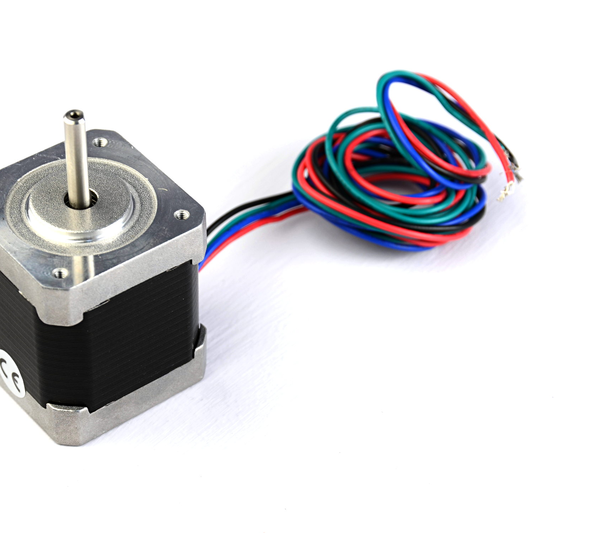
STEP MOTORS
Each motor cable is connected according to the color in the connection diagram

Slide 8
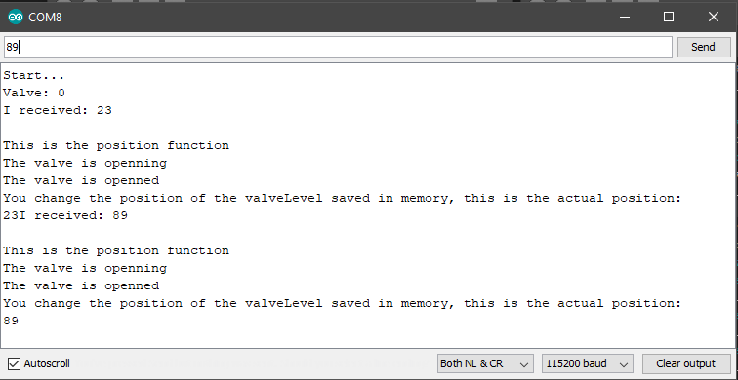

Slide 9
