Slide 1
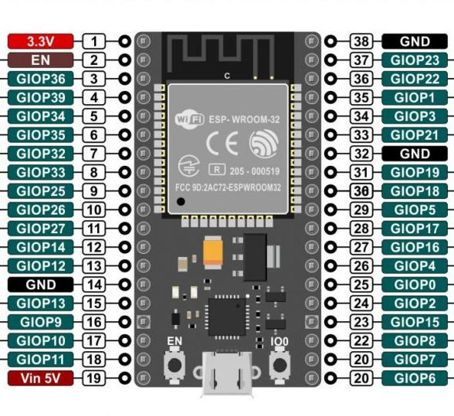
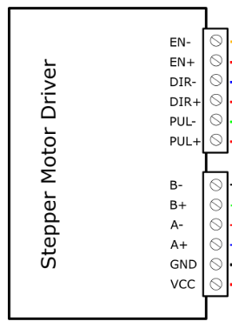

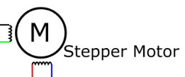
STEP MOTOR 1

Slide 2
STEP MOTOR 2

Slide 3
STEP MOTOR 3

Slide 4
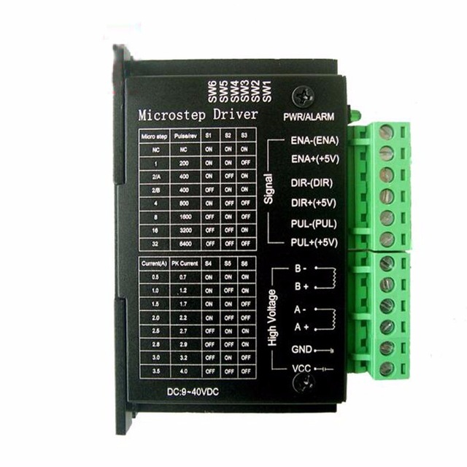
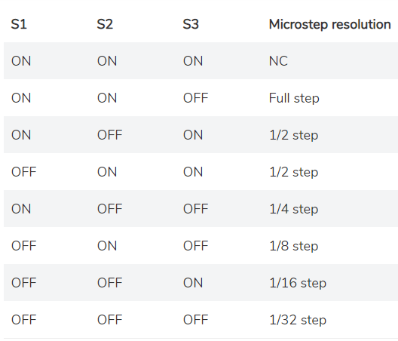
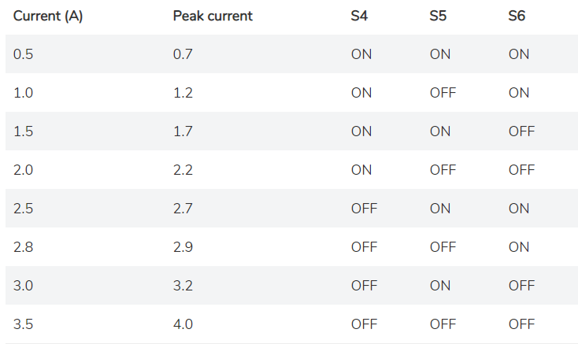
TB 6600 Driver
The configuration of the switches so that the driver can command the NEMA 17 stepper motor is shown in the images shown

Slide 5
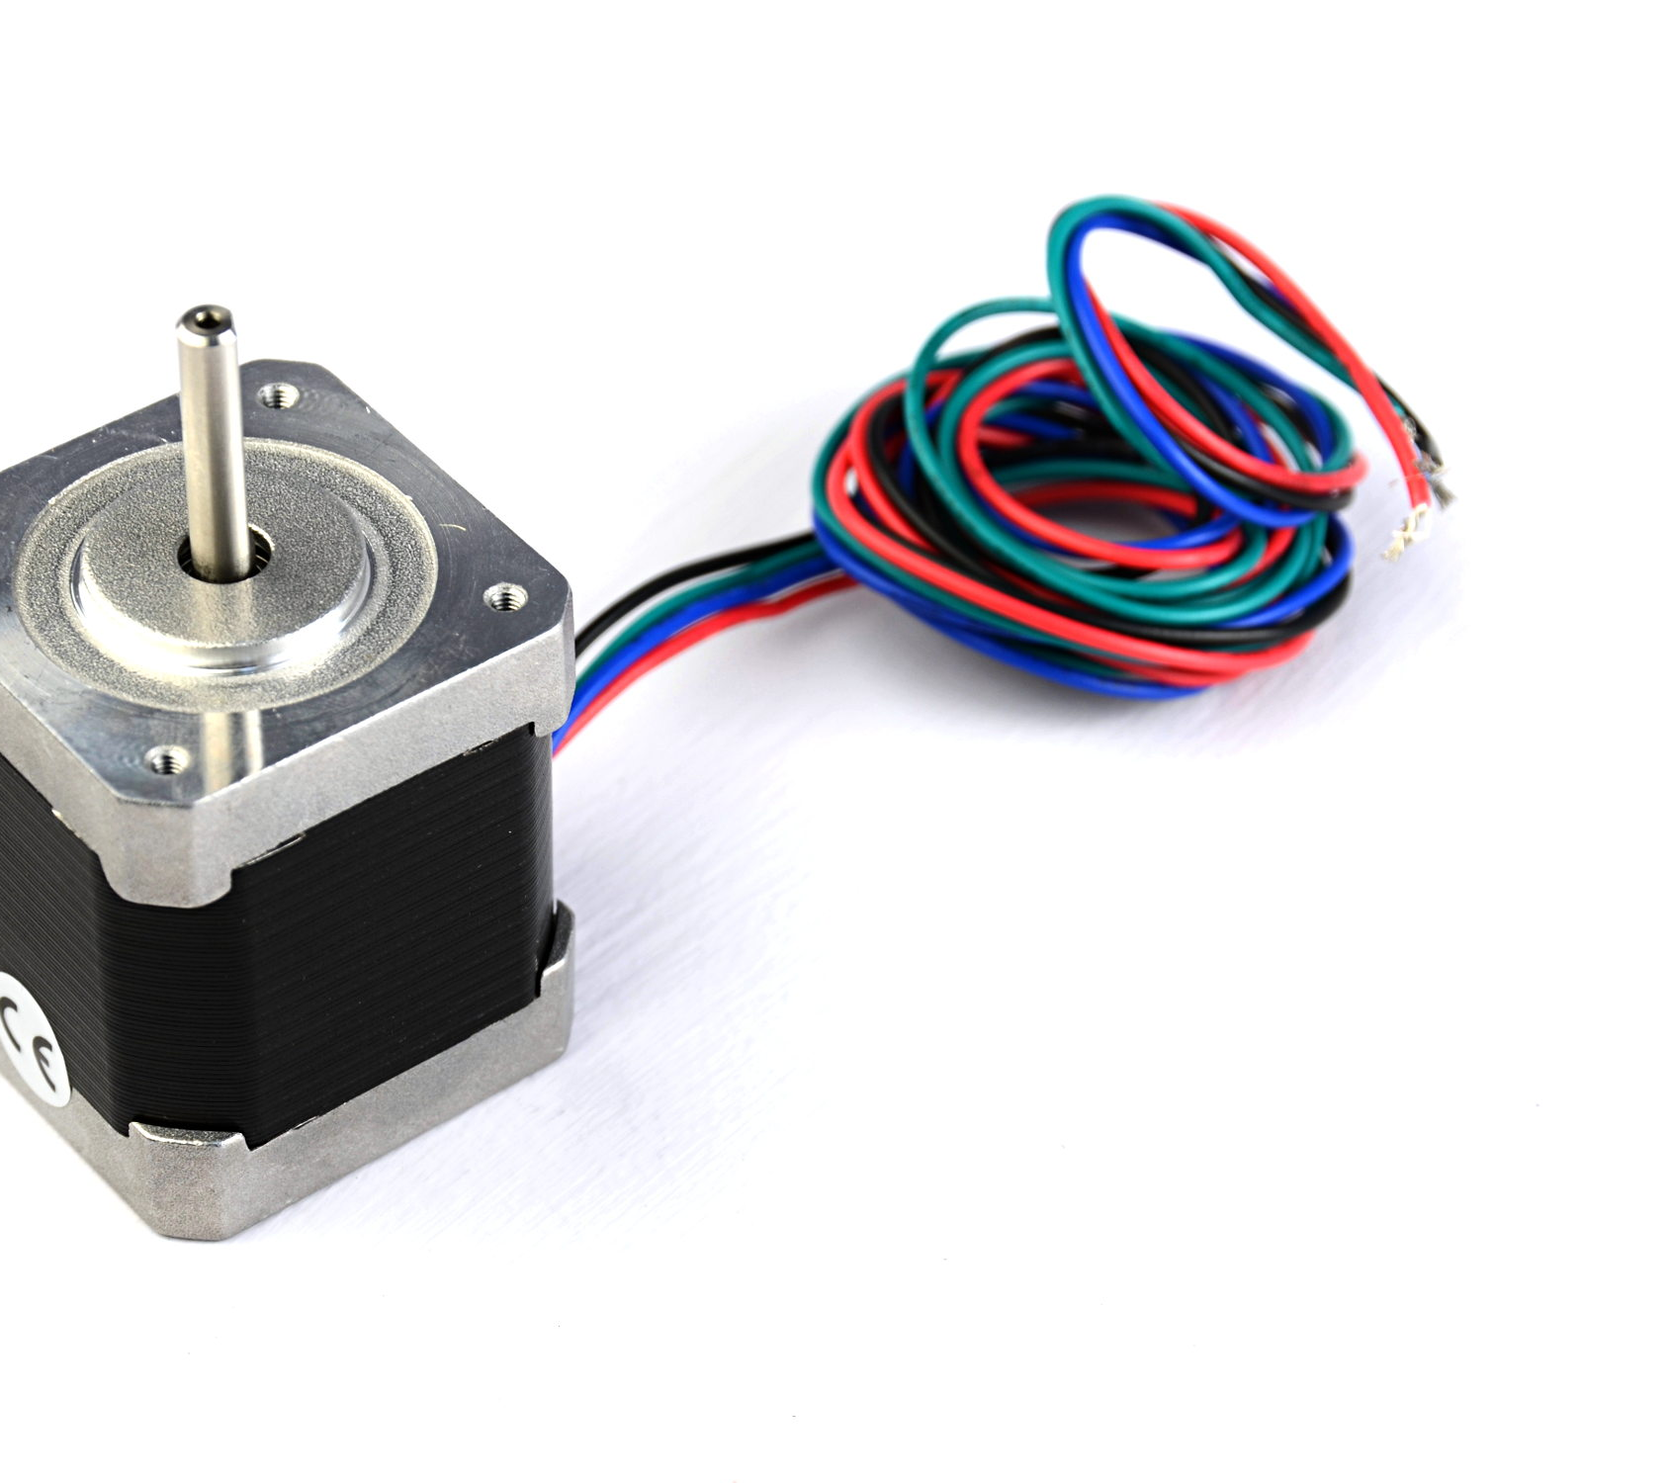
STEP MOTORS
Each motor cable is connected according to the color in the connection diagram

Slide 6
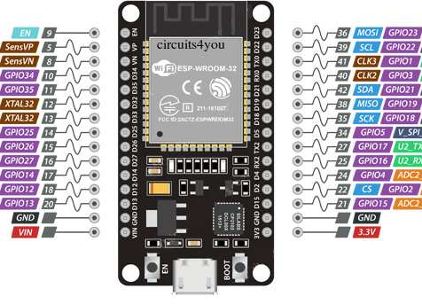
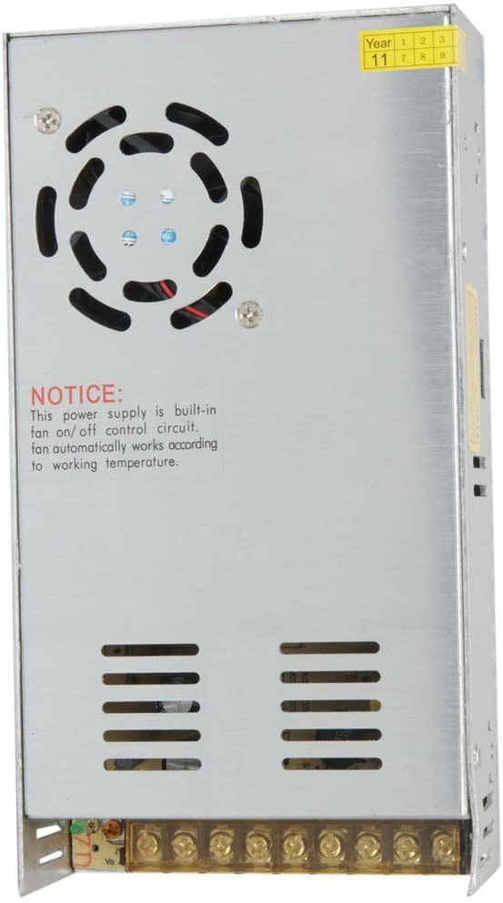
POWER SOURCE
The driver must be connected from 9 to 42V and the ESP-32 Card must be connected with 3.3 V.

