Slide 1
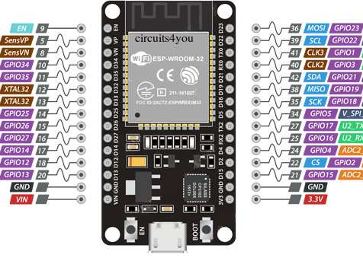
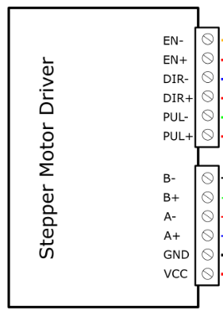

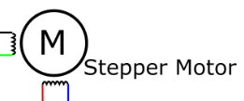
STEP MOTOR 1

Slide 2
STEP MOTOR 2

Slide 3
STEP MOTOR 3

