Slide 1
AutoEDA – Deep Learning Powered Automated Exploratory Data Analysis
COIMBATORE INSTITUTE OF TECHNOLOGY
DEPARTMENT OF COMPUTING - DATA SCIENCE
SEPTEMBER-2025
PRESENTED BY
LATHIKA S – 2303717673822018
VARUN S – 2303717673821054

Slide 2






PROBLEM STATEMENT
Proposed Solution
Development of an Automated Exploratory Data Analysis Framework Using Recurrent Neural Networks and Flask-Based No-Code Visualization Interface.
Automatically performs:
Data cleaning, visualization, and pattern discovery.
Anomaly detection using RNN autoencoders.
Feature importance detection using attention mechanisms.
Deploy as a Flask-based web application allowing users to upload datasets and view instant insights.
Addressing the Problem
Overcomes the time-consuming and complex nature of manual Exploratory Data Analysis (EDA).
Reduces human errors and dependency on programming skills required for traditional analysis.
Utilizes Recurrent Neural Networks (RNNs) to automatically detect anomalies, trends, and patterns in sequential data.
Provides a Flask-based no-code interface to simplify data uploading, processing, and visualization.
Innovation and Uniqueness
Integrates Deep Learning (RNN + Attention) into EDA automation – rarely seen in current tools.
Provides interpretable EDA (explainable patterns and anomalies).
End-to-end pipeline: from dataset upload → analysis → visualization → export.
No coding required, making EDA accessible to non-programmers and analysts.
Automated Data Cleaning
Sequential Pattern Recognition
Deep Learning Anomaly Detection
Attention-Based Feature Insights
No-Code Flask Dashboard
Interactive EDA Visualization

Slide 3
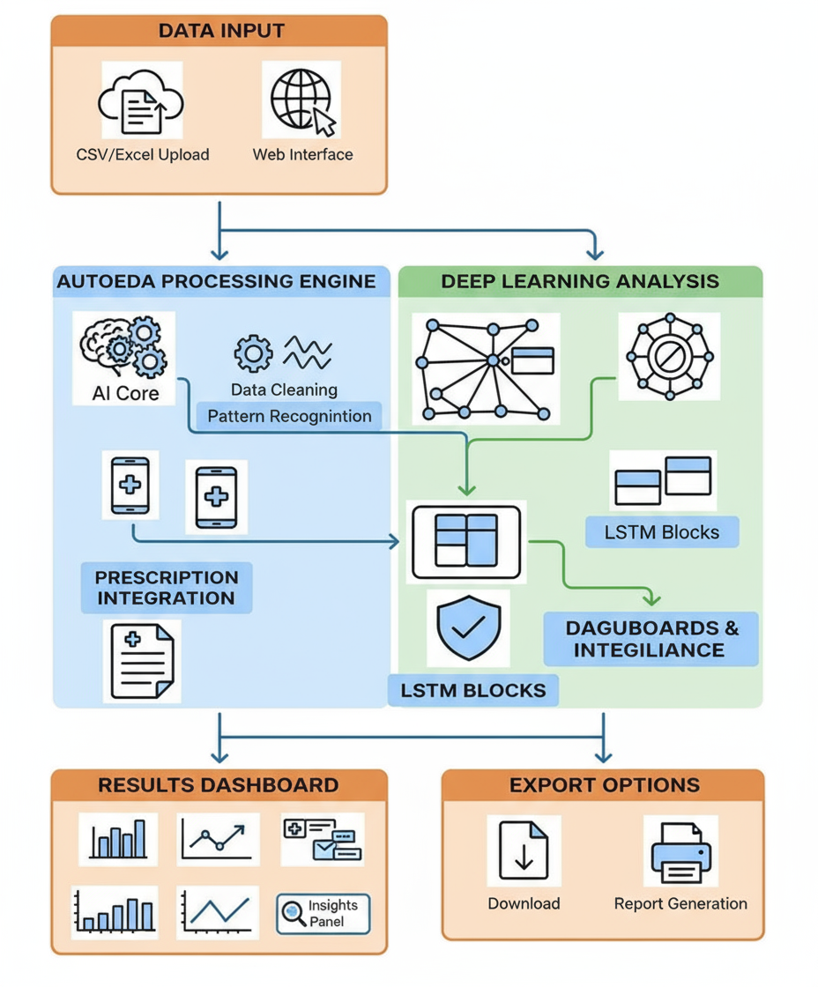
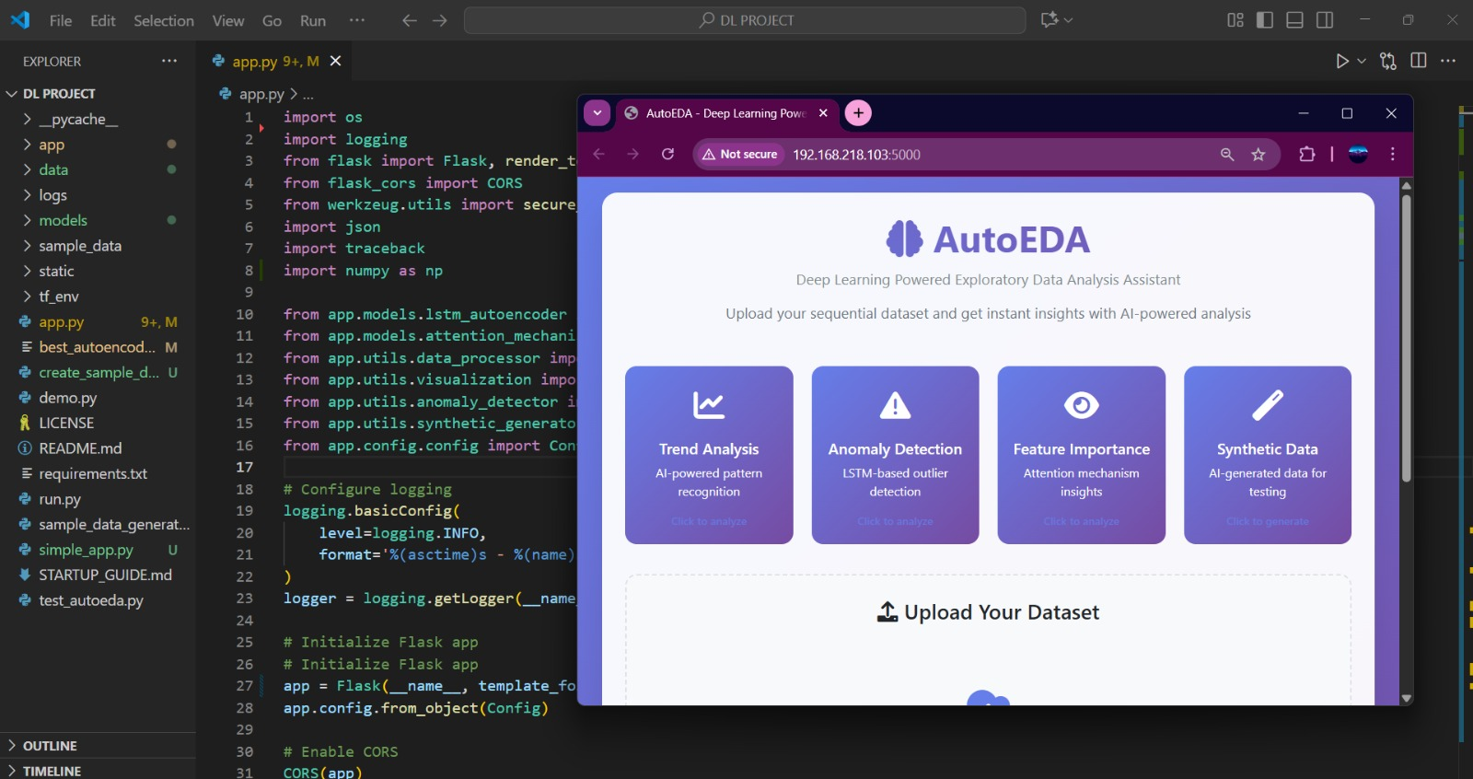
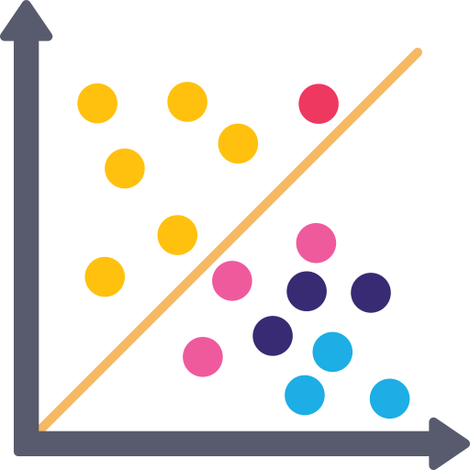





TECHNICAL APPROACH
Process for Implementation
Develop a Flask web app with data upload, automated preprocessing, and TensorFlow/Keras integration.
Use LSTM autoencoders for anomaly detection, attention-based RNNs for feature insights, and Plotly visualizations in Docker.

Slide 4

FEASIBILITY AND VIABILITY
Analysis of Feasibility
Potential Challenges and Risks
⚠️ Noisy data can lower accuracy.
⚠️ Deep learning results are hard to explain.
⚠️ Big data may cause high memory use.
⚠️ Users/Clients hesitate to trust AI tools.
The project is cost-effective, utilizing open-source technologies with minimal hosting expenses and strong potential for ROI through institutional adoption.
Growing global demand for no-code AI and automated analytics tools makes AutoEDA highly relevant and commercially viable.
Strategies for Overcoming Risks
✅ Preprocessing – Validate, clean, and scale data.
✅ Explainable AI – Use visualizations and interpretable layers.
✅ Optimization – Batch processing and lightweight APIs for speed.
✅ User-Focused Design – Intuitive UI and tutorials to boost trust.
Built on proven frameworks like TensorFlow, Flask, and Pandas, ensuring reliable performance and easy scalability.
A user-friendly, no-code dashboard enables effortless deployment, use, and maintenance by both technical and non-technical users.

Slide 5
IMPACT AND BENEFITS
Stakeholder | Impact | Benefits
Data Analysts | Reduced manual effort through automated EDA | Saves time, improves analysis efficiency, and increases productivity
Businesses / Organizations | Faster and more accurate insights from data | Enables data-driven decisions and early anomaly detection
Students & Researchers | Hands-on exposure to deep learning-based EDA systems | Enhances learning and research capabilities in AI-driven analytics
Developers / Data Engineers | Access to modular, extensible architecture | Allows integration of new models and scalable system improvements
Non-Technical Users | Simplified, no-code interface for complex EDA tasks | Promotes accessibility and wider adoption of data analysis tools
Efficiency: Reduces EDA time by 70%.
Accessibility: Enables non-programmers to perform data exploration.
Accuracy: Deep learning models detect hidden anomalies and correlations.
Scalability: Handles diverse data formats and domains
Innovation: Bridges the gap between data analysis and deep learning automation.
🌍 Overall Benefits
Social
Awareness of safe antimicrobial use

Slide 6
THANK YOU!

