Slide 1
AI-Powered Nutrition Chatbot & Meal Planner using NLP
COIMBATORE INSTITUTE OF TECHNOLOGY
DEPARTMENT OF COMPUTING - DATA SCIENCE
SEPTEMBER-2025
PRESENTED BY
LATHIKA S – 2303717673822018
VARUN S – 2303717673821054

Slide 2

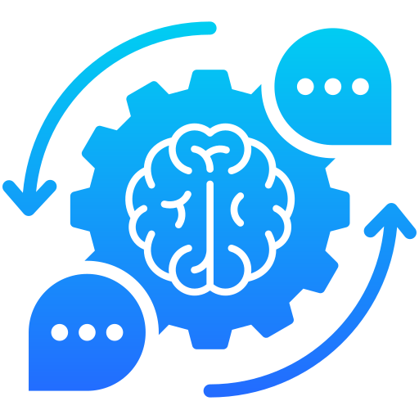
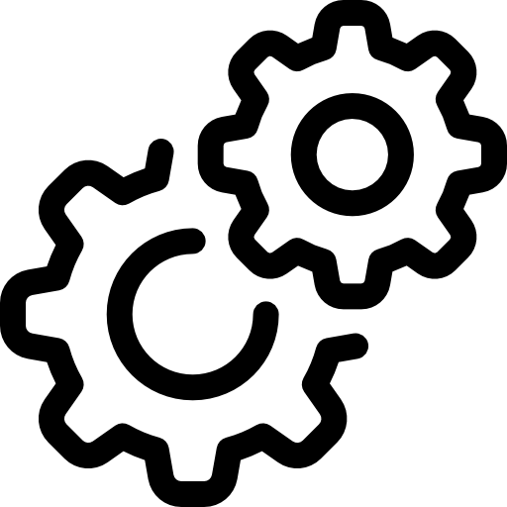
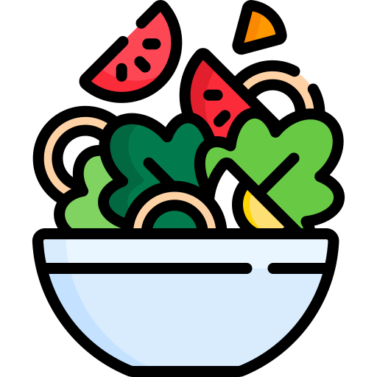


PROBLEM STATEMENT
Proposed Solution
Addressing the Problem
People struggle with tracking nutrition quality and meal balance.
Generic meal planners fail to adapt to personal goals, health conditions, or dietary restrictions.
Lack of an AI system that understands natural language and responds intelligently.
The solution offers real-time, AI-driven personalization with evidence-based nutrition guidance.
Implementation of an AI-Powered Personalized Nutrition and Wellness Dashboard with NLP-Driven Meal Intelligence and Secure Health Data Management
Automatically extracts nutritional data from user-input meals.
Syncs with trusted nutrition databases for accurate insights and it offers an intuitive interface with strong data privacy.
Innovation and Uniqueness
Hybrid AI + NLP model for 3× higher ingredient parsing accuracy.
Real-time adaptive 7-day meal generation using live nutrition data.
AI-based ingredient substitution for allergens and diet preferences.
Cohere-powered chatbot for personalized, context-aware conversations.
Intelligent Food Recognition
NLP-Based Ingredient Extraction
AI-Powered Nutrition Analysis
AI-Driven Diet Suggestions
Conversational Chatbot
Smart Meal Planning Dashboard

Slide 3
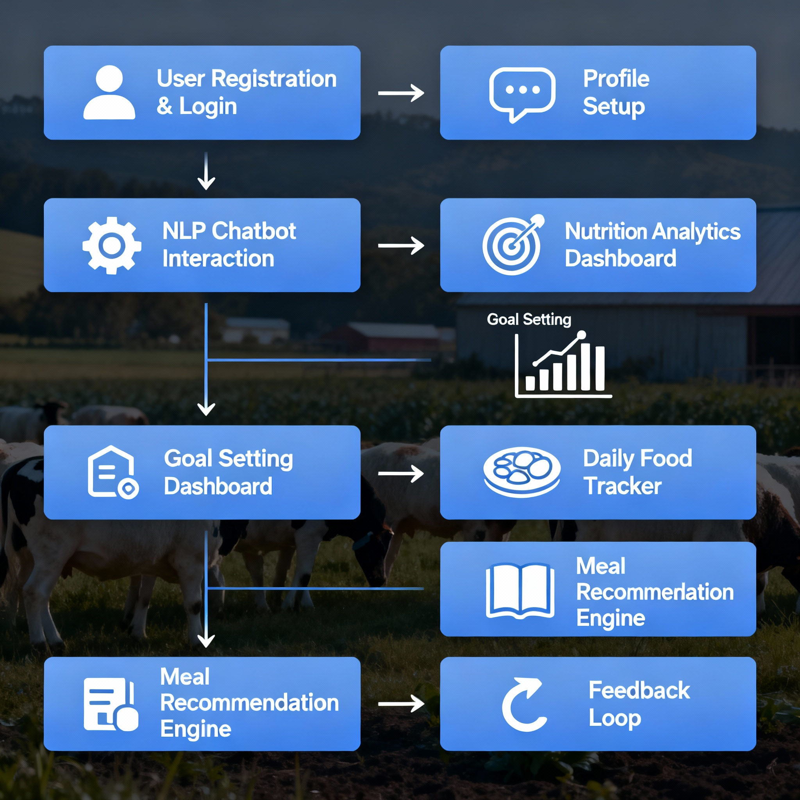
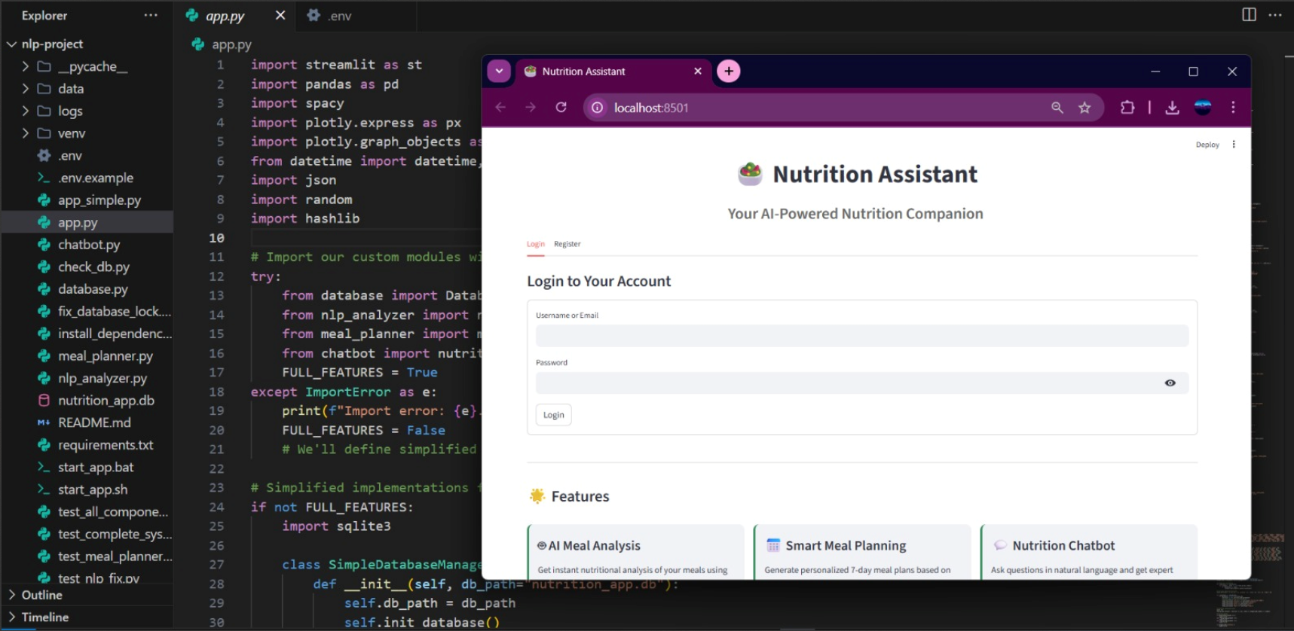


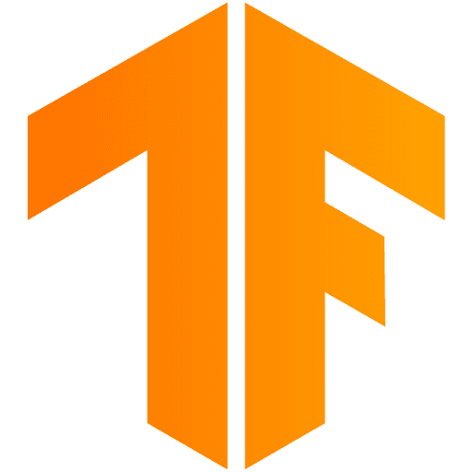
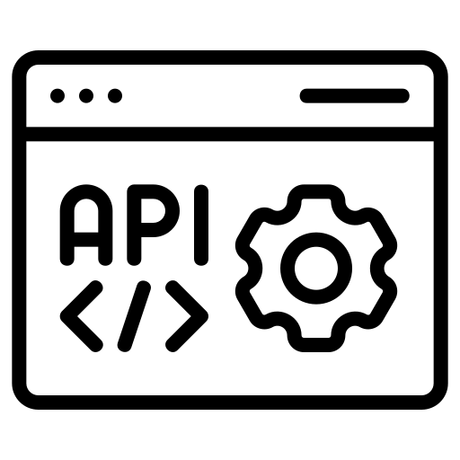

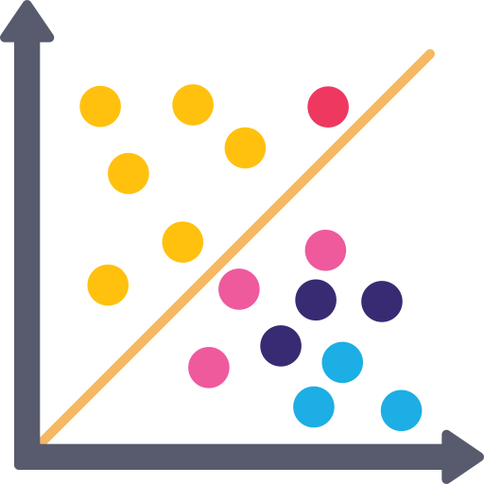
TECHNICAL APPROACH
Process for Implementation
Built an NLP-powered Streamlit web app using spaCy and Cohere for ingredient parsing, meal analysis, and personalized diet recommendations with interactive visualizations.
Integrated CalorieNinjas and Spoonacular APIs for real-time nutrition insights and meal planning, enabling context-aware chatbot responses tailored to user profiles.

Slide 4

FEASIBILITY AND VIABILITY
Analysis of Feasibility
Potential Challenges and Risks
External APIs may have downtime or usage limits.
Web-scraped or API-provided nutrition data might contain inconsistencies.
Handling user health and dietary information requires strict data security.
Increased user load can slow down NLP processing and real-time recommendations.
Rising global demand for AI-based personalized nutrition platforms makes the solution highly relevant.
Low-cost, API-driven architecture supports scalable, subscription-based revenue growth.
Strategies for Overcoming Risks
Maintain local backup datasets and caching to ensure continuity when APIs fail.
Cross-verify data from multiple sources and use confidence scoring for accuracy.
Apply encryption, anonymization, and compliance with GDPR-like standards.
Use asynchronous processing, model optimization, and cloud auto-scaling for performance.
Built entirely on open-source NLP frameworks and APIs, ensuring flexibility and easy scalability.
Streamlit-based interface offers seamless deployment and simple user onboarding.

Slide 5
IMPACT AND BENEFITS
Stakeholder | Impact | Benefits
Users | Gain personalized nutrition insights, meal suggestions, and allergen-safe diet plans for healthier living. | Improved dietary awareness by 60%, healthier food choices leading to 25% better goal adherence.
Healthcare Professionals | Access structured dietary data and AI-driven nutritional analysis to assist in patient care. | Reduces manual dietary tracking time by 40%, enabling faster and data-backed consultations.
Fitness Trainers | Receive customized diet recommendations aligned with workout goals for optimized performance. | Enhances client performance outcomes by 30%, with personalized nutrition-meal sync.
Developers / Researchers | Utilize a scalable NLP-driven framework for innovative health and nutrition applications. | Reduces development time by 50%, supports integration with APIs and data science workflows.
Efficiency: Automates nutrition tracking and analysis, reducing manual effort by 65%.
User Retention: Personalized recommendations increase user engagement by 45%.
🌍 Overall Benefits
Innovation: Combines NLP, health analytics, and AI recommendation systems for a next-gen digital nutrition ecosystem.
Accuracy:NLP-based ingredient extraction improves data precision by 35% compared to manual logging.
Scalability: Supports multi-user and multilingual environments with minimal computational overhead.
Social
Awareness of safe antimicrobial use

Slide 6
THANK YOU!

