Slide 1
COLLABORATIVE TO-DO LIST
MANAGER
DONE BY
VENKATESH D – 2303717673821056
VARUN S – 2303717673821054
LOKESH JAYANTH - 2303717673821019

Slide 2
INTRODUCTION
What is the Project About?
A collaborative ToDo list application that allows multiple users to manage shared tasks in real time over a network using Java sockets.
Objective:
To enable real-time task collaboration with a responsive GUI, ensuring efficient communication and synchronization among users

Slide 3
TOOLS AND TECHNOLOGIES
Programming Language: Java
GUI Framework: Java Swing
Networking: Java Sockets (TCP/IP)
Multithreading: Java Threads
Data Structure: DefaultListModel
Error Handling: JOptionPane
Other Tools: JDK

Slide 4
KEY FEATURES
Real-Time Task Updates: Instant Updates for all users
Multi-User Collaboration: Shared task lists with
user/group tracking..
c. Priority & Deadlines: Tasks categorized by
priority (High/Medium/Low) and deadlines.
d. User-Friendly GUI: Intuitive Swing interface with visual
task status (✓, …, [ ]).

Slide 5
CORE COMPONENTS
NetworkManager.java: Handles sockets, broadcasts, and sync.
ModernTodoListGUI.java: Swing UI with task rendering (TaskListRenderer).
TodoList.java: Backend logic for tasks/groups.
Task.java: Task model with status, priority, and deadline.

Slide 6
System Architecture
Server-Client Model:
Server: Broadcasts task list updates to all clients.
Clients: Send changes (add/edit/delete) to the server
Data Flow: ToDoList object serialized over sockets.

Slide 7
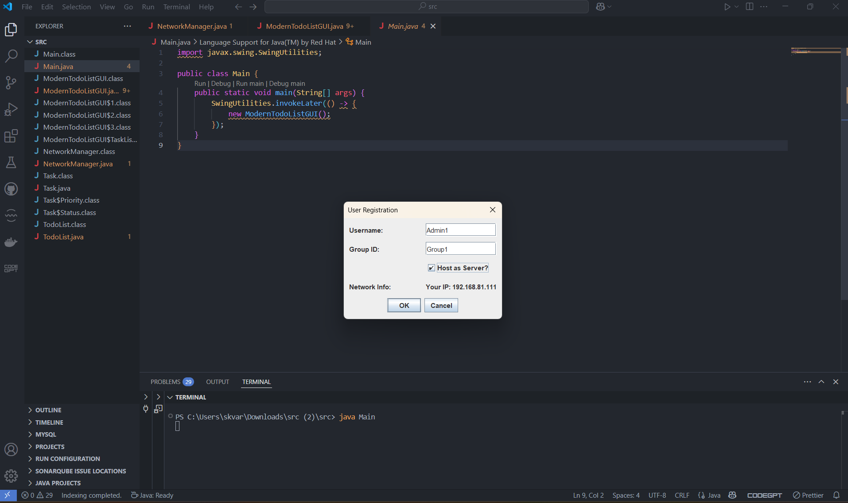
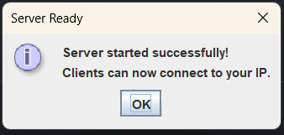
SERVER CONNECTION

Slide 8
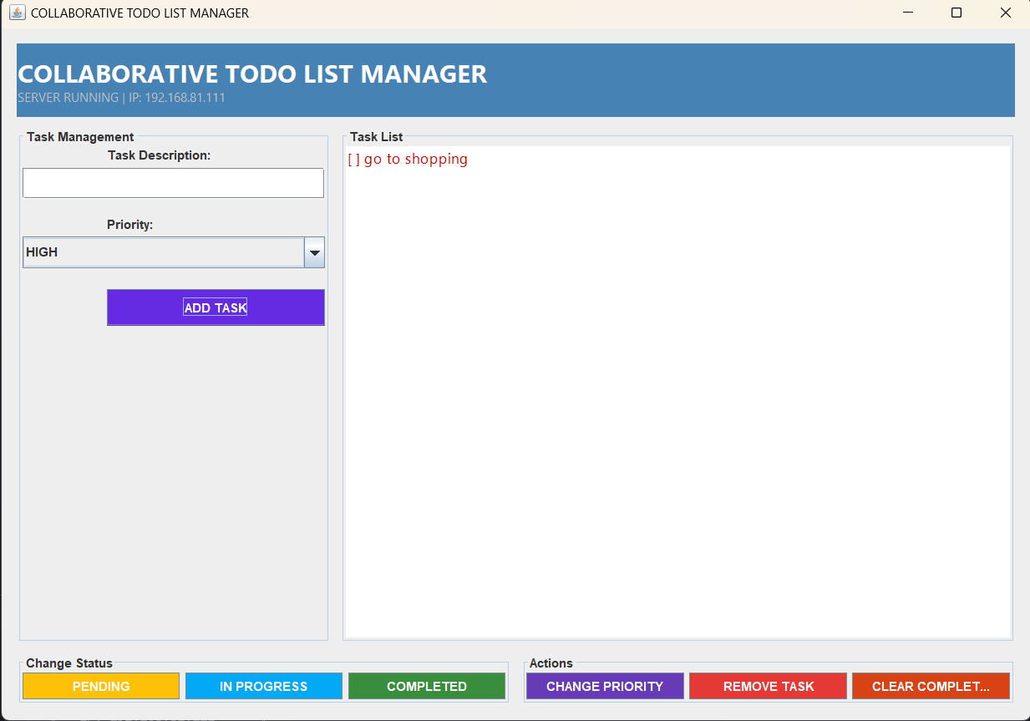
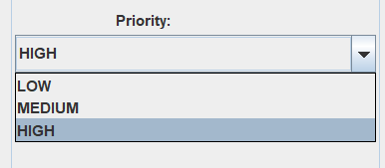
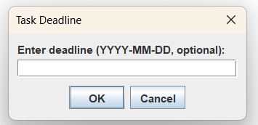
SERVER GUI

Slide 9
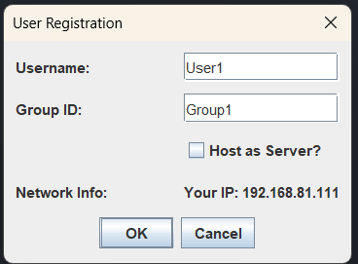
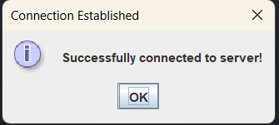
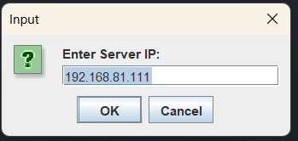
CLIENT CONNECTION

Slide 10
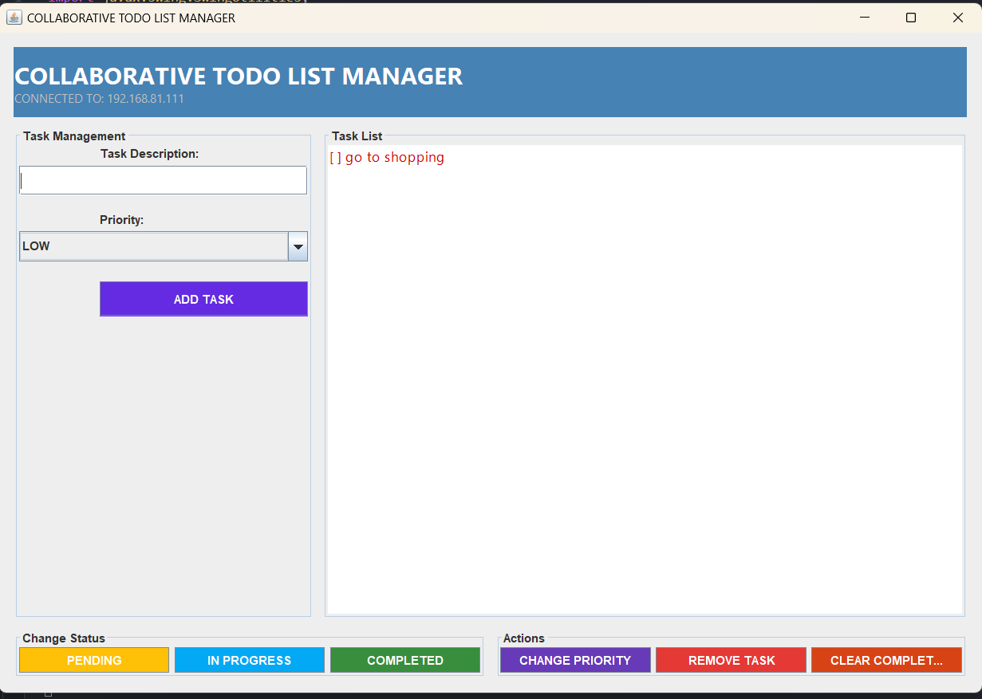
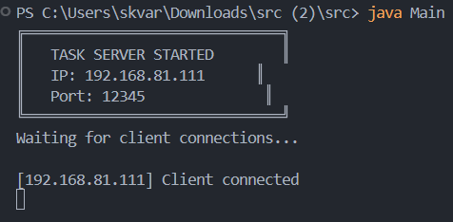
CLIENT GUI

Slide 11
CHALLENGES & SOLUTIONS
Challenge: Synchronizing tasks across clients without conflicts. Solution: Thread-safe BlockingQueue for updates.
Challenge: Dynamic UI updates. Solution: SwingUtilities.invokeLater() for thread-safe GUI changes.

Slide 12
FUTURE ENHANCEMENTS
Cloud Integration: Save tasks to a database.
Mobile App: Android/iOS client.
Notifications: Deadline reminders.
Enable offline mode with sync-on-reconnect.
File attachments (e.g., upload documents to tasks)
Role-based access (Admin/User permissions).

Slide 13
CONCLUSION
Successfully built a real-time collaborative task manager using Java.
Enabled multi-user sync via sockets with an intuitive Swing GUI.
Demonstrated core Java skills: networking, multithreading, and OOP.

Slide 14
THANK YOU

