Slide 1
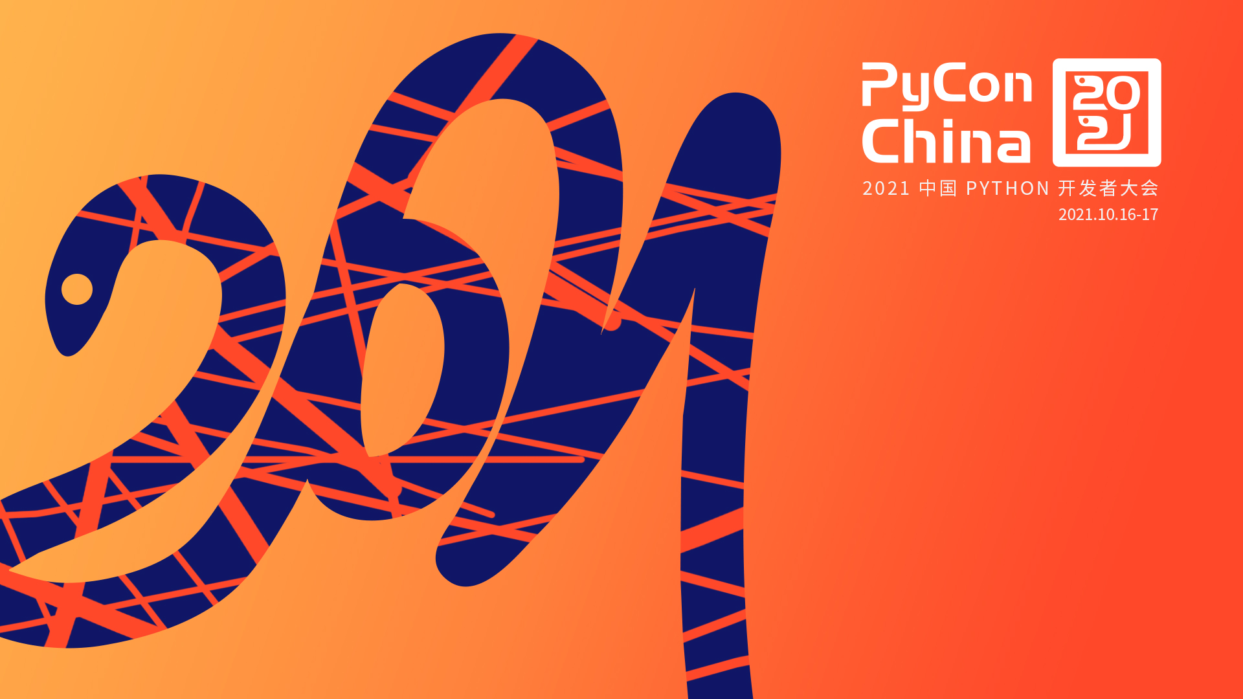
用Pyparsing/PEG
设计自己的计算机语言
宋丛威
Design your own programming language
using Pyparsing/PEG
William Song

Slide 2
介绍
动机：
原理：
工具：
作品

Slide 3
Introduction to PEG
Features
Behavior: no backtrack
Implementation: Recursive descent algorithm，easily implementing by functional language(such as Haskell)
Definition: Strict definition of functions
Expression: No (direct) left-recursive rule, uncommunicated `|`
Performance: parsing fast
Power: almost equivalent to CFG but disambiguous, could design any computer language

Slide 4
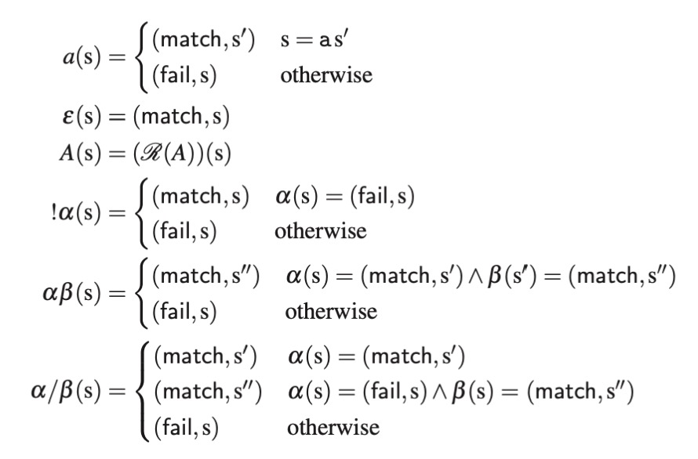
Introduction to PEG
Definition

Slide 5
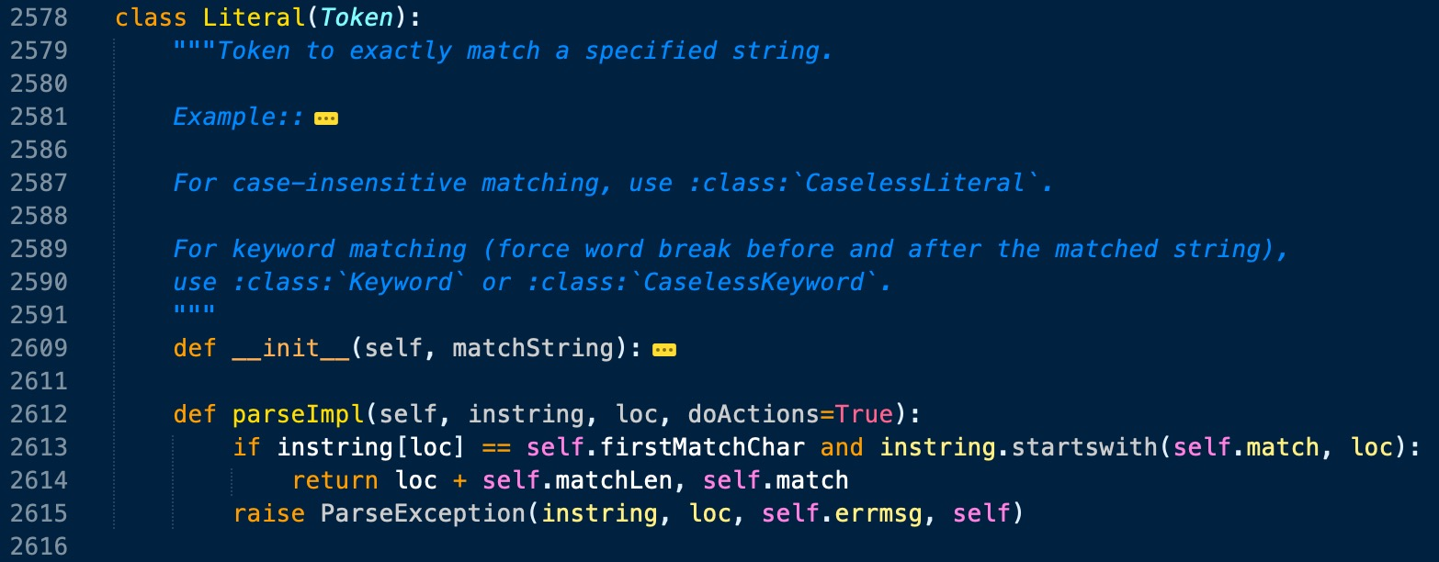
Implement PEG by pyparsing
Source code
Significant class: ParserElement, ParseResults
Common method: parseString
Core method: parseImpl
Wrapper method: _parse
A subclass

Slide 6
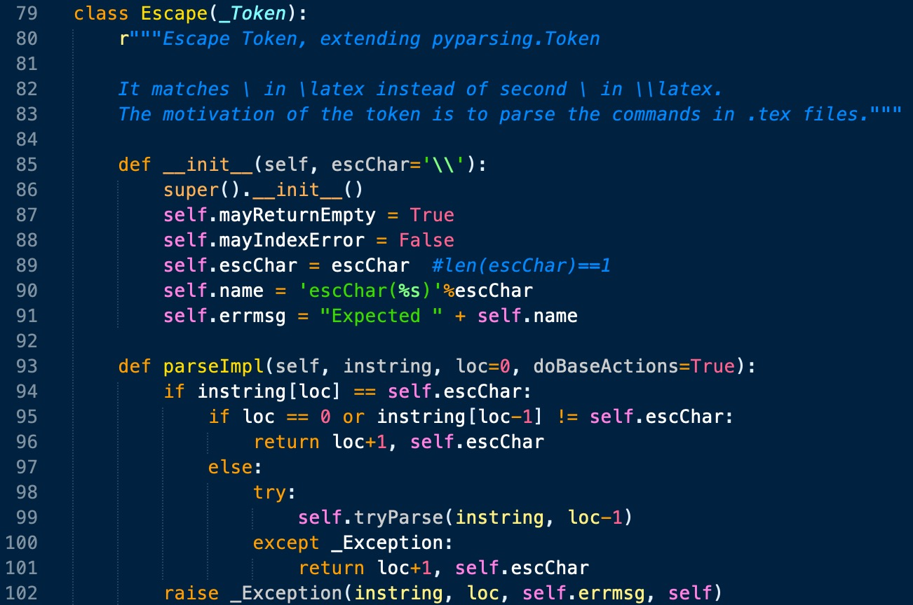
Implement PEG by pyparsing
DIY parser

Slide 7
Implement PEG by pyparsing(digression)
PrecededBy: is suggested by me
Parsers for CJK characters are also proposed by me

Slide 8
Design trick
Cascading

Slide 9
My works
Links：https://github.com/Freakwill/pyparsing_ext
https://github.com/Freakwill/texparsing

Slide 10
Summary
It is recommended to implement PEG by your self with your favorite language.
And try libs to construct PEG parser written by other languages, such as
“PEG/Go”, “Lpeg/Lua”, “peg/leg/C”, “Treetop/Ruby”, “PEG.js/JavaScript”.
PEG is the future; PEG is all your need; Python and the BDFL choose PEG; Forget CFG.

Slide 11
文献
[1] Aaron Moss. Derivatives of Parsing Expression Grammars. https://arxiv.org/pdf/1405.4841.pdf
[2] Bryan Ford, Parsing Expression Grammars: A Recognition-Based Syntactic Foundation. ACM SIGPLAN Symposium on Principles of Programming Languages (POPL), 2004.
[3] McGuire P. Getting Started with Pyparsing[M]. O'Reilly Media, 2007.
[4] Medeiros，Sérgio，Mascarenhas F ，Ierusalimschy R . Left Recursion in Parsing Expression Grammars[C], Brazilian Symposium on Programming Languages. Springer，Berlin，Heidelberg，2012.

Slide 12
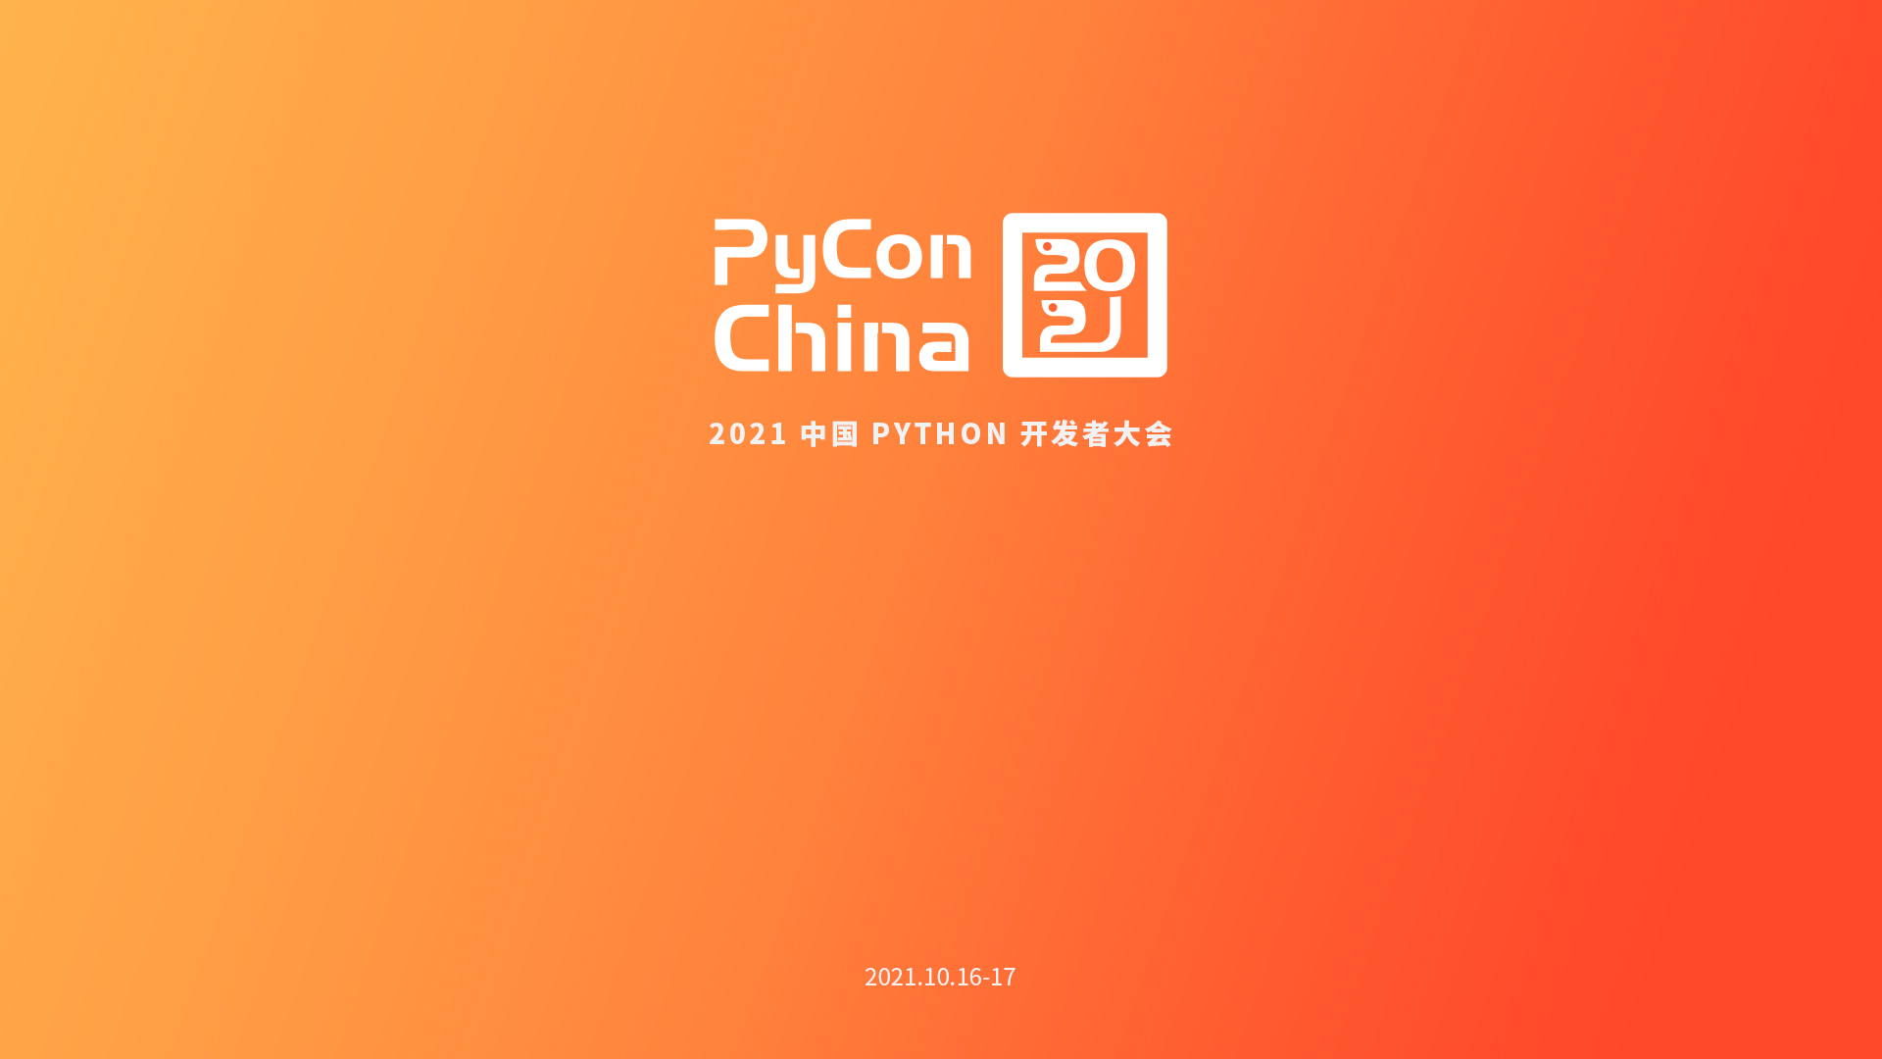
Thanks!

