Slide 1
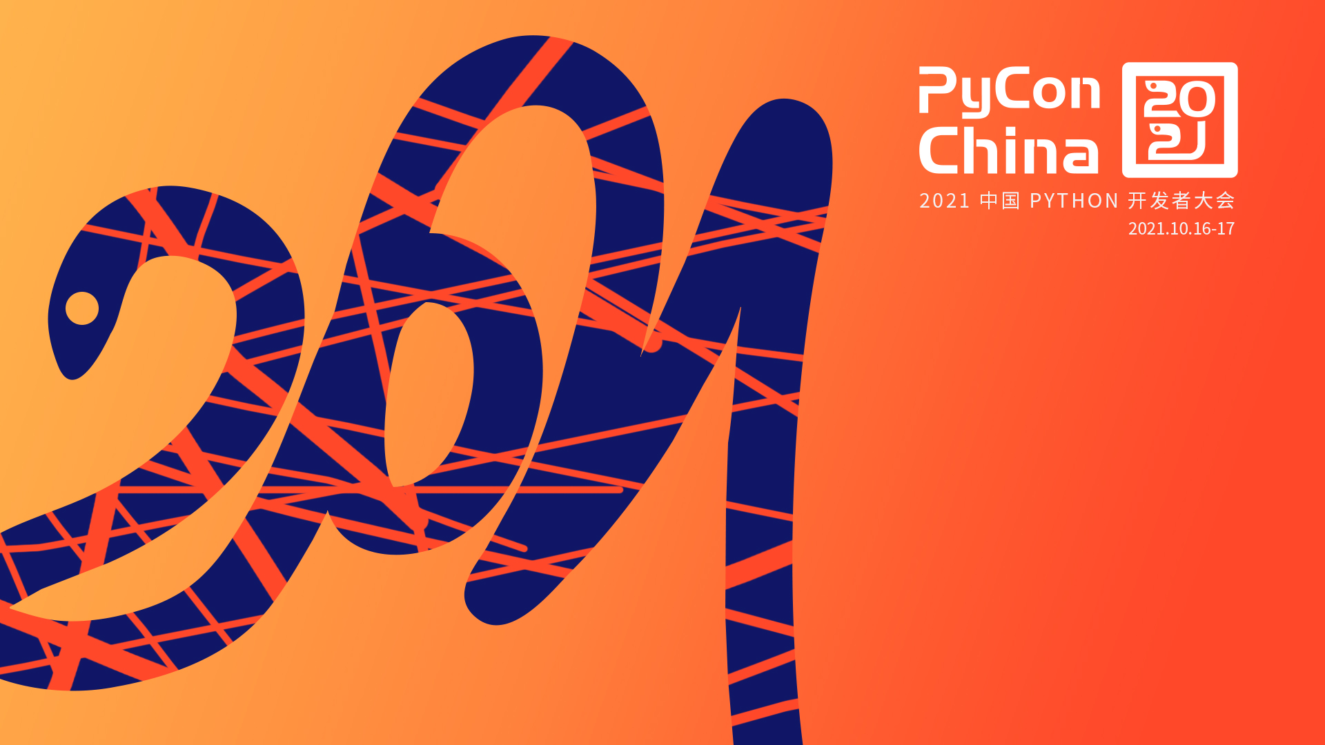
用Pyparsing/PEG
设计自己的计算机语言
宋丛威
Design your own programming language
using Pyparsing/PEG
William Song

Slide 2
Prelude
Motivate：invent DSL to make life and work convenient, curious to the implementation of computer languages. PEG is more easy to understand and applied to develop DSL
Tools：pyparsing/Python

Slide 3
Content
Introduction to PEG
Implement PEG by pyparsing
DIY
Show my works

Slide 4
Introduction to PEG
Features
Behavior: no backtrack
Algorithm: Recursive descent algorithm，easily implementing by functional language(such as Haskell)
Definition: Strict definition of functions
Expression: No (direct) left-recursive rule, uncommunicated `|`
Performance: parsing fast
Power: almost equivalent to CFG but unambiguous, could design any computer language

Slide 5
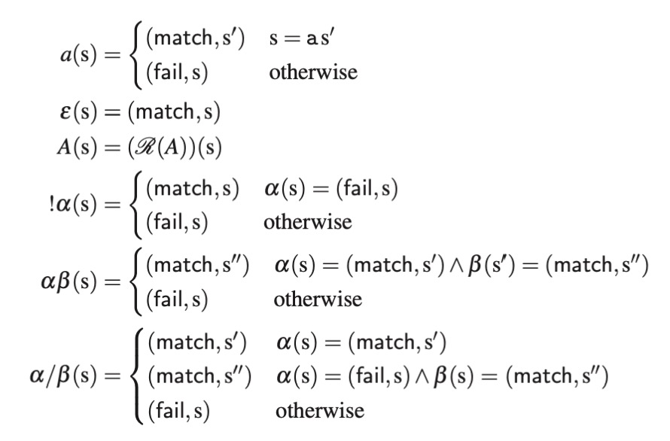
Introduction to PEG
Definition
Comment: the mappings could be regarded as Monoid, adapted to be implemented by Haskell

Slide 6
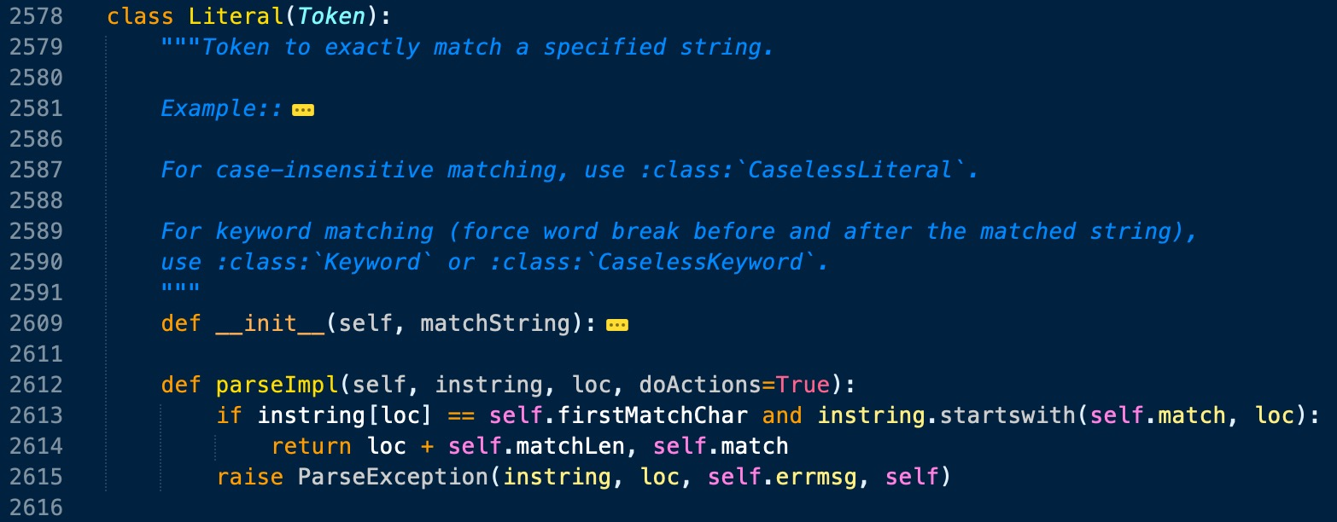
Implement PEG by pyparsing
Source code
Significant classes: ParserElement, ParseResults
Common method: parseString
Core method: parseImpl
Wrapper method: _parse
A subclass

Slide 7
Implement PEG by pyparsing(digression)
PrecededBy: is suggested by me
Parsers for CJK characters are also proposed by me

Slide 8
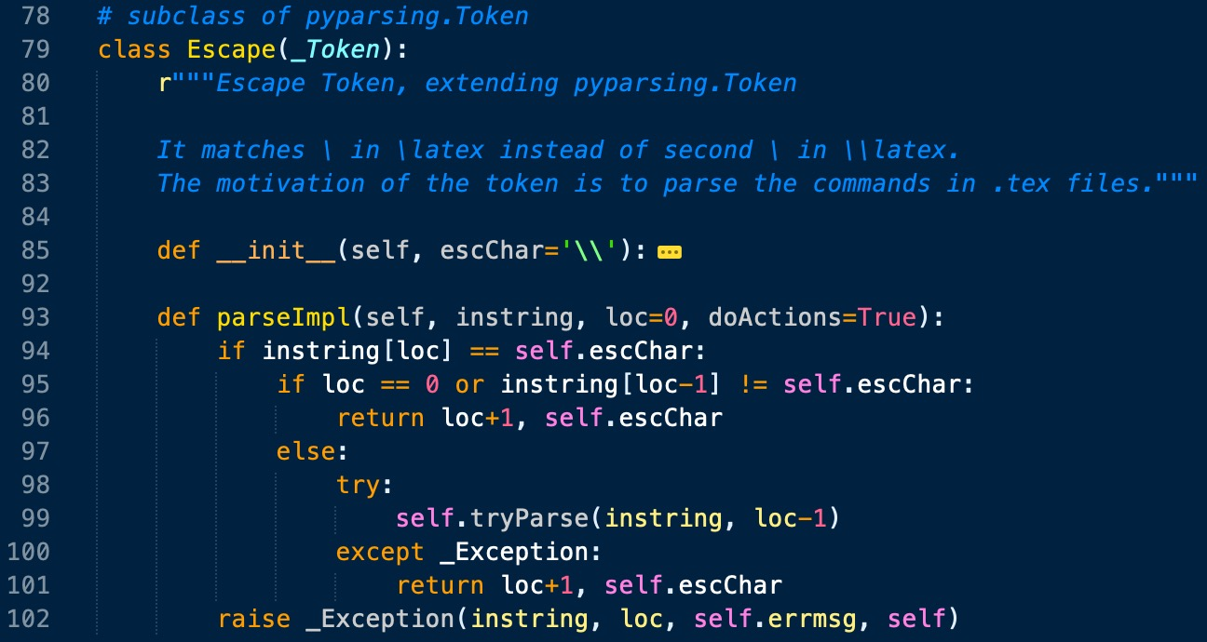
Design trick
DIY parser

Slide 9
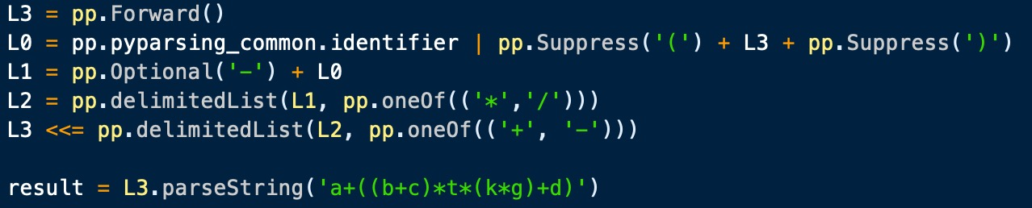
Design trick
Cascading
Code

Slide 10
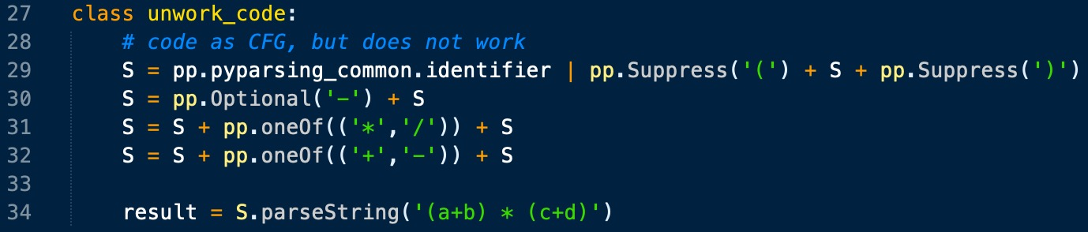
Design trick
Mistake

Slide 11
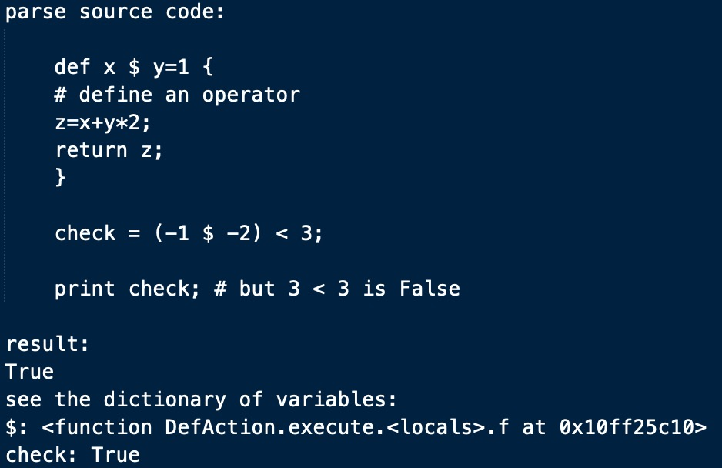
My works
Links：
https://github.com/Freakwill/pyparsing_ext
https://github.com/Freakwill/texparsing
https://github.com/Freakwill/already

Slide 12
Summary
PEG is more efficient then CFG in most aspects.
Pyparsing is a mellifluous tool to design PEG.
It is recommended to implement PEG by your self with your favorite language.
There are many libs written by different languages to construct parsers, such as
“PEG/Go”, “Lpeg/Lua”, “peg/leg/C”, “Treetop/Ruby”, “PEG.js/JavaScript”.
PEG is the future; PEG is all your need; Python and the BDFL choose PEG; Forget CFG.

Slide 13
References
[1] Aaron Moss. Derivatives of Parsing Expression Grammars. https://arxiv.org/pdf/1405.4841.pdf
[2] Bryan Ford, Parsing Expression Grammars: A Recognition-Based Syntactic Foundation. ACM SIGPLAN Symposium on Principles of Programming Languages (POPL), 2004.
[3] McGuire P. Getting Started with Pyparsing[M]. O'Reilly Media, 2007.
[4] Medeiros，Sérgio，Mascarenhas F ，Ierusalimschy R . Left Recursion in Parsing Expression Grammars[C], Brazilian Symposium on Programming Languages. Springer，Berlin，Heidelberg，2012.
[5] https://github.com/yiyuezhuo/pyparsing-doc-zh

Slide 14
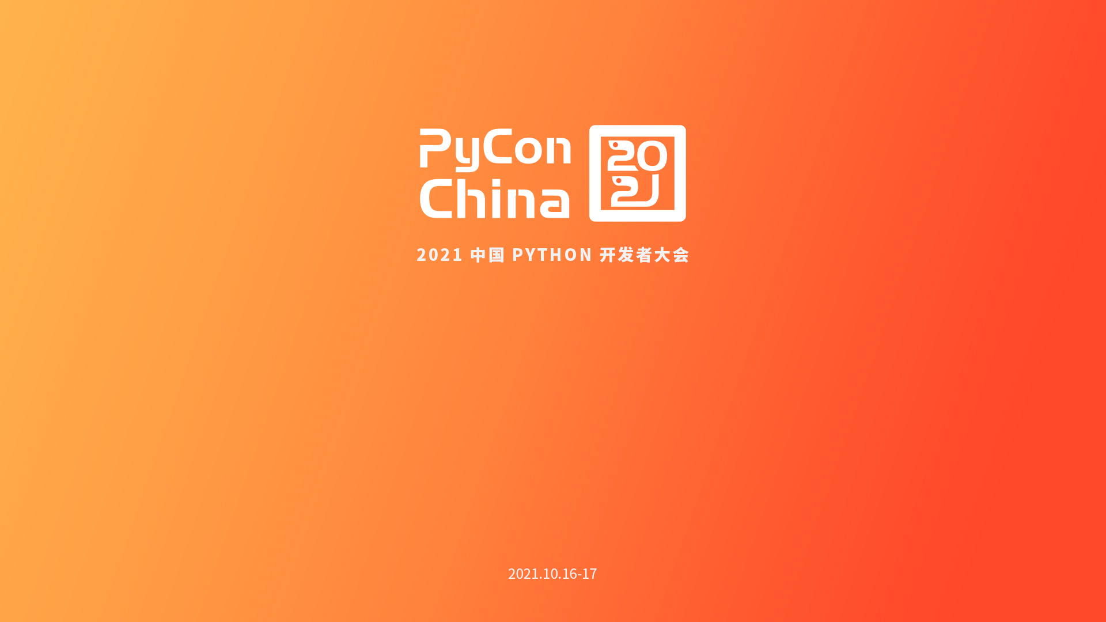
Thanks! ppt link: https://github.com/Freakwill/pycon2021-ppt

