Slide 1

Cohesion
By Tower Defense

Slide 2
Agenda
Definition
High and Low Cohesion
Measuring
Live Demonstration
Software

Slide 3
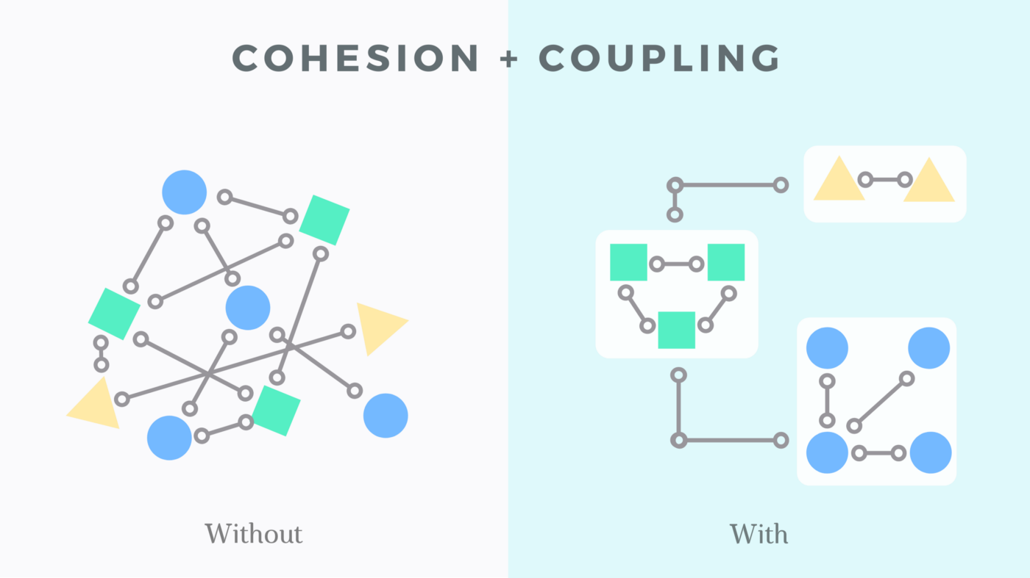
Definition
Cohesion refers to the degree to which elements within a module work together to fulfill a single, well-defined purpose.
High cohesion means that elements are closely related and focused on a single purpose, while low cohesion means that elements are loosely related and serve multiple purposes.
Notes:
In computer programming, cohesion refers to the degree to which the elements inside a module work together to fulfill a single purpose. In one sense, it is a measure of the strength of relationship between the methods and data of a class and some unifying purpose or concept served by that class. In another sense, it is a measure of the strength of relationship between the class's methods and data themselves.
Cohesion is an ordinal type of measurement and is usually described as “high cohesion” or “low cohesion”. High cohesion means that elements are closely related and focused on a single purpose, while low cohesion means that elements are loosely related and serve multiple purposes.

Slide 4
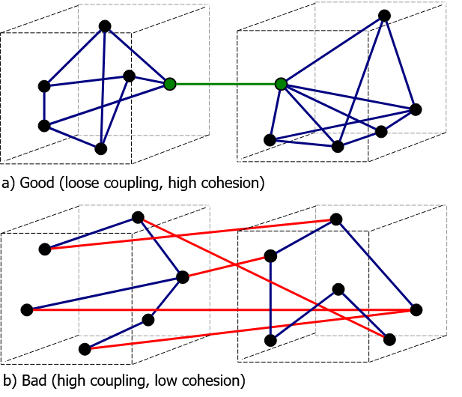
High and Low Cohesion
High cohesion is preferable, because it is associated with several desirable traits of software including robustness, reliability, reusability, and understandability.
In contrast, low cohesion is associated with undesirable traits such as being difficult to maintain, test, reuse, or even understand.

Slide 5
Measuring
Logical Flow
Consistency
Clarity and Understanding
Connection and Relevance
Contextual Appropriateness
Notes:
Measuring coherence can be subjective to some extent, as it often depends on the context and the specific criteria you are using. The most common ways to assess coherence:
Logical Flow: Coherent texts or arguments should have a logical progression of ideas. You can evaluate whether the ideas are presented in a clear and sequential manner, with each point building upon the previous ones.
Consistency: Coherent statements or systems should be internally consistent. This means that there should be no contradictions or conflicts within the given context. Look for logical consistency in the reasoning, evidence, and conclusions.
Clarity and Understanding: Coherent communication should be clear and easily understood by the intended audience. Check if the message is conveyed in a concise and unambiguous way, avoiding unnecessary jargon or complexity.
Connection and Relevance: Coherence often involves establishing connections between different parts of a text or argument. Assess if the various elements or ideas are relevant to the overall topic or purpose and if they contribute to the central message.
Contextual Appropriateness: Consider the context in which coherence is being evaluated. Different disciplines or fields may have their own specific requirements for coherence. Assess whether the communication aligns with the expectations and norms of the given context.
While these measures can provide a general framework for evaluating coherence, it's important to note that different situations may require different criteria. Coherence is a nuanced concept that can be influenced by factors such as the intended audience, the purpose of communication, and the specific subject matter being discussed.

Slide 6


Slide 7
Software
Tools like SonarQube, ESLint, and Pylint analyze source code
Identify potential issues and enforce coding standards
They can flag potential code, like duplicated code or inconsistent naming conventions
Notes:
Yes, there are software tools and metrics that can help in assessing certain aspects related to coherence in code. While they may not provide a definitive measure of coherence, they can offer insights into code quality and maintainability. Some popular code quality analysis tools that can indirectly assess coherence include:
Static Code Analysis Tools: Tools like SonarQube, ESLint, and Pylint analyze source code to identify potential issues and enforce coding standards. They can flag potential code smells, such as duplicated code, complex control flow, or inconsistent naming conventions, which can indirectly impact code coherence.

Slide 8
Thanks for listening

