Slide 1


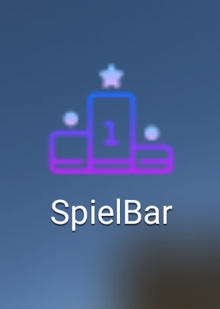
SpielBar
a gaming project for a future nerd bar

Slide 2
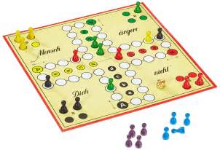
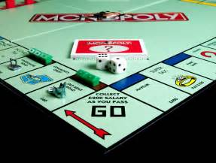
Why Board Games?

Slide 3
What is it?
SpielBar reunions the online playing with the real interaction of people

Slide 4
What can you Do?
Play with your group
For example with your friends ;)
Play with other guys
Enter the bar and say „Hey today i want to meet new people and play with them“
Look out for events
Every one knows quiz night
This could be now doing with the help of app
Check out Highscore
Would it be cool to play against Hamburg?

Slide 5
How do we do this?
An interface for smart tables, tablets or your own devices connected with the WLAN in the bar

Slide 6
Our App
Video presentation of the app

