Slide 1
2019
ACM SIGOPS
Best Paper Awards
(Attempt #2)

Slide 2
SOSP Best Papers
Award process
Group of highly rated papers considered (~6)
Small subset of PC carefully read final versions
Intensive online discussions
Results by consensus of committee
Result: Two award papers

Slide 3
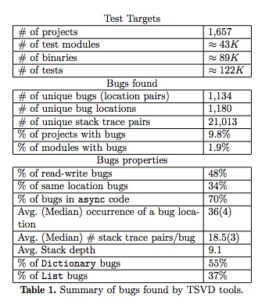
Efficient and Scalable Thread-Safety Violation Detection
Guangpu Li*
Shan Lu*
Madanlal Musuvathi^
Suman Nath^
Rohan Padhye+
*University of Chicago
^Microsoft Research
+UC Berkeley

Slide 4
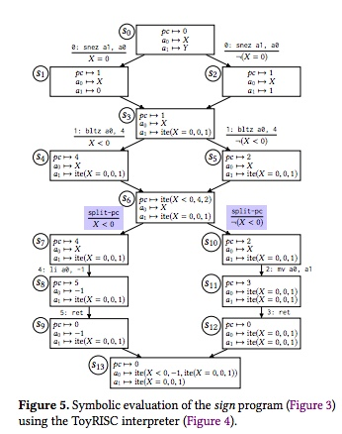
Scaling symbolic evaluation for automated verification of systems code with Serval
Luke Nelson*
James Bornholt*
Ronghui Gu+
Andrew Baumann^
Emina Torlak*
Xi Wang*
*University of Washington
+Columbia University
^Microsoft Research

Slide 5
SOSP Student Research Competition 2019
Angela Demke Brown (University of Toronto)
Jeanna Neefe Matthews (Clarkson University)

Slide 6

About ACM SRC
Students present on-going research
Compete for prizes
Only the second time SRC comes to SIGOPS
Winners, undergraduate and graduate, will represent SIGOPS to compete in ACM SRC Grand Finals
Thank you to Microsoft for sponsoring
$500 travel support to each participant
Prizes to winners of SIG SRCs
Prizes to winners of ACM Grand Finals including travel for winners and advisors to the ACM Awards Banquet

Slide 7
Paper selection/ Poster Session
23 research abstracts submitted
15 selected for on-site poster presentation
13 were able to attend and present
All 15 will be invited to submit their revised abstracts and posters

Slide 8
Presentation Round
5 were further selected to the presentation round
2 undergraduate
3 graduate
All 5 are getting awards tonight!

Slide 9


Student Research Competition Finalists
Oral Presentations were today, 5-6:30pm!
Undergraduate:
Luis Gerhorst - EnergyTimers: Integrating Physical Energy Measurement Devices into OS Kernels
Ziyi Zhang - Visualizing Critical Sections in Rust
Graduate:
Swapnil Gandhi - Wave: A Substrate for Distributed Graph Processing on Commodity Clusters
Zhenyu Song - Robustly Improving Byte Miss Ratio with Workload-Learning Caching
Samyukta Yagati - Efficient Privacy Policies in Multiverse Databases
Sponsored by

Slide 10
Undergraduate Silver Medalist
Ziyi Zhang
University of Science and Technology of China
Visualizing Critical Sections in Rust

Slide 11
Undergraduate Gold Medalist
Luis Gerhorst
Friedrich-Alexander-Universität Erlangen-Nürnberg (FAU)
EnergyTimers: Integrating Physical Energy Measurement Devices into OS Kernels

Slide 12
Graduate Bronze Medalist
Swapnil Gandhi
Indian Institute of Science
Wave: A Substrate for Distributed Graph Processing on Commodity Clusters

Slide 13
Graduate Silver Medalist
Zhenyu Song
Princeton University
Robustly Improving Byte Miss Ratio with Workload-Learning Caching

Slide 14
Graduate Gold Medalist
Samyukta Yagati
MIT
Efficient Privacy Policies in Multiverse Databases

Slide 15
Thanks to..
Microsoft for sponsoring
The authors of the 23 submissions and their advisors
SRC program committee
Those who helped circulating the CFP
Aditya Akella (Univ. of Wisconsin, Madison)
Rong Chen (Shanghai Jiao Tong)
Natacha Crooks (Cornell/Berkeley)
Dilma Da Silva (Texas A&M)
Jason Flinn (Univ. of Michigan)
Ana Klimovic (Google)
Geoff Kuenning (Harvey Mudd )
Wyatt LLoyd (Princeton)
Shan Lu (Univ. of Chicago)
Iqbal Mohomed (Samsung AI Centre - Toronto)
Simon Peter (Univ. of Texas at Austin)
Malte Schwarzkopf (MIT CSAIL / Brown)
Ioan Stefanovici (Microsoft Research)
Nandita Vijaykumar (CMU/ Univ. of Toronto)
Junfeng Yang (Columbia)

Slide 16
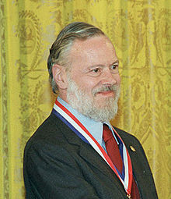
2019 SIGOPS Dennis M. Ritchie Doctoral Dissertation Award
With this award, ACM will encourage the creativity that Ritchie embodied and at the same time provide a reminder of Ritchie's legacy and what a difference a person can make in the field of software systems research.
SIGOPS
AT&T Labs Research
Bell Labs Alcatel Lucent
Sponsored by:
Also supported by:
The Ritchie Family
Presented by Hank Levy

Slide 17
2019 Ritchie Award Committee
Ed Bugnion (EPFL)
Robbert van Renesse (Cornell)
Hank Levy (University of Washington)

Slide 18
Comments about the thesis document:
“This is an exemplary dissertation. Its outstanding technical content is matched by an exceptionally clear-minded and successful effort at developing the additional depth, perspective, and clarity that make dissertations irreplaceable statements of scholarship, instead of binders for conference papers.”
“ [this dissertation] is much more than the “sum of its parts” – it is a significant advance over the underlying papers published about this work, laying out all the pieces in a coherent and thoughtful way.”
The technical work is clever, creative, and elegant; the limitations and indebtedness to prior work are generously discussed, the narrative offers remarkably lucid explanations of the minutest technical detail at a resolution that conference papers cannot match.

Slide 19
2019 Dennis M. Ritchie Thesis Award winner
Sebastian Angel, University of Texas, Austin
Unobservable communications over untrusted infrastructure
Advisor, Michael Walfish

Slide 20
Technical comments:
Sebastian’s work focuses on Pung, a messaging system designed to provide cryptographically strong guarantees on communication metadata. Pung can reasonably support over 100,000 users (several orders of magnitude higher than prior work), and it defends against an extremely powerful adversary – one that observes all network traffic and controls all of the servers.
Pung immediately struck me as one of the most creative and clever approaches to both Private Information Retrieval and unobservable communication, alone or in combination, in recent years.

Slide 21
2019 Dennis M. Ritchie Thesis Award
Notes:
Committee
Me, Jinyang Li (NYU), Herbert Bos (Vrije University)

Slide 22
SIGOPS 2018, 2019 Hall Of fame awardS
Presented by Frans Kaashoek and Robbert van Renesse

Slide 23
The SIGOPS Hall of Fame Award
Recognizes the most influential Operating Systems papers
Now restricted to papers that appeared 10 to 11 years previously
For the 2018 awards: from 1 October 2007 to 30 September 2009
Award committee: PC chairs from SOSP 2007 and OSDI 2008
Frans Kaashoek, Rich Draves, Robbert van Renesse
For the 2019 awards: from 1 October 2008 to 30 September 2010
Award committee: PC chairs from OSDI 2008 and SOSP 2009
Rich Draves, Robbert van Renesse, Tom Anderson
Past winners are listed at
https://www.sigops.org/award-hof.html

Slide 24
2018 Hall of Fame Award recipient
Cristian Cadar, Daniel Dunbar, and Dawson Engler
Stanford University
KLEE: Unassisted and Automatic Generation of High-Coverage Tests for Complex Systems Programs OSDI 2008
“KLEE shows how to scale symbolic execution to generating automatic tests that achieve high coverage and applying it to widely-used software, including the GNU COREUTILS utility programs. The authors demonstrated KLEE’s effectiveness on heavily-used programs by finding bugs that manual testing has missed. The ideas and results have been an inspiration for many subsequent work on automatic bug finding”

Slide 25
2018 Hall of Fame Award recipient
Yuan Yu, Michael Isard, Dennis Fetterly, Mihai Budiu,
Úlfar Erlingsson, Pradeep Kumar Gunda, and Jon Currey Microsoft Research
DryadLINQ: A System for General-Purpose Distributed Data-Parallel Computing Using a High-Level Language OSDI 2008
“DryadLINQ demonstrated how to provide declarative operations on top of a distributed dataflow system, making it convenient for programmers to compute on large data sets using relational operators while providing high-performance. Its techniques include translating data-parallel operations into a distributed execution plan for the Dryad data flow system. The paper demonstrated its effectiveness by showing results from Dryad in production on clusters with thousands of computers.”

Slide 26
2019 Hall of Fame Award recipient
Kirk Glerum, Kinshuman Kinshumann, Steve Greenberg, Gabriel Aul, Vince Orgovan, Greg Nichols, David Grant, Gretchen Loihle, and Galen Hunt (Microsoft)
Debugging in the (Very) Large:
Ten Years of Implementation and Experience SOSP 2009
“This paper describes the successful decade-long effort to dramatically improve the security and reliability of Windows by collecting and analyzing data on every crash experienced by every PC anywhere in the world. Although we now take it for granted that deployed software should always "phone home" error reports, the work described in this paper was the first to do so at global scale.”

Slide 27
2019 Hall of Fame Award recipient
Gerwin Klein, Kevin Elphinstone, Gernot Heiser, June Andronick, David Cock, Philip Derrin, Dhammika Elkaduwe, Kai Engelhardt, Rafal Kolanski, Michael Norrish, Thomas Sewell, Harvey Tuch, and Simon Winwood (NICTA, UNSW, Open Kernel Labs, and ANU)
seL4: formal verification of an OS kernel SOSP 2009
“The seL4 project was the first to provide a machine-checked proof of correctness and security properties of a high-performance microkernel. The authors used a unique approach that fuses formal and operating systems techniques, resulting in a general purpose operating system kernel that performs as well as a state-of-the-art microkernel and whose behavior can be precisely predicted for any input. The work has become the basis for a large amount of subsequent work in provably correct systems.”

Slide 28
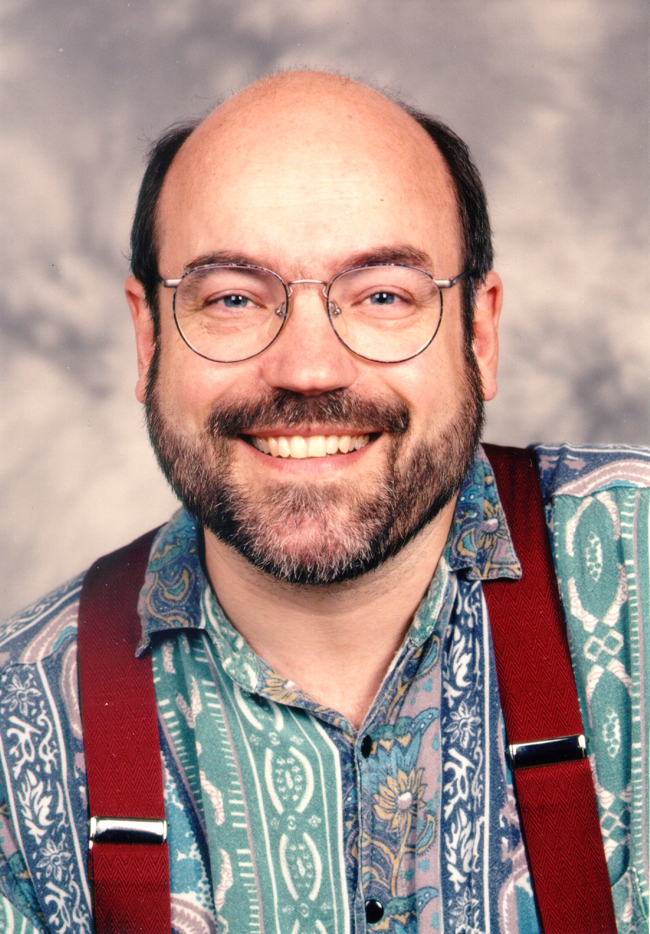
2019
ACM SIGOPS
Mark Weiser Award

Slide 29
Mark Weiser (1952-1999)
1988-1995: Managed Xerox PARC CSL
1995: SOSP program chair
1996-1999: CTO, Xerox PARC
Severe Tire Damage:
first live band on the Internet

Slide 30
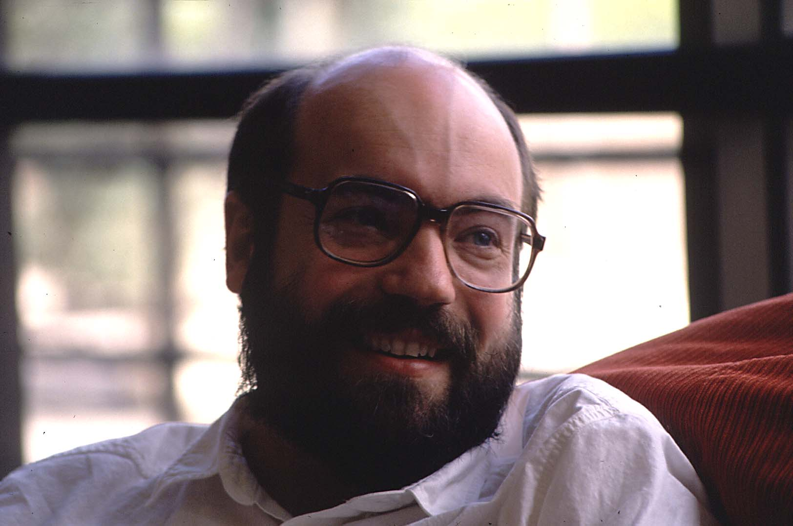
"Ubiquitous computing names the third wave in computing, just now beginning. First were mainframes, each shared by lots of people. Now we are in the personal computing era, person and machine staring uneasily at each other across the desktop. Next comes ubiquitous computing, or the age of calm technology, when technology recedes into the background of our lives."

Slide 31
The Mark Weiser Award
Created in 2001 by ACM SIGOPS
“To be given to individuals who have demonstrated creativity and innovation in operating systems research”
Recipients must have begun career no earlier than 20 years prior to nomination
Chosen based on “contributions that are highly creative, innovative, and possibly high-risk, in keeping with the visionary spirit of Mark Weiser”

Slide 32
Previous Recipients
2011: Miguel Castro
2012: Jeff Dean
Sanjay Ghemawat
2013: Stefan Savage
2014: Eddie Kohler
2015: Yuanyuan Zhou
2016: Ant Rowstron
2017: Nickolai Zeldovich
2018: Andrea Arpaci-Dusseau
Remzi Arpaci-Dusseau
2001: Frans Kaashoek
2002: Mendel Rosenblum
2003: Mike Burrows
2004: Brian Bershad
2005: Tom Anderson
2006: Dawson Engler
2007: Peter Chen
2008: Peter Druschel
2009: Eric Brewer
2010: Robert Morris
2019 award committee:
Jeff Dean*, Robert Morris, Andrea Arpaci-Dusseau

Slide 33
A few quotes from the letters
“incredibly innovative, technically deep, and impactful”
“contributions have been both prolific and profound”
“the sum total of insight [of a certain body of work] far exceeds that produced by anyone else in the field”
“can’t think of a more deserving candidate for the Weiser award”

Slide 34
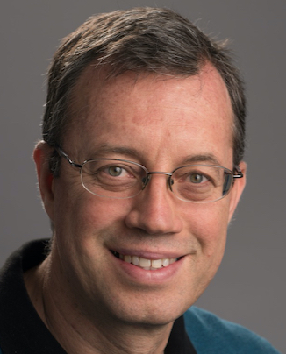
The 2019 Weiser Award winner
Ion Stoica

