Slide 1



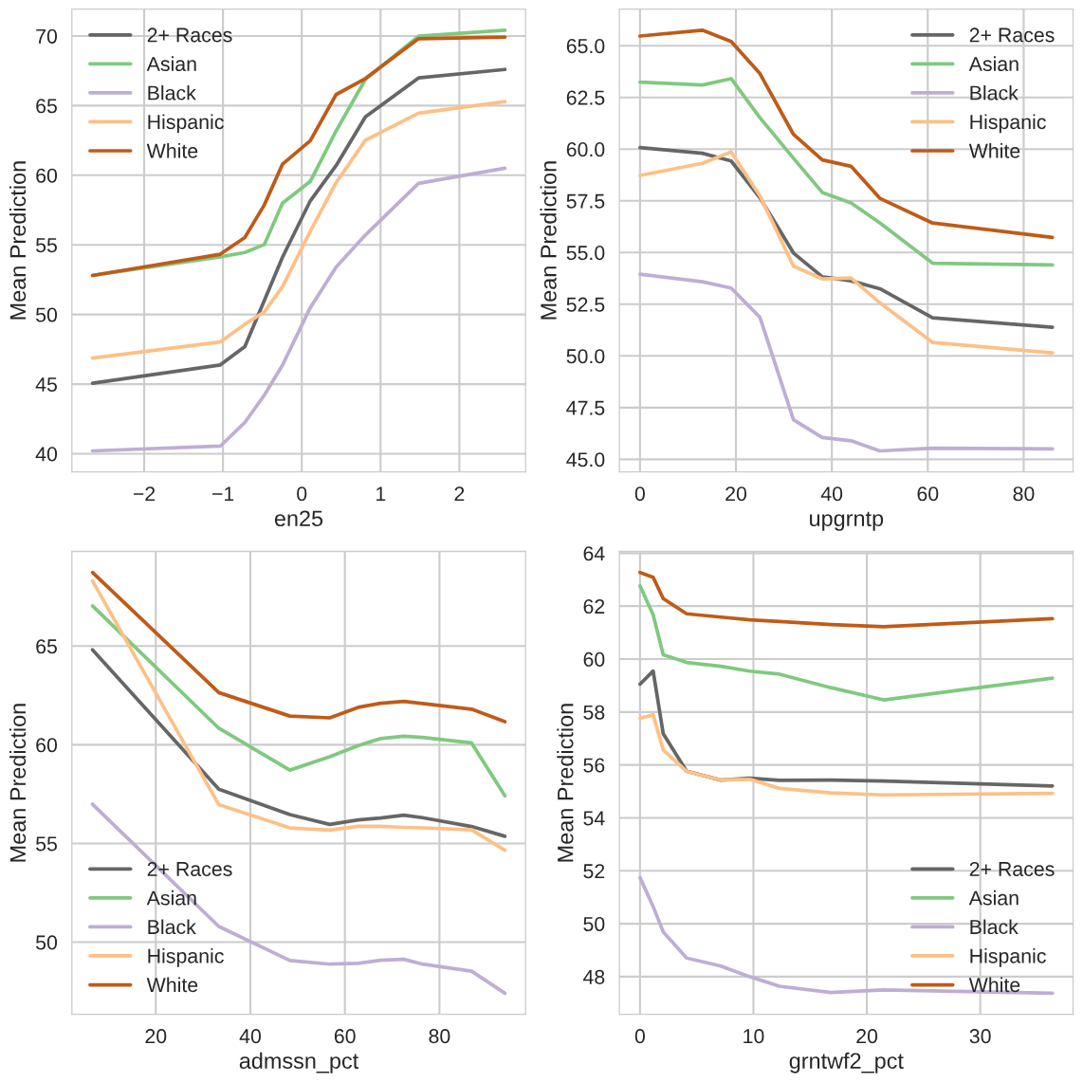
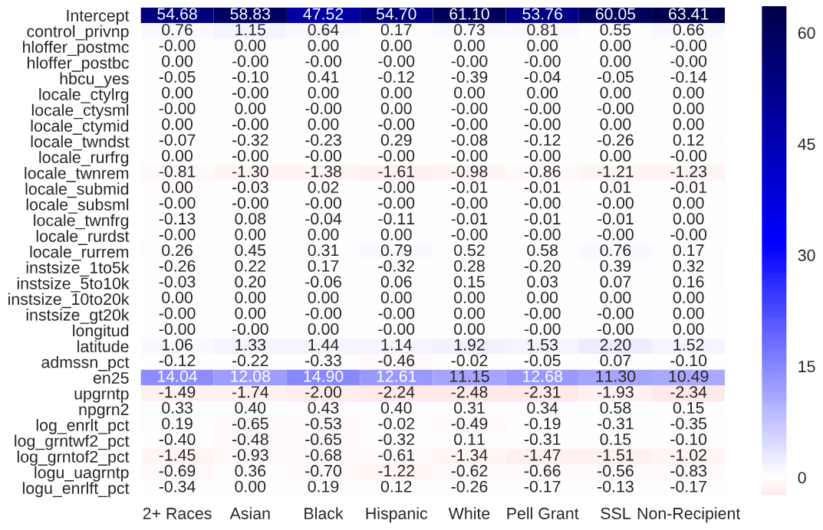
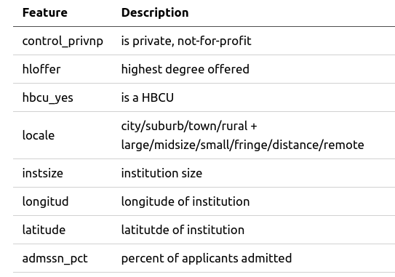
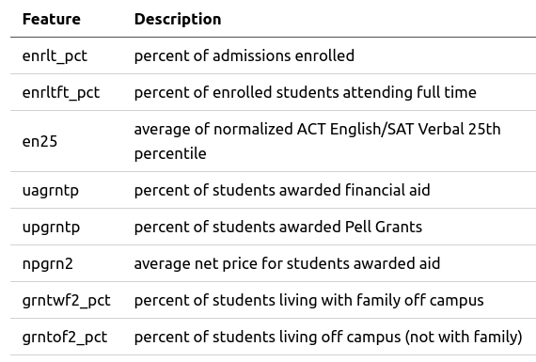
Predicting Graduation Rates
Fred Berendse, Ph.D.
/github.com/fred-b-berendse
in
/in/fred-b-berendse
fred.b.berendse@gmail.com
Background
Models
Models
Results
Education is touted as the great equalizer that opens doors for the disenfranchised. For that reason, it is necessary to examine how our educational institutions, from pre-K to post-secondary, are facilitating (or hampering) the path toward equity.
Linear Regression with Lasso
Partial Dependence Plots
All three models have relatively the same values of R-squared and RMSE.
Five-fold cross validation was used to optimize the Lasso shrinkage parameter to 0.08.
Lasso Regression Coefficients
Objectives
Determine the primary factors influencing post-secondary graduation rates of majority and minority groups.
Utilize regression models and predict graduation rates based on institutional metrics.
Markov-Chain Monte Carlo
A MCMC regressor utilizing a subset of features from the Lasso regression model gives the following distributions of coefficients.
Random Forest Regression
Data
Five-fold cross validation provided a best RF model with 160 trees, a MSE split criterion, 2 or more samples per split, and considered features per split.
The IPEDS database consists of annual survey data collected from post-secondary institutions. Targets are bachelor’s degrees completed within 6 years in 2016-17. Features include institutional, admissions, and student financial aid data. There were 682 institutions with all considered features. Variance inflation factors above 5 were eliminated, resulting in the feature set below.
$\sqrt{n}$
Partial Dependence Plots
Conclusions
Tech Stack
All three models agree on the most important features consistent across all race and aid status groups:
English 25th acceptance percentile
Percent of students awarded Pell grant
Percent applicants admitted
Percent students living with family
Notes:
1

