Slide 1



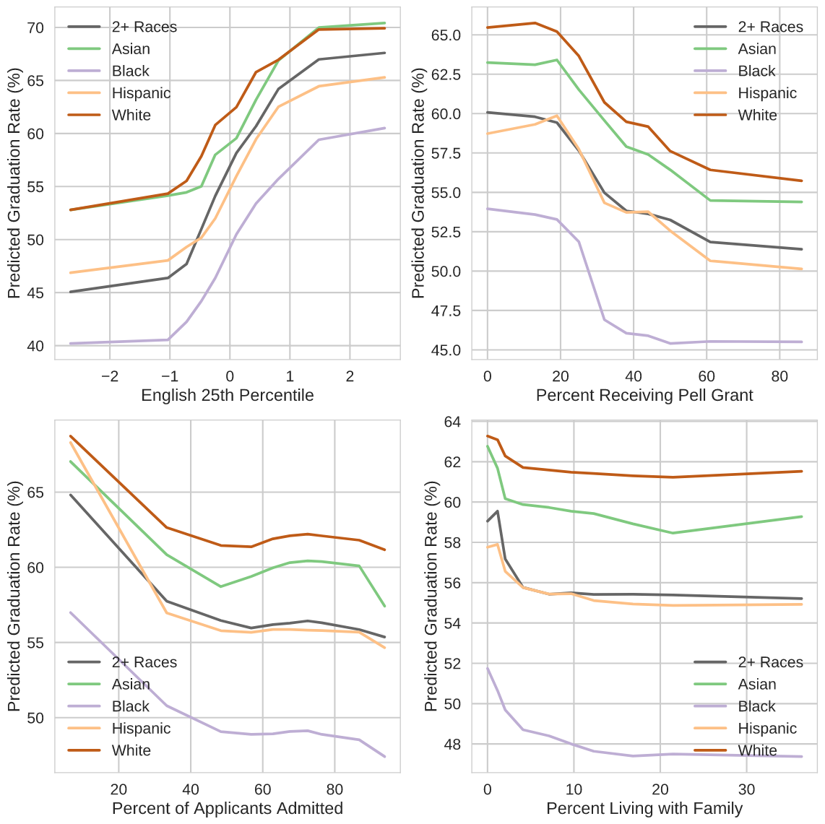
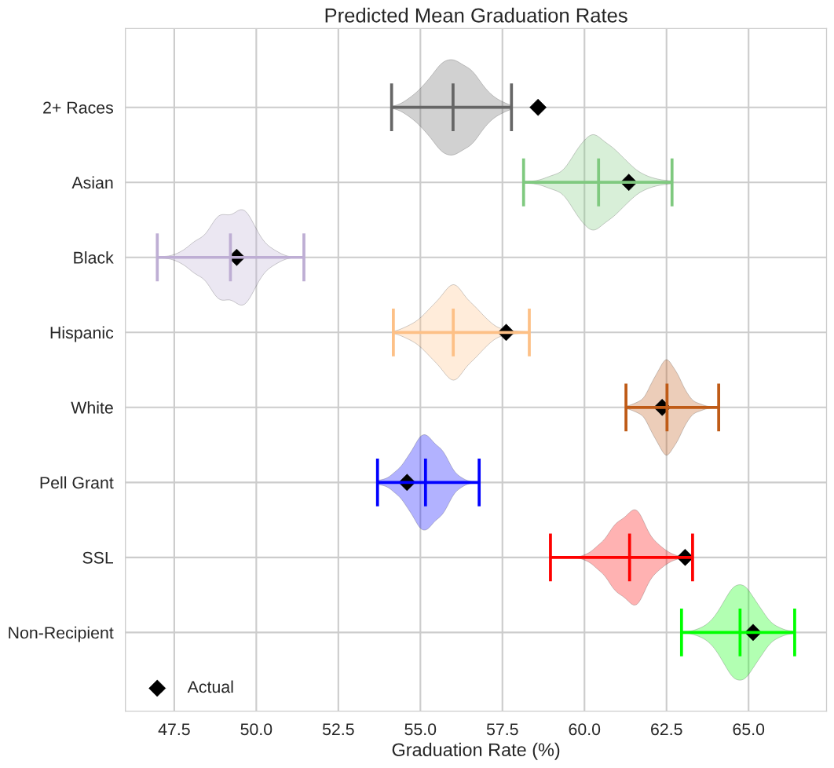
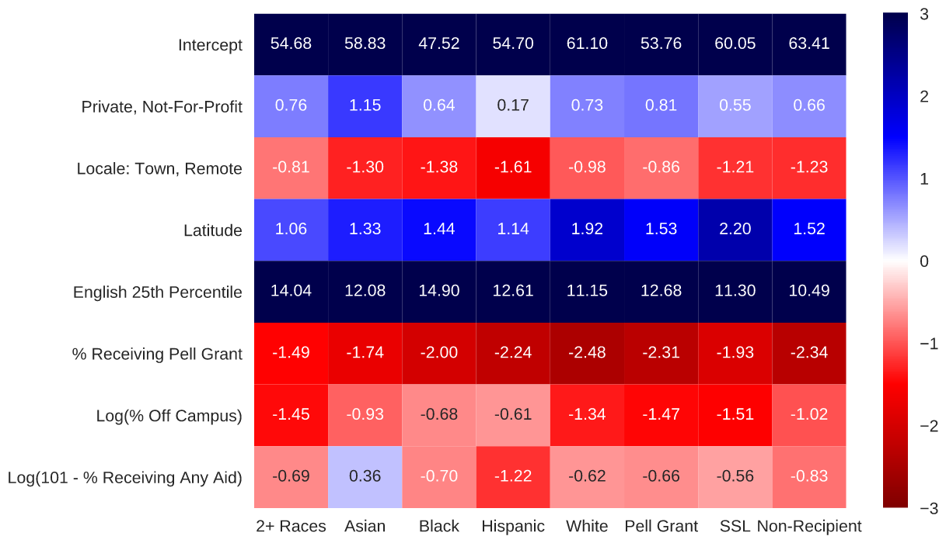
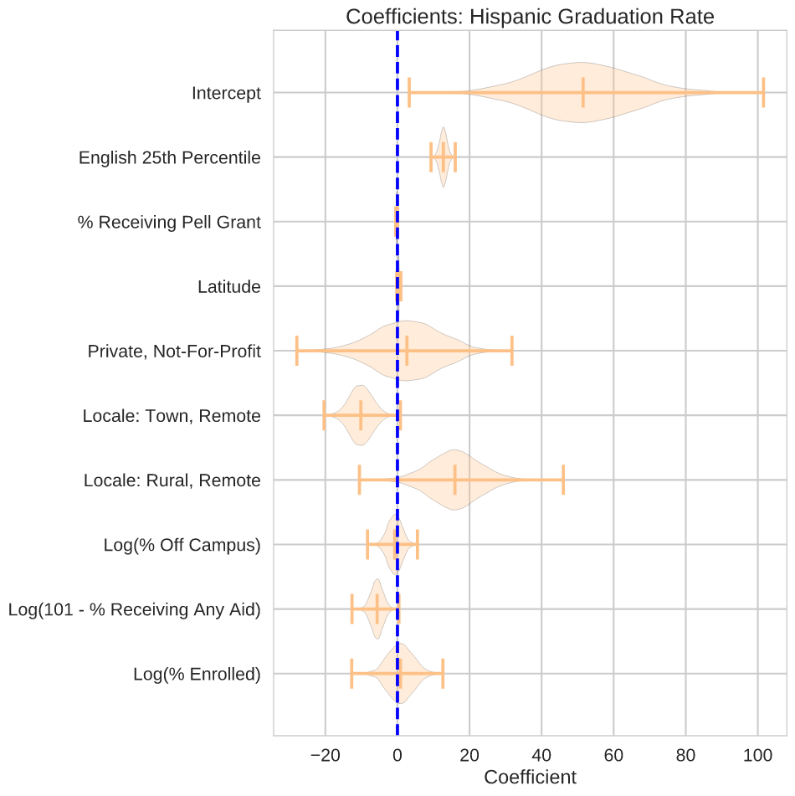
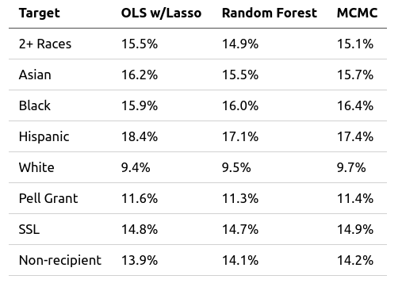
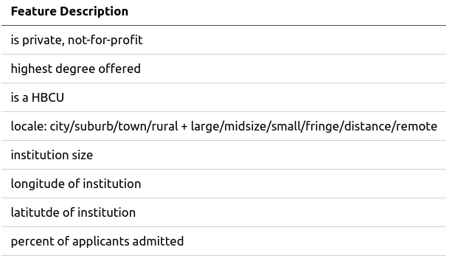
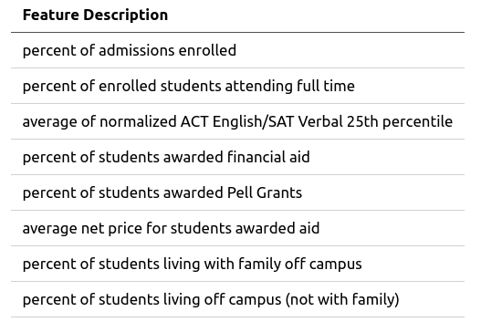









Predicting Graduation Rates
Fred Berendse, Ph.D.
/github.com/fred-b-berendse
in
/in/fred-b-berendse
fred.b.berendse@gmail.com
Background
Models
Models
Education is touted as the great equalizer that opens doors for the disenfranchised. For that reason, it is imperative to examine how our educational institutions, from pre-K to post-secondary, are facilitating (or hampering) the path toward equity.
Linear Regression with Lasso
Partial Dependence Plots
Predicted Mean Graduation Rate
Below are the most important coefficients after Lasso regularization:
Lasso Regression Coefficients
Objectives
Determine the primary factors influencing post-secondary graduation rates of majority and minority groups.
Utilize regression models and predict graduation rates based on institutional metrics.
Markov Chain Monte Carlo
A MCMC regression utilizing the important features from the Lasso regression model was performed. All fits obtained convergence (i.e. Gelman-Rubin statistic near 1.00). All racial/aid target groups obtained similar coefficient distributions.
Random Forest Regression
Coefficients: Hispanic Graduation Rate
Partial dependence plots for the four most important features are shown. Higher test benchmarks, fewer Pell Grants, and more selective admissions correlate with higher graduation rates.
Model Comparison
Data
All three models have similar RMSEs with random forest holding a slight edge in performance.
The IPEDS database consists of annual survey data collected from post-secondary institutions. Targets are bachelor’s degrees completed within 6 years in 2016-17. Features include institution characteristics, admissions data, and student financial aid data. There are 682 institutions with all considered features. Variance inflation factors above 5 were eliminated, resulting in the feature set below.
Partial Dependence Plots
Conclusions
Tech Stack
All three models agree that ACT/SAT acceptance benchmarks are positively correlated with graduation rates for all groups. Percentage of students receiving a Pell Grant is negatively correlated with graduation rate in the Lasso and random forest models.
Notes:
<number>

