Slide 1



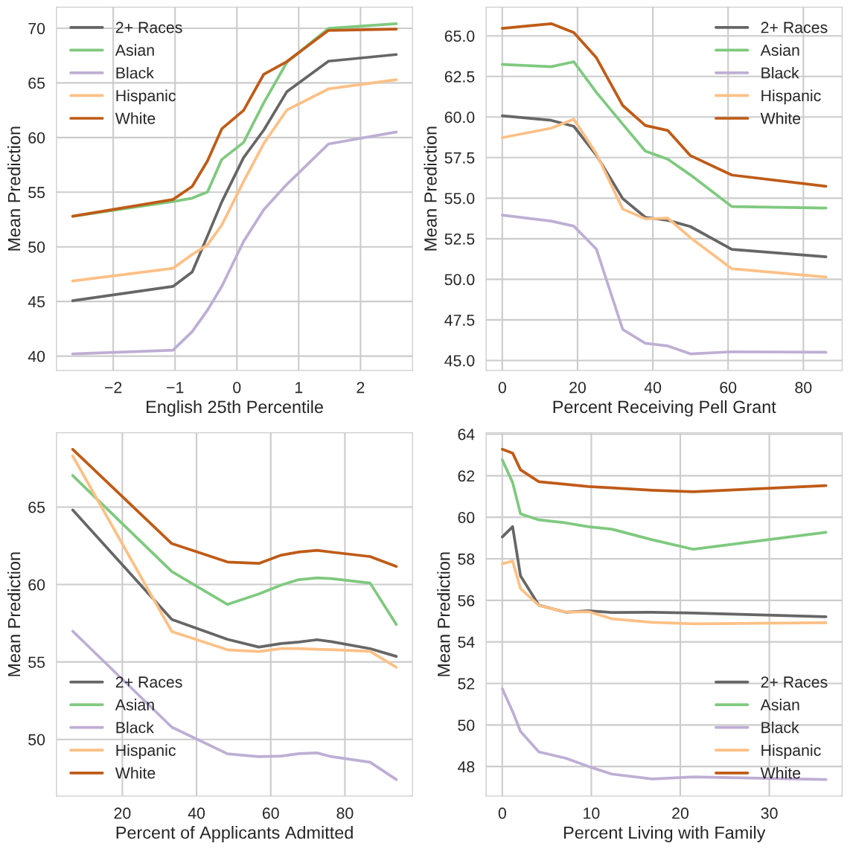
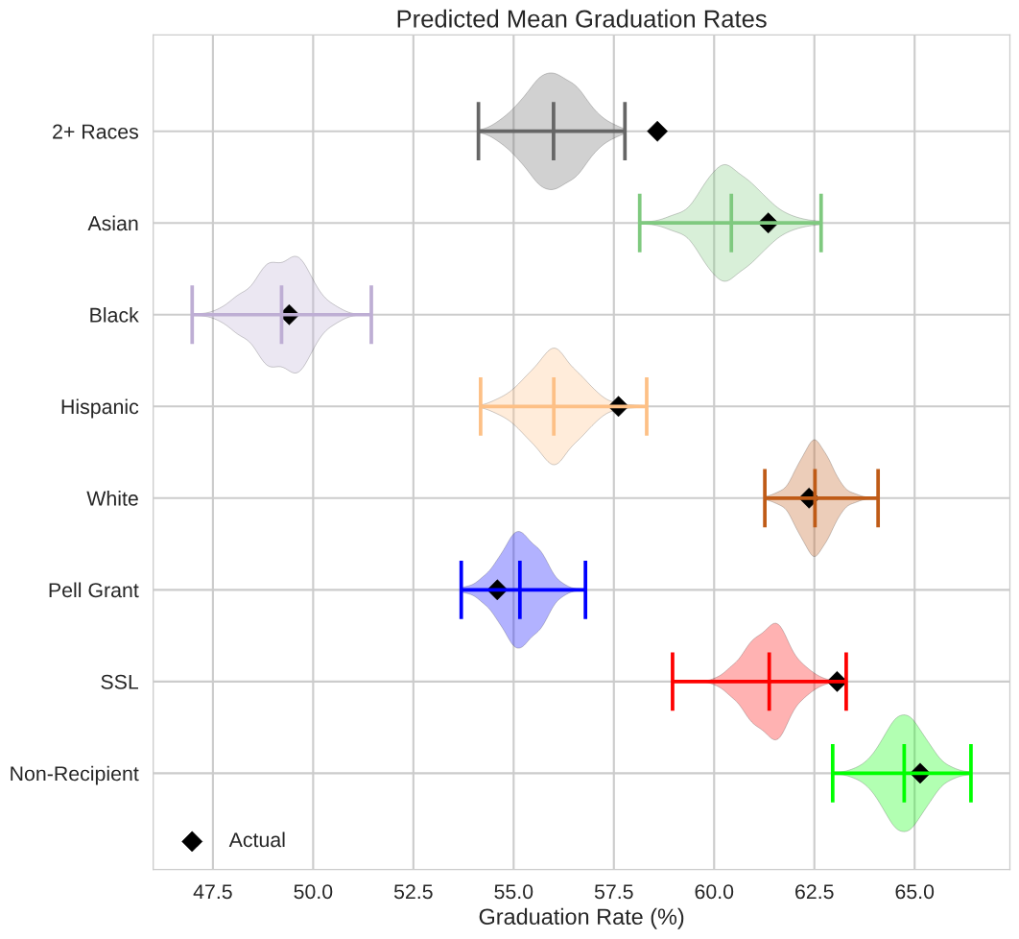
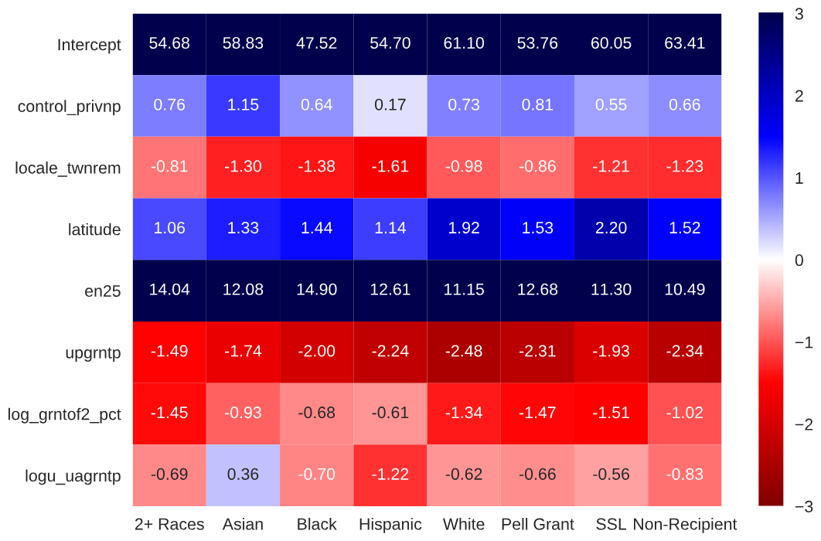
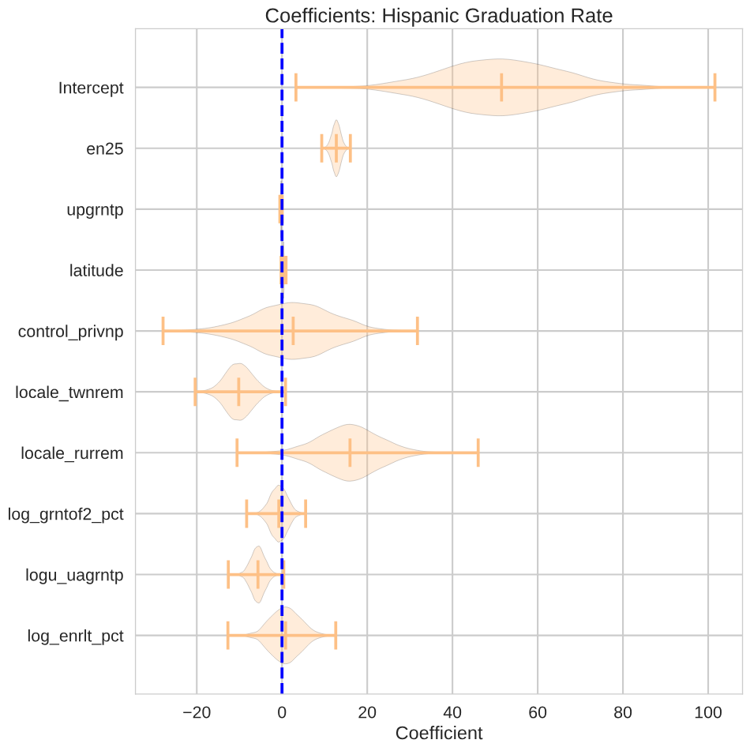
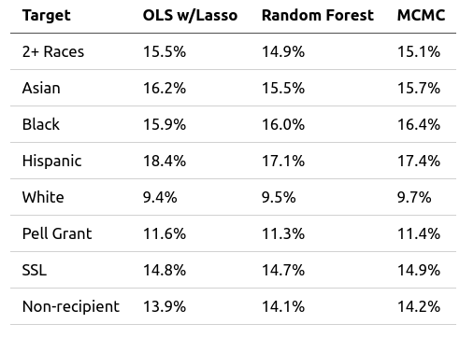
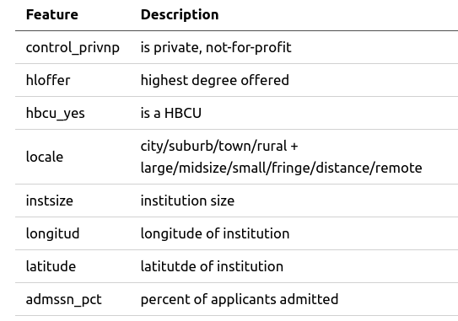
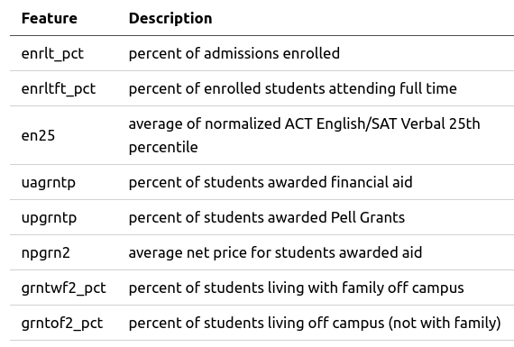









Predicting Graduation Rates
Fred Berendse, Ph.D.
/github.com/fred-b-berendse
in
/in/fred-b-berendse
fred.b.berendse@gmail.com
Background
Models
Models
Models
Education is touted as the great equalizer that opens doors for the disenfranchised. For that reason, it is necessary to examine how our educational institutions, from pre-K to post-secondary, are facilitating (or hampering) the path toward equity.
Linear Regression with Lasso
Partial Dependence Plots
Predicted Mean Graduation Rate
Below are the most important coefficients after Lasso Regularization:
Lasso Regression Coefficients
Objectives
Determine the primary factors influencing post-secondary graduation rates of majority and minority groups.
Utilize regression models and predict graduation rates based on institutional metrics.
Markov-Chain Monte Carlo
A MCMC regression utilizing the important features from the Lasso regression model was performed. All fits obtained convergence (i.e. Gelman-Rubin statistic near 1.00). All racial/aid target groups obtained similar coefficient distributions.
Random Forest Regression
Coefficients: Hispanic Graduation Rate
Data
Five-fold cross validation provided a best RF model with 160 trees, a MSE split criterion, 2 or more samples per split, and considered features per split.
Model Comparison
The IPEDS database consists of annual survey data collected from post-secondary institutions. Targets are bachelor’s degrees completed within 6 years in 2016-17. Features include institution characteristics, admissions data, and student financial aid data. There were 682 institutions with all considered features. Variance inflation factors above 5 were eliminated, resulting in the feature set below.
$\sqrt{n}$
All three models have similar RMSEs with Random Forest holding a slight edge in performance.
Partial Dependence Plots
Tech Stack
Conclusions
All three models agree on the most important features consistent across all race and aid status groups:
English 25th acceptance percentile
Percent of students awarded Pell grant
Percent applicants admitted
Notes:
<number>

