Slide 1

Predicting Graduation Rates
Can one accurately predict an institution’s graduation rate for minority and low-socioeconomic-status students based on an institution’s features?

Slide 2
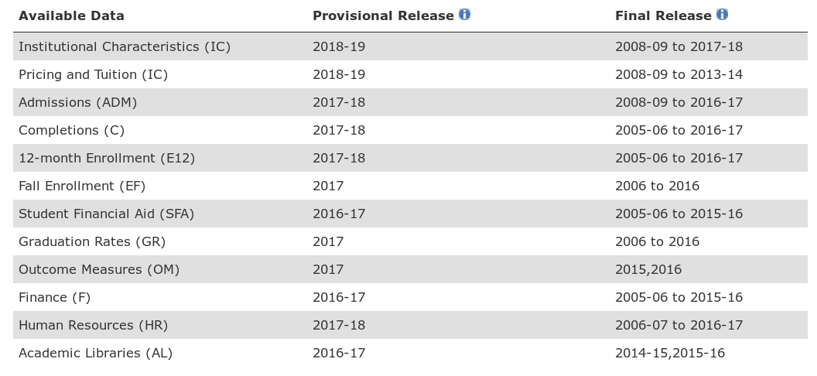
The IPEDS Dataset
Collected by the US Department of Education annually
Over 7000 post-secondary institutions

Slide 3
The IPEDS Dataset
Table | Rows | Full Rows | Description
HD2017 | 7153 | 7153 | Institutional characteristics: name, location, locale, highest deg. awarded, etc.
ADM2017 | 2075 | 920 | Application, admission and enrollment data including SAT/ACT percentiles
GR2017 | 54714 | 49981 | Number of bachelor’s degree completions in 150% normal time by gender and race/ethnicity
GR2017_PELL_SSL | 9116 | 5557 | Number of bachelor's degree completions in 150% normal time by Pell Grant recipients, Subsidized Stafford Loan recipients, and non-recipients
SSL2017 | 6394 | 0 | Number of students paying in-state/out-of-state tuition and receiving grant/scholarship aid

Slide 4
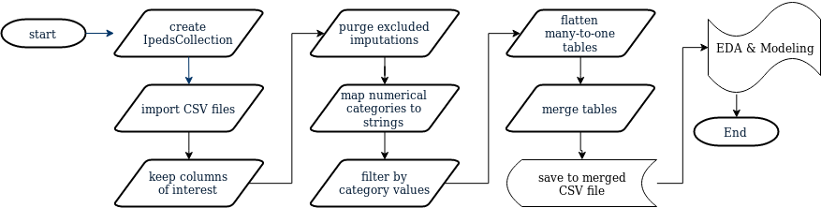
Data Cleaning Process

Slide 5
Data Cleaning Challenges
Flattening many-to-one tables before merging
Merging SAT and ACT benchmark percentiles into one score
Imputing graduation rates for groups not reported

Slide 6
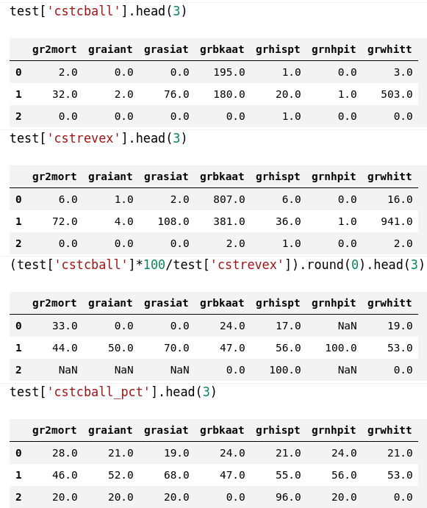
Data Cleaning Challenges
Laplace Smoothing
Without Smoothing
With Smoothing

Slide 7
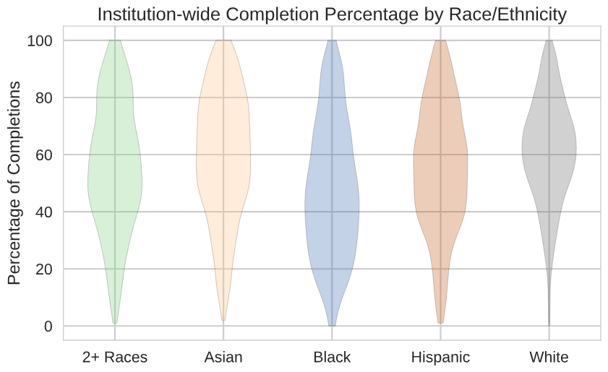
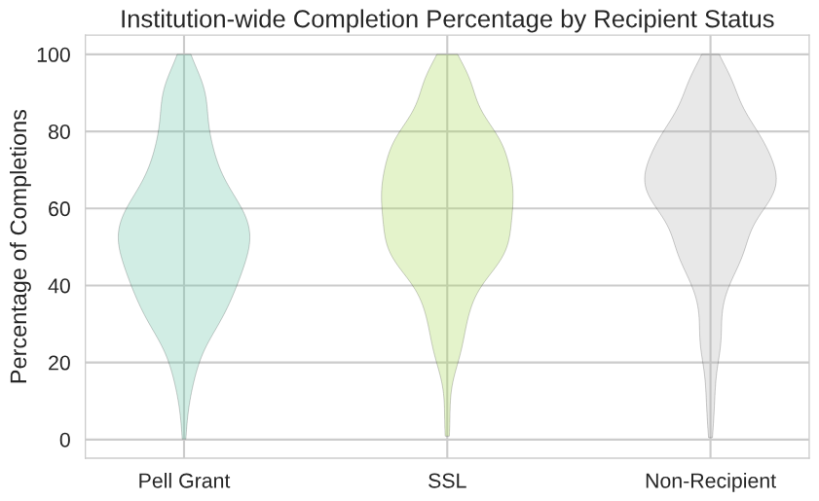
Exploratory Data Analysis
Lower mean completion percentages for some groups

Slide 8
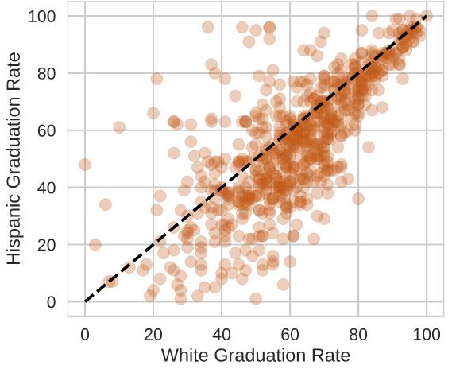
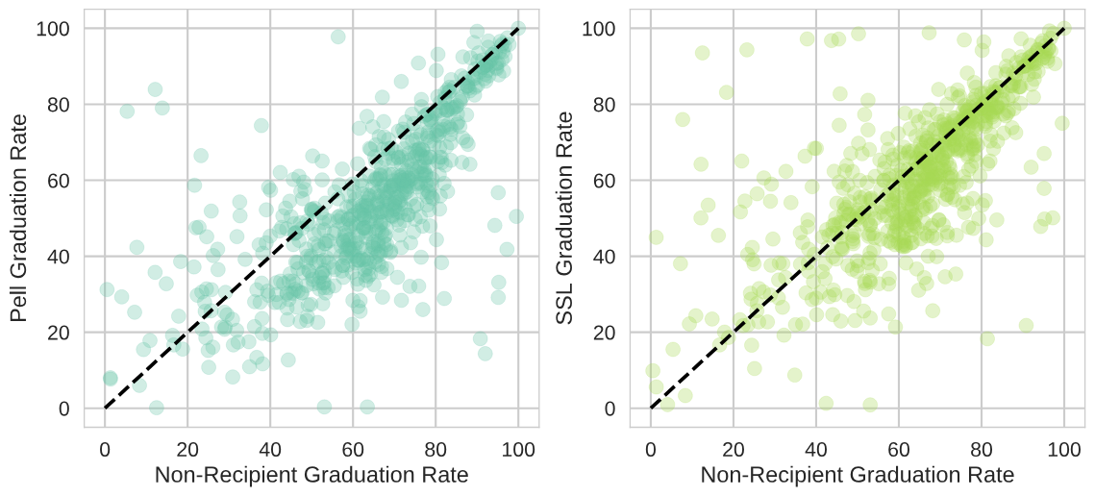
Exploratory Data Analysis
Strong correlation of graduation rates between different groups

Slide 9
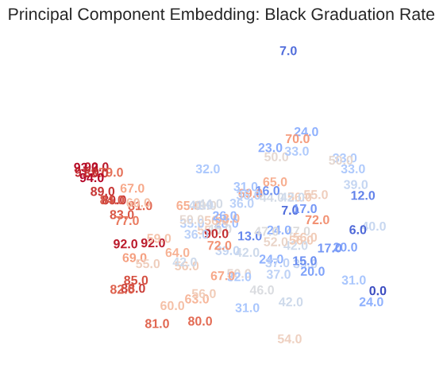
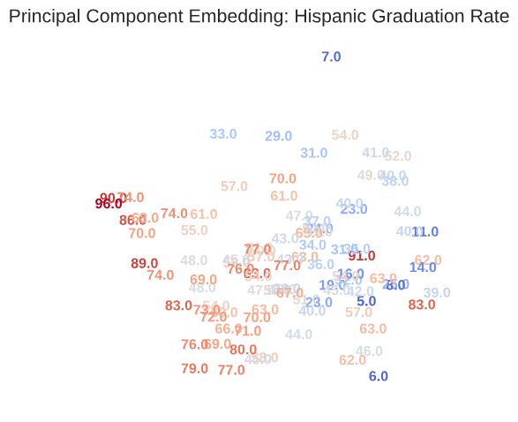
Exploratory Data Analysis
First PCA axis weighted by:
Benchmark SAT/ACT scores
Percentage of students receiving a Pell Grant

Slide 10
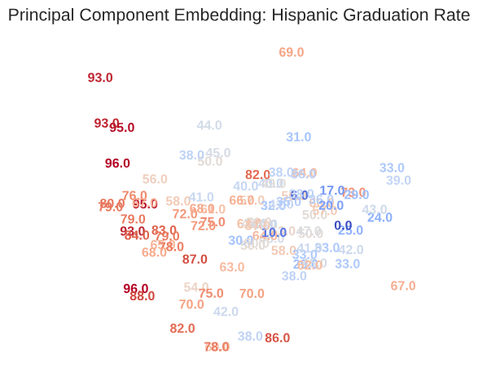
Exploratory Data Analysis
Laplace smoothing affects separation of Asian graduation rates in PCA
With Smoothing Without Smoothing

Slide 11
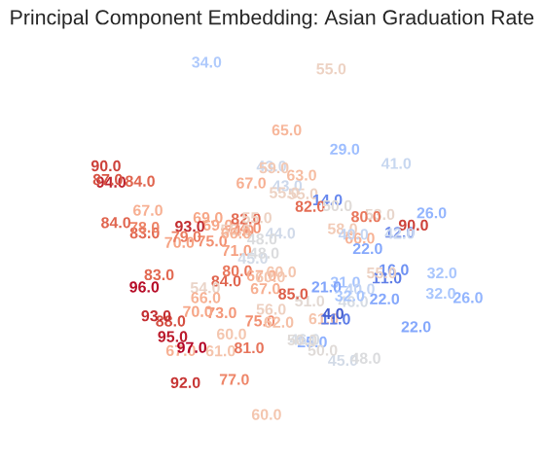
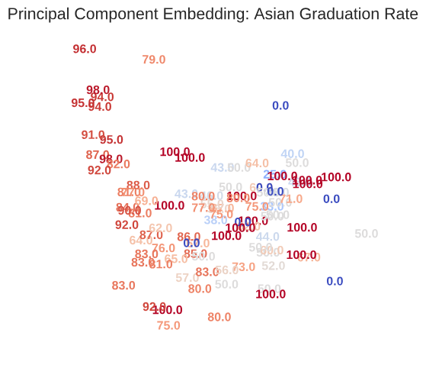
Exploratory Data Analysis
Laplace smoothing affects separation of Asian graduation rates in PCA
With Smoothing Without Smoothing

Slide 12
Linear Regression Modeling
Variance Inflation Factors used to remove co-linear features (cutoff = 5)
Surviving Features
Feature | VIF
Latitude | 1.09
Longitude | 1.14
% Enrolled Full Time | 1.20
% Enrolled | 1.29
% Admitted | 1.42
Feature | VIF
% living off campus (w/ family) | 1.44
% living off campus (w/o family) | 1.32
English 25th percentile | 2.81
% awarded any aid | 1.84
% awarded Pell Grant | 3.17

Slide 13
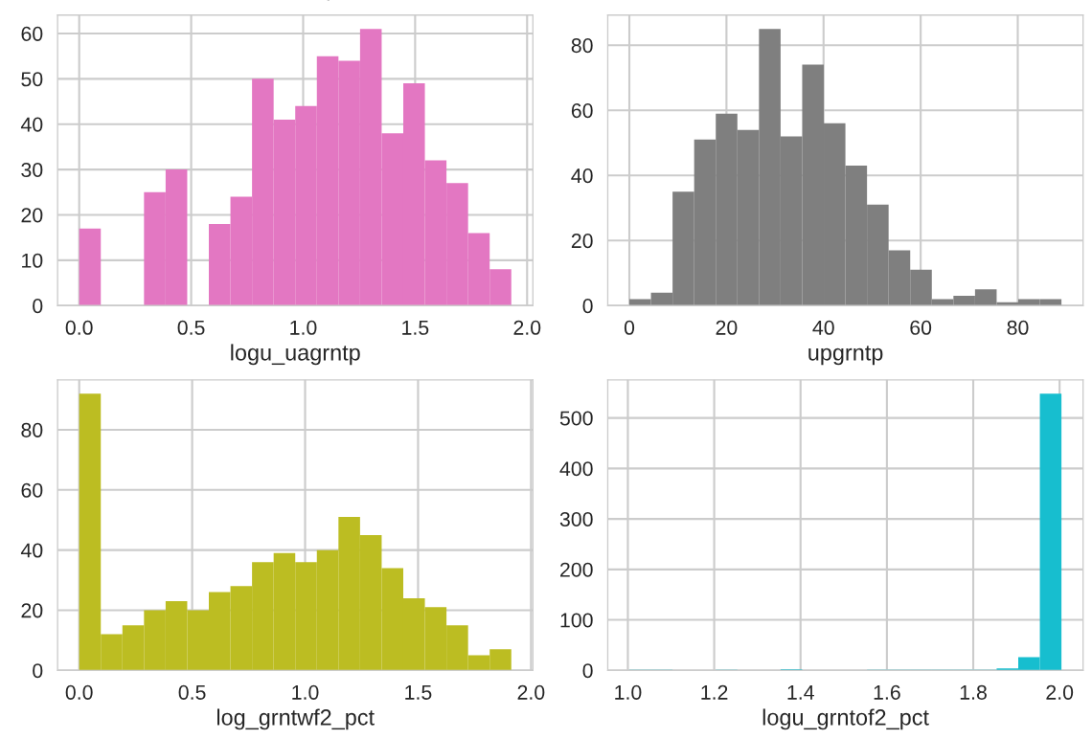
Linear Regression Modeling
Some features have very asymmetric distributions even after log transformations.

Slide 14
Linear Regression Modeling
Regression Metrics
Target | Train R² | Test R² | RMSE
2 or More Races | 0.56 | 0.44 | 15.4
Asian | 0.49 | 0.41 | 17.2
Black | 0.59 | 0.52 | 15.4
Hispanic | 0.52 | 0.38 | 16.6
White | 0.70 | 0.60 | 10.9
Pell Grant | 0.67 | 0.55 | 12.5
Sub. Stafford Loan | 0.57 | 0.46 | 14.1
Non-Recipient | 0.54 | 0.39 | 15.4

Slide 15
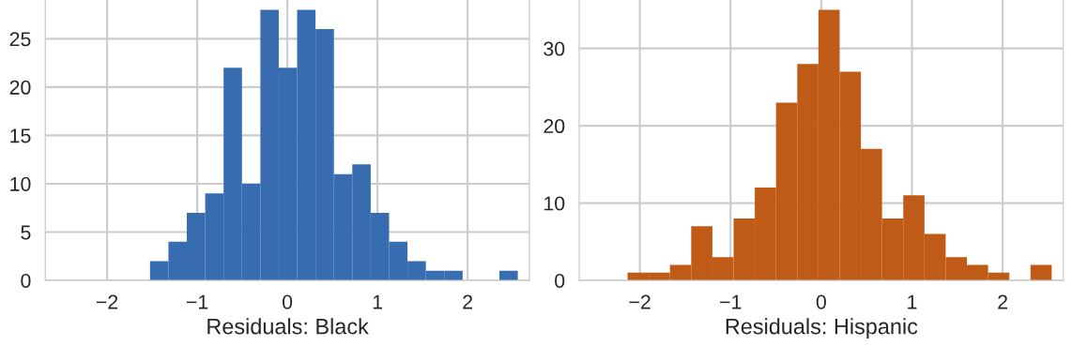
Linear Regression Modeling
Residuals have normal-like distributions

Slide 16
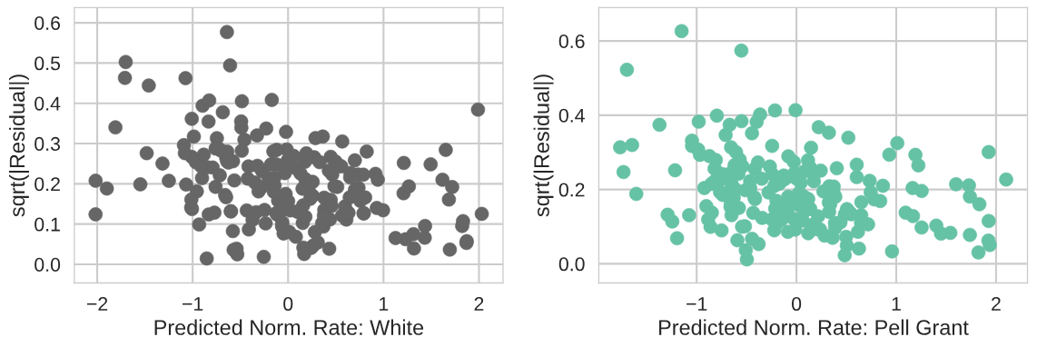
Linear Regression Modeling
Homoscedacity tested with spread-location plots

Slide 17
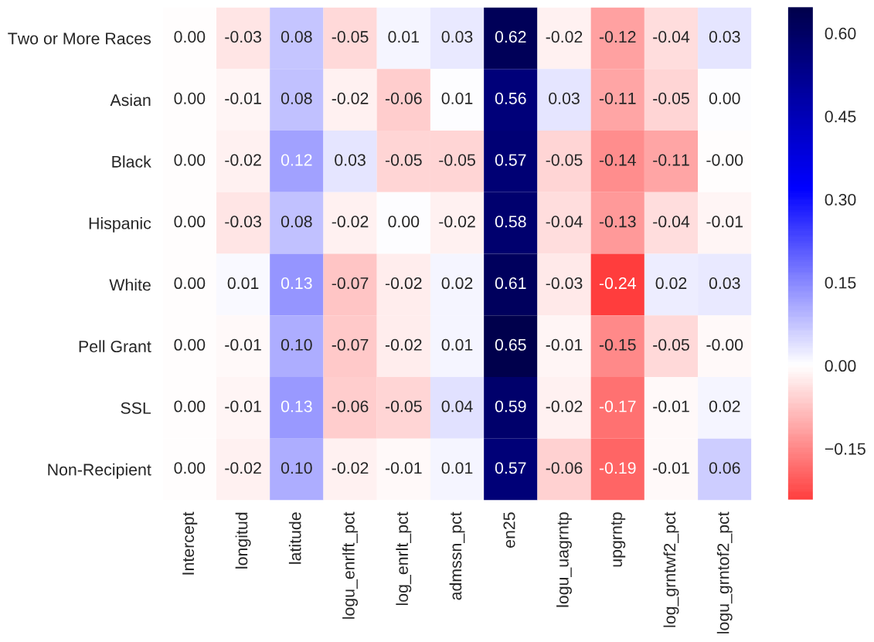
Linear Regression Modeling
Normalized coefficients

Slide 18
Lasso Regularization
sklearn’s LassoLarsCV
5-fold cross validation
500 maximum iterations
Best Hyperparameter Results
Shrinkage parameter α = 0.002
Converged within 10 iterations
Target | Test R²
2 or More Races | 0.44
Asian | 0.41
Black | 0.52
Hispanic | 0.38
White | 0.60
Pell Grant | 0.55
Sub. Stafford Loan | 0.46
Non-Recipient | 0.39

Slide 19
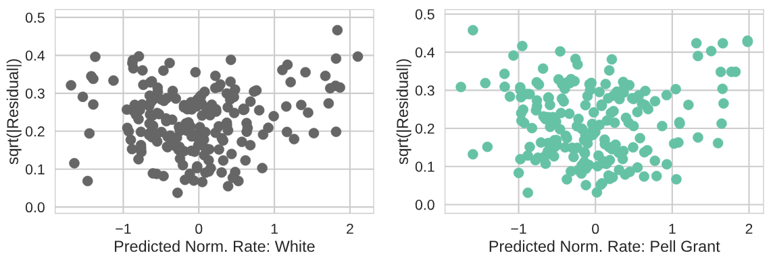
Lasso Regularization
Improved spread-location plots

Slide 20

Lasso Regularization
Normalized coefficients

Slide 21
Random Forest Modeling
sklearn’s RandomForestRegressor + RandomizedSearchCV
5-fold cross validation
Hyperparameter | Baseline | Search Range | Best Model
number of trees | 100 | 100 - 1000 | 600
criterion for split | MSE | MSE, MAE | MAE
Min # for split | 2 | 2, 5, 10, 20 | 5
Min # per leaf | 1 | 1, 2, 5 | 2
Max features per split | sqrt(n) | n, sqrt(n) | sqrt(n)

Slide 22
Random Forest Modeling
Model Metrics
Target | Test R² | Test RMSE
2 or More Races | 0.44 (0.42) | 15.30 (15.72)
Asian | 0.38 (0.38) | 17.27 (17.31)
Black | 0.56 (0.55) | 14.92 (14.86)
Hispanic | 0.36 (0.32) | 16.65 (17.23)
White | 0.63 (0.62) | 10.52 (10.70)
Pell Grant | 0.57 (0.55) | 12.33 (12.23)
Sub. Stafford Loan | 0.48 (0.47) | 13.84 (14.21)
Non-Recipient | 0.39 (0.37) | 15.34 (15.70)
Baseline model results in parentheses

Slide 23
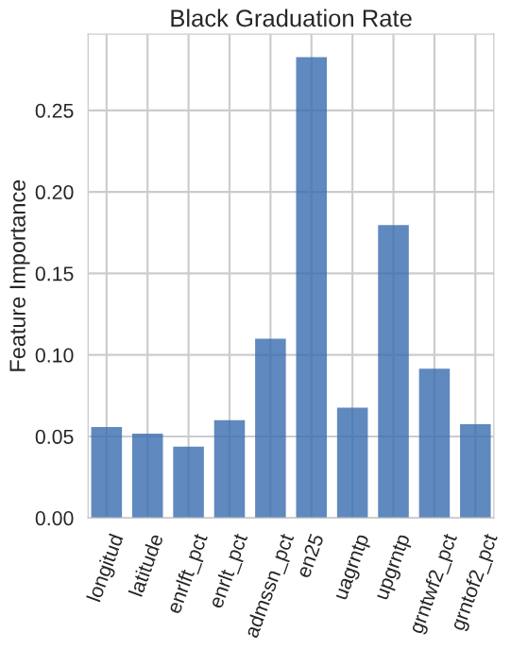
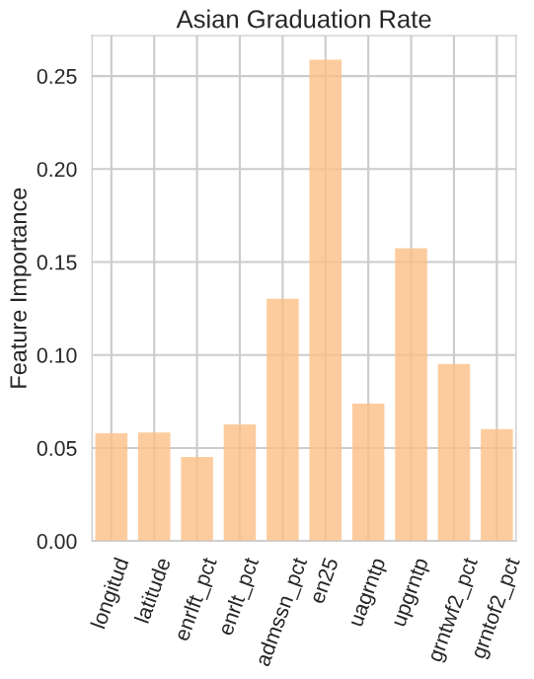
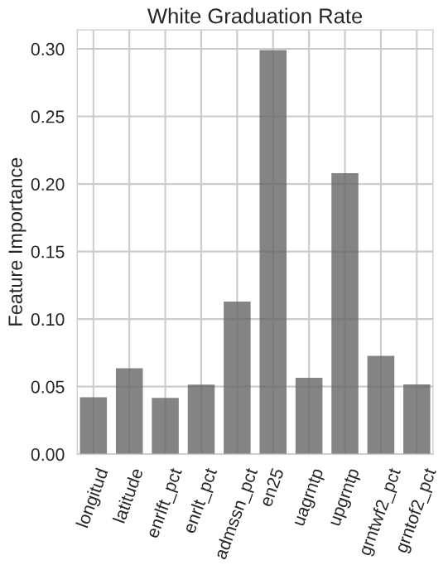
Random Forest Modeling
Feature Importance

Slide 24
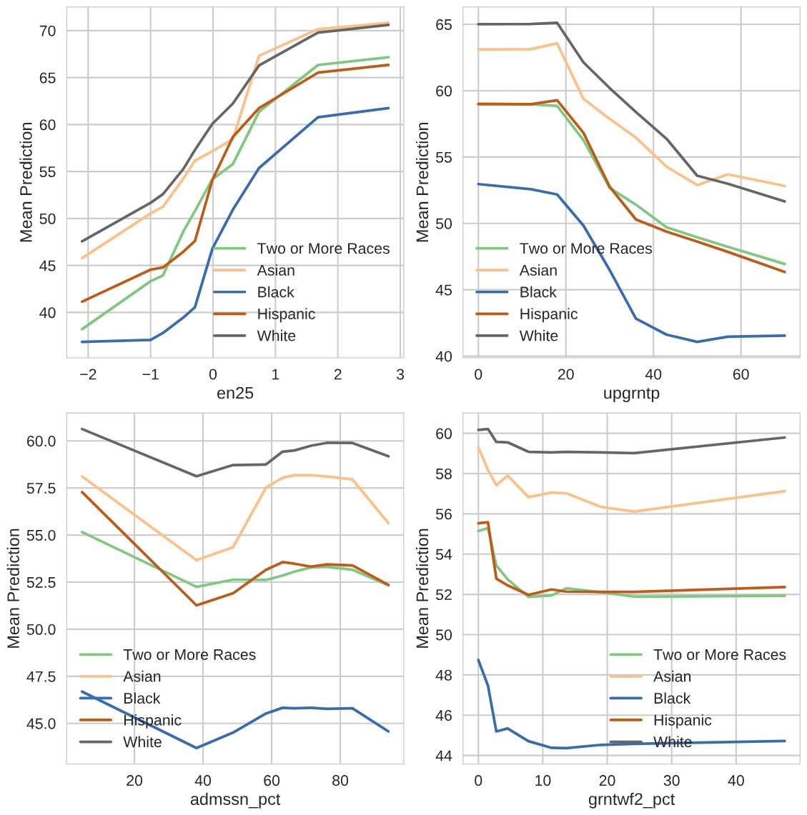
Random Forest Modeling
Partial Dependence

Slide 25
Conclusions
R² values 0.4 – 0.6 for all models
Most important predictors:
  SAT/ACT benchmarks (positive correlation)
  percent of undergraduates receiving Pell Grant (negative correlation)
Next Steps
Incorporate institutional categorical data
Add degree categories as an additional feature

