Slide 1
A neural network from scratch for MONK and ML-CUP25
Machine Learning 2025 Project, University of Pisa
Fabio Federico
MSc Computer Science, Software curriculum
f.federico4@studenti.unipi.it
Gabriele Cristofaro
MSc Computer Science, AI curriculum
g.cristofaro3@studenti.unipi.it
Team Netfix · 26/10/2026 · Type of project: A (Python 3.12 + NumPy)
Notes:
Title slide. Mandatory: surnames (also in the PDF and zip file names), team nickname, degree, emails, date, project type A with the language.

Slide 2
Abstract and objectives
Objectives
Abstract
A multilayer perceptron trained by back-propagation (SGD with momentum, L2) written from scratch with NumPy. ML-CUP25: grid search with 3-fold CV on 80% of the data and 10 random initializations per configuration, internal test on the other 20%. Final model: one 12-64-64-4 ReLU network (η 0.01, α 0.9, λ 0.01), internal test MEE 20.85 ± 0.29.
1
Build a correct MLP simulator and validate it on the three MONK tasks with small networks
2
Select and assess a model for ML-CUP25 with a rigorous procedure, reporting mean ± std over random initializations
3
Explore the effects of different hyperparameters and regularization on the tasks at hand
Notes:
Section 1 of the Report-info: aims, models and algorithms (just defined), significant assumptions.
The abstract (max 5 rows) must name the CUP model, the validation technique and the novelties, if any. The same text, shortened, goes into team-name_abstract.txt.

Slide 3
Implementation overview
Language: Python 3.12, using NumPy for vector operations and Matplotlib for curve plotting
Network: built as a Neural Network Library core with an application layer on top
Experiments: abstracted as programmable JSON configurations
Parallelization: the code supports parallel execution on different cores to boost training times
runner JSON config → select / assess
model_selection grid search, k-fold CV, stratified hold-out, early stopping, repeated trials
nn dense layers; sigmoid, tanh, ReLU, identity; MSE; SGD with classical / Nesterov momentum; linear LR decay; L2, L1; uniform, Glorot, He init
data MONK 1-of-k, CUP split, scaling
utils metrics, plots, seeds, saving
Notes:
Section 2 of the Report-info: code description in short, tools/libraries, software design choices if interesting.
Do not insert a picture of the network. Do not describe algorithms already seen in the lectures.

Slide 4
Implemented features and CUP choices
Architecture
MLP of any depth; CUP: 2 hidden layers of 64 units, 4 linear outputs
Activation functions
Sigmoid, tanh, ReLU, identity; CUP: ReLU hidden, identity output
Training algorithm
Backprop + SGD, classical or Nesterov momentum; CUP: classical, α 0.9
Learning rate
Fixed, or linear decay from η₀ to η_{τ} in τ epochs; CUP: fixed, η 0.01
Batch / on-line / mini-batch
All three; CUP: full batch; MONK: Table 1
Initialization
Uniform, Glorot, He; CUP: He, 10 random inits per configuration
Regularization
L2 (Tikhonov) and L1 on the weights, not on the biases; CUP: L2, λ 0.01
Stop conditions
Max epochs, early stopping (patience 100); retraining: CV TR-error target
Loss and metrics
MSE loss, no penalty in tables; MONK: accuracy; CUP: MEE, original scale
Notes:
Check list of the Report-info (Your contributions): architectures and number of layers, activations, training algorithm, batch / on-line / mini-batch, initialization (multiple trials with different random weights? std reported?), regularization (L2 is a must), stop conditions.
Be schematic: technique names and numbers.

Slide 5
Beyond the basics
Retraining guided by the CV
A fold trains on about two thirds of the design data, so its best epoch does not transfer to the final retraining. We record the training error at the best validation epoch of each fold and stop the retraining when the network reaches that error.
Several starts per configuration
Each configuration is trained from several random initializations on every fold. The ranking uses the mean, and we keep two spreads apart: across initializations, how much the starting point matters, and across folds, how much the data split does.
Parallel and reproducible
Configurations, folds and initializations are independent, so they run in parallel on all the cores. Every random choice (split, weights, shuffling) comes from one master seed, so any run can be repeated exactly.
Notes:
Novelties: what goes beyond the standard course pipeline. Repeated initializations alone are required by the course (slide 4).
Reproducibility was used in practice: the MONK runs were repeated with the same seeds to add the MSE, with identical accuracies.

Slide 6
MONK results
17 one-hot inputs → 4 tanh units → 1 sigmoid unit; MSE loss, Glorot init. Model selection: grid search with stratified hold-out (80% TR / 20% VL); MONK 3 (reg.): 5-fold CV.
Table 1. Mean ± std over 50 inits, MSE without penalty. N = Nesterov; CV stop = retraining up to the TR-MSE target of the CV.
Task | Units, η, α, λ, batch, epochs | MSE TR | MSE TS | Acc. TR (%) | Acc. TS (%)
MONK 1 | 4, η 0.7, batch, 1400 ep | 0.005 ± 0.015 | 0.009 ± 0.019 | 99.6 ± 1.5 | 99.3 ± 2.0
MONK 2 | 4, η 0.08, α 0.9 N, on-line, 71 ep | 0.002 ± 0.008 | 0.004 ± 0.013 | 99.8 ± 1.0 | 99.6 ± 1.5
MONK 3 | 4, η 0.5, batch, 300 ep | 0.045 ± 0.002 | 0.042 ± 0.004 | 94.9 ± 0.4 | 95.8 ± 0.5
MONK 3 (reg.) | 4, η 0.7, α 0.9, λ 0.01, batch, CV stop | 0.069 ± 0.006 | 0.055 ± 0.007 | 93.4 ± 0.2 | 97.1 ± 0.3
Notes:
[*] Lack of results here invalidates the report. Report the MEAN over the initializations, not the best one; MSE without penalty.
Values are read at build time from results/final/*_summary.json and configs/final/*_config.json.
MONK 2 without L2: the fine grid (configs/monk2/monk2_grid_fine_s2026.json) ranks no-penalty configurations first; the earlier λ 5e-4 run (99.6 ± 1.2% TS) is kept as results/final/MONK2_l2_*.
MONK 3 (reg.): a hold-out grid could not separate the configurations (top 9 within one validation pattern) and its pick, λ 1e-3, gave 95.1% TS; 5-fold CV ranks λ 0.01 first in all top 8 configurations.

Slide 7
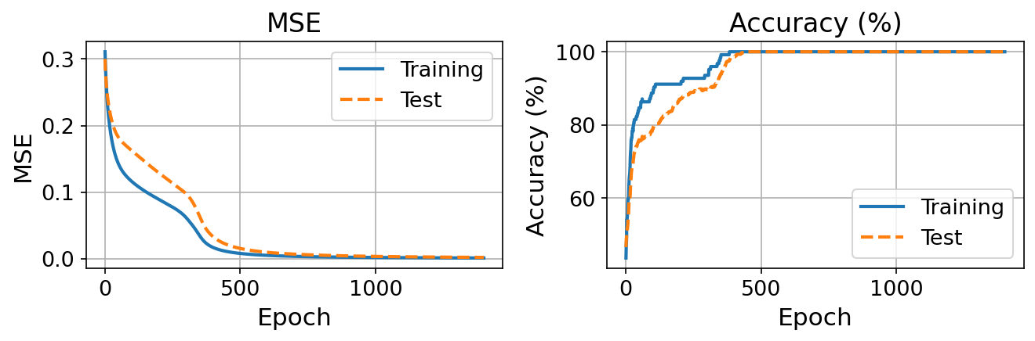
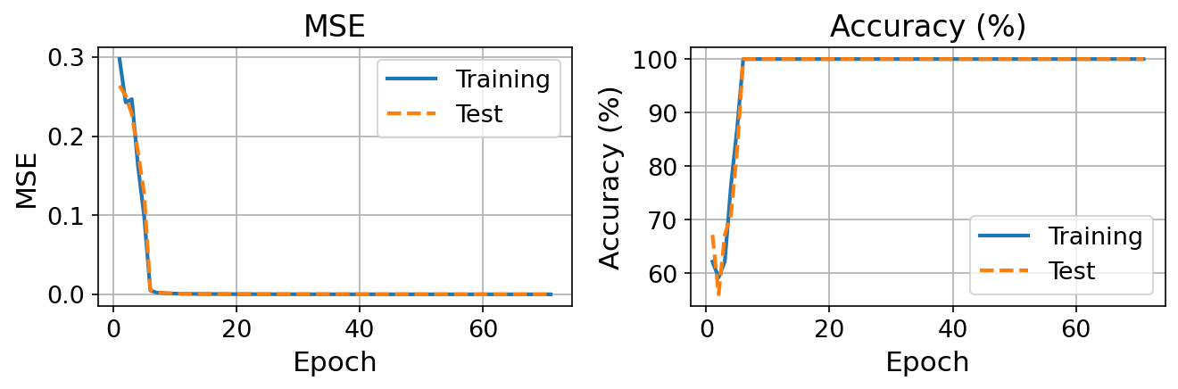
MONK learning curves (1/2)
MONK 1
TS accuracy 99.3 ± 2.0%; 100% in 37 of 50 trials
Fig. 1. Trial with median TS accuracy.
MONK 2
TS accuracy 99.6 ± 1.5%; 100% in 44 of 50 trials
Fig. 2. Trial with median TS accuracy.
Notes:
[*] MSE and accuracy plots for each MONK. Readable in black and white (different line styles), large fonts for legend and axes, one point per epoch (mean over the epoch for mini-batch).
Source: results/final/MONK*_learning_curve.png.

Slide 8
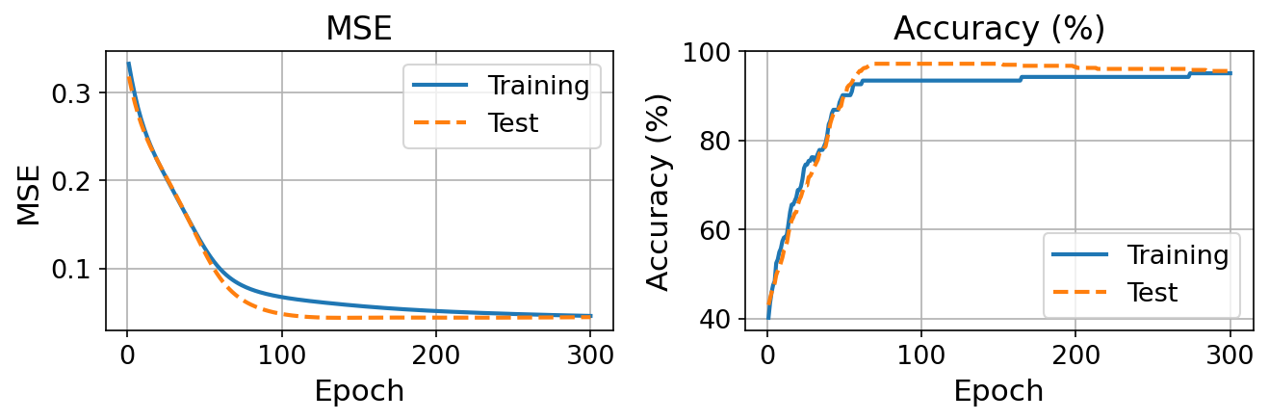
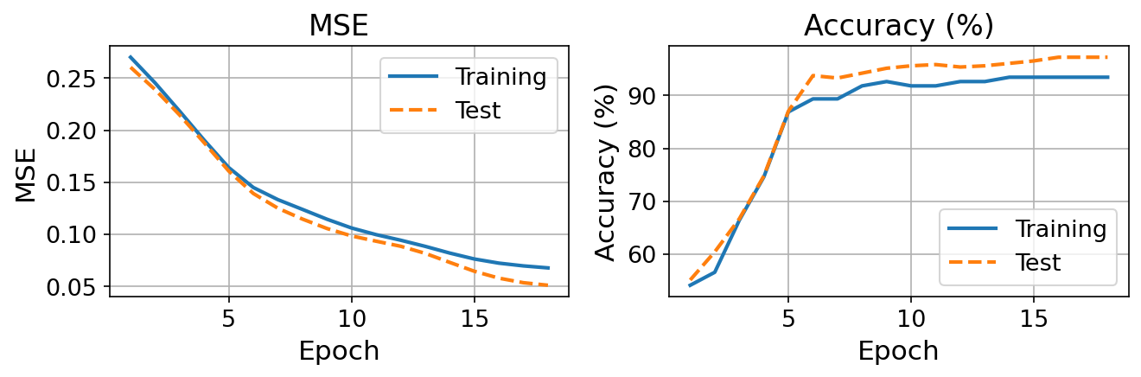
MONK learning curves (2/2)
MONK 3
TS 95.8% above TR 94.9%: 5% of the training labels are noisy [2]
Fig. 3. Trial with median TS accuracy.
MONK 3 (reg.)
TS 97.1 ± 0.3%, TR 93.4%: L2 (λ 0.01) stops the fit of the noisy labels
Fig. 4. As Fig. 3, with L2; stops at the CV TR-MSE target.
Notes:
MONK 3: the training set has 5% misclassified examples [2], so TR accuracy stays below 100%.
Without L2 the TS accuracy of the representative trial peaks near 97% around epoch 70 and ends at 95.6%. With λ 0.01 the network keeps TR at 93.4% and TS at 97.1% (97.2% in 42 of 50 trials). 8 trials never reach the TR-MSE target (they settle at 0.082 because of the penalty) and stop at 1000 epochs, still at 97.2% TS.

Slide 9
CUP: data and validation schema
ML-CUP25: 500 labelled patterns (12 inputs, 4 targets), blind test of 1000 data-points. Inputs and targets are standardized only for the training procedure, while the MEE is always represented in the original scale.
ML-CUP25 training file (500 patterns)
Fold 1
Fold 2
Fold 3
Internal test
Design set, 80% (400): 3-fold CV for model selection, TR ≈ 267 / VL ≈ 133 per fold, 10 inits each
20% (100): hold-out, used once
Model selection: best configuration of the fine grid by mean VL MEE
Assessment: 30 retrainings on the 400 design patterns up to the CV TR-MEE target; TS used once
Final model: trial-0 seeds, retrained on all 500 patterns up to the same target → blind test
Notes:
[*] Validation schema: splitting TR / VL / internal TS with percentages and K. Answer the template question: is there a final retraining?
Split and seeds from the code: internal test 20% with seed 0, the same in every run (src/data/cup.py).
k = 3 and 10 inits from configs/cup/cup_grid_fine.json.
Final model (experiments/cup_final.py): seeds of assessment trial 0, fixed before looking at the test; fitted on all 500 labelled rows and stopped at the same cv_stop_target.

Slide 10
CUP model selection: grid search
1 Screening
4-config grids, k = 3
2 Coarse grids
147 configs, k = 5, 5 inits
3 Fine grid
60 configs, k = 3, 10 inits
Table 2. Explored values (full batch everywhere); ranking by mean VL MEE, ties by VL loss.
Hyper-parameter | Coarse grids | Fine grid
Hidden units | 32, 64, 128, 32-32, 64-32, 64-64, 64-64-32 | 64-64
Activation / init | tanh, sigmoid / Glorot; ReLU / He | ReLU / He
η (fixed) | 1e-4 to 0.5, 8 values (ReLU ≤ 0.01) | 0.009, 0.01, 0.011
α (classical momentum) | none | 0, 0.75, 0.85, 0.88, 0.9
λ (L2) | none | none, 0.008, 0.009, 0.01
Max epochs / patience | 2500 / 50 | 2000 / 100
Notes:
[*] Schema and range of the explored hyper-parameters, number of configurations.
Coarse grids: results/cup/2026-10-25_202307 (tanh), _205508 (sigmoid), _214320 (ReLU); η above 0.01 removed for ReLU after divergence. Fine grid: configs/cup/cup_grid_fine.json.

Slide 11
CUP: what drove the search
Table 3. Best configuration of each attempt: MEE, mean ± std across 5 folds (5 inits each).
Grid | Best configuration | TR MEE | VL MEE
Coarse, tanh / Glorot (56) | 64-64-32, η 0.01 | 20.17 | 22.09 ± 1.06
Coarse, sigmoid / Glorot (56) | 64-64, η 0.1 | 23.35 | 23.78 ± 1.63
Coarse, ReLU / He (35) | 32-32, η 0.01 | 20.44 | 22.39 ± 1.20
64-64 ReLU, momentum | η 0.005, α 0.9 | 17.70 | 21.49 ± 0.75
64-64 ReLU, momentum + L2 | η 0.009, α 0.85, λ 0.01 | 18.20 | 21.22 ± 1.30
1
Activation: tanh and ReLU are within one std, sigmoid is clearly worse
2
Momentum and L2 bring the 64-64 ReLU network from 22.4 to about 21.2 VL MEE
3
Learning rate: with full batch η ≥ 0.1 is unstable (one tanh / He run: VL MEE 81)
Notes:
Different seeds and splits across these runs: the comparison is indicative.
Rows from results/cup/: 2026-10-25_202307, _205508, _214320, _223011, _225141; the diverged run is 2026-10-25_165349.

Slide 12
CUP final model
Table 4. MEE, original scale: mean ± std over 30 retrainings; VL from the model selection.
How it was selected
Lowest mean VL MEE in the fine grid (60 configurations, 3-fold CV × 10 inits)
Hyper-parameters
12-64-64-4: ReLU hidden, linear outputs, He init
SGD η 0.01, α 0.9 (classical), full batch, L2 λ 0.01
Stops at TR MEE 16.69 (CV target), 2597-4828 epochs
Blind test: trial-0 seeds (fixed in advance), refit on all 500 patterns
Set | Patterns | MEE
Training (TR) | 400 | 16.69 ± 0.00
Validation (VL) | 3 × 133 | […] ± […]
Internal test (TS) | 100 | 20.85 ± 0.29
Hardware
AMD Ryzen 7 260 (8 cores / 16 threads), 16 GB RAM
Notes:
[*] How the FINAL model was selected, which candidate and why, its hyper-parameters, and how the initialization for the blind test was chosen.
[*][*] Table with MEE for TR, VL and internal TS in the original scale. VL comes from the model selection (CV mean).
The course asks the criterion that sets up the final network among the possible initializations: e.g. a seed fixed in advance. Never pick it by internal test MEE.
Machine description is mandatory.
TR is the CV target by construction (every retraining stops there). VL: mean ± std of the chosen row of the fine grid.

Slide 13
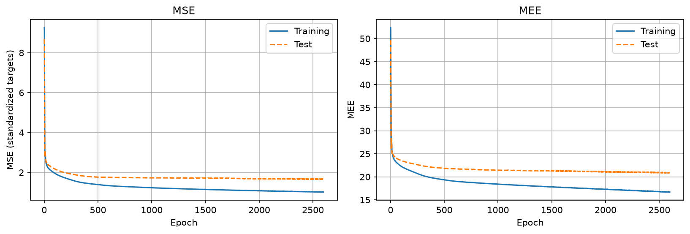
CUP final model: learning curve
Fig. 5. Assessment retraining on the 400 design patterns (trial with median TS MEE): MSE on standardized targets (left), MEE (right).
Notes:
[*] Learning curve TR / (VL) / TS of the FINAL model (it is unique). The VL curve may be missing if the retraining uses all the design data.
The test curve is only recorded: it never decides when to stop (say it explicitly if asked).
The blind-test network is fitted on all 500 rows and has no test curve: this is one of the 30 assessment retrainings, with the same hyper-parameters and stopping rule.

Slide 14
Discussion: what our runs show
Regularization pays off where the labels are noisy
MONK 3: L2 (λ 0.01) lowers TR accuracy to 93.4% but raises TS to 97.1% (95.8% without). MONK 2 needs none: 99.6% TS (Table 1).
1
A small hold-out cannot rank close configurations
MONK 3: on a 25-pattern hold-out the top 9 configurations were within one pattern; 5-fold CV put λ 0.01 first in all top 8.
2
The data split matters more than the initialization
CUP grids: VL MEE std across folds 0.75-1.63, across initializations 0.10-0.43 in the same runs (Table 3).
3
Stopping at the CV training error adapts to each run
All 30 CUP retrainings reached TR MEE 16.69, after 2597 to 4828 epochs: a fixed epoch count would have left them at different fits.
4
Notes:
MONK 3 hold-out grid: results/monk3/2026-10-26_104148 (λ 1e-3 picked, 95.1% TS at assessment); 5-fold grid: configs/monk3/monk3_grid_l2_kfold.json.
Fold and initialization spreads: val_std and val_init_std of the rows of Table 3.

Slide 15
Conclusions
Takeaways
Blind test results
Nickname: Netfix
Results: Netfix_ML-CUP25-TS.csv
Abstract: Netfix_abstract.txt
1
With 4 hidden units the simulator reaches the expected MONK results: ≥ 99.3% TS on MONK 1-2, 97.1% on MONK 3 with L2
2
On the CUP, ReLU + He with momentum and L2 gave the best validation; internal test MEE 20.85 ± 0.29
3
Reliable selection needs enough validation data: k-fold CV separates configurations that a small hold-out cannot
Notes:
What you have drawn and what you learned (in short). Blind test: name of the result file and nickname.

Slide 16
References
[1] A. Micheli: Machine Learning, course slides, Università di Pisa, 2025.
[2] S. Thrun et al.: The MONK's Problems: A Performance Comparison of Different Learning Algorithms, Tech. Rep. CMU-CS-91-197, Carnegie Mellon University, 1991.
[3] X. Glorot, Y. Bengio: Understanding the difficulty of training deep feedforward neural networks, Proc. AISTATS, JMLR W&CP 9, 249–256, 2010.
[4] K. He, X. Zhang, S. Ren, J. Sun: Delving Deep into Rectifiers, Proc. IEEE ICCV, 1026–1034, 2015.
[5] I. Sutskever, J. Martens, G. Dahl, G. Hinton: On the importance of initialization and momentum in deep learning, Proc. ICML, PMLR 28, 1139–1147, 2013.
[6] L. Prechelt: Early Stopping — But When?, in Neural Networks: Tricks of the Trade, LNCS 1524, Springer, 55–69, 1998.
[7] C. R. Harris et al.: Array programming with NumPy, Nature, 585, 357–362, 2020.
Notes:
Uniform style: authors, title, journal / proceedings, volume, pages, year. Numbered, and each number cited in the slides (e.g. Glorot [3] and He [4] on the features slide). Keep only the references actually cited.

Slide 17
Appendix

Slide 18
Reproducibility
Every run is a JSON config; results, seeds and plots are saved in results/<task>/<run_id>/. The configurations of the reported runs, with their seeds, are in configs/final/.
python -m runner --config configs/monk3/monk3_assess_l2.json
python -m runner --config configs/cup/cup_grid_fine.json
python -m runner --config configs/cup/cup_assessment_top1.json
python -m experiments.cup_final --assessment-run results/cup/RUN_ID
python -m experiments.cup_predict --model results/cup/RUN_ID/model.npz

