Slide 1

UQ-Guided Hyperparameter Optimization for Iterative Learners
North Carolina State University
Jiesong Liu, Computer Science Department, North Carolina State University
Notes:
Hello, everyone. My name is Jiesong, a Computer Science PhD student at NC State.
Today, I’m gonna talk about my research ``Uncertainty Quantification-Guided Hyperparameter Optimization for Iterative Learners“.

Slide 2
Hyperparameter Optimization
North Carolina State University
DNN model hyperparameter optimization (HPO)
Type of hyperparameter
Traditional: learning rates, etc.
More complex ones: neural architectures
Iterative learners
Can obtain intermediate validation loss after each iteration
Want to find the best hyperparameter
Notes:
DNN models have many hyperparameters including traditional ones such as learning rates and more complex ones like neural architectures.
For iterative learners (like DNNs), researchers can obtain intermediate validation loss after each iteration and use them for model assessment; the main goal of HPO is to explore a vast candidate space to find candidates that lead to optimal model performance.
To find the optimal hyperparameter, we can first focus on one early stopping method called successive halving.1’’

Slide 3
Early stopping methods for HPO
North Carolina State University
Successive Halving
Detect early on a configuration that will be bad and discard it.
loss
budget
Round 0
Notes:
suppose that on the x-axis we have compute budget which you can think of as the number of epochs and then on the y-axis we have the loss.
Now suppose that in round zero we start with a group of randomly sampled configurations, or we call candidates, and what we then do is after making a number of training steps we evaluate all of these candidates, and as its name suggests, what we do is we simply throw away the worst half of candidates and we stop training them. And we continue training the best half.

Slide 4
Early stopping methods for HPO
North Carolina State University
Successive Halving
Detect early on a configuration that will be bad and discard it.
loss
budget
Round 1
Notes:
Now this time round one we increase the budget by a factor of two for each of these remaining
individual candidate.

Slide 5
Early stopping methods for HPO
North Carolina State University
Successive Halving
Detect early on a configuration that will be bad and discard it.
loss
budget
Round 2
Notes:
Now the process simply repeats so we evaluate their performance at this point and we throw away the worst half off

Slide 6
Early stopping methods for HPO
North Carolina State University
Successive Halving
Detect early on a configuration that will be bad and discard it.
loss
budget
Round 3
Notes:
until we have only one fully trained candidate.

Slide 7
Problem
North Carolina State University
Uncertainty in DNN models
Data uncertainty
Model uncertainty
Notes:
The question here, for successive halving, is that there is uncertainty involved.
Uncertainty in DNN models mainly arises from two factors: inherent noise in the data and variability in model predictions, referred to as model uncertainty. While data uncertainty remains constant, it is the model uncertainty—which stems from limited knowledge and variability in predictions—that plays a critical role in hyperparameter optimization (HPO).

Slide 8
Problem
North Carolina State University
Uncertainty in DNN models
Lack of consideration of uncertainty.
Accuracy
Config 1
Config 2
x
k₃
k₂
k₁
Notes:
Because of the uncertainty, a model that performs poor in the early stage could turn out to be the best model after convergence. But this candidate is likely to be thrown away by existing HPO methods if it falls into the worst half of the candidate pool at the end of some HPO round.
3’07

Slide 9
Problem
North Carolina State University
Problem with Successive Halving (SH)
Lack of consideration of uncertainty.
Notes:
This slide highlights the challenge with Successive Halving (SH) in hyperparameter optimization. SH eliminates half of the candidate configurations at every checkpoint based solely on the current validation loss.
Here, the x-axis represents training checkpoints, and the y-axis shows validation loss.
In a given SH run, half of the candidates are eliminated at each checkpoint marked by a vertical red dashed line.
The solid blue line represents the best validation loss up to the current point, while the orange dashed line signifies the true quality (in terms of validation loss after convergence) of the candidates SH keeps at that specific point.
From the figure, we see that in every round, SH discards the actually best candidates, causing a continuous increase of the regret. The
reason is that the discarding decision of SH is solely based on the current validation loss, but model uncertainty, particularly pronounced in the early stages, obfuscating the true model potential.
I’d love to stop here and take any questions. Background, problems
7’

Slide 10
Methods
North Carolina State University
Uncertainty-aware HPO
Quantify uncertainty and estimate performance based on validation history (l₁, l₂, …, l_{t-1}).
Final loss/accuracy of a configuration is represented as N(μ,σ²)
Notes:
To overcome this challenge, we introduce uncertainty-aware HPO and model the converged loss as a normal distribution.
We leverage validation history to construct an estimated loss curve. Our goal is to better understand the structure of loss curves and improve candidate evaluation during the HPO process.
Our solution builds on the validation history collected during HPO, represented as a sequence of loss metrics: l(y,M1(X)),⋯ ,l(y,Mt(X)). We aim to construct an estimated loss curve based on this history.
Before formula, introduce some notation.
Let Mγt denote the model with hyperparameter γ trained on the training set after t epochs, and Mγ∗ the converged model.
Mγt(x) gives the prediction on a given input x ∈ Rd.
We use l(·, ·) to denote the metric that evaluates the performance of a candidate model. Given a hyperparameter configuration γc, the validation loss of a model instance, l(y, M ∗ (X)), can be affected by training data and other factors, and hence has some uncertainty. N (μc∗, σc2∗) represents the distribution of l(y, Mγ∗ (X)), where, σc2∗ embodies the uncertainty.

Slide 11
Methods
North Carolina State University
Uncertainty-aware HPO
Quantify uncertainty and estimate performance based on validation history (l₁, l₂, …, l_{t-1}).
Final loss/accuracy of a configuration is represented as N(μ,σ²)
The first term (momentum) models the decaying trend of the loss curve
The second term (bias) models a latent effect underlying the hyperparameter space by allowing correlation among the candidates
u is a vector length of r; k is defined as k_{t} =[t^{−1/2},t⁻¹]
Uncertainty is measured as the estimation variance of the regression
Notes:
Our approach decomposes the loss curve into two main components:
Momentum (the first part) – This models the decaying trend of the loss curve over training epochs.
Bias Term – This captures a latent structure in the hyperparameter space, introducing correlation among candidates.
We also include a noise component to account for variability in observations.
Each candidate in HPO is represented as a vector in a r dimensional space. For modeling the loss curve, we define a vector kt∈RL with elements representing functions of training epochs t. In our experiments, we use kt=[t^−1/2,t^−1], capturing the typical decreasing trend of loss curves as training progresses.

Slide 12
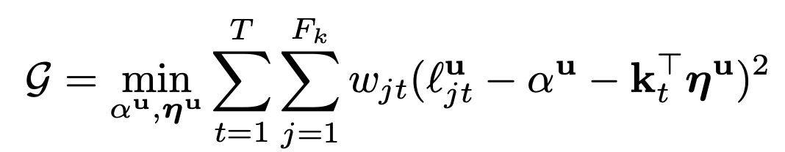
Methods
North Carolina State University
Uncertainty-aware HPO
Weighted Least Squares for Loss Curve Parameter
For each candidate u, let α_{u} = u⊤Z. The objective function G is formulated as:
G=αu​,ηu​min​t=1∑T​j=1∑Ft​​wjt​(lu,j,t​−αu​−
w_{jt} = 1/F_{t}σ²_{t}
F_{t} is the number of models trained with time t.
F_{t}
Notes:
In this slide, we explain how the loss curve parameters {αu,ηu} for a candidate u​ are determined by minimizing a weighted least squares objective
u
alpha denotes the bias term
G minimizes over all possible alpha and eta trying to optimize the sum where the lowercase t iterates from 1 to capital T, which denotes the current time step. And j sums up all the repetitions at time t.
w j t is the coefficent term that takes into account the number of repetitions and the local variance.

Slide 13
Methods
North Carolina State University
Uncertainty-aware HPO
Quantify uncertainty and estimate performance based on validation history (l₁, l₂, …, l_{t-1}).
For a candidate i at iteration T:
The validation losses across training epochs form a vector v of dimension D=∑_{t=1}^{T}F_{t}​
Each element v_{d}​ represents the observed loss at epoch t_{d​}, modeled as N(μ_{i,td}, σ_{td}²)
Notes:
This slide outlines how we quantify the mean and variance of the loss curve and use it to make inferences about the converged loss. These estimations provide quantified uncertainty, which guides model selection and resource allocation.
For a candidate i at iteration T , concatenating the validation losses across training epochs (indexed by lowercase t) will lead to a validation loss vector v of dimension capital D = 􏰏Tt=1 Ft, which is the summation of all of the repetitions across timesteps.
For each lowercase d whose range is from {1,··· ,D}, the dth element in v is an observation of loss at time td that follows the normal distribution N (μit_d, σt_d^2 ) with td mapping the index d to its corresponding epoch t.

Slide 14
Methods
North Carolina State University
Uncertainty-aware HPO
Quantify uncertainty and estimate performance based on validation history (l₁, l₂, …, l_{t-1}).
For a candidate i at iteration T:
The validation losses across training epochs form a vector v of dimension D=∑_{t=1}^{T}F_{t}​
Each element v_{d}​ represents the observed loss at epoch t_{d​}, modeled as N(μ_{i,td}, σ_{td}²)
Weighted Least Squares Problem
To estimate the loss curve, we solve the weighted least squares problem W^{1/2}​v=W^{1/2}​Aβ
Here, W is a diagonal matrix with weights W_{dd}=1/F_{td}σ²_{td}​
A=[1 K], where K[d,:]=k_{td}⊤​, and β⊤=[α η⊤].
The parameter σ_{t}² is computed empirically as the variance of the loss in recent epochs
Notes:
For a given candidate u (for better readability, we omit the superscript u in the notations in the following discussion), the weighted least squares problem can be formulated as solving the equation W12v=W21Aβforβwith W∈RD×D being a diagonal matrix of weights W = 1 . dd Ftσ2
d td
A is a concatenation of [1 K], K∈RD×(L+1)with the d-th row of K matrix is actually the transpose of the momentum vector k,andβis the concatenation of the parameters we want to optimize.
The empirical estimate of σt^2 is computed as the variance of the loss in the recent several epochs of t—which, you can think of that those instances can be regarded as results of small perturbations to the model at epoch t.

Slide 15
Methods
North Carolina State University
Uncertainty-aware HPO
Quantify uncertainty and estimate performance based on validation history (l₁, l₂, …, l_{t-1}).
Solving for the Estimator
Estimation for β: β​=(A⊤WA)⁻¹(A⊤Wv)
The covariance of this estimator is: Σ_{β}​​=(A⊤WA)⁻¹.
The estimated curve at time t is v(t)=[1 k_{t}⊤​]β​.
The variance of this estimation is: σ²(t)=[1 k_{t}⊤​]Σ_{β}​​[1 k_{t}​​]^{T}.
Finally, we approximate the loss distribution for candidate using the formulas for v(t) and σ²(t). We approximate the distribution of the converged loss as:
ℓ(y, Mγ_{i}​∗​(X))∼N(v(N),σ²(N)) where N represents a large number of epochs (e.g., N=200 in our experiments).
Notes:
Now is the Estimation Process.
We first compute the estimator for beta, and its covariance matrix for future use.
Then the estimated point in the curve at time t is given by v(t), which is the dot product of the auxiliary vector and our estimator beta.
Now we can compute the variance of this estimation, which is the product of the auxiliary vector times the covariance matrix times the transpose of the auxiliary vector.

Slide 16
Methods
North Carolina State University
UQ-Guided HPO Scheme
Iteratively discard configurations based on confidence level.
Confidence Curve
K
P
Probabilistic Model
Discarding Mechanism
Configs
k
Budget
Ends
k
…
Round Start
Round 1
Round 2
Round 3
Round r
Notes:
Using this uncertainty quantification, we unify the most important two operations in HPO together: which are the selection of candidates and the scheduling of training budget. We call this formal decision process as UQ-guided scheme. This UQ-Guided scheme builds on a probablistic uncertainty-based model. This model will approximate the statistical effects of discarding a set of candidates at the end of a round in HPO. It then discard certain number of candidates to the extent that it is confident enough that the final best candidate is in the remaining candidate pool while keeping the budget consumption efficient.

Slide 17
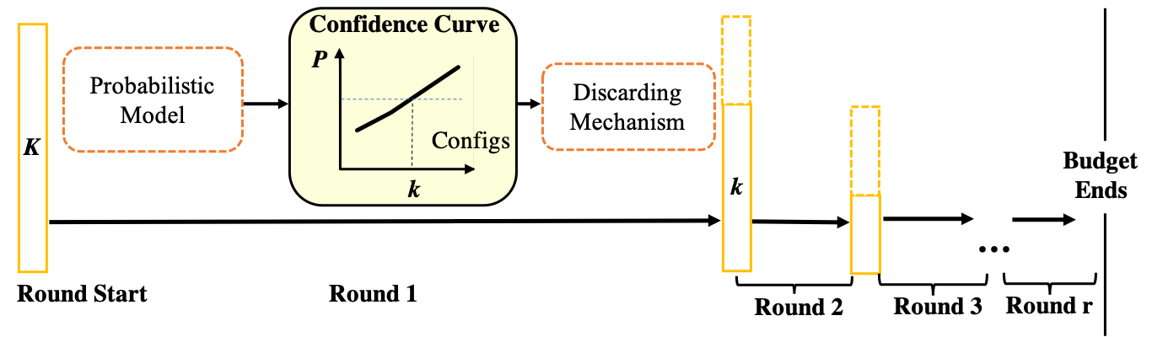



Methods
North Carolina State University
UQ-Guided HPO Scheme
Probabilistic model.
Use discarding mechanism.
$$p(x)$$
f ($($μ_{i}, σ_{i}²$)_{i=1}^{K}$ , k)
l_{K}
l_{i} ~ N (μ_{i}, σ_{i}²)
Sweet Point
l₂
l: probability distribution of loss after convergence
k↓
l₁
μ_{K}
μ₂
μ₁
$$x$$
k↑
k
Notes:
If we set R to be the predefined budget resources (e.g., training epochs) for each round. For the first round, K candidates each get trained for KR epochs. Based on the observed validation loss and the quantified uncertainty for each candidate, our method represents each candidate’s converged loss with a probability distribution.
From that, it constructs a confidence curve,(through that probabilistic model) capturing the probability that the best configuration is among the current top k candidates for 1 ≤ k ≤ K. From the curve, it then calculates f((μi, σi2)Ki=1, k), which captures the effects of keeping k top candidates (1 ≤ k ≤ K) for the next round, by considering the tradeoff between the risks of discarding the best candidate and the training budget each top candidate can get.
From that, it identifies the best k value, discards the least promising K − k candidates, and enters the next round. The process continues until the total budget is used up.
We now delve into the probabilistic model and the discarding mechanism.

Slide 18
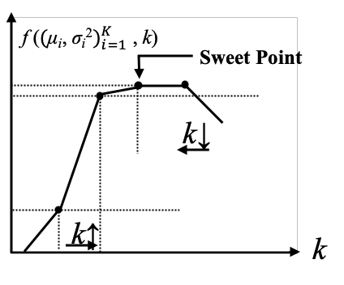
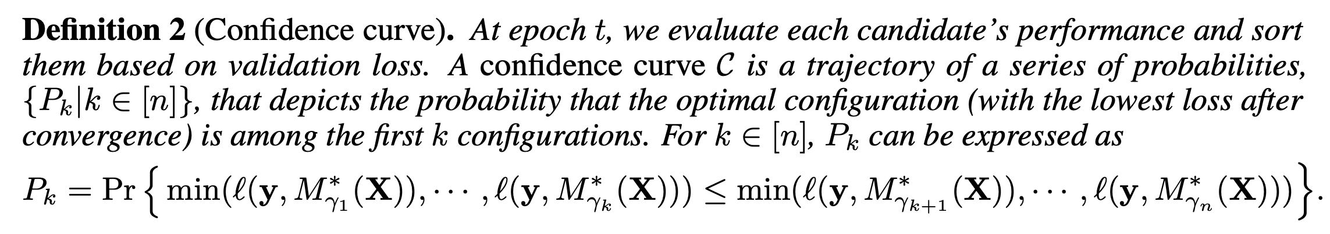
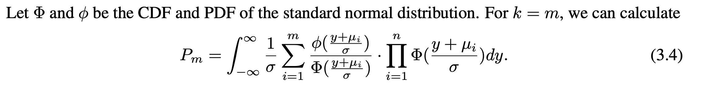
Methods
North Carolina State University
UQ-Guided HPO Scheme
Confidence Curve Derived from Uncertainty Quantification

Slide 19
Results
North Carolina State University
UQ-oblivious method (SH, HB, BOHB, SS)
UQ-Guided method (SH+, HB+. BOHB+, SS+)
Datasets
NAS-BENCH-201
ImageNet
Benefits
Better Top 1 Rank (The real ranking of the candidate ultimately chosen by the method)
Better regret (The accuracy difference between the returned candidate the real best candidates)
Notes:
The figure really shows the effects of our UQ scheme.
The results of NAS-BENCH-201 are trained on ImageNet.
We developed four UQ-guided HPO methods for existing HPO approaches.
Hyperband plus (HB+) originates from the popular HPO design Hyperband (HB). HB is an HPO method trying to better balance exploration and exploitation than SH does by adding an outer loop for grid search of the value of K.
HB+ simply extends HB by using SH+ rather than SH as its inner loop, changing the target of the grid search to the initial value of K.
Bayesian Optimization and Hyperband plus (BOHB+) is developed from BOHB. BOHB is similar to HB except that it replaces the random sampling from the uniform distribution with BO-based sampling. BOHB+ makes the corresponding changes from HB+ by adopting BO-based sampling for its outer loop.
Sub-sampling Plus (SS+) builds on the Sub-sampling (SS) algorithm by integrating uncertainty quantification (UQ) into its candidate selection process. Unlike other methods, SS retains all candidates throughout the HPO process. Each round, it selects candidates with lower validation loss than the most trained candidate or defaults to training the most trained one if none qualify.
SS+ enhances this by using UQ to compare candidates. Instead of relying solely on validation loss, it calculates the probability that a candidate’s convergence loss is lower than the most trained candidate’s. If this probability exceeds a threshold (0.9 in our experiments), the candidate is selected for further training. This UQ-guided approach improves decision-making during HPO
For each comparison, we show three metrics.
Top-1 rank refers to the real ranking of the candidate ultimately chosen by the method. And we have results on different trials and on differnet fraction of budgets.
Regret (\%) refers to the accuracy difference between the returned candidate and the real best candidate.
In the Figure, the average results of 30 repetitions are reported. For the right two columns, we also report the uncertainty bands, defined as the interval between the 30th and 70th percentiles.
The benefits of the UQ-guided scheme are obvious, both for individual trials and across different fractions of budgets. It brings a 21-55\% regret reduction.

Slide 20
Thanks for listening
North Carolina State University
jliu93@ncsu.edu
Notes:
If you are interested in our work, don’t hesitate to take a look at our paper and poster.

