Slide 1
CIS 470 Mobile App Development
Lecture 14
Wenbing Zhao
Department of Electrical Engineering and Computer Science
Cleveland State University

Slide 2
Networking
How to connect to the web using HTTP
How to consume XML web services
How to consume JSON web services

Slide 3
Fetch Web Content using HTTP
Create a new app as usual and name it Networking
Add the INTERNET permission in manifest
Add an ImageView in activity_main.xml
<uses-permission android:name="android.permission.INTERNET"/>
<?xml version="1.0" encoding="utf-8"?> <androidx.constraintlayout.widget.ConstraintLayout xmlns:android="http://schemas.android.com/apk/res/android" xmlns:app="http://schemas.android.com/apk/res-auto" xmlns:tools="http://schemas.android.com/tools" android:layout_width="match_parent" android:layout_height="match_parent" tools:context=".MainActivity"> <ImageView android:src="@color/material_grey_300" android:layout_width="209dp" android:layout_height="272dp" android:id="@+id/imageView" app:layout_constraintBottom_toBottomOf="parent" app:layout_constraintLeft_toLeftOf="parent" app:layout_constraintRight_toRightOf="parent" app:layout_constraintTop_toTopOf="parent" /> </androidx.constraintlayout.widget.ConstraintLayout>

Slide 4
Fetch Web Content using HTTP
import androidx.appcompat.app.AppCompatActivity; import androidx.core.app.ActivityCompat; import androidx.core.content.ContextCompat; import android.Manifest; import android.content.pm.PackageManager; import android.graphics.Bitmap; import android.graphics.BitmapFactory; import android.os.AsyncTask; import android.os.Bundle; import android.util.Log; import android.widget.ImageView; import android.widget.Toast; import java.io.IOException; import java.io.InputStream; import java.io.InputStreamReader; import java.net.HttpURLConnection; import java.net.URL; import java.net.URLConnection;
Modify MainActivity.java. We will first fetch an image, then the text/html
public class MainActivity extends AppCompatActivity { ImageView img; final private int REQUEST_INTERNET = 123; @Override protected void onCreate(Bundle savedInstanceState) { super.onCreate(savedInstanceState); setContentView(R.layout.activity_main); if (ContextCompat.checkSelfPermission(this, Manifest.permission.INTERNET) != PackageManager.PERMISSION_GRANTED) { ActivityCompat.requestPermissions(this, new String[]{Manifest.permission.INTERNET}, REQUEST_INTERNET); } else{ downloadSomething(); } }

Slide 5
Fetch Web Content using HTTP
private void downloadSomething() { String texturl = "https://www.google.com/"; String imgurl = "https://upload.wikimedia.org/wikipedia/commons/0/04/New_York_Empire_Apples.jpg"; new DownloadImageTask().execute(imgurl); new DownloadTextTask().execute(texturl); } @Override public void onRequestPermissionsResult(int requestCode, String[] permissions, int[] grantResults) { switch (requestCode) { case REQUEST_INTERNET: if (grantResults[0] == PackageManager.PERMISSION_GRANTED) { downloadSomething(); } else { Toast.makeText(MainActivity.this, "Permission Denied", Toast.LENGTH_SHORT).show(); } break; default: super.onRequestPermissionsResult(requestCode, permissions, grantResults); } }

Slide 6
private InputStream OpenHttpConnection(String urlString) throws IOException { InputStream in = null; int response = -1; URL url = new URL(urlString); URLConnection conn = url.openConnection(); if (!(conn instanceof HttpURLConnection)) throw new IOException("Not an HTTP connection"); try{ HttpURLConnection httpConn = (HttpURLConnection) conn; httpConn.setAllowUserInteraction(false); httpConn.setInstanceFollowRedirects(true); httpConn.setRequestMethod("GET"); httpConn.connect(); response = httpConn.getResponseCode(); if (response == HttpURLConnection.HTTP_OK) { in = httpConn.getInputStream(); } } catch (Exception ex) { Log.d("Networking", ex.getLocalizedMessage()); throw new IOException("Error connecting"); } return in; } private InputStream download(String URL) { InputStream in = null; try { in = OpenHttpConnection(URL); return in; } catch (IOException e1) { Log.d("NetworkingActivity", e1.getLocalizedMessage()); } return null; }

Slide 7
private Bitmap DownloadImage(String URL) { Bitmap bitmap = null; InputStream in = download(URL); if(in != null) { bitmap = BitmapFactory.decodeStream(in); try { in.close(); } catch (IOException e1) { Log.d("NetworkingActivity", e1.getLocalizedMessage()); } } return bitmap; }
private class DownloadImageTask extends AsyncTask<String, Void, Bitmap> { protected Bitmap doInBackground(String... urls) { return DownloadImage(urls[0]); } protected void onPostExecute(Bitmap result) { ImageView img = (ImageView) findViewById(R.id.imageView); img.setImageBitmap(result); } }
The three periods after the final parameter's type indicate that the final argument may be passed as an array or as a sequence of arguments. Varargs can be used only in the final argument position

Slide 8
private String DownloadText(String URL) { int BUFFER_SIZE = 2000; InputStream in = download(URL); InputStreamReader isr = new InputStreamReader(in); int charRead; String str = ""; char[] inputBuffer = new char[BUFFER_SIZE]; try { while ((charRead = isr.read(inputBuffer))>0) { String readString = String.copyValueOf(inputBuffer, 0, charRead); str += readString; inputBuffer = new char[BUFFER_SIZE]; } in.close(); } catch (IOException e) { Log.d("Networking", e.getLocalizedMessage()); return ""; } return str; } private class DownloadTextTask extends AsyncTask<String, Void, String> { protected String doInBackground(String... urls) { return DownloadText(urls[0]); } @Override protected void onPostExecute(String result) { Toast.makeText(getBaseContext(), result, Toast.LENGTH_LONG).show(); } } }

Slide 9
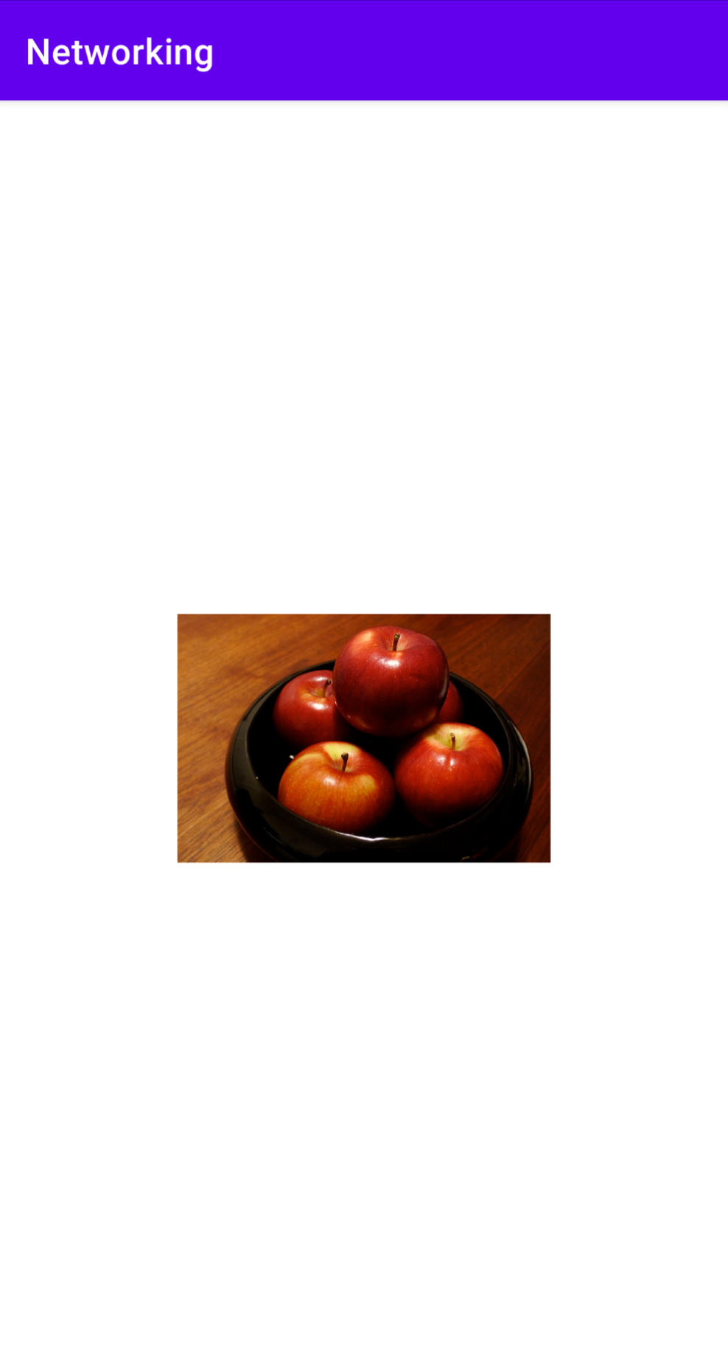
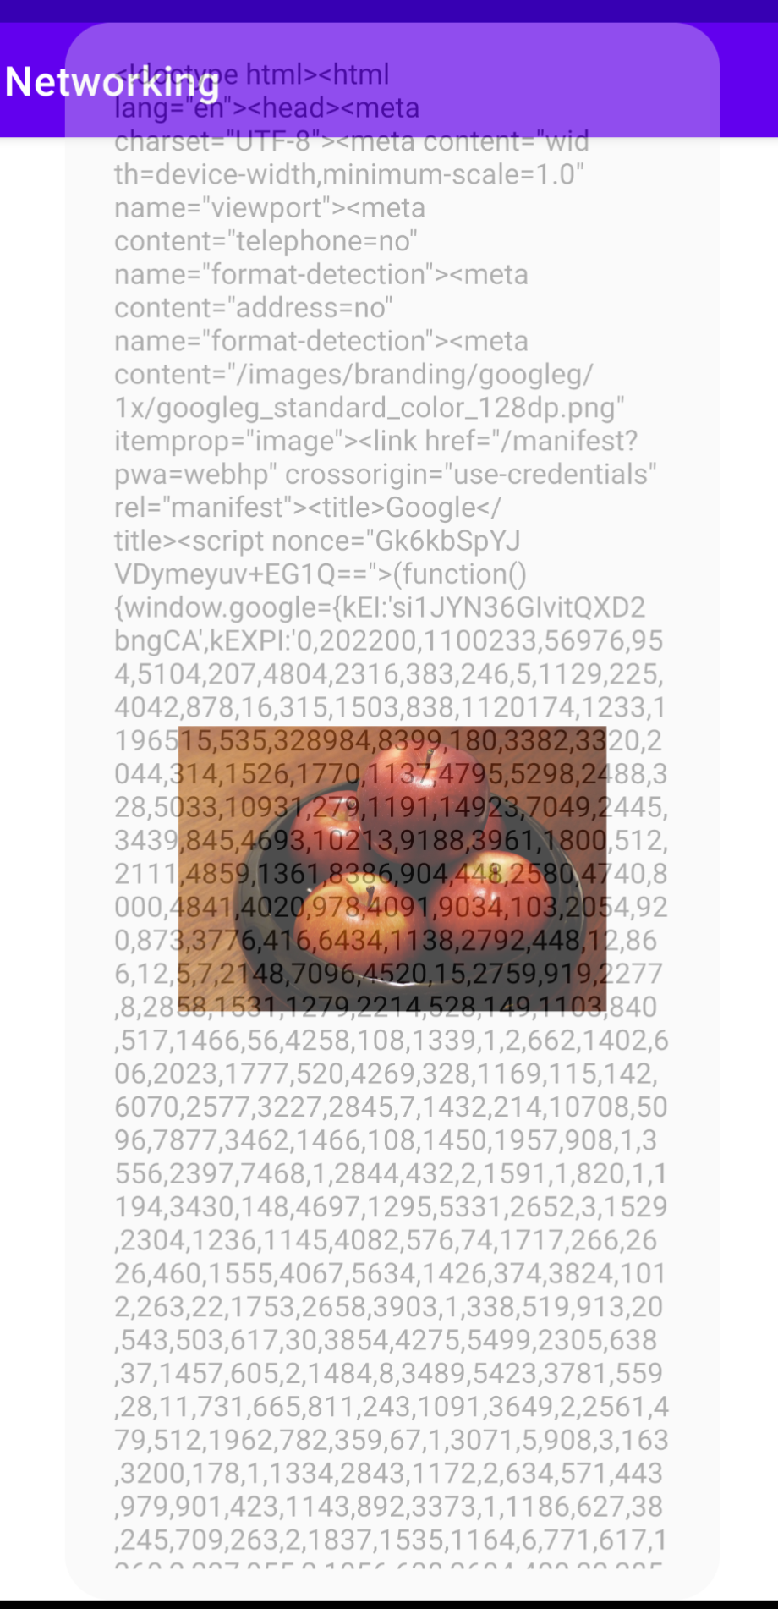
Fetch Web Content using HTTP

Slide 10
Consuming JSON Services
[
{
"appeId":"1",
"survId":"1",
"location":"",
"surveyDate":"2008-03 14",
"surveyTime":"12:19:47",
"inputUserId":"1",
"inputTime":"2008-03-14 12:21:51",
"modifyTime":"0000-00-00 00:00:00”
},
{
"appeId":"2",
"survId":"32",
"location":"",
"surveyDate":"2008-03-14",
"surveyTime":"22:43:09",
"inputUserId":"32",
"inputTime":"2008-03-14 22:43:37",
"modifyTime":"0000-00-00 00:00:00"
}
]
XML is expensive both for decoding and transmission
JSON is a concise representation of XML document
Create another app and name it JSON
Add INTERNET permission in manifest

Slide 11
Consuming JSON Services
https://www.tutorialspoint.com/android/android_json_parser.htm
import androidx.appcompat.app.AppCompatActivity; import android.os.AsyncTask; import android.os.Bundle; import android.util.Log; import android.widget.Toast; import org.json.JSONArray; import org.json.JSONObject; import java.io.BufferedInputStream; import java.io.BufferedReader; import java.io.IOException; import java.io.InputStream; import java.io.InputStreamReader; import java.net.HttpURLConnection; import java.net.MalformedURLException; import java.net.URL; public class MainActivity extends AppCompatActivity { @Override protected void onCreate(Bundle savedInstanceState) { super.onCreate(savedInstanceState); setContentView(R.layout.activity_main); new ReadJSONFeedTask().execute( "https://api.androidhive.info/contacts/"); }
Modify MainActivity.java

Slide 12
Consuming JSON Services
public String readJSONFeed(String address) { URL url = null; try { url = new URL(address); } catch (MalformedURLException e) { e.printStackTrace(); }; StringBuilder stringBuilder = new StringBuilder(); HttpURLConnection urlConnection = null; try { urlConnection = (HttpURLConnection) url.openConnection(); } catch (IOException e) { e.printStackTrace(); } try { InputStream content = new BufferedInputStream( urlConnection.getInputStream()); BufferedReader reader = new BufferedReader( new InputStreamReader(content)); String line; while ((line = reader.readLine()) != null) { stringBuilder.append(line); } } catch (IOException e) { e.printStackTrace(); } finally { urlConnection.disconnect(); } return stringBuilder.toString(); }
Modify MainActivity.java

Slide 13
Consuming JSON Services
private class ReadJSONFeedTask extends AsyncTask<String, Void, String> { protected String doInBackground(String... urls) { return readJSONFeed(urls[0]); } protected void onPostExecute(String result) { try { System.out.println("result: "+result); JSONObject jsonObj = new JSONObject(result); JSONArray contacts = jsonObj.getJSONArray("contacts"); Log.i("JSON", "Number of contacts in feed: " + contacts.length()); for (int i = 0; i < contacts.length(); i++) { JSONObject tmp = contacts.getJSONObject(i); Toast.makeText(getBaseContext(), tmp.getString("name") + " - " + tmp.getString("email"), Toast.LENGTH_SHORT).show(); } } catch (Exception e) { e.printStackTrace(); } } } }
Modify MainActivity.java

Slide 14
Homework#17
Modify the JSON app: instead of displaying the list of contacts in a sequence of toasts, store the contacts in an array and display them in a ListView nicely as part of the layout for the main activity

Slide 15
Extra credit assignment #2
Modify the Networking app:
Load a webpage that has at least two images
Analyze the text received and find the <img> component
Analyze the html page received and fetch every images referenced by the page
Store the fetched images in a Bitmap array
Display the thumbnail images in a GridView
On touching each thumbnail in the GridView, display the full image

