Slide 1
CIS 470 Mobile App Development
Lecture 17
Wenbing Zhao
Department of Electrical Engineering and Computer Science
Cleveland State University

Slide 2
Notifications
What is notification
Create and send notifications
Example

Slide 3
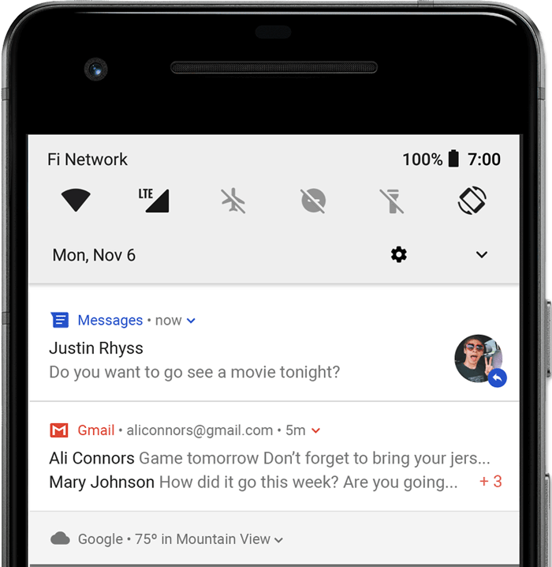
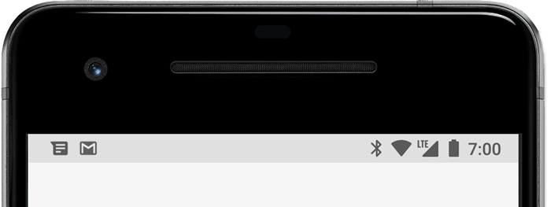
Notifications
A notification is a message that Android displays outside your app's UI to provide the user with reminders, communication from other people, or other timely information from your app
Users can tap the notification to open your app or take an action directly from the notification
When you issue a notification, it first appears as an icon in the status bar
Users can swipe down on the status bar to open the notification drawer, where they can view more details and take actions with the notification

Slide 4
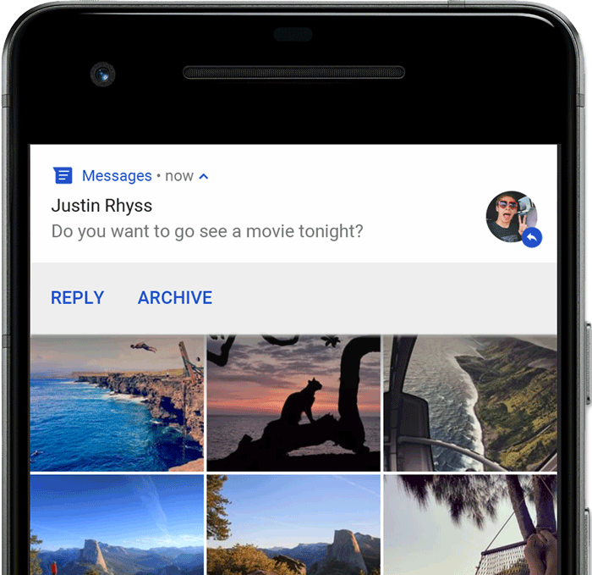
Notifications
Heads-up notification
Beginning with Android 5.0, notifications can briefly appear in a floating window called a heads-up notification. This behavior is normally for important notifications that the user should know about immediately, and it appears only if the device is unlocked
The heads-up notification appears the moment your app issues the notification and it disappears after a moment, but remains visible in the notification drawer as usual

Slide 5
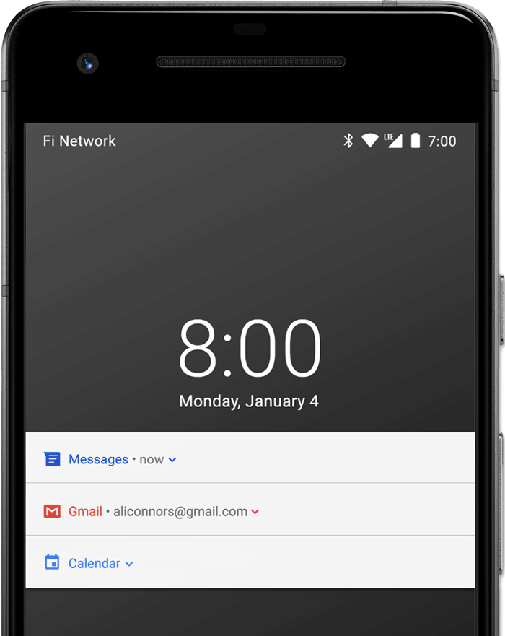
Notifications
Lock screen
Beginning with Android 5.0, notifications can appear on the lock screen.
You can programmatically set the level of detail visible in notifications posted by your app on a secure lock screen, or even whether the notification will show on the lock screen at all
Starting with Android 8.0, users can choose to disable or enable lock screen notifications for each notification channel

Slide 6
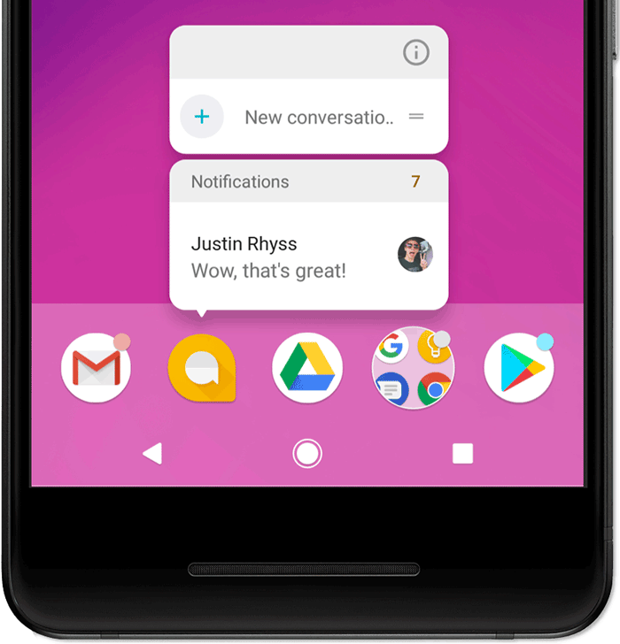
Notifications
App icon badge
In supported launchers on devices running Android 8.0 (API level 26) and higher, app icons indicate new notifications with a colored "badge" (also known as a "notification dot") on the corresponding app launcher icon.
Users can long-press on an app icon to see the notifications for that app. Users can then dismiss or act on notifications from that menu, similar to the notification drawer

Slide 7
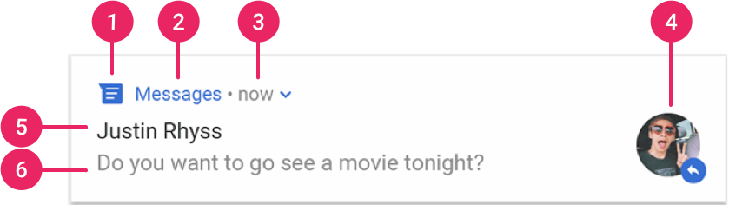
Notifications
Notification anatomy
Small icon: This is required and set with setSmallIcon()
App name: This is provided by the system
Time stamp: This is provided by the system, but you can override with setWhen() or hide it with setShowWhen(false)
Large icon: This is optional (usually used only for contact photos; do not use it for your app icon) and set with setLargeIcon()
Title: This is optional and set with setContentTitle()
Text: This is optional and set with setContentText()

Slide 8
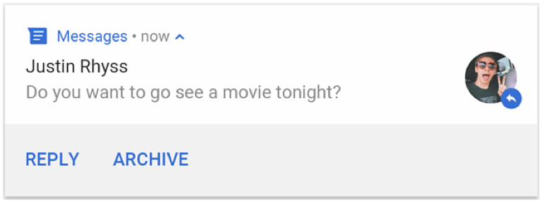
Notifications
Notification actions
Although it's not required, every notification should open an appropriate app activity when tapped
In addition to this default notification action, you can add action buttons that complete an app-related task from the notification (often without opening an activity)
Starting in Android 7.0 (API level 24), you can also add an action to reply to messages or enter other text directly from the notification
Starting in Android 10 (API level 29), the platform can automatically generate action buttons with suggested intent-based actions

Slide 9
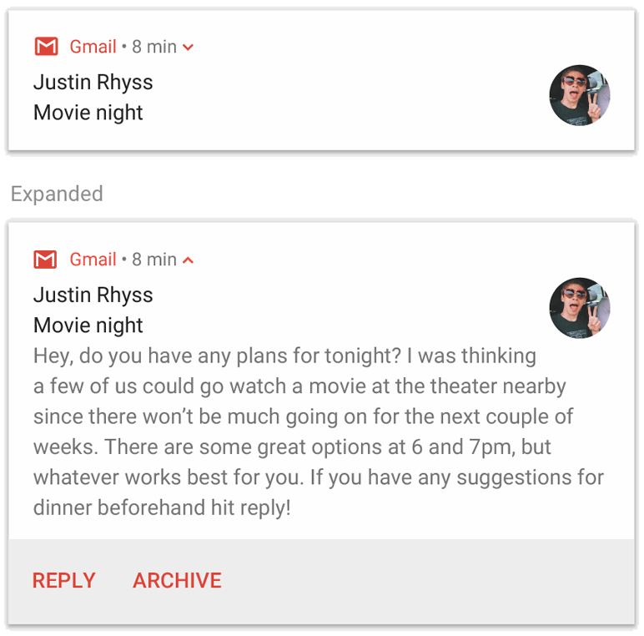
Notifications
Expandable notification
By default, the notification's text content is truncated to fit on one line. If you want your notification to be longer, you can enable a larger text area that's expandable by applying an additional template

Slide 10
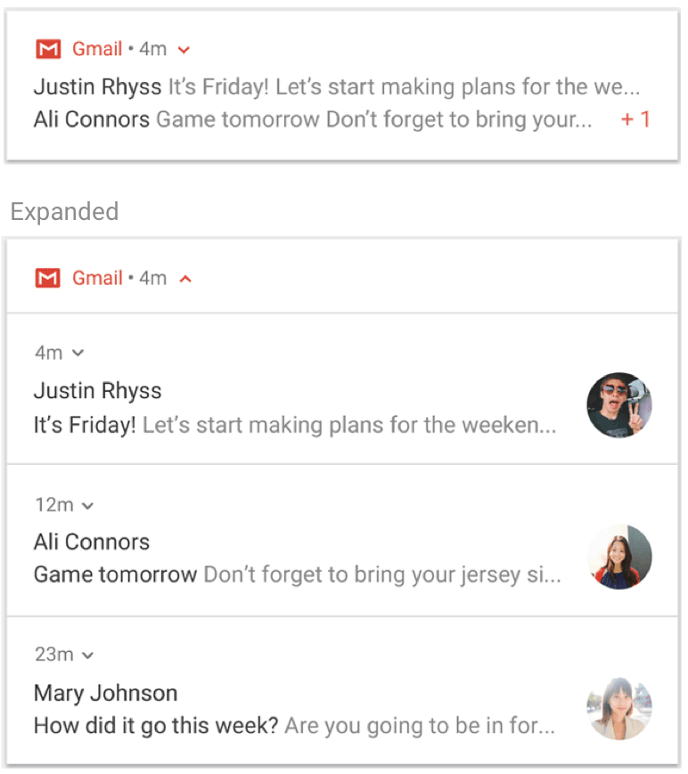
Notifications
Notification updates and groups
To avoid bombarding your users with multiple or redundant notifications when you have additional updates, you should consider updating an existing notification rather than issuing a new one, or consider using the inbox-style notification to show conversation updates
However, if it's necessary to deliver multiple notifications, you should consider grouping those separate notifications into a group (available on Android 7.0 and higher)
A notification group allows you to collapse multiple notifications into just one post in the notification drawer, with a summary. The user can then expand the notification to reveal the details for each individual notification

Slide 11
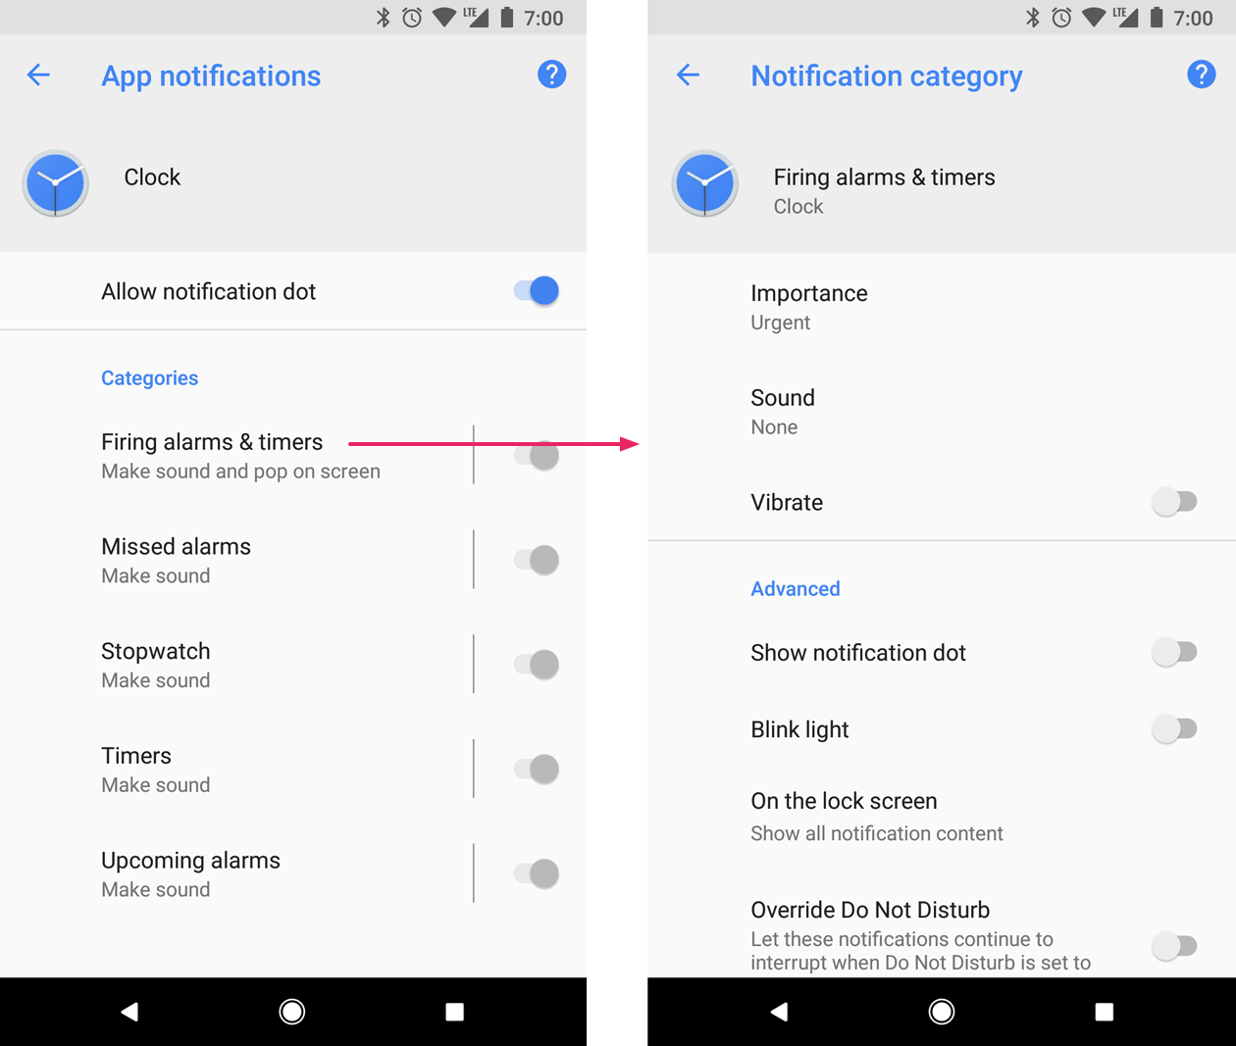
Notification Channels
Starting in Android 8.0 (API level 26), all notifications must be assigned to a channel or it will not appear
By categorizing notifications into channels, users can disable specific notification channels for your app (instead of disabling all your notifications), and users can control the visual and auditory options for each channel
Users can also long-press a notification to change behaviors for the associated channel

Slide 12
Notification Channels
One app can have multiple notification channels—a separate channel for each type of notification the app issues
An app can also create notification channels in response to choices made by users of your app
For example, you may set up separate notification channels for each conversation group created by a user in a messaging app

Slide 13
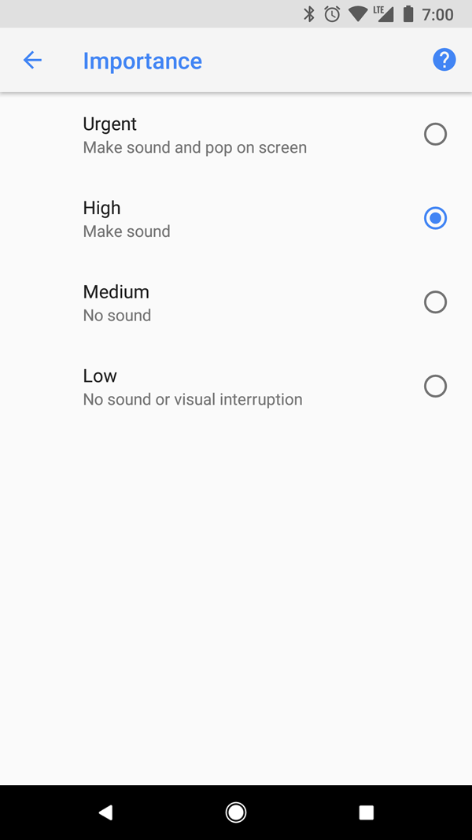
Notification importance
Android uses the importance of a notification to determine how much the notification should interrupt the user (visually and audibly)
The higher the importance of a notification, the more interruptive the notification will be
On Android 8.0 (API level 26) and above, importance of a notification is determined by the importance of the channel the notification was posted to
Users can change the importance of a notification channel in the system settings =>
On Android 7.1 (API level 25) and below, importance of each notification is determined by the notification's priority

Slide 14
Notification importance
The possible importance levels are the following:
Urgent: Makes a sound and appears as a heads-up notification
High: Makes a sound
Medium: No sound
Low: No sound and does not appear in the status bar

Slide 15
Create and Send Notifications
import android.support.v7.app.AppCompatActivity; import android.os.Bundle; import android.support.v7.app.ActionBar; import android.view.View; import android.view.animation.AnimationUtils; import android.widget.Button; import android.widget.ImageSwitcher; import android.widget.ImageView; import android.widget.Toast; import android.widget.ViewSwitcher; public class MainActivity extends AppCompatActivity { private ImageSwitcher imgSwitcher; private Button btnViewWindows,btnViewButterfly; v) { Toast.makeText(getApplicationContext(), "View Butterfly" , Toast.LENGTH_LONG).show(); imgSwitcher.setImageResource(R.mipmap.butterfly); } }); } }
Step 1 - Create Notification Channel
Step 2 - Setting Notification Properties
Step 3 - Attach Actions
Step 4 - Generate the notification

Slide 16
Create a channel and set the importance
Before you can deliver the notification on Android 8.0 and higher, you must register your app's notification channel with the system by passing an instance of NotificationChannel to createNotificationChannel()
So the following code is blocked by a condition on the SDK_INT version
private void createNotificationChannel() { // Create the NotificationChannel, but only on API 26+ because // the NotificationChannel class is new and not in the support library if (Build.VERSION.SDK_INT >= Build.VERSION_CODES.O) { CharSequence name = getString(R.string.channel_name); String description = getString(R.string.channel_description); int importance = NotificationManager.IMPORTANCE_DEFAULT; NotificationChannel channel = new NotificationChannel(CHANNEL_ID, name, importance); channel.setDescription(description); // Register the channel with the system; you can't change the importance // or other notification behaviors after this NotificationManager notificationManager = getSystemService(NotificationManager.class); notificationManager.createNotificationChannel(channel); } }

Slide 17
Create a channel and set the importance
Because you must create the notification channel before posting any notifications on Android 8.0 and higher, you should execute this code as soon as your app starts
It's safe to call this repeatedly because creating an existing notification channel performs no operation
Notice that the NotificationChannel constructor requires an importance, using one of the constants from the NotificationManager class
This parameter determines how to interrupt the user for any notification that belongs to this channel—though you must also set the priority with setPriority() to support Android 7.1 and lower

Slide 18
Create Notification Builder
To get started, you need to set the notification's content and channel using a NotificationCompat.Builder object. The following example shows how to create a notification with the following:
A small icon, set by setSmallIcon(). This is the only user-visible content that's required.
A title, set by setContentTitle().
The body text, set by setContentText().
The notification priority, set by setPriority()
NotificationCompat.Builder builder = new NotificationCompat.Builder(this, CHANNEL_ID) .setSmallIcon(R.drawable.notification_icon) .setContentTitle(textTitle) .setContentText(textContent) .setPriority(NotificationCompat.PRIORITY_DEFAULT);
Notice that the NotificationCompat.Builder constructor requires that you provide a channel ID. This is required for compatibility with Android 8.0 (API level 26) and higher, but is ignored by older versions.

Slide 19
Attach Actions
Every notification should respond to a tap, usually to open an activity in your app that corresponds to the notification
To do so, you must specify a content intent defined with a PendingIntent object and pass it to setContentIntent()
Notice this code calls setAutoCancel(), which automatically removes the notification when the user taps it
// Create an explicit intent for an Activity in your app Intent intent = new Intent(this, AlertDetails.class); intent.setFlags(Intent.FLAG_ACTIVITY_NEW_TASK | Intent.FLAG_ACTIVITY_CLEAR_TASK); PendingIntent pendingIntent = PendingIntent.getActivity(this, 0, intent, 0); NotificationCompat.Builder builder = new NotificationCompat.Builder(this, CHANNEL_ID) .setSmallIcon(R.drawable.notification_icon) .setContentTitle("My notification") .setContentText("Hello World!") .setPriority(NotificationCompat.PRIORITY_DEFAULT) // Set the intent that will fire when the user taps the notification .setContentIntent(pendingIntent) .setAutoCancel(true);

Slide 20
Generate the Notification
To make the notification appear, call NotificationManagerCompat.notify(), passing it a unique ID for the notification and the result of NotificationCompat.Builder.build()
Remember to save the notification ID that you pass to NotificationManagerCompat.notify() because you'll need it later if you want to update or remove the notification
NotificationManagerCompat notificationManager = NotificationManagerCompat.from(this); // notificationId is a unique int for each notification that you must define notificationManager.notify(notificationId, builder.build());

Slide 21
Example
import androidx.core.app.NotificationCompat;
import androidx.core.app.NotificationManagerCompat;
import android.app.Activity;
import android.app.NotificationChannel;
import android.app.NotificationManager;
import android.app.PendingIntent;
import android.app.TaskStackBuilder;
import android.content.Context;
import android.content.Intent;
import android.graphics.Color;
import android.os.Build;
import android.os.Bundle;
import android.view.View;
import android.widget.Button;
Create a new project and name it MyNotification
Modify MainActivity.java
public class MainActivity extends Activity {
Button b1;
String channel_name="testchannel";
String channel_description="description here";
String CHANNEL_ID = "wenbing";
int notificationId = 123;
@Override
protected void onCreate(Bundle savedInstanceState) {
super.onCreate(savedInstanceState);
setContentView(R.layout.activity_main);
b1 = (Button)findViewById(R.id.button);
b1.setOnClickListener(new View.OnClickListener() {
@Override
public void onClick(View v) {
addNotification();
}
});
createNotificationChannel();
}

Slide 22
Example
Modify MainActivity.java
private void createNotificationChannel() { // Create the NotificationChannel, but only on API 26+ because // the NotificationChannel class is new and not in the support library if (Build.VERSION.SDK_INT >= Build.VERSION_CODES.O) { CharSequence name = channel_name; String description = channel_description; int importance = NotificationManager.IMPORTANCE_DEFAULT; NotificationChannel channel = new NotificationChannel(CHANNEL_ID, name, importance); channel.setDescription(description); // Register the channel with the system; you can't change the importance // or other notification behaviors after this NotificationManager notificationManager = getSystemService(NotificationManager.class); notificationManager.createNotificationChannel(channel); } }

Slide 23
Example
Modify MainActivity.java
private void addNotification() { // Create an explicit intent for an Activity in your app Intent intent = new Intent(this, NotificationView.class); intent.setFlags(Intent.FLAG_ACTIVITY_NEW_TASK | Intent.FLAG_ACTIVITY_CLEAR_TASK); PendingIntent pendingIntent = PendingIntent.getActivity(this, 0, intent, 0); NotificationCompat.Builder builder = new NotificationCompat.Builder(this, CHANNEL_ID) .setSmallIcon(R.drawable.ic_launcher_foreground) .setContentTitle("My notification") .setContentText("Hello World!") .setPriority(NotificationCompat.PRIORITY_DEFAULT) // Set the intent that will fire when the user taps the notification .setContentIntent(pendingIntent) .setAutoCancel(true); System.out.println("added notification"); NotificationManagerCompat notificationManager = NotificationManagerCompat.from(this); notificationManager.notify(notificationId, builder.build()); }

Slide 24
Example
Create a new Java file: NotificationView.java, which will be used to display new layout as a part of the new activity launched when notification is clicked
import android.os.Bundle; import android.app.Activity; public class NotificationView extends Activity{ @Override public void onCreate(Bundle savedInstanceState){ super.onCreate(savedInstanceState); setContentView(R.layout.notification); } }

Slide 25
Example
<TextView android:id="@+id/textView2" android:layout_width="wrap_content" android:layout_height="wrap_content" android:text="CSU CIS 470" android:textColor="#ff87ff09" android:textSize="30dp" android:layout_below="@+id/textView1" android:layout_centerHorizontal="true" android:layout_marginTop="48dp" />
<ImageButton android:layout_width="wrap_content" android:layout_height="100dp" android:id="@+id/imageButton" android:src="@drawable/abc" android:layout_below="@+id/textView2" android:layout_centerHorizontal="true" android:layout_marginTop="42dp" /> <Button android:layout_width="wrap_content" android:layout_height="wrap_content" android:text="Notification" android:id="@+id/button" android:layout_marginTop="62dp" android:layout_below="@+id/imageButton" android:layout_centerHorizontal="true" /> </RelativeLayout>
Modify layout XML file res/layout/activity_main.xml
<RelativeLayout xmlns:android="http://schemas.android.com/apk/res/android" xmlns:tools="http://schemas.android.com/tools" android:layout_width="match_parent" android:layout_height="match_parent" android:paddingBottom="@dimen/activity_vertical_margin" android:paddingLeft="@dimen/activity_horizontal_margin" android:paddingRight="@dimen/activity_horizontal_margin" android:paddingTop="@dimen/activity_vertical_margin" tools:context="MainActivity"> <TextView android:id="@+id/textView1" android:layout_width="wrap_content" android:layout_height="wrap_content" android:text="Notification Example" android:layout_alignParentTop="true" android:layout_centerHorizontal="true" android:textSize="30dp" />

Slide 26
Example
Add a new layout XML file res/layout/notification.xml
<?xml version="1.0" encoding="utf-8"?> <LinearLayout xmlns:android="http://schemas.android.com/apk/res/android" android:orientation="vertical" android:layout_width="fill_parent" android:layout_height="fill_parent" > <TextView android:layout_width="fill_parent" android:layout_height="400dp" android:text="Hi, Your Detailed notification view goes here...." /> </LinearLayout>

Slide 27
Example
Add/modify values
<?xml version="1.0" encoding="utf-8"?> <resources> <dimen name="activity_vertical_margin">30sp</dimen> <dimen name="activity_horizontal_margin">30sp</dimen> </resources>
dimens.xml
<resources> <string name="action_settings">Settings</string> <string name="app_name">MyNotification</string> </resources>
strings.xml
Make or find an icon, name it abc.png/jpg, and placed it to the drawable foler

Slide 28
Example
<?xml version="1.0" encoding="utf-8"?> <manifest xmlns:android="http://schemas.android.com/apk/res/android" package="com.wenbing.mynotification"> <application android:allowBackup="true" android:icon="@mipmap/ic_launcher" android:label="@string/app_name" android:roundIcon="@mipmap/ic_launcher_round" android:supportsRtl="true" android:theme="@style/AppTheme"> <activity android:name=".MainActivity"> <intent-filter> <action android:name="android.intent.action.MAIN" /> <category android:name="android.intent.category.LAUNCHER" /> </intent-filter> </activity> <activity android:name=".NotificationView" android:label="Details of notification" android:parentActivityName=".MainActivity"> <meta-data android:name="android.support.PARENT_ACTIVITY" android:value=".MainActivity"/> </activity> </application> </manifest>
Modify manifest

Slide 29
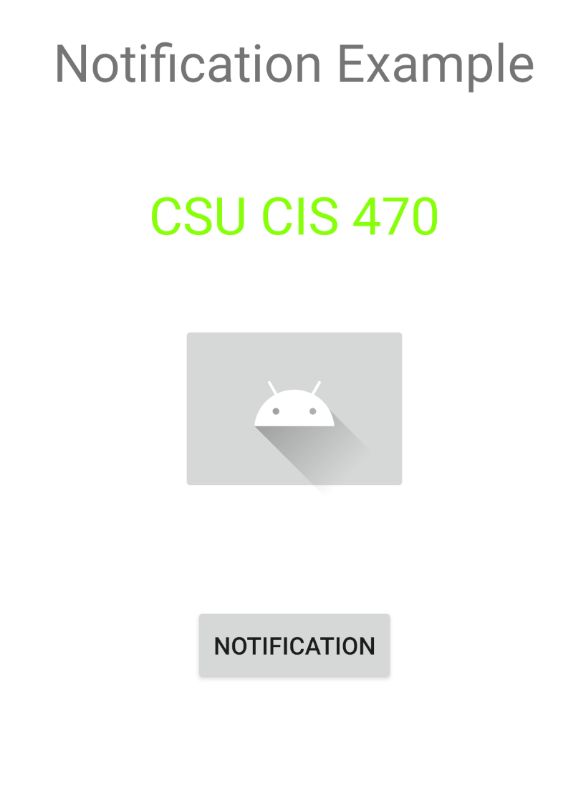
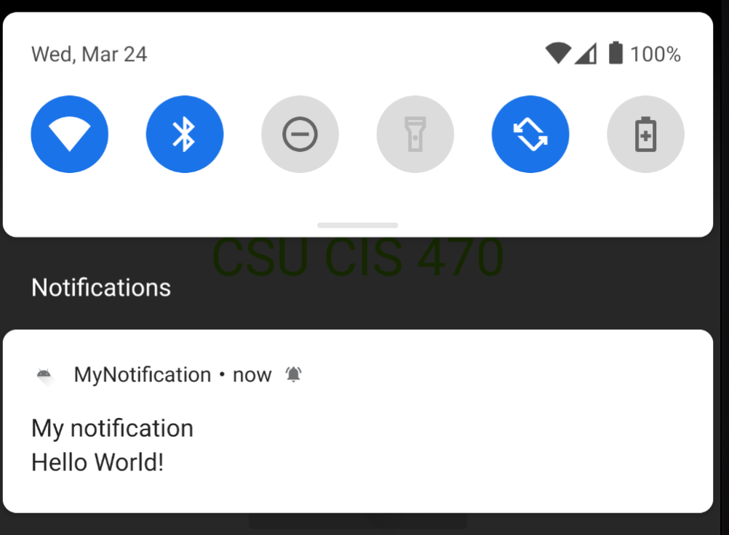
Example
Outcome

Slide 30
Homework #20
Modify the MyNotification app such that when you click the notification, you will be directed to the main activity of the app

