Slide 1
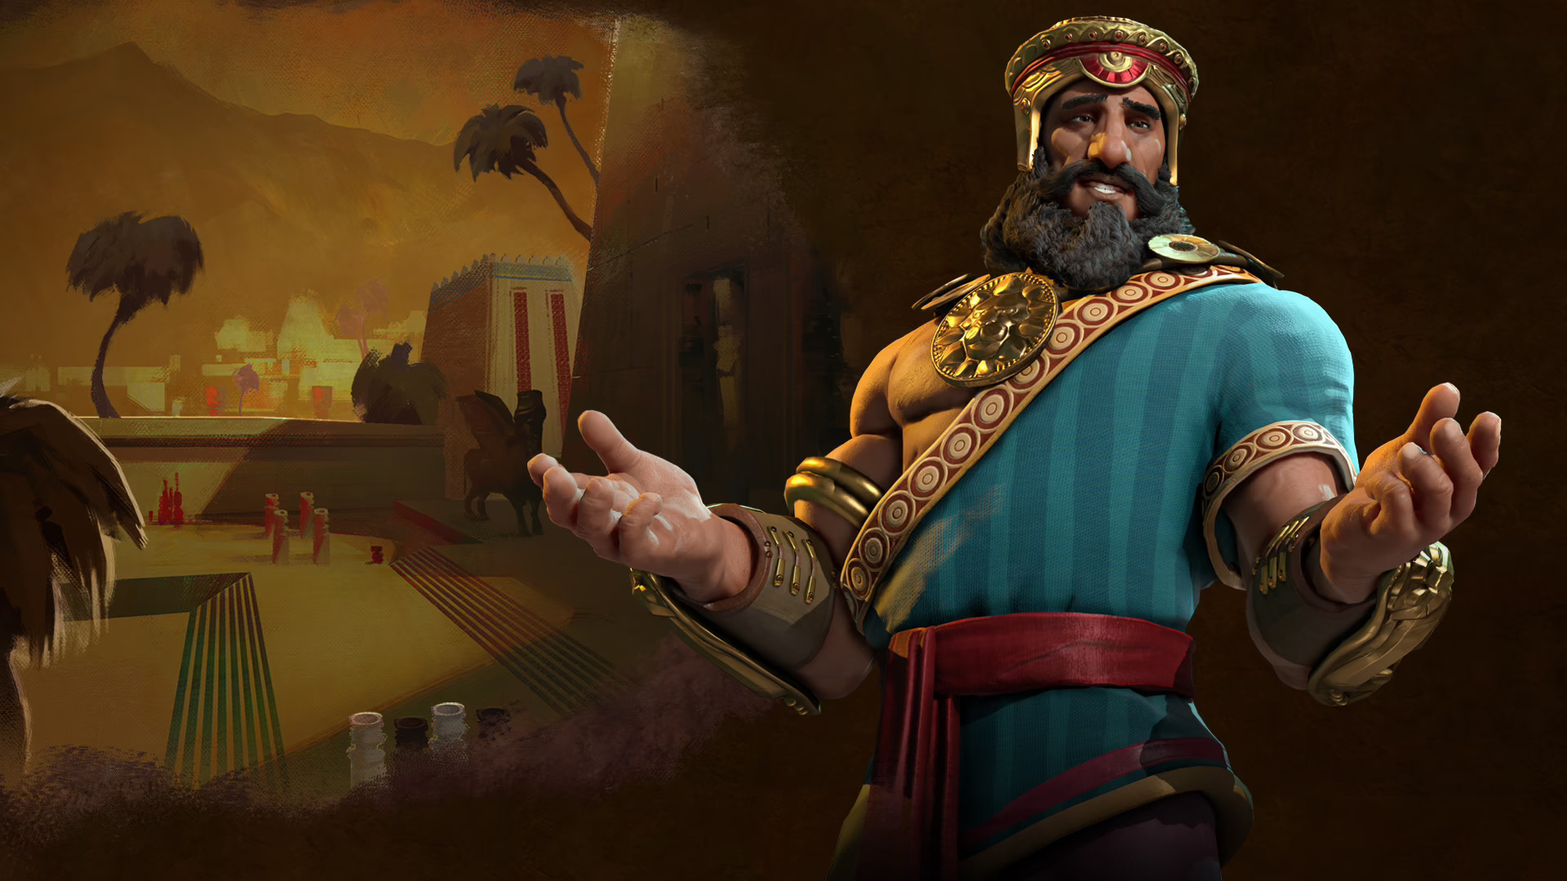
The Epic of Gilgamesh

Slide 2
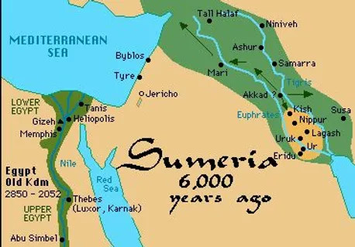
Map of ancient Sumeria

Slide 3
Characteristics of epic poetry
Long narratives in verse
Origins in oral tales, legends and myths
Provides insights to ancient civilizations
Historic value because it pre-dates writing
Physical and spiritual transformation of the hero
Includes supernatural events and activities
Never ends in failure

Slide 4
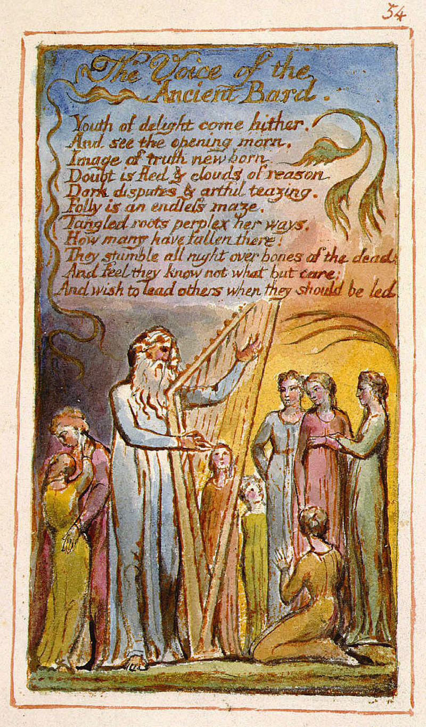
An ancient bard drawn with lyre retelling an epic

Slide 5
Poems vs Epic poems
Written about any subject matter | Grand tales of heroes that deal with great accomplishments, the supernatural and mythology
Can be written in many forms without following any type of structure | Long form writing with specific sections, books or verses
Focus on conveying a message, literally or figuratively | Uses many different forms of writing to enrich the story and portray the hero as God-like

Slide 6
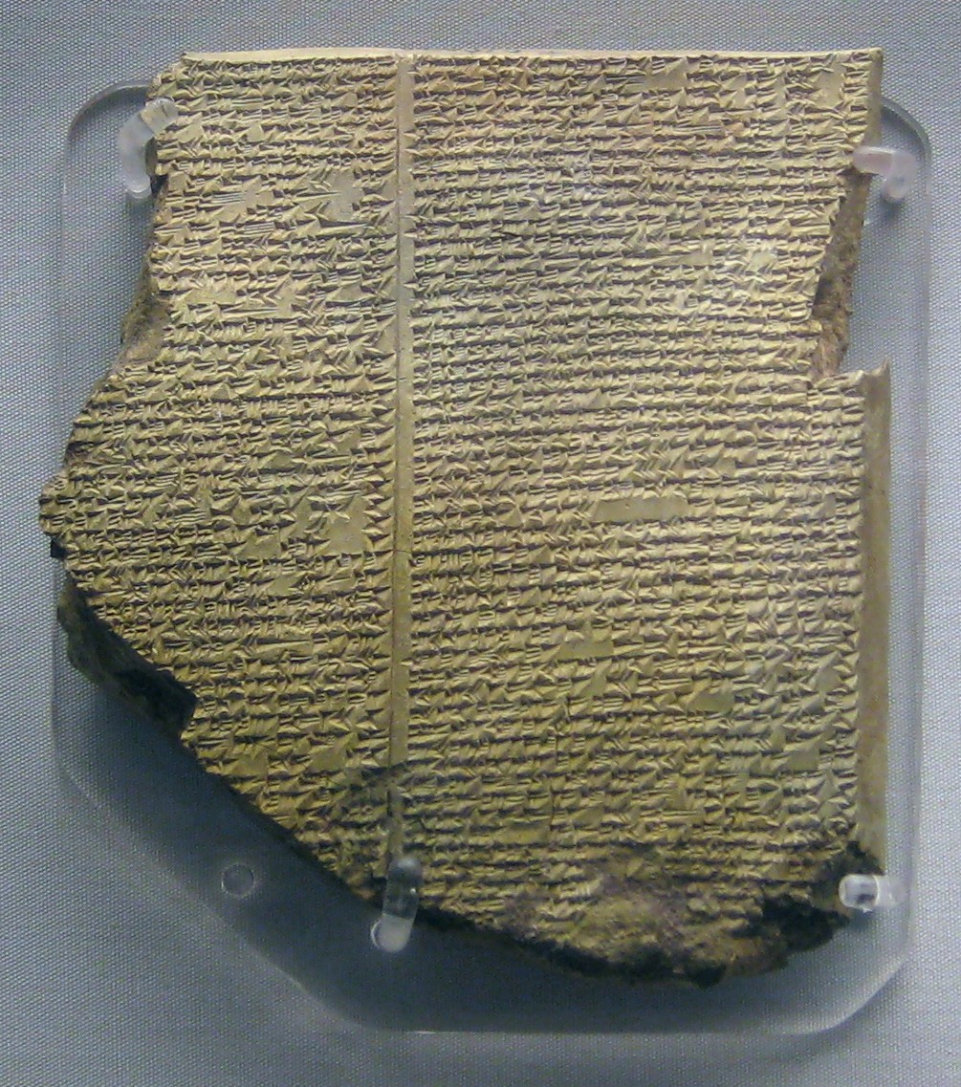
A portion of the Epic of Gilgamesh estimate date 2100- 1200 BC

Slide 7
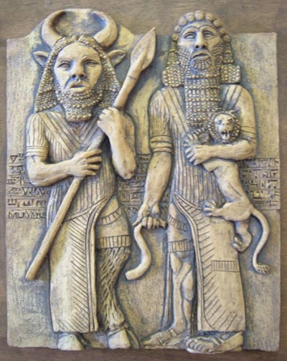
Gilgamesh and Enkidu

