Slide 1
LE COBOL
Decimal-precise invoicing for French freelancers, built on the same arithmetic banks have used since 1959.
Live
https://lecobol.com
Repo
github.com/FredBourouliou/Webstack---Portfolio-Project---Pitch
Author
Frédéric Bourouliou — solo, full-stack
School
Holberton — Webstack Portfolio Project, May 2026
LE COBOL · ● live
01 / 12

Slide 2
THE PROBLEM
3 million freelancers,
three real pains.
▸ Decimal precision. Cents must add up. Floats don't.
▸ Legal compliance. Articles 286 + 242 nonies A + 293 B of the French CGI. No gaps, 10-year retention, VAT threshold tracking.
▸ Sovereignty. SaaS = data on US servers, vendor lock-in, monthly subscription you can't get out of.
// JavaScript, Python, Ruby, Java floats, ...
0.1 + 0.2 = 0.30000000000000004
// In COBOL, since 1959
0.1 + 0.2 = 0.30
An invoicing tool that can't add to two decimals isn't a tool — it's a liability.
3.2M micro-entrepreneurs actifs · URSSAF juin 2025
10M+ companies impacted by e-invoicing 2026
LE COBOL · ● live
02 / 12

Slide 3
THE SOLUTION
Four boring technologies,
each load-bearing.
COBOL 1959
POSTSCRIPT 1985
Native fixed-point decimal. The PICTURE clause defines exact storage. No floats. No surprises on cents.
Direct PDF rendering. Text-based intermediate language. Pixel-perfect placement by coordinate. Ghostscript converts .ps → .pdf.
HTMX 2020
APACHE CGI 1993
Server-driven UI. 14 KB of JS. No JSON API. No virtual DOM. No build step. The response is the new view.
Original server-side glue. Apache forks the COBOL binary at each request. No app server, no runtime, no daemon to monitor.
LE COBOL · ● live
03 / 12

Slide 4
STACK
Old-tech where it counts,
modern where it matters.
LAYER | TECH | YEAR
Compute / business logic | GnuCOBOL 3.x | 1959
PDF rendering | PostScript + Ghostscript | 1985
Web server | Apache 2.4 + mod_cgi | 1995
Frontend | HTML5 + HTMX 2.x + CSS3 | 2020
Storage | ISAM (indexed COBOL files) | 1966
External API | recherche-entreprises.api.gouv.fr | —
OS / Infra | Ubuntu 22.04 LTS · AWS EC2 t3.micro · eu-west-3 | —
TLS | Let's Encrypt R13, HSTS | —
Lighthouse 100 / 93 / 100 / 100
14 KB JS shipped
0 application-level deps
Single VPS · ~5 €/mo
LE COBOL · ● live
04 / 12

Slide 5
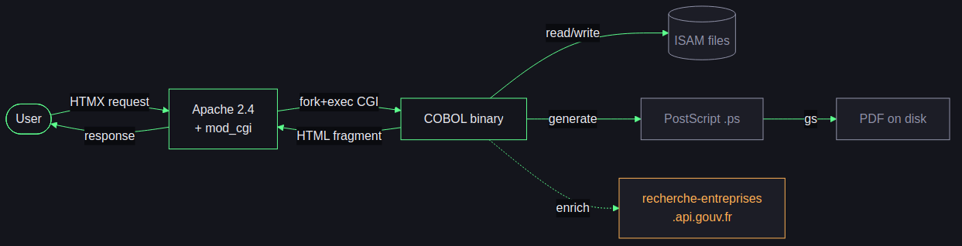
ARCHITECTURE
One request → one process → one binary.
THE 7 BINARIES
FILE | PURPOSE | LOC
hello.cob | smoke test | 76
auth.cob | login + sessions | 579
client.cob | CRUD clients | 738
invoice.cob | CRUD invoices | 1 391
dashboard.cob | KPIs + aging | 873
pdf-gen.cob | PS orchestration | 905
sirene.cob | INSEE enrichment | 338
~4 900 LOC + 11 copybooks (.cpy)
vs ~50-100k LOC + 200 MB of node_modules in an equivalent SaaS stack.
Shared code via COBOL copybooks: record structures, CGI utils, auth checks.
LE COBOL · ● live
05 / 12

Slide 6
ANATOMY
A peek inside invoice.cob
01 INVOICE-RECORD.
05 INV-NUMBER PIC X(9). *> "2026-0001"
05 INV-CLIENT-ID PIC X(10).
05 INV-DATE PIC X(10). *> YYYY-MM-DD
05 INV-AMOUNT-HT PIC 9(7)V99. *> max 9 999 999.99 €
05 INV-AMOUNT-TVA PIC 9(7)V99. *> base 10, exact
05 INV-AMOUNT-TTC PIC 9(7)V99.
05 INV-URSSAF-RATE PIC 9V9999. *> 0.231 = 23.1%
05 INV-STATUS PIC X(8). *> DRAFT / SENT / PAID
05 INV-LINES OCCURS 10 TIMES. *> inline, bounded
10 INV-DESC PIC X(50).
10 INV-QTY PIC 9(4)V99.
10 INV-UNIT-RATE PIC 9(5)V99.
10 INV-LINE-TOTAL PIC 9(7)V99.
HIERARCHICAL TYPING
Levels 01 / 05 / 10 — structure in the language, not in convention. No naming policy, no JSON schema.
FIXED-POINT DECIMAL
PIC 9(7)V99 = 7 digits + 2 decimals. Base 10 native, no IEEE 754 drift. Cents fall right, every time.
INLINE COLLECTIONS
OCCURS 10 TIMES = bounded array inside the record. One disk read, one atomic write. Trade-off 1NF for atomicity at solo scope.
LE COBOL · ● live
06 / 12

Slide 7
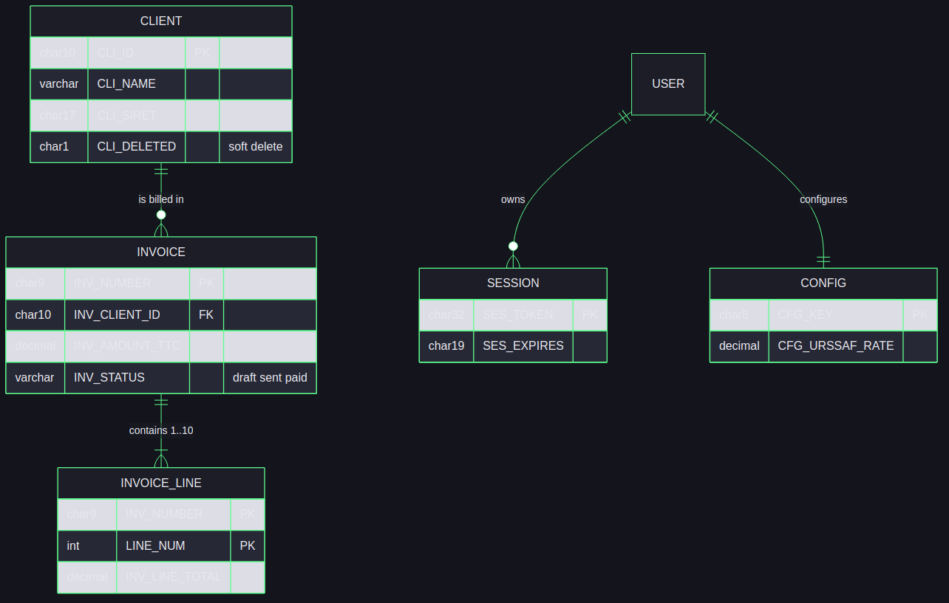
DATABASE
ISAM, with a relational mind.
CONCEPTUAL / PHYSICAL
▸ 6 entities · 4 ISAM files (CONFIG is a singleton, USER is hardcoded)
▸ Primary + alternate keys via B+tree (Berkeley DB), O(log n)
▸ INVOICE_LINE embedded in INVOICE via OCCURS 10 — one read per invoice
▸ Soft delete on clients — invoice history must survive (Article 286 CGI)
▸ OVERDUE never stored — derived at render time
SQL EQUIVALENT
Documented in Cobill/docs/schema.sql — 5 tables with FK, CHECK constraints, indexes. Ready for SQLite/PostgreSQL migration if multi-tenant arrives.
LE COBOL · ● live
07 / 12

Slide 8
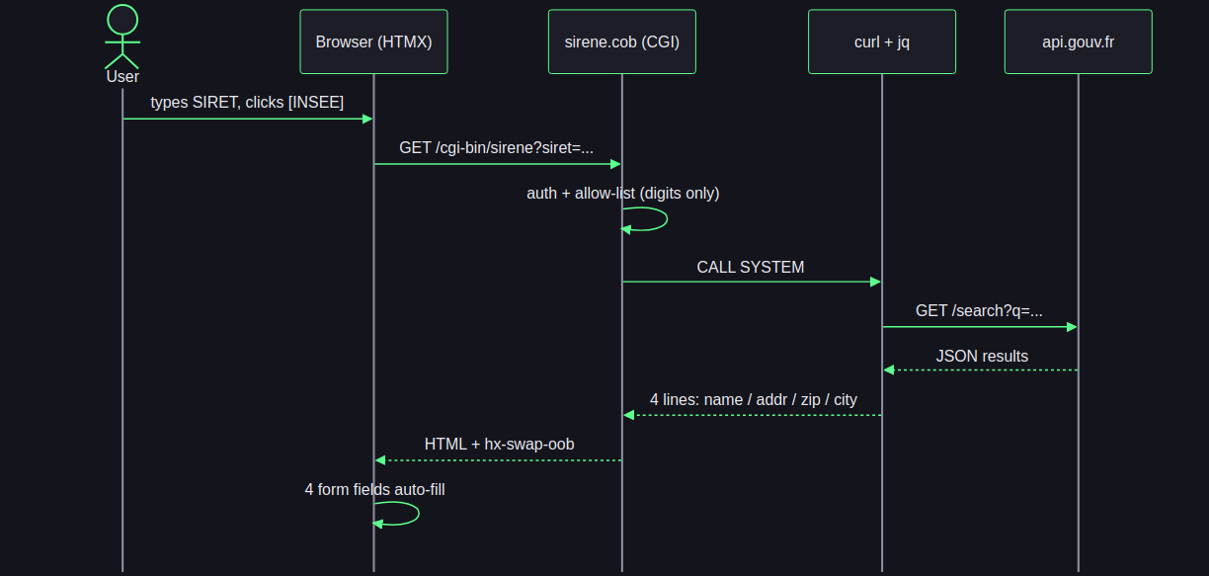
EXTERNAL API
Type a SIRET, the form fills itself.
WHY IT'S THE RIGHT CALL
▸ Free, public (DINUM), no API key, no PII collected
▸ No user PII leaves the server — only the SIRET, itself public data
▸ 5-second timeout on curl — graceful fallback to manual entry
▸ HTML-escaped output — XSS-safe even with weird API payloads
HTMX IDIOM
hx-swap-oob='true' updates multiple form inputs from a single HTTP response. No custom JavaScript written.
LE COBOL · ● live
08 / 12

Slide 9
SECURITY & QUALITY
Six lines of defense.
TRANSPORT
AUTH
SESSIONS
Let's Encrypt R13, HTTPS forced, HSTS max-age=31536000 with includeSubDomains, automatic renewal via systemd timer.
sha512crypt via libc crypt(3), 16-char salt. Same hash family as /etc/shadow. Plaintext never touches disk. FFI binding via -fstatic-call.
32-hex random token, HttpOnly + SameSite=Lax + Secure, 24 h expiry, ISAM-persisted, expired sessions refused on every request.
XSS DEFENSE
SANITIZATION
DEFENSE IN DEPTH
Every output through HTML-ESCAPE — 5 chars in critical order. & first to avoid re-escape. No JS templating to attack.
Allow-list digits-only on SIRET input. Shell injection structurally impossible — not by escape, by construction. Same principle on every user input.
Apache FilesMatch denies .dat / .idx / .cob / .cpy / .ps. UFW restricts to 22 / 80 / 443. 5 OWASP headers. Secrets in /etc/cobill/cobill.env (perms 0640).
LE COBOL · ● live
09 / 12

Slide 10
● LIVE DEMO · ~7 MINUTES
lecobol.com
01
Login on the production site (real crypt(3) round-trip)
02
Create a client — enter a SIRET, hit [INSEE], the form auto-fills from the gov API
03
Create an invoice with 3 × 33,33 € — observe the line total reads exactly 99,99, not 99,990000...
04
Generate the PDF — PostScript via Ghostscript, served straight from disk
05
Open the dashboard — quarterly URSSAF, VAT-threshold projection, aging buckets on overdue invoices
LE COBOL · ● live
10 / 12

Slide 11
REPORT
What worked, what didn't,
what's next.
SUCCESSES
FRICTIONS / FAILURES
▸ Working COBOL CGI by Day 3
▸ Decimal precision verified end-to-end (3 × 33,33 = 99,99)
▸ Production deploy on Day 22: HTTPS, hashed auth, 29-assertion smoke test
▸ External API integration on Day 25 — SIRET enrichment via gov.fr
▸ French legal model documented: Articles 286, 242 nonies A, 293 B CGI
▸ PostScript learning curve (Days 8–10 nearly fully burned)
▸ CALL "crypt" resolution: needed -fstatic-call, debugged in production
▸ Apache envvars shell-mangled $ in $6$… hashes — single-quote fix
▸ Auth originally reload-ed instead of restart-ed — env vars stayed cached
WHAT I'D IMPROVE
WHAT'S NEXT
▸ Per-user accounts (single admin today)
▸ Rate-limit on /cgi-bin/auth (mod_evasive or fail2ban)
▸ Off-host backups (EBS snapshots → S3 → Glacier lifecycle)
▸ FastCGI if/when concurrency outgrows fork-per-request
▸ Facture électronique 2026/2027 — PDP integration or Chorus Pro for B2G
▸ Multi-user with bcrypt-grade per-user hashing
▸ Stripe payment links embedded in invoice PDFs
▸ Quote → invoice conversion + recurring invoices
LE COBOL · ● live
11 / 12

Slide 12
IN CLOSING
IN CLOSING
Banks figured this out in 1959.
Most web frameworks still haven't.
A 67-year-old language can still be the correct answer when correctness on money is non-negotiable.
https://lecobol.com
github.com/FredBourouliou/Webstack---Portfolio-Project---Pitch
QUESTIONS ?
LE COBOL · ● live
12 / 12

