Slide 1
A Dynamic Systems Approach to Psychopathology and Intervention
Merlijn Olthof
m.olthof@pwo.ru.nl
Dynamics Of Complex Systems, 2018

Slide 2
Schedule
Theory
Empirical studies
Take Home Message
Notes:
From this complexity approach to psychotherapy for depression, we can formulate the following questions. Critical fluctuations indicate the destabilization of an old pathological pattern and a possible pattern transition towards a more healthy pattern. 328 participants

Slide 3
I. Theory
Intervention & Clinical Change
The nature of pathology
Notes:
From this complexity approach to psychotherapy for depression, we can formulate the following questions. Critical fluctuations indicate the destabilization of an old pathological pattern and a possible pattern transition towards a more healthy pattern. 328 participants

Slide 4

Change in Psychopathology: input-output model
Research is focused on interventions
Intervention causality
Randomized controlled trial
Research goal: optimize intervention
What intervention works best?
Notes:
Research is focussed on the input: interventions. We think of interventions as seperate causal factors. This is the conception of intervention causality. The same causality as with billiards. Imagine the white ball is the intervention.

Slide 5
Anomalies of the linear input-output model
Common factors in psychotherapy explain more variance than specific ingredients (Wampold & Imel, 2015)
Discontinuous changes are common, often preceding specific interventions (Hayes et al., 2007; Schiepek et al., in prep.)
Limited predictability:
Huge individual differences
Equifinality & multifinality
Notes:
Anomalies with this conception of intervention and clinical change. 1. The causal role of the intervention. 2. Change is not continuous, i.e. proportional to intervention efforts such as in billiards. 3. Limited predictability of treatment outcome, unlike billiards which can be fully modelled Newtonian. PAUZE: we need a new theoretical perspective

Slide 6
Complexity, network & idiosyncratic approaches
Network Approach (Cramer et al., 2016)
Dynamic Systems Theory (Hayes & Strauss, 1998)
Synergetics (Schiepek et al., 2016)
Commonalities:
Idiosyncratic perspective on psychopathology
Psychopathologies as emergent states, not entity-like categories
Intervention effects show strong time- and context-dependence
Notes:
These approaches can deal with these anomalies. Commonalities 1. No one sizes fits all. 2. Still general principles underlying clinical change on a macroscopic level 3. interventions are not external causal factors causing change, they interact with the system, that is continously changing by self-organization

Slide 7
Self-organized clinical change
Clinical change = system wide reorganization
Internally driven causality (instead of intervention causality)
Discontinuous change in the form of an order transition (instead of continuous change)
Sensitivity to initial conditions (multifinality & equifinality)
Sensitive periods: time- and context-dependence of intervention effects (instead of independent treatment effects)
Notes:
When change is self-organized, we get a different conceptualization of clinical change. 1. Not induced like a billiard ball, but comes from within/interactions, 2. change is not continous but often abrupt, 3. change is limited predictable 4. Sometimes small interventions will have large effects, sometimes large interventions will have virtually no effect. Intervent effects are thus not independent, as assumed in RCTs and manualized treatment.

Slide 8
System wide reorganization: order transition profile
Stable State
Destabilization
Critical Point
Change in control parameters
Notes:
Model of system wide reorganization. CP example: motivation to change, Destabilization: critical fluctuations, Multi-stability.
Explain that the valley reforms itself continuously, destabilization = opportunity for different states to emerge.

Slide 9
Psychopathology as emergent state: Attractors
Cognition
Rumination
Behaviour
Lying Awake
Emotion
Mood
Notes:
Two levels: 1) states, 2) landscapes.

Slide 10
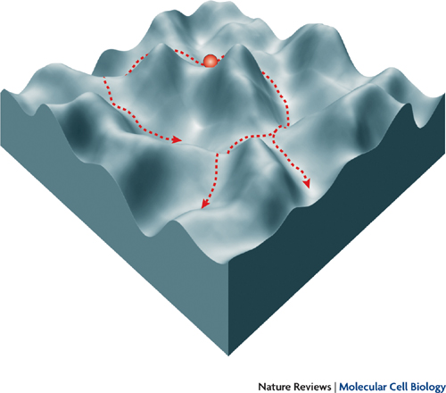
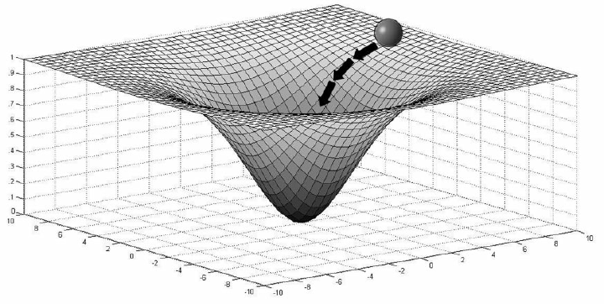
Psychopathology as emergent state: Landscapes
Rigid Flexible Random
1/f noise: Wijnants, 2014; Van Orden et al., 2011; Haken & Tschacher, 2017
Notes:
Two levels: 1) states, 2) landscapes.

Slide 11
II. Empirical Studies
Aim: study hypothesis from CST about how change occurs in psychopathology
Tools: time-series analysis of longitudinal data
Coded observational data (e.g. Lichtwarck-Aschoff et al., 2012)
Experience sampling data (e.g. Wichers & Groot, 2016)

Slide 12
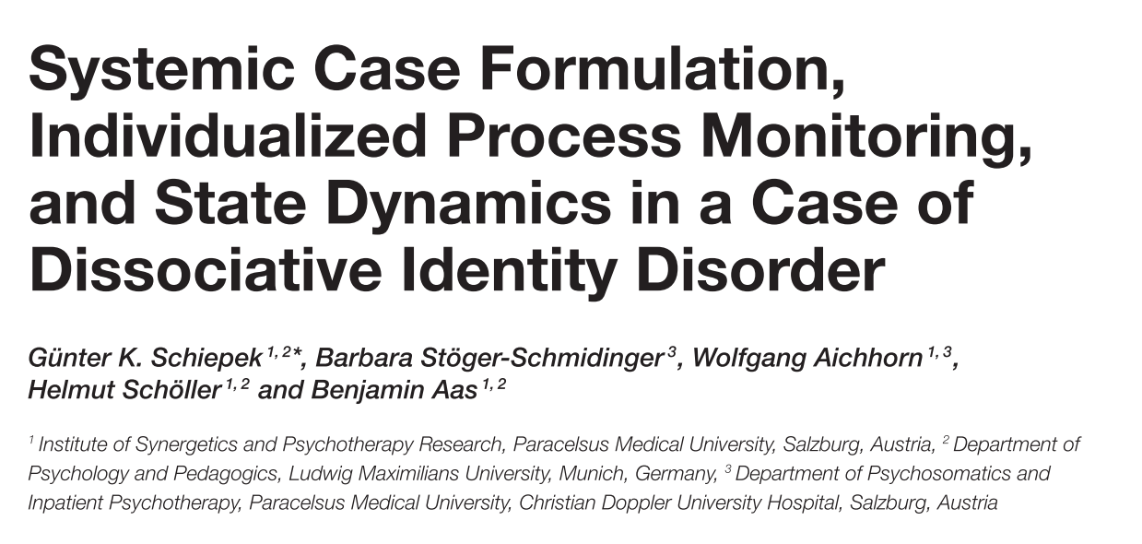
Schiepek
Notes:
From this complexity approach to psychotherapy for depression, we can formulate the following questions. Critical fluctuations indicate the destabilization of an old pathological pattern and a possible pattern transition towards a more healthy pattern. 328 participants

Slide 13
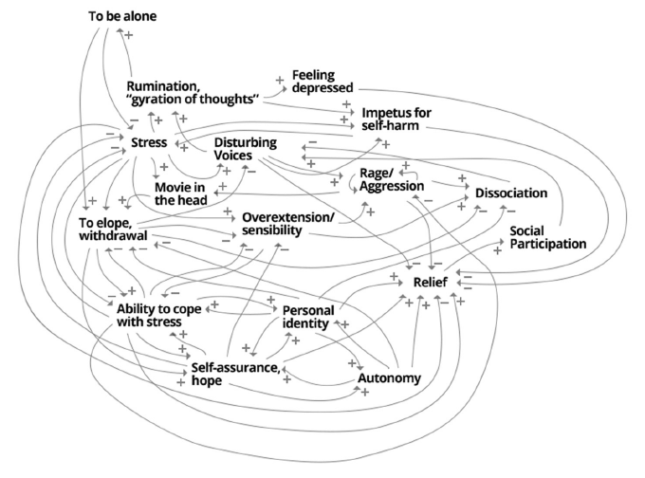

Slide 14
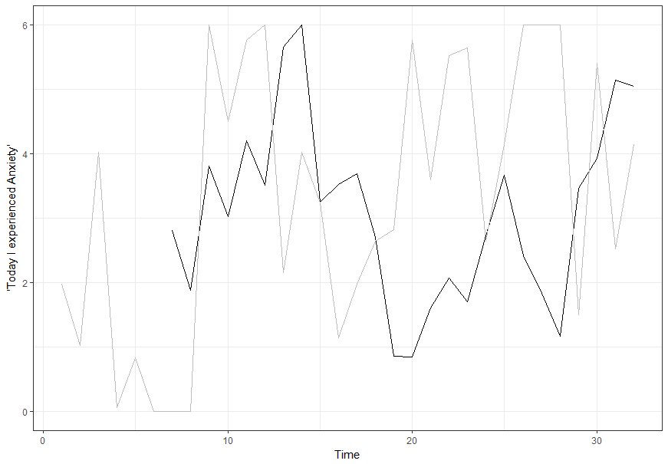
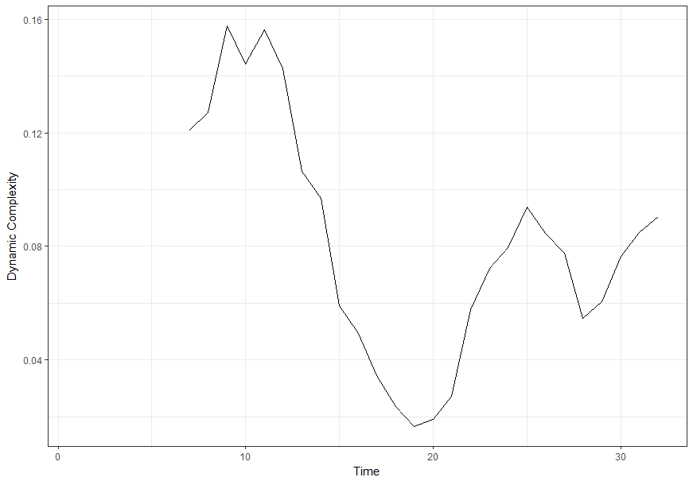
EWS: Dynamic Complexity for Short Time Series
Validation study: Schiepek & Strunk, 2010
Notes:
Daily self-ratings on the thepary process questionairre. Dynamic complexity: an index for critical fluctuations, for every item of every participant. Than we take the sum.

Slide 15
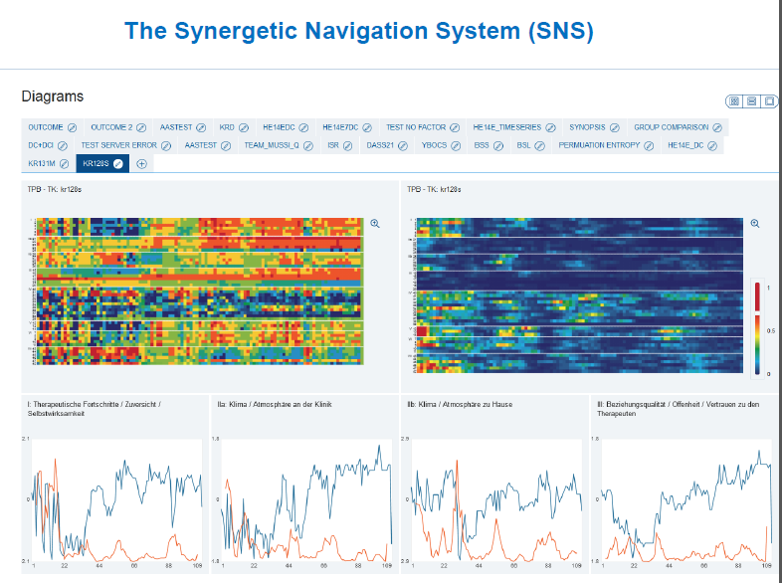
Dynamic Assesment with the SNS
Process questionnaires
Individualized questionnaires
Diary Entry’s
Build-In (nonlinear) analysis
Moving inter-item correlation matrices
Dynamic Complexity
Recurrence Plots
https://showcase.sns-live.de/login
Schiepek et al, 2016
Notes:
Named after Hakens Synergetics. It’s a colourfull place. We will have a look.

Slide 16
Critical Fluctuations as an Early-Warning Signal for Sudden Gains and Losses in Psychotherapy
Olthof, van Rooij, Hasselman, Schiepek, Strunk, Aas & Lichtwarck-Aschof, in prep.
Notes:
From this complexity approach to psychotherapy for depression, we can formulate the following questions. Critical fluctuations indicate the destabilization of an old pathological pattern and a possible pattern transition towards a more healthy pattern. 328 participants

Slide 17
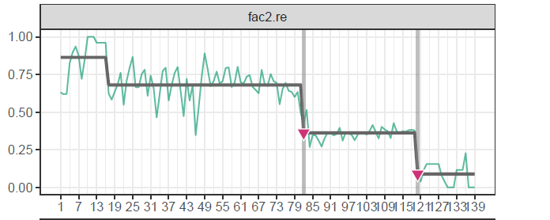
Sudden Gains and Losses
Notes:
From this complexity approach to psychotherapy for depression, we can formulate the following questions. Critical fluctuations indicate the destabilization of an old pathological pattern and a possible pattern transition towards a more healthy pattern. 328 participants

Slide 18
Hypothesis
If Sudden Gains and Losses are Phase Transitions…
we expect to find EWS preceding sudden gains and losses
More specifically: We expect sudden gains/losses to be preceded by a temporal increase in dynamic complexity of ES data

Slide 19
Participants & procedure
Patients with mood disorders (N=329)
Collected with the Synergetic Navigation System¹ between 2008-2014
Therapy Process Questionnaire (TPQ²)
Factor I: Therapy progress
Factor II: Impairment by symptoms and problems
Factor III: Relationship quality and trust in therapist
Factor IV: Dysphoric affect
Factor V: Relationship with fellow patients
¹Schiepek et al. (2016), ²Haken & Schiepek (2010)
Notes:
Data from Schiepek & Strunk. Synergetic Navigation System: an online process-monitoring system which used by many clinicians in Austria and Germany.

Slide 20
Data-Analysis
First analyse…
Sudden gains and losses → casnet::ts_levels()
Dynamic complexity time series → casnet::dyn_comp()
Then aggregate…
Multilevel event-history model predicting sudden gains and losses with EWS

Slide 21
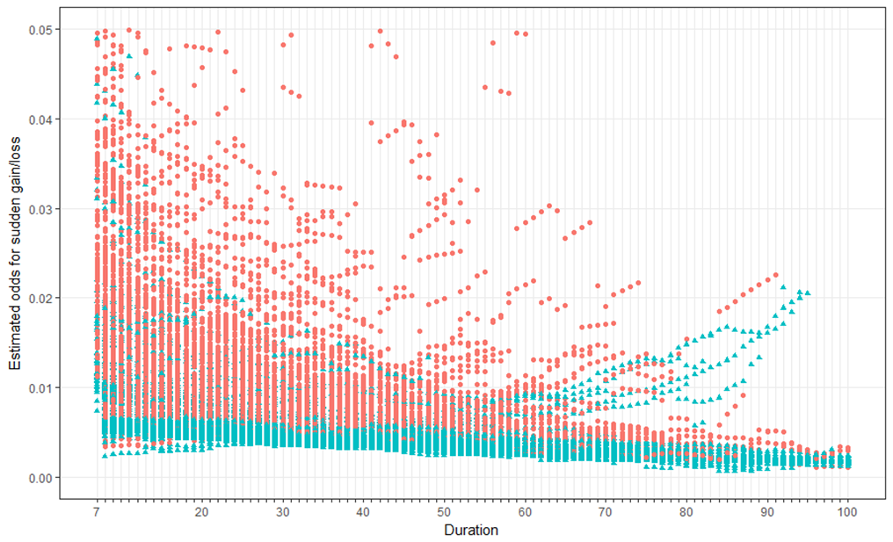
Results
Red = high dynamic complexity
Blue = low dynamic complexity

Slide 22
Conclusions / limitations
Higher dynamic complexity is related to a higher chance to have a sudden gain or loss in the upcoming 4 days
Sudden gains and losses are likely to reflect phase transitions
Early-warning signals in daily ES data have a potential for clinical practice
Testing this potential demands a different study design

Slide 23
Meer:
Fartacek, Schiepek, Kunrath, Fartacek & Plöderl, 2016.
Schiepek, Tominschek & Heinzel, 2014
Hayes & Strauss, 1998
Lichtwarck-Aschoff, Hasselman, Cox, Pepler & Granic, 2012
Heinzel, Tominschek & Schiepek, 2014
Van de Leemput, Wichers, Cramer et al., 2014
Hayes, Laurenceau, Feldman, Strauss & Cardaciotto, 2007
Tschacher, W., Scheier, C., & Hashimoto, Y. (1997).
Ramseyer, F., & Tschacher, W. (2011).
Kowalik, Z., Schiepek, G., Kumpf, K., Roberts, L., & Elbert, T. (1997).
Granic, I., O’Hara, A., Pepler, D., & Lewis, M. D. (2007).
Notes:
From this complexity approach to psychotherapy for depression, we can formulate the following questions. Critical fluctuations indicate the destabilization of an old pathological pattern and a possible pattern transition towards a more healthy pattern. 328 participants

Slide 24
III. Take Home Message
A DS approach to psychopathology is a theoretical framework for the understanding of idiosynchratic psychopathology and clinical change based on general principles of complex systems.
“Adapting psychological intervention to the particulars of individual clients’ change processes but do so according to the generalities of a formal theory.” (Schiepek et al., in prep.)
Notes:
From this complexity approach to psychotherapy for depression, we can formulate the following questions. Critical fluctuations indicate the destabilization of an old pathological pattern and a possible pattern transition towards a more healthy pattern. 328 participants

Slide 25
Personal note: why DS in Clinical Psychology?
Kitcher (2004): The ends of the sciences: finding truths, clarifying ideas
Clarifying Psychopathology:
Comorbidity
Individual differences
Equifinality & multifinality
Time dependence
Context dependence

Slide 26
Thank you for your attention!
Practicum:
EWS in a Clinical Case Study
It will be fun.
Thinking about your major research project?
Merlijn Olthof
m.olthof@pwo.ru.nl
Anna Lichtwarck-Aschoff
a.lichtwarck-aschoff@pwo.ru.nl

